Slide 1
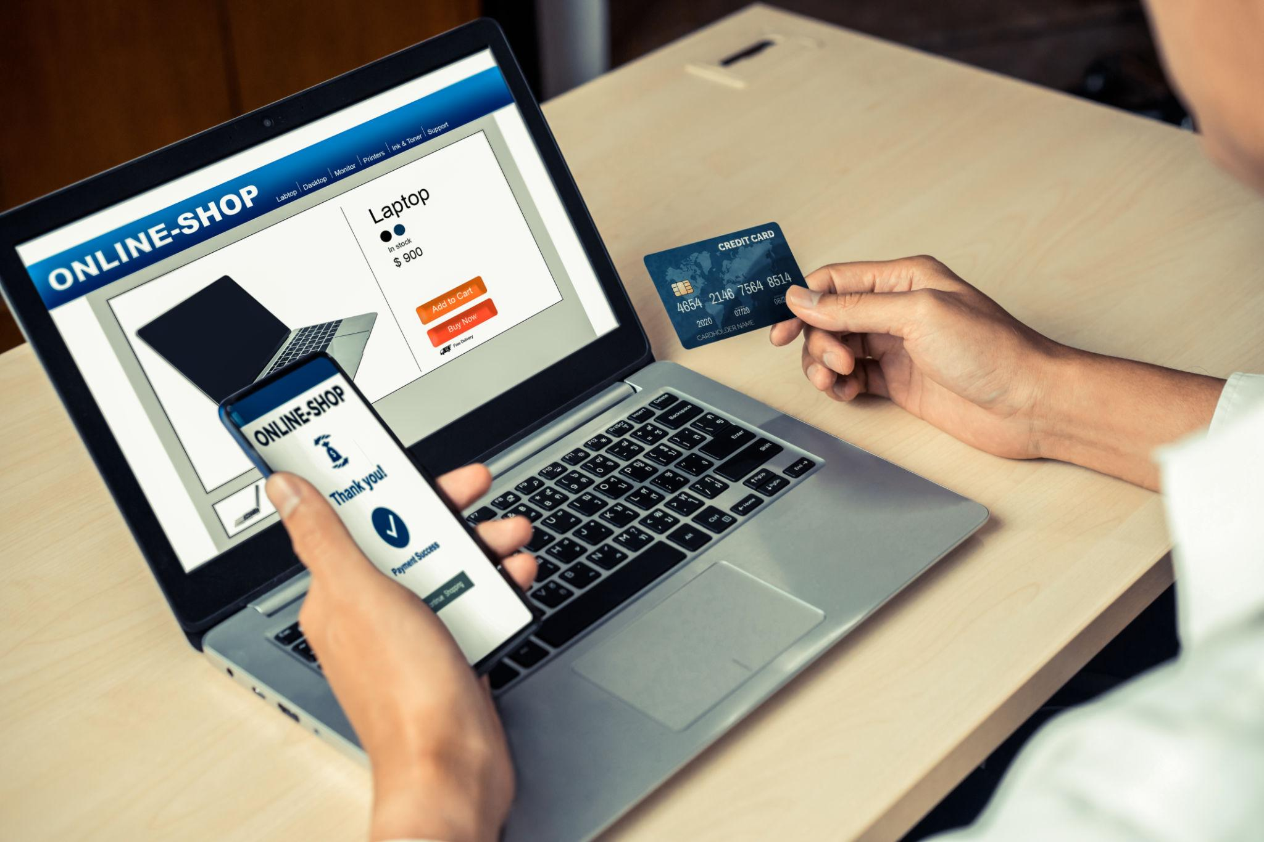
FLIPSHOP
Shopping Website
Detailed Project Presentation
HTML • CSS • JavaScript
TEAM MEMBERS
Mohan Sai
Siva
Sai
Mounika
Lavanya

Slide 2
01 • INTRODUCTION
What is E-Commerce?
E-Commerce means buying and selling products or services through the internet.
ONLINE CATALOG
DIGITAL CART
ONLINE CHECKOUT
. Users can view products, prices, images and details
Users select products and quantities before checkout.
The system calculates the bill and provides a payment step.
Goal: provide a convenient, organized and user-friendly shopping experience.
02

Slide 3
02 • PROBLEM
Problem Statement
TIME
LIMITED ACCESS
COMPARISON
Physical shopping can require travel and waiting.
Store timings and location can restrict shopping.
Comparing products and prices may take extra effort.
MANUAL BILLING
CONVENIENCE
INFORMATION
Manual calculations can lead to delays or errors.
Customers need an easy cart, checkout and payment flow.
Customers need product details before purchasing.
03

Slide 4

03 • SOLUTION
Proposed Solution
We propose a centralized E-Commerce website where customers can complete the shopping journey online.
1
2
3
4
5
6
LOGIN
BROWSE
SELECT
CART
CHECKOUT
ORDER
Result: a structured digital shopping experience from product discovery to order placement.
04

Slide 5
04 • TECHNOLOGY
Technology Stack — What Works for What?
HTML5
Creates pages, headings, buttons, forms, product cards and navigation.
STRUCTURE
CSS3
Controls colors, fonts, spacing, layouts, animations and responsive design.
DESIGN
JavaScript
Handles login logic, cart actions, calculations, validation and interactions.
BEHAVIOR
VS CODE
Used to write, organize, edit and test project files.
DEVELOPMENT
GITHUB
Stores project code and supports team version control.
COLLABORATION
Technology flow: HTML → CSS → JavaScript → GitHub collaboration
05

Slide 6
05 • FEATURES
Main Features
PRODUCT CATEGORIES
SEARCH
SIZE & QUANTITY
CART
Men, Women, Electronics, Home Needs and more.
Find products quickly.
Choose product variations before adding to cart.
Review selected items and quantities.
AUTO BILLING
LOGIN
CHECKOUT
PAYMENT UI
Calculate subtotal and total dynamically.
Basic user account interface.
Collect required order details.
Provide a payment-selection step.
09

Slide 7
06 • BENEFITS
Benefits of the Project
CUSTOMER BENEFITS
TIME SAVING
BUSINESS BENEFITS
Shopping from anywhere; easy browsing; product information; convenient cart and checkout.
Simplifies product discovery and reduces unnecessary store visits.
A digital storefront can present many products in an organized way.
AUTOMATION
USER EXPERIENCE
LEARNING BENEFITS
Cart totals and basic calculations are handled automatically.
Responsive design and clear navigation improve usability.
Demonstrates practical HTML, CSS, JavaScript and GitHub skills.
10

Slide 8
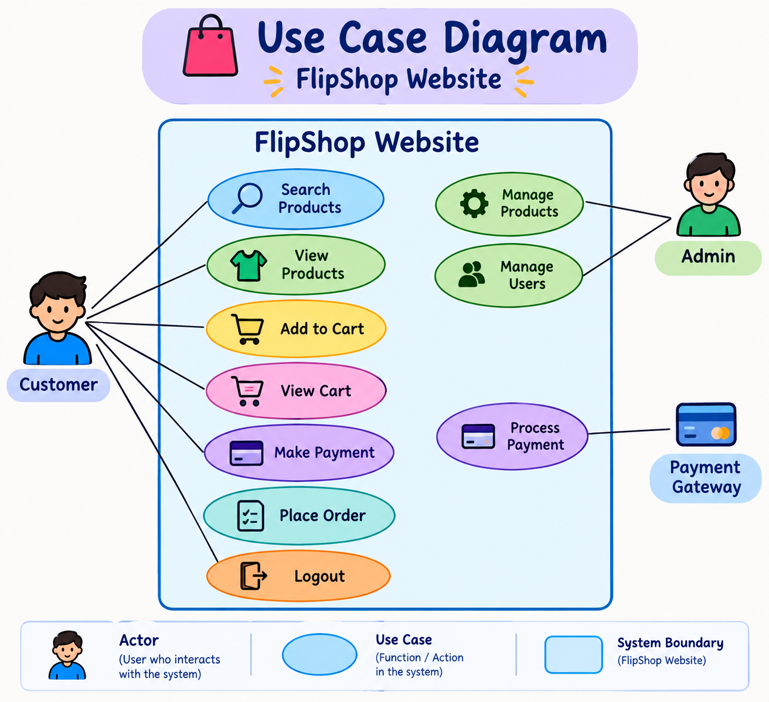

Slide 9
CONCLUSION
FlipShop is a user-friendly online shopping website. It makes shopping easier by providing product search, product details, cart management, billing, and checkout options in one place. Through this project, we learned how HTML, CSS, and JavaScript work together to create an interactive e-commerce website.
HTML → CSS → JavaScript → GitHub
Benefits: Convenience • Automation • Responsive UI • Team Collaboration
THANK YOU
Questions & Discussion
https://splendorous-kleicha-9a62f1.netlify.app/

