Slide 1
TCV One ERP
Core Database — Entity Relationship Overview
tcvonedb · MySQL 8+
Master Data
Quotation
Purchase
Sales
Inventory
Payments
Service
HR / Audit
20 Tables · Full FK Relationships · GST Compliant

Slide 2
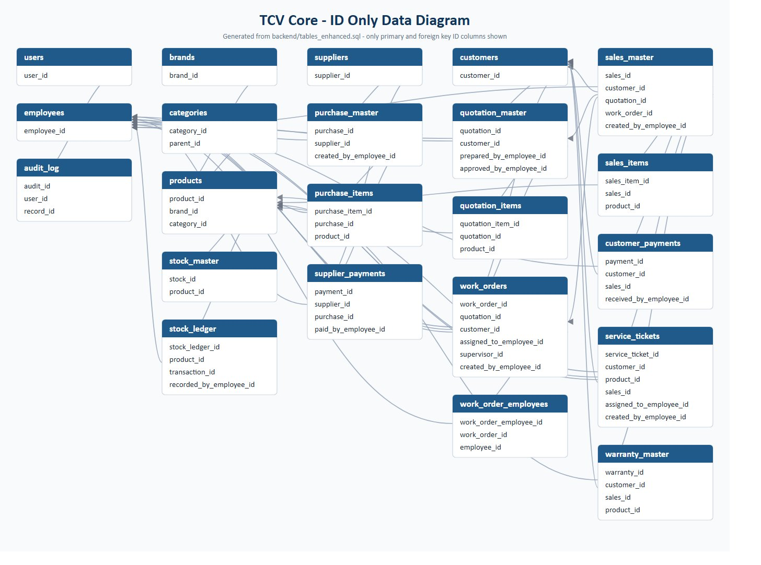
TCV Core — ID-Only Entity Relationship Diagram
Generated from tcvonedb · Primary keys + Foreign keys only

Slide 3
Master Data Module
Foundation entities — no FK dependencies
users
customers
brands
Key Notes
🔑 user_id
🔑 customer_id
🔑 brand_id
• users and employees are separate — users log in, employees work • categories is self-referencing via parent_id for hierarchical grouping • products link to both brand and category • These tables are referenced by almost every other module
products
🔑 product_id
↗ brand_id → brands
employees
suppliers
categories
↗ category_id → categories
🔑 employee_id
🔑 supplier_id
🔑 category_id
↗ parent_id (self-ref)
🔑 Primary Key ↗ Foreign Key

Slide 4
Quotation Module
quotation_master → quotation_items
customers
quotation_master
Flow
🔑 customer_id
🔑 quotation_id
1. Customer requests quote 2. Employee prepares quotation_master 3. Line items in quotation_items per product 4. Manager approves — approved_by_employee_id set 5. Approved quote links to work_order or sales
↗ customer_id → customers
products
↗ prepared_by_employee_id
↗ approved_by_employee_id
🔑 product_id
↗ brand_id
employees
↗ category_id
🔑 employee_id
quotation_items
🔑 quotation_item_id
↗ quotation_id → quotation_master
↗ product_id → products
🔑 Primary Key ↗ Foreign Key

Slide 5
Purchase Module
PO → GRN → Supplier Payment
suppliers
purchase_master
Flow
🔑 supplier_id
🔑 purchase_id
products
1. Raise PO (purchase_master) 2. Add line items per product 3. Goods received — stock_ledger updated 4. Record supplier payment
↗ supplier_id → suppliers
↗ created_by_employee_id → employees
🔑 product_id
↗ brand_id
↗ category_id
employees
🔑 employee_id
purchase_items
🔑 purchase_item_id
↗ purchase_id → purchase_master
↗ product_id → products
supplier_payments
🔑 payment_id
↗ supplier_id → suppliers
↗ purchase_id → purchase_master
↗ paid_by_employee_id → employees
🔑 Primary Key ↗ Foreign Key

Slide 6
Sales Module
sales_master → sales_items → customer_payments
customers
sales_master
Flow
🔑 customer_id
🔑 sales_id
1. Quote approved → create sales_master 2. Add line items per product 3. Record customer payment 4. sales_id referenced by warranty & service
↗ customer_id → customers
↗ quotation_id → quotation_master
customer_payments
↗ work_order_id → work_orders
🔑 payment_id
↗ created_by_employee_id
↗ customer_id → customers
quotation_master
↗ sales_id → sales_master
🔑 quotation_id
↗ received_by_employee_id
↗ customer_id
sales_items
🔑 sales_item_id
work_orders
↗ sales_id → sales_master
↗ product_id → products
🔑 work_order_id
↗ quotation_id
↗ customer_id
🔑 Primary Key ↗ Foreign Key

Slide 7
Inventory Module
stock_master → stock_ledger
products
stock_master
🔑 product_id
🔑 stock_id
employees
↗ brand_id
↗ product_id → products
↗ category_id
🔑 employee_id
stock_ledger
🔑 stock_ledger_id
↗ product_id → products
↗ transaction_id (source doc)
↗ recorded_by_employee_id
How stock_ledger.transaction_id works
GRN (purchase_items)
Sales Invoice (sales_items)
Stock IN after goods received
Stock OUT after sale
Work Order consumption
Manual adjustment
Stock OUT for job materials
Stock correction with employee audit trail
🔑 Primary Key ↗ Foreign Key

Slide 8
Work Orders & Service Tickets
work_orders · work_order_employees · service_tickets · warranty_master
quotation_master
work_orders
service_tickets
🔑 quotation_id
🔑 work_order_id
🔑 service_ticket_id
↗ customer_id
↗ quotation_id → quotation_master
↗ customer_id → customers
↗ customer_id → customers
↗ product_id → products
↗ assigned_to_employee_id
↗ sales_id → sales_master
↗ supervisor_id → employees
↗ assigned_to_employee_id
customers
↗ created_by_employee_id
↗ created_by_employee_id
🔑 customer_id
work_order_employees
warranty_master
employees
🔑 warranty_id
🔑 work_order_employee_id
↗ customer_id → customers
🔑 employee_id
↗ work_order_id → work_orders
↗ sales_id → sales_master
↗ employee_id → employees
↗ product_id → products
🔑 Primary Key ↗ Foreign Key

Slide 9
Audit Log & Cross-Module Summary
audit_log
Cross-Module Foreign Key Connections
🔑 audit_id
From Table
FK Column
→ To Table
Purpose
↗ user_id → users
↗ record_id (any table PK)
sales_master
quotation_id
quotation_master
Quote-to-Invoice traceability
sales_master
work_order_id
work_orders
Job-to-Invoice linkage
work_orders
quotation_id
quotation_master
Quote approved → job raised
service_tickets
sales_id
sales_master
Post-sale service request
warranty_master
sales_id
sales_master
Warranty on sold item
stock_ledger
transaction_id
(any doc)
Polymorphic: GRN / sale / WO
supplier_payments
purchase_id
purchase_master
Payment against PO
customer_payments
sales_id
sales_master
Payment against invoice
audit_log
record_id
(any table PK)
Universal change tracking
🔑 Primary Key ↗ Foreign Key audit_log.record_id = polymorphic reference to any table's PK

Slide 10
TCV One — Complete Table Index
20 tables · 5 module groups · MySQL 8+ · tcvonedb
Master Data
Quotation
Purchase
users
quotation_master
purchase_master
employees
quotation_items
purchase_items
customers
supplier_payments
suppliers
Inventory
brands
stock_master
Work / Service
categories
stock_ledger
work_orders
products
work_order_employees
service_tickets
Sales
warranty_master
sales_master
sales_items
customer_payments
HR / Audit
audit_log

