Slide 1

School of Electronics Engineering (SENSE)
Project-I (2026)
Leveraging Agentic AI for Intelligent Personalized Health Monitoring
Explainable, Safety-Aware Fall-Risk Prediction from Smart-Ring Data
Student Name(s):
G Sivakumar — 23BCE1834
Kriti Sahana V — 23BCE1868
Guide's Signature with Date
Guide:
Dr. Sheena Christabel Pravin, SENSE
Signature: _____________________
Programme / School:
B.Tech ECM — SENSE, VIT Chennai
Date: _________________________
Review & Date:
Review-III · 28.10.2026 (Wednesday)
1
Notes:
Introduce the team and the title. This slide is signed by the guide and scanned before the review.

Slide 2
Project Overview — Introduction & Background
Why this problem matters
What we built
1
Falls are the leading cause of injury-related harm in older adults
Risk rises quietly over days — poor sleep, low HRV, less walking
A
Smart-ring app
Flutter + Kotlin app collects HR, HRV, SpO₂, temperature, sleep, stress and steps all day
2
Wearables mostly detect a fall after it has happened
They do not say that today's risk is higher than usual
B
Fall-risk engine
Turns the vitals into a daily Fall Risk Score (0–100); every point traced to a measurement
3
LLM health chatbots state numbers they cannot be trusted with
A wrong heart rate or a missed emergency is dangerous
C
Verified AI agent
Explains the score in plain language, detects emergencies, checks every number it says
2
Notes:
Start with the problem: falls are the leading cause of injury in older adults. Wearables detect a fall only after it happens, LLM chatbots invent numbers, and ML risk scores are black boxes. Then introduce the three parts we built.

Slide 3
Project Overview — Significance & Motivation
1
Predict, don't just detect
A daily risk estimate gives time to act — rest, review medication, avoid risky activity — before a fall happens.
2
Trust through transparency
The score is a fixed formula with published weights; the app shows how every point was earned. No black box.
3
Safety first
Emergencies are detected from three independent signals, including the ring's own fall event, so a calm-sounding message after a fall is not missed.
4
Fair for women
Normal menstrual-cycle changes in temperature, heart rate and HRV are not mistaken for rising risk.
Low-cost consumer ring + phone · explainable AI · a screening aid, never a diagnosis
3
Notes:
Four reasons this matters: predicting instead of reacting, trust through explanations, safety, and fairness for women. Stress that the system is a screening aid, never a diagnosis.

Slide 4
Problem Statement & Objectives
Problem statement
Given daily vital-sign and activity data from a smart ring, estimate each user's fall risk for the next 24 hours in a way that is explainable, personal, fair across the menstrual cycle, and explained by an AI agent that never invents numbers and never misses an emergency.
Objective | How it was achieved | Outcome
Collect continuous vitals from a ring | Android app, background measurement loop, Supabase sync | Working on our ring
Estimate daily fall risk transparently | Personal baselines + evidence-weighted engine | Every point traceable
Explain every score | "How your score is calculated" page in the app | Measure-by-measure breakdown
Detect emergencies reliably | Keyword + LLM + ring fall-event fusion | 3/3 caught, 0 false alarms
Stop the AI inventing numbers | Grounded generation + numeric verification | Grounding 0.979 (vs 0.723)
Treat women fairly | Cycle-phase-matched baselines | 43% less false physiology risk
Validate on real people | PhysioNet LTMM, 73 older adults | AUC 0.686 ≈ clinical TUG 0.683
4
Notes:
Read the problem statement, then walk through the objectives table: each objective, how it was achieved, and the measured outcome.

Slide 5
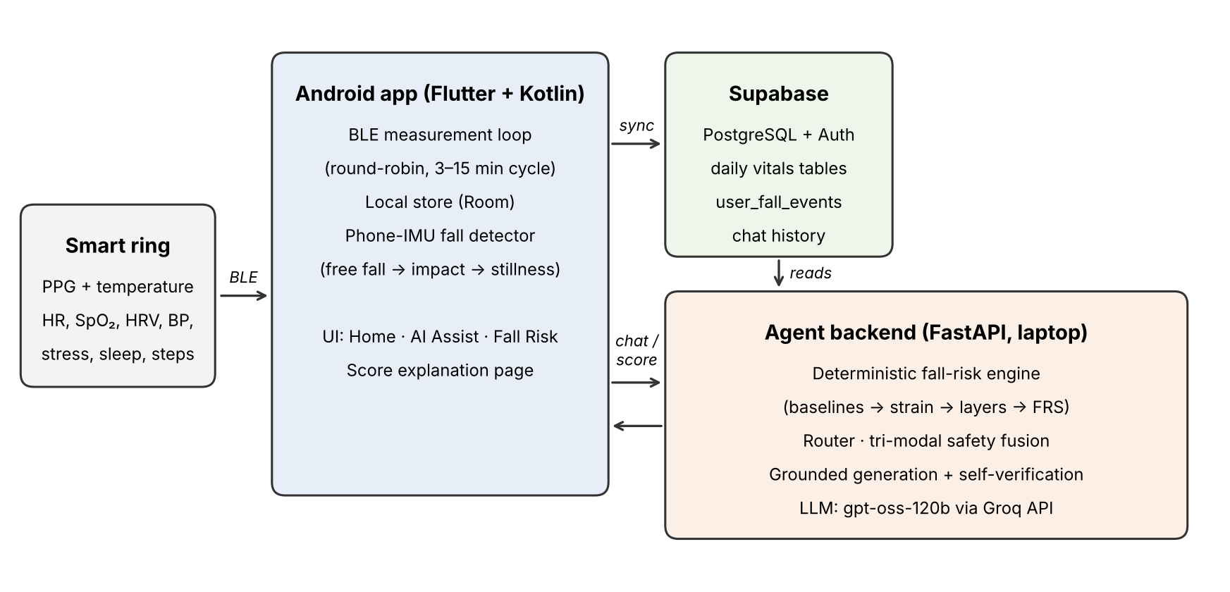
System Architecture — Overall Block Diagram
Smart ring → Android app → Supabase → agent backend (laptop) → Groq LLM
Design principle: a deterministic engine computes the score; the LLM only explains numbers it is given, and every number is checked. Reproducible and safe.
5
Notes:
Left to right: the ring sends vitals over BLE to the Android app, which stores them on the phone (Room) and syncs to Supabase. The FastAPI backend on the laptop reads Supabase, runs the fall-risk engine and the agent, and answers the app. Key principle: the LLM never computes the score.

Slide 6
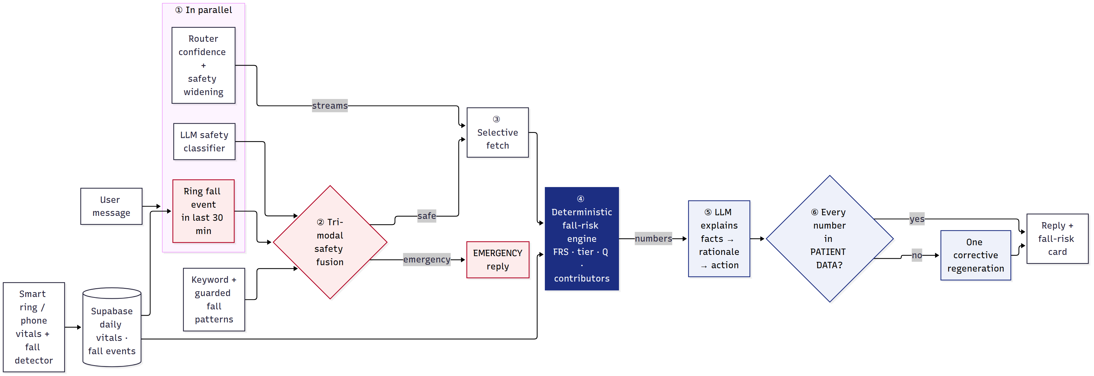
System Architecture — Agent Workflow
1
Stage 1 — understand
Router picks data streams; keyword, LLM and ring fall-event signals are fused
2
Stage 2 — fetch
Only the selected streams are read from Supabase (0.88 on average, not 12)
3
Stage 3 — answer & verify
Engine computes; LLM explains (fact → rationale → action); numbers checked
6
Notes:
Each chat message runs in three stages. Stage 1 runs the router, the LLM safety classifier and the ring fall-event lookup in parallel and fuses the three safety signals. Stage 2 fetches only the needed data. Stage 3 runs the engine, the LLM explains, and every number is verified.

Slide 7
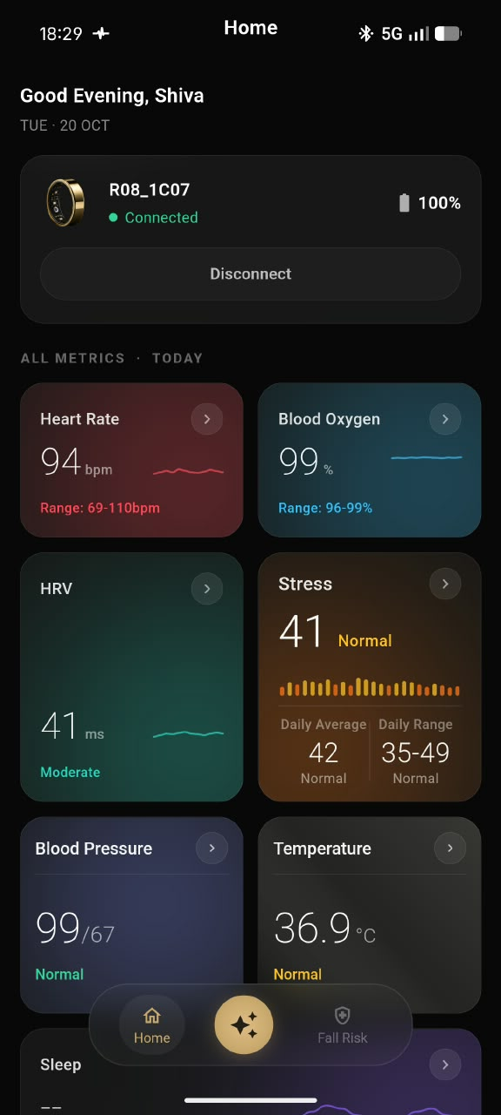
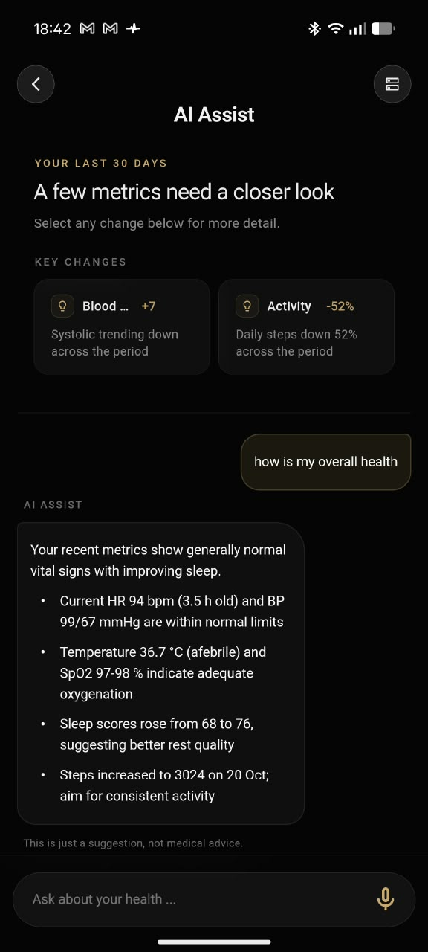
Implementation — Module 1: Smart-Ring App
1
Ring connection
Native Kotlin plugin on the vendor BLE SDK; foreground service keeps the ring connected; Home card shows status, battery % and Pair / Disconnect
2
Measurement loop
Steps → HR → SpO₂ → stress → BP → HRV → temperature; 3-min cooldown, 15 min when healthy; starts within seconds of the ring binding
3
Storage & sync
Every reading saved first in Room (works offline), then batched to Supabase every 5 min
4
Fall detection
Phone motion sensors (the ring has no accelerometer stream); a dropped phone is rejected
5
Three tabs
Home (vitals + detail charts) · AI Assist (chat) · Fall Risk (score + "how it is calculated")
Home
AI Assist
7
Notes:
Show the two screenshots. Explain the native BLE plugin, the measurement loop, local storage and sync, and phone-based fall detection. Mention the pairing fix: measurements now start within seconds of pairing.

Slide 8
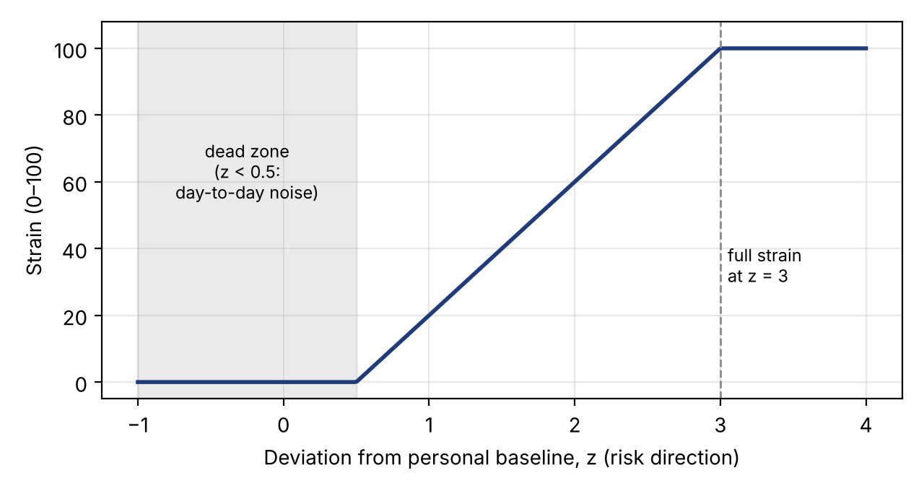
Implementation — Module 2: Fall-Risk Engine
1
Personal baseline
2
Deviation z
3
Strain 0–100
4
Four layers
Last 28 days (≥ 7 points):
normal = median
spread = 1.4826 × MAD
z = (today − median) ÷ spread,
sign flipped where low is bad
(HRV, SpO₂, sleep)
100 × clip((z − 0.5) ÷ 2.5)
z ≤ 0.5 → 0 (dead zone)
z ≥ 3 → 100
Physiology, Recovery,
Motion, Fall history —
weighted average of strains
Layer | Inputs (weight inside the layer)
Physiology (P) | HRV 0.35, resting HR 0.25, SpO₂ 0.25, temp 0.15
Recovery (RC) | Sleep 0.40, sleep score 0.30, stress 0.30
Motion (MO) | Daily steps 0.5, near-falls 0.5
Fall history (FH) | 0 / 60 / 100 for 0 / 1 / ≥ 2 falls in a year
Example: HRV median 45 ms, spread 7.4, today 30 → z = 2.0 → strain 60
8
Notes:
Walk through the four steps with the HRV example: median 45 ms, usual variation 7.4, today 30 gives z = 2.0 and strain 60. The median and MAD are used because one bad day cannot distort them. The dead zone ignores normal day-to-day wobble.

Slide 9
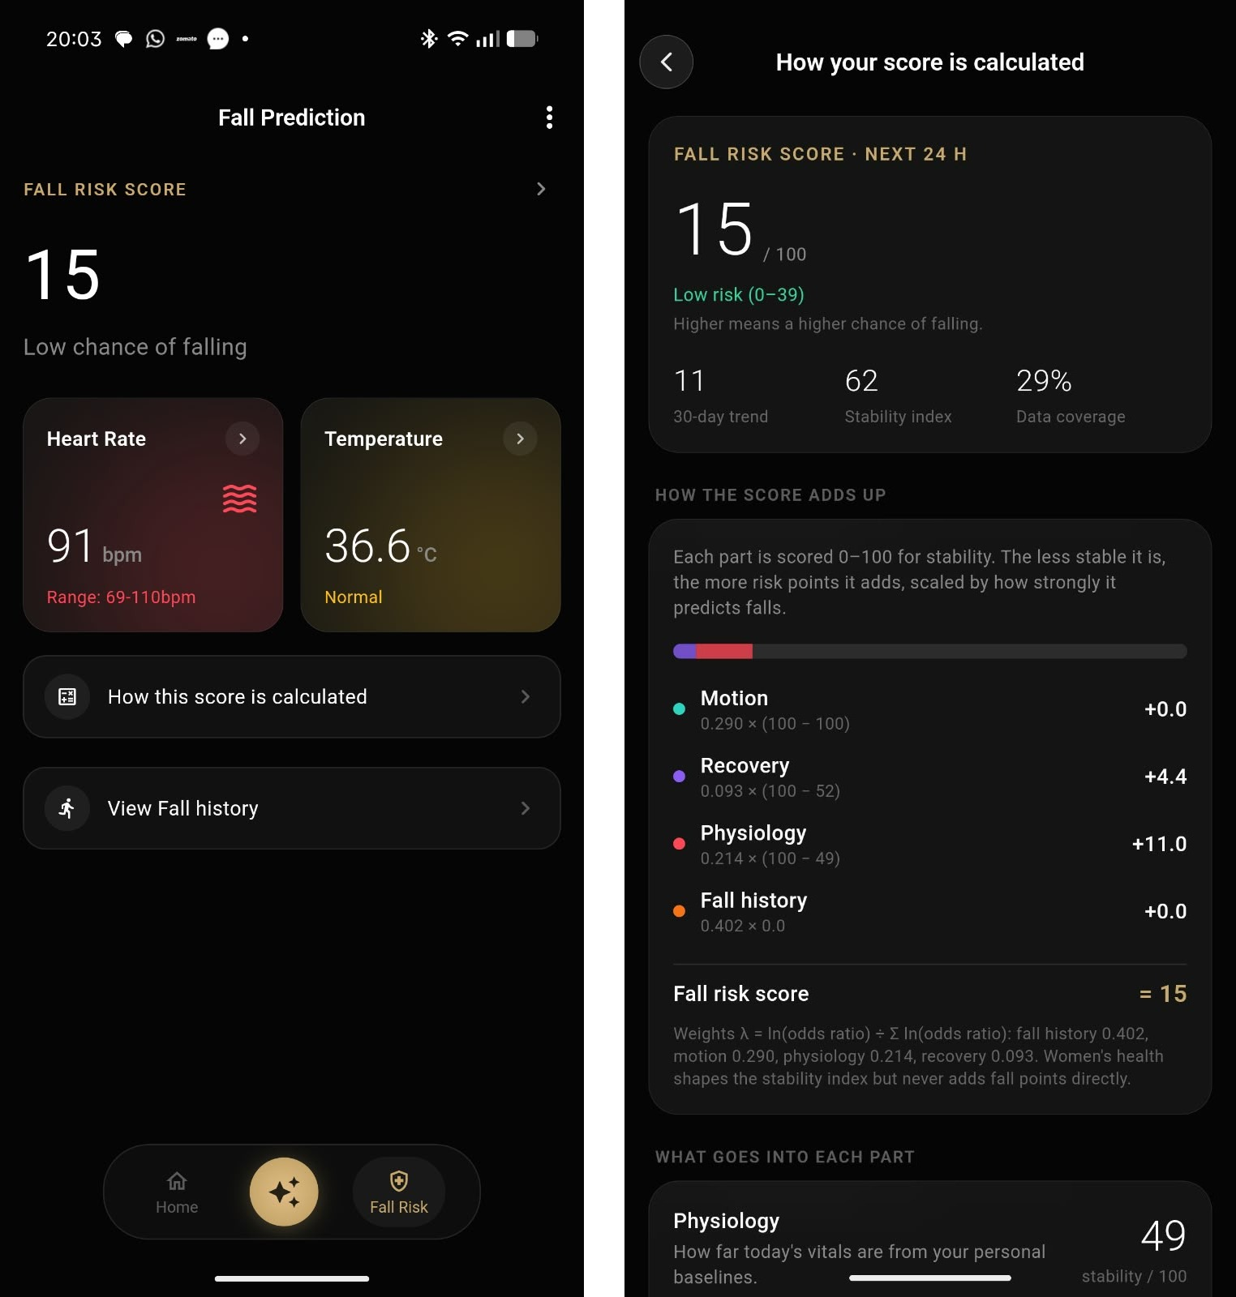
Implementation — Evidence-Derived Weights & Explainability
Layer | Odds ratio | Source | λ
Fall history | 2.8 | Deandrea 2010 (74 studies) | 0.402
Motion / gait | 2.1 | Deandrea 2010 | 0.290
Physiology | 1.73 | Mol 2019 | 0.214
Recovery / sleep | 1.27 | Baker 2024 (SWAN) | 0.093
λ = ln(OR) ÷ Σ ln(OR)
FRS = 0.402·FH + 0.290·MO + 0.214·P + 0.093·RC
Why ln(OR)? In logistic regression each factor's coefficient is β = ln(OR) — so these are the published models' own coefficients, scaled to sum to 1.
Tiers: LOW < 40 · MODERATE 40–69 · HIGH ≥ 70
Missing data: weights renormalised; confidence Q shows coverage
The app shows the same weights and every layer's points
9
Notes:
The layer weights come from published odds ratios. In logistic regression each risk factor's coefficient is ln(OR), so using ln(OR) as weights is using the published model's own coefficients, scaled to sum to 1. We did not train a model on a small dataset. Point at the app screenshot: the same weights appear on the score page.

Slide 10
Implementation — Module 3: Explainable, Safety-Aware Agent
1
Confidence-scored router
2
Tri-modal safety fusion
3
Grounded answer + verification
LLM picks which of 12 data streams a question needs
"How did I sleep?" → sleep only; "How am I doing?" → all
Safety widening: safety question + confidence < 0.75 → fetch fall risk, HR, SpO₂, HRV too
Keyword router as a fallback
Keyword signal: "fell", "chest pain"… (ignores "fell asleep")
LLM signal: triggers at confidence ≥ 0.7, overrides a keyword at ≥ 0.85
Biometric signal: ring / phone fall in the last 30 min
Any one strong signal → emergency reply
Engine output given to the LLM as literal values
Reply as JSON: facts → rationale → action
Every number in the reply looked up in the user's data
Wrong number → one corrective regeneration
10
Notes:
Router: picks only the data needed; when a question is safety-related and the router is unsure, it fetches more, not less. Safety: any one strong signal triggers emergency mode; the biometric signal catches a fall even when the message sounds calm. Grounding: every number is checked and corrected once if wrong.

Slide 11
Implementation — Integration & Performance Optimisation
Smart ring
Android app
Room (phone)
Supabase
FastAPI + engine
Agent → app
BLE · local-first storage · 5-min batched sync · JWT auth · app ↔ laptop over Wi-Fi (server address set in the app)
0.88
3 → 15 min
5 min
seconds
data streams fetched per answer (baseline agent: all 12)
adaptive measurement cooldown when vitals are normal
batched cloud uploads instead of one request per reading
to the first reading after pairing (was a full cooldown)
High-rate phone motion sensors run only while the risk tier is elevated, then switch off after 10 minutes
Router, safety classifier and fall-event lookup run in parallel, so safety adds checks without serial waits
CI on GitHub Actions: analyse, test and build the APK on every change
11
Notes:
Integration path from ring to answer. Optimisations: adaptive measurement cooldown, batched uploads, selective fetching (0.88 streams per answer instead of 12), and high-rate fall sensors only when risk is elevated. The pairing fix means the first reading arrives in seconds instead of minutes.

Slide 12
Results — Agent Evaluation (11 Scenarios)
3 / 3
0 / 8
0.979
emergencies caught
false alarms
strict numeric grounding
Version | Emergencies | Grounding | Stale data
A – Plain LLM | 0/3 | 0.723 | 0/1
B – Plain RAG | 0/3 | 0.606 | 0/1
C – Baseline agent | 2/3 | 0.955 | 0/1
D – Our agent | 3/3 | 0.979 | 1/1
No version raised a false alarm, including the "I fell asleep" keyword trap
Self-verification fired once and raised that reply from 0.80 to 1.00
12
Notes:
Four versions on the same 11 scenarios, 3 of them emergencies. Only version D caught all three — one emergency was visible only through the ring's fall event, because the message sounded calm. D also had the highest grounding and was the only one to disclose stale data.

Slide 13
Results — Fall Risk Scores & Cycle-Aware Baselines
Demo user | FRS | Tier | Top contributors
Arun (healthy) | 6 | LOW | steps +5.2, SpO₂ +1.1
Meera (luteal + poor recovery) | 47 | MODERATE | past fall +24.1, HRV +7.5
Ravi (4-day-old data) | 3 | LOW | confidence Q 70, disclosed
Lakshmi (recent fall) | 71 | HIGH | falls +40.2, near-falls +14.5
Priya (healthy luteal) | 4 | LOW | HRV +2.5
Every score is the exact sum of its contributions (checked by a unit test)
Stale data lowers confidence Q, and the agent must say so
Cycle-aware baselines: luteal +0.3 °C, +2 bpm, −7% HRV are treated as normal
−43% (Priya) and −40% (Meera); Meera's false flags 2 → 0
13
Notes:
The engine puts each demo user in the expected tier and explains why — for Lakshmi, past falls and near-falls dominate. On normal luteal days, cycle-aware baselines cut physiology risk by about 40% and removed Meera's two false flags, while her genuine strain was still detected.

Slide 14
Results — Validation on Real Data (PhysioNet LTMM)
Why LTMM: our ring users have no recorded falls; LTMM is the public dataset with real older adults, movement sensors and known fall history
Data: 73 adults (35 fallers, 38 non-fallers), lower-back accelerometer, 1-min lab walk at 100 Hz
Method: same idea as the engine — no training, fixed rules, feature directions from the literature
Honest limitations
Sensor on the back, not the finger — validates the approach
Tests the motion layer only
Fallers defined by past falls; n = 73 (CI 0.56–0.81)
3-day home walking did not add information (0.650 vs 0.655)
14
Notes:
Our ring users have never fallen, so we validated the approach on PhysioNet LTMM: 73 older adults, 35 fallers and 38 non-fallers. With no training, our gait index scored AUC 0.686, the same as the Timed Up and Go test doctors use. A trained model reached only 0.721. Limitations: back-worn sensor, motion layer only, past falls, small sample.

Slide 15
Results — Comparison with Existing Solutions
Existing work | What it does | What is missing | Our approach
Merrill et al., 2026 (Nature Comms) | LLM agent on wearable data, 84% numeric accuracy | No emergency handling | Tri-modal safety fusion: 3/3 emergencies
Mohammed et al., 2026 (ICAART) | Fact → rationale → action health agent | Fetches all data; no safety layer | Selective routing (0.88 streams) + safety widening
Lu et al., 2026 | Query-conditioned graph retrieval | Retrieval not linked to safety | Safety-asymmetric router
SelfCheckGPT, Self-Refine (2023) | Hallucination checks, self-critique | Not checked against real data | Every number checked against the user's data (0.979)
Deandrea 2010, Hausdorff 2001 | Fall risk factors, gait variability | Population level, no daily score | Daily personal score using those odds ratios
Trained fall models (e.g. TCNs) | High accuracy on labelled data | Black box, needs fall labels | Untrained, explainable; AUC on par with TUG
Wearable baselines (Oura, smartwatch studies) | Personal baselines | One baseline for the whole cycle | Cycle-phase-matched baselines (−43%)
15
Notes:
Each existing work solves part of the problem. Our contribution is combining a transparent evidence-weighted score, cycle-aware baselines, three-signal safety and verified LLM numbers.

Slide 16
Results — Performance Benchmarking & Validation
Check | What it verifies | Result
Engine unit tests | Baselines, strain, cycle, tiers | Pass
Contribution sum | Points add up to the score | Pass
Safety tests | "fell asleep" guard, override, biometric | Pass
Grounding tests | Digit-boundary matching | Pass
Backend total | 123 tests | All pass
App total | 127 tests, incl. 320 px layouts | All pass
Static analysis | flutter analyze | No issues
Build | GitHub Actions APK | Success
Live single query on the laptop: ≈ 3.0 s (router + safety 1.4 s, fetch, answer + verify 1.6 s)
Real-data validation: LTMM AUC 0.686 vs clinical TUG 0.683 (slide 14)
16
Notes:
Latency: in the batch evaluation version D averaged 19.6 s because it makes extra router, safety and verification calls — the cost of safety. A single live query on the laptop took about 3 s. Testing: 123 backend and 127 app tests pass, analyser clean, APK builds on every change.

Slide 17
Standards Followed & SDG Mapping
Standards followed
SDG mapping
IEC 62304 — medical software life-cycle — structured development and testing
ISO 14971 — risk management — missed emergencies vs false alarms
IEC 82304-1 — health software safety — screening estimate, never a diagnosis
ISO/IEC 23894 — AI risk management — the LLM never computes the score
Bluetooth 5 (BLE), ISO/IEEE 11073 — ring–phone link, vital-sign data
ISO/IEC 27001, DPDP Act 2023 — protecting biometric data, consent, deletion
RFC 8446 (TLS 1.3), RFC 7519 (JWT) — encrypted transport, user authentication
TRIPOD — transparent reporting of the LTMM experiments
SDG 3 — Good Health and Well-being
Early warning and emergency detection
3
5
SDG 5 — Gender Equality
Cycle-aware baselines give women fair scores
9
SDG 9 — Industry, Innovation, Infrastructure
Ring + cloud + explainable AI
10
SDG 10 — Reduced Inequalities
Affordable hardware, plain-language answers
17
Notes:
Standards that guided design, risk management, data protection and reporting. SDG 3 is the main goal; SDG 5 through cycle-aware fairness; SDG 9 and 10 through low-cost, explainable technology.

Slide 18
Live & Video Demonstration
Live demonstration plan (≈ 8 min)
Video demonstration
Screen recording of the same flow (phone screen + laptop log), kept as a backup and played if the Wi-Fi or the ring fails during the review.
Setup
Phone and laptop on the phone's hotspot
uvicorn main:app --host 0.0.0.0 --port 8000
Laptop IP entered in AI Assist → server
1
Home — ring connected with battery %; open a vital card and its chart
2
Pair / Disconnect — disconnect, pair again — measurements start within seconds
3
Fall Risk — score and tier → "How your score is calculated", one layer's points
4
AI Assist — "How is my overall health?" → real numbers matching Home
5
Safety — "I fell and feel dizzy" → emergency mode
6
Laptop log — router streams, three safety signals, timing, grounding score
18
Notes:
Run the demo on the phone hotspot (campus Wi-Fi often blocks phone-to-laptop traffic). Keep the laptop terminal visible to show the Version D log. If anything fails, play the recorded video.

Slide 19
Conclusion — Project Achievements
3 / 3
0.979
0.686
−43%
emergencies caught,
0 false alarms
numeric grounding
(plain LLM 0.723)
AUC on real data —
clinical TUG 0.683
false physiology risk
on normal luteal days
A complete system: smart ring → Android app → Supabase → explainable engine → verified AI agent, all modules integrated and working
A transparent Fall Risk Score: personal baselines, evidence-derived weights, every point traceable in the app
An agent that never computes the score itself, checks every number, discloses stale data, and catches emergencies from text and from the ring
An untrained, explainable method that performs on par with a clinical test on real older adults
19
Notes:
A complete, working system from ring to verified answer. Read the four numbers, then the summary.

Slide 20
Limitations & Future Scope
Limitations
Future scope
1
No real fall outcomes from ring users yet (validation used LTMM)
1
Prospective study: follow users for months and record real falls
2
LTMM sensor is on the lower back; the ring gives no raw accelerometer stream
2
Use the ring's own motion data for gait features when the SDK allows
3
Phone-detected falls are not yet uploaded to the backend
3
Upload phone fall events so the biometric safety signal works on real falls
4
Backend runs on a laptop on the same Wi-Fi
4
Deploy the backend to the cloud for use anywhere
5
Weights come from published studies, not calibrated on our users
5
Calibrate weights on real outcomes; caregiver alerts with consent
20
Notes:
Be upfront about the limitations, then show that each one maps to a concrete next step.

Slide 21
References (1/2)
[1] H. H. Mohammed, G. Kiss, J. A. Serrano, and F. Lindseth, “Agentic health analytics for personalized insights from wearable data,” in Proc. 18th Int. Conf. Agents and Artificial Intelligence (ICAART), Marbella, Spain, vol. 3, pp. 2050–2061, 2026.
[2] M. A. Merrill et al., “Transforming wearable data into personal health insights using large language model agents,” Nature Communications, vol. 17, Art. no. 1143, 2026.
[3] Z. Lu, M. Abbasian, and A. M. Rahmani, “Query-conditioned graph retrieval for contextualized LLM reasoning in personalized wearable data,” arXiv:2605.18763, 2026.
[4] W. Zhang et al., “RubricsTree: Scalable and evolving open-ended evaluation of personal health agents across health memory and medical skills,” arXiv:2606.18203, 2026.
[5] P. Saha et al., “Picking the right specialist: Attentive neural process-based selection of task-specialized models as tools for agentic healthcare systems,” arXiv:2602.14901, 2026.
[6] S. Yao et al., “ReAct: Synergizing reasoning and acting in language models,” in Proc. Int. Conf. Learning Representations (ICLR), 2023.
[7] P. Manakul, A. Liusie, and M. J. F. Gales, “SelfCheckGPT: Zero-resource black-box hallucination detection for generative large language models,” in Proc. Conf. Empirical Methods in Natural Language Processing (EMNLP), pp. 9004–9017, 2023.
[8] A. Madaan et al., “Self-Refine: Iterative refinement with self-feedback,” in Advances in Neural Information Processing Systems (NeurIPS), vol. 36, 2023.
[9] S. Ateia and U. Kruschwitz, “Can language models critique themselves? Investigating self-feedback for retrieval augmented generation at BioASQ 2025,” in CLEF 2025 Working Notes (BioASQ Lab), 2025.
[10] Z. Fu, F. Li, J. Gu, H. Wang, P. Nakov, B. Hooi, M.-Y. Kan, and J. Wu, “Better with experience: Self-evolving LLM agents for evidence-grounded health community notes,” arXiv:2606.02215, 2026.
[11] S. Deandrea, E. Lucenteforte, F. Bravi, R. Foschi, C. La Vecchia, and E. Negri, “Risk factors for falls in community-dwelling older people: A systematic review and meta-analysis,” Epidemiology, vol. 21, no. 5, pp. 658–668, 2010.
[12] J. M. Hausdorff, D. A. Rios, and H. K. Edelberg, “Gait variability and fall risk in community-living older adults: A 1-year prospective study,” Arch. Phys. Med. Rehabil., vol. 82, no. 8, pp. 1050–1056, 2001.
21
Notes:
IEEE format; the same references as the report bibliography.

Slide 22
References (2/2)
[13] A. Mol, P. T. Bui Hoang, S. Sharmin, E. M. Reijnierse, R. J. van Wezel, C. G. Meskers, and A. B. Maier, “Orthostatic hypotension and falls in older adults: A systematic review and meta-analysis,” J. Am. Med. Dir. Assoc., vol. 20, no. 5, pp. 589–597, 2019, doi: 10.1016/j.jamda.2018.11.003.
[14] J. Baker, M. Hood, L. Swanson, C. Kline, K. Ylitalo, J. Cauley, R. Green, and C. Karvonen-Gutierrez, “Sleep quality and duration and risk of falls in older adult women: The Study of Women’s Health Across the Nation (SWAN),” Innovation in Aging, vol. 8, suppl. 1, p. 112, 2024, doi: 10.1093/geroni/igae098.0360.
[15] T. Mishra et al., “Pre-symptomatic detection of COVID-19 from smartwatch data,” Nature Biomedical Engineering, vol. 4, no. 12, pp. 1208–1220, 2020.
[16] E. Alzueta et al., “Tracking sleep, temperature, heart rate, and daily symptoms across the menstrual cycle with the Oura ring in healthy women,” Int. J. Women’s Health, vol. 14, pp. 491–503, 2022, doi: 10.2147/IJWH.S341917.
[17] E. de Jager, B. Caulfield, E. Angelidi, B. MacNamee, and S. Holden, “Wearable-derived heart rate variability across the menstrual cycle, hormonal contraceptive use, and reproductive life stages in females: A living systematic review,” Sports Medicine, vol. 56, no. 5, pp. 1153–1173, 2026, doi: 10.1007/s40279-025-02388-y.
[18] A. Askhatova et al., “A temporal convolutional network approach for gait-based fall risk prediction to support safe sport participation in older adults,” MethodsX, vol. 16, Art. no. 103845, 2026, doi: 10.1016/j.mex.2026.103845.
[19] A. Weiss, M. Brozgol, M. Dorfman, T. Herman, S. Shema, N. Giladi, and J. M. Hausdorff, “Does the evaluation of gait quality during daily life provide insight into fall risk? A novel approach using 3-day accelerometer recordings,” Neurorehabil. Neural Repair, vol. 27, no. 8, pp. 742–752, 2013.
[20] J. McCamley, M. Donati, E. Grimpampi, and C. Mazzà, “An enhanced estimate of initial contact and final contact instants of time using lower trunk inertial sensor data,” Gait & Posture, vol. 36, no. 2, pp. 316–318, 2012.
[21] R. Moe-Nilssen and J. L. Helbostad, “Estimation of gait cycle characteristics by trunk accelerometry,” J. Biomechanics, vol. 37, no. 1, pp. 121–126, 2004.
[22] D. Drover, J. Howcroft, J. Kofman, and E. D. Lemaire, “Faller classification in older adults using wearable sensors based on turn and straight-walking accelerometer-based features,” Sensors, vol. 17, no. 6, Art. no. 1321, 2017.
[23] J. M. Hausdorff, “Long Term Movement Monitoring Database (LTMM), version 1.0.0,” PhysioNet, doi: 10.13026/C2S59C.
22
Notes:
IEEE format; the same references as the report bibliography.

Slide 23
Thank You
Project-I (2026) · SENSE · VIT Chennai
23

