Slide 1
Tourist Demand Forecasting using Machine Learning
UNDER THE GUIDANCE OF
Mr. Kumar Anurupam Sir

Slide 2
ABSTRACT:
Our tourism demand forecasting model to forecast arrivals for the tourist place Tirumala Tirupati Devastanam(TTD). We have considered attributes Day Speciality(weekend or non-weekend ),Weather condition(Based on temperature), Google Trends(frequency of ttd related keywords searched on goolgle),Twitter trend(whether opinion of twitter is +ve, -ve or neutral). Our model uses structured variables to build a tourism demand forecasting model based on Light Gradient Boosting Machine Regressor.

Slide 3
INTRODUCTION:
Motivation for the work:
Tourism industry contributes significantly to economic growth worldwide.
Forecasting tourist volume is crucial for predicting future economic development.
Tourism demand forecasting aids in planning, policy making, and resource allocation.
Predicting tourist arrivals helps destinations and businesses make efficient decisions

Slide 4
CONT...
Real-word Application:
The project's real-world applications span destination management, marketing, revenue management, policy making, and safety.
Forecasting tourist arrivals enhances decision-making processes and contributes to the sustainable growth of the tourism industry.
The outcomes of the project can be implemented by various stakeholders to optimize their operations and provide better experiences for tourists

Slide 5
RELATED WORK/EXISTING WORK
Previous research in tourism demand forecasting has investigated different methodologies and variables. Some studies have focused on utilizing Google Trends data and comparing accuracy across countries and cities. Others have explored the use of web search index and image data for forecasting tourism demand. In this project, the objective was to forecast tourist arrivals at the Tirumala Venkateswara Temple (TTD) using search engine data, Twitter trends, historical data, and weather conditions. The proposed approach involved employing a Light Gradient Boosting Machine Regressor (LGBMR) model, incorporating these variables to enhance the accuracy of tourism demand forecasting.

Slide 6
CONT…
LIMITATIONS:
Here we have concern in the availability of the dataset.Due lo lack of good dataset many proposed models didn`t performed upto the level.
Spreading the forecasting for the multiple destinations is not possible.

Slide 7
PROPOSED METHOD:
This study used regression models to forecast the number of pilgrim arrivals at TTD, focusing on correlated keywords like Tirupati, Tirumala, VIP darshan, and tirumala darshan. Various machine learning models have been explored for tourism demand forecasting, including using Google Trends and comparing accuracy between countries and cities. The proposed approach involved using data from Google Trends, historical data, weather data, and Twitter trends, with a Light Gradient Boosting Machine Regressor (LGBMR) model yielding accurate forecasts. The process involved data collection, preprocessing, feature selection, training, validation, and output prediction

Slide 8
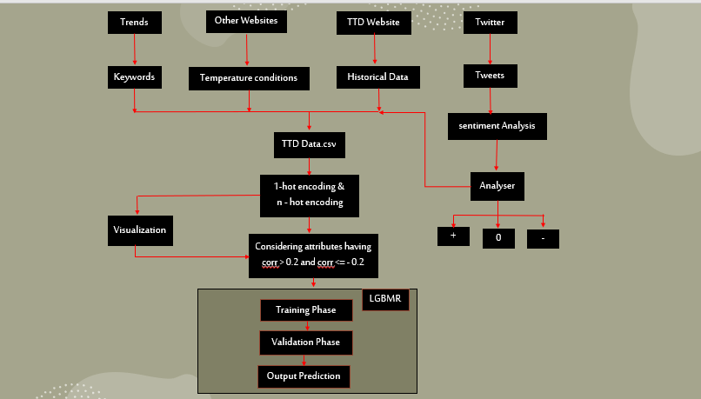

Slide 9
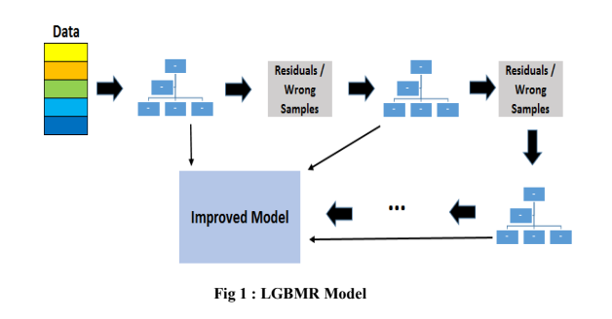
LGBMR MODEL:

Slide 10
CONT…
LightGBM uses a leaf-wise tree growth strategy, which differs from
the level-wise strategy employed by many other gradient boosting
implementations. In leaf-wise growth, the algorithm selects the leaf node
with the maximum delta loss (improvement in the loss function) as the next
node to grow. This approach leads to faster convergence and better
accuracy.

Slide 11
CONT…
LightGBM optimizes the gradient descent algorithm by using a
technique called Gradient-Based One-Side Sampling (GOSS) and
Exclusive Feature Bundling (EFB). GOSS selects a small percentage of
large-gradient data instances and the full set of small-gradient instances,
resulting in a more efficient gradient approximation. EFB combines
exclusive feature values to reduce memory usage and speed up training.

Slide 12
EXPERIMENTAL SETUP
Technologies used:
Selenium | LGBM algorithm
Matplotlib | Pandas
Scikit-Learn | Numpy
Sentiment Analyzer | Jupyter Notebook
Seaborn | plotly | Matplotlib

Slide 13
CONT…
DATASET:
The dataset used in this project includes historical tourism demand records, Google Trends data, tweets related to the destination, weather conditions, and weekday information. The dataset is carefully curated, structured, and updated to capture various factors that influence tourism demand. Data preprocessing techniques were applied to handle missing values and outliers. The dataset serves as a foundation for training and evaluating the tourism demand prediction model, providing valuable insights for accurate forecasting

Slide 14
CONT…
SYSTEM HARDWARE:
Modera Operating System
4 GB RAM
10 GB Free Disk Space
X86 64-bit CPU(Intel/AMD Architecture)

Slide 15
RESULTS:
We evaluated four machine learning algorithms - LightGBM, Decision Tree, Regression, and XGBoost - to predict tourist demand for TTD. LightGBM performed the best, with the lowest MAE and RMSE values and the highest R^2 value. The results highlight the potential of our model in forecasting tourist demand for TTD and assisting in resource allocation and crowd management. Further refinement may be needed for improved accuracy

Slide 16
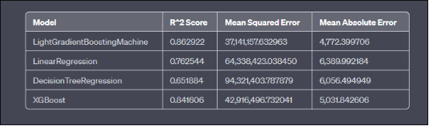
CONT…

Slide 17
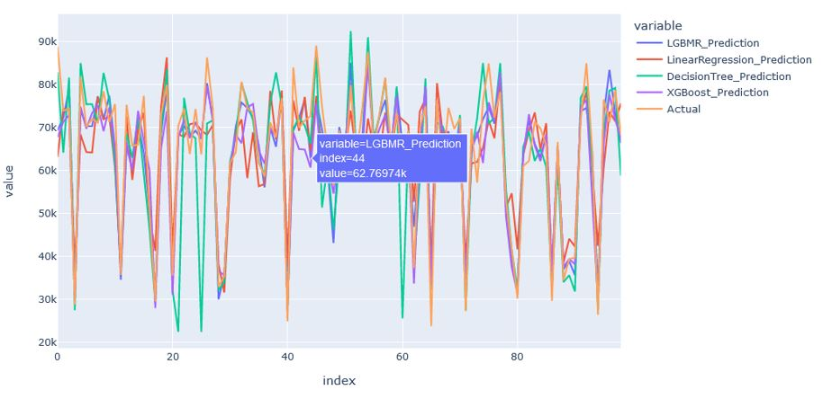
CONTD…
RESULTS COMPARISION:

Slide 18
CONCLUSION:
Our tourist demand prediction project for Thirumala Thirupathi Devasthanam (TTD) utilized the Selenium framework and effective preprocessing techniques. LightGBM showed superior accuracy in predicting tourist demand. This highlights the importance of machine learning in optimizing resource allocation and enhancing visitor experiences at TTD. Refinement and collaborations will advance tourist demand prediction, contributing to TTD's growth and success.

Slide 19
FUTURE SCOPE
Geometric Location Analysis: Incorporate geometric location as a factor in the prediction model to analyze the impact of transportation connectivity, city development, and proximity to other tourist destinations on tourist demand.
Integration of Additional Social Networking Data: Improve the model's performance by incorporating reliable social networking data sources such as Instagram or Facebook to capture user-generated content, sentiment analysis, and social engagement metrics for predicting tourist demand.

Slide 20
COND…
Prediction of Multiple Destinations: We want to improve our model to predict the tourist arrivals for the multiple destinations.Due to lack of dataset avaliability we are restricting it to TTD only.
Collaboration with Tourism Stakeholders: Collaborate with tourism authorities, travel agencies, and other stakeholders to gather insights, incorporate feedback, and ensure the model aligns with industry needs for better decision-making and enhanced visitor experiences

Slide 21
REFERNECES:
https://drive.google.com/drive/u/0/folders/1D79qkvtBdHIS2uV6PeixbfX6JA5c--hf
https://drive.google.com/drive/u/0/folders/1Fe411WLN8xl6vzlC_1Ftznej6_PSjy0k
https://drive.google.com/drive/u/0/folders/1wylQ4EkjJov9jJpi4ZUuWgSf_0YVF5KS
https://drive.google.com/drive/u/0/folders/19gfLumZbdaDNKg3gHXhui6crtOv6GGTS
https://drive.google.com/drive/u/0/folders/1IeQLpFyh0XlICgdePwQzV5qG4VCf4mZv

Slide 22


Slide 23
THANK YOU EVERYONE

