Slide 1
Superstore Sales Analytics
End-to-End Data Analyst Internship Project
Data Wrangling → EDA & BI → Cohort Deep-Dive → Storytelling & Hypothesis Testing
Data: 2015–2018 | 9,800 Orders | 793 Customers | Total Sales: $2.26M

Slide 2
OVERVIEW
Objective & Project Roadmap
Where should Superstore focus to grow profitable, repeatable revenue?
01
02
03
04
Data Immersion & Wrangling
EDA & Business Intelligence
Deep-Dive: Cohort Analysis
Storytelling & Hypothesis Testing
Cleaned and structured 9,800 raw orders into an analysis-ready dataset
Uncovered revenue patterns across region, category, and segment using SQL + visualization
Explained WHY those patterns exist — retention & lifetime value by acquisition cohort
Statistically validated key findings and packaged results for stakeholders
2

Slide 3
TASK 1
Data Immersion & Wrangling
Foundation: turning raw transactional data into an analysis-ready dataset
Data profiling
Identified missing values, duplicate records, and inconsistent date/text formatting across 9,800 raw rows
Cleaning & transformation
Standardized date formats, resolved category/sub-category naming, removed duplicate order lines
Feature engineering
Derived Order Month, Order Weekday, and other fields to support downstream time-based analysis
Output
A single clean, documented dataset (with data dictionary) used as the single source of truth for Tasks 2–4
3

Slide 4
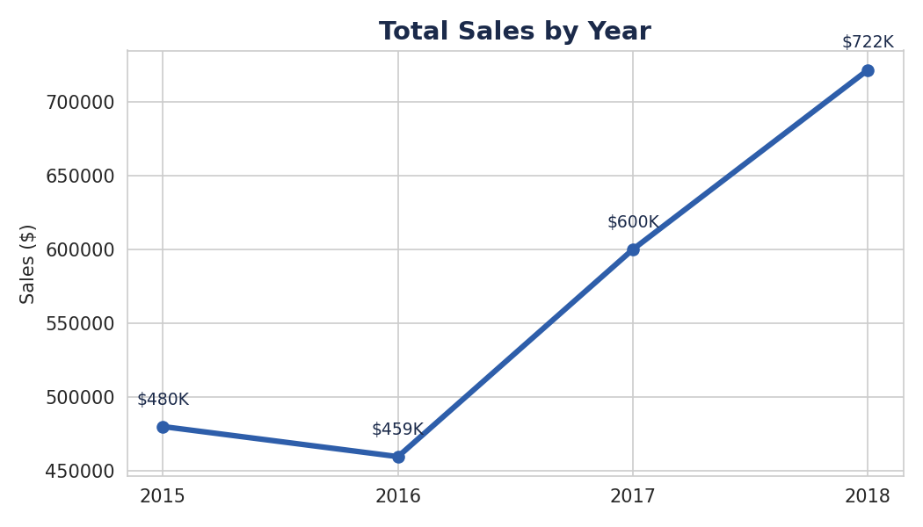
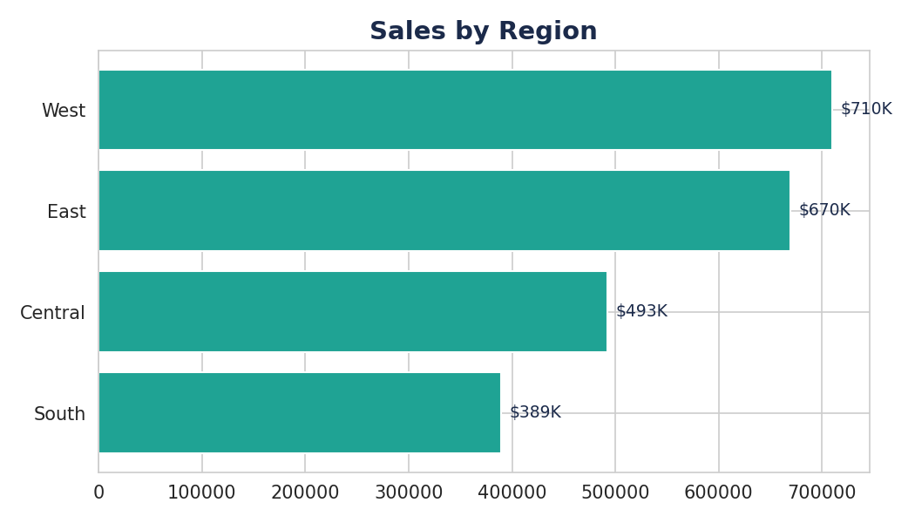
TASK 2
EDA & Business Intelligence — Headline Numbers
TOTAL SALES
TOTAL ORDERS
AVG ORDER VALUE
YOY GROWTH
$2.26M
9,800
$231
+20.3%
2015–2018
793 customers
per order
2017 → 2018
4

Slide 5
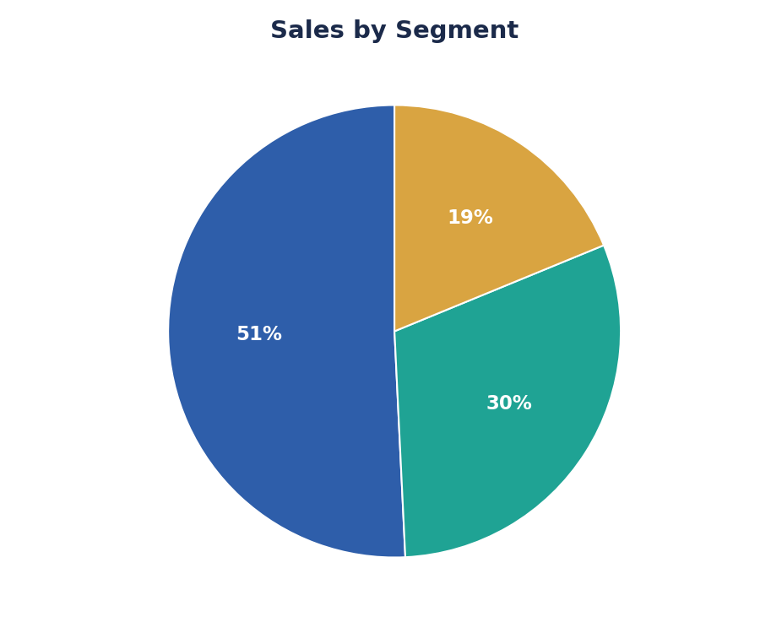
TASK 2
Where the Revenue Concentrates
●
Consumer segment drives 51% of total revenue — more than Corporate and Home Office combined
●
Phones ($328K) and Chairs ($323K) are the top two revenue sub-categories
●
West ($710K) and East ($670K) regions together generate over 60% of total sales
●
South region lags at $389K — a candidate for focused growth investment
5

Slide 6
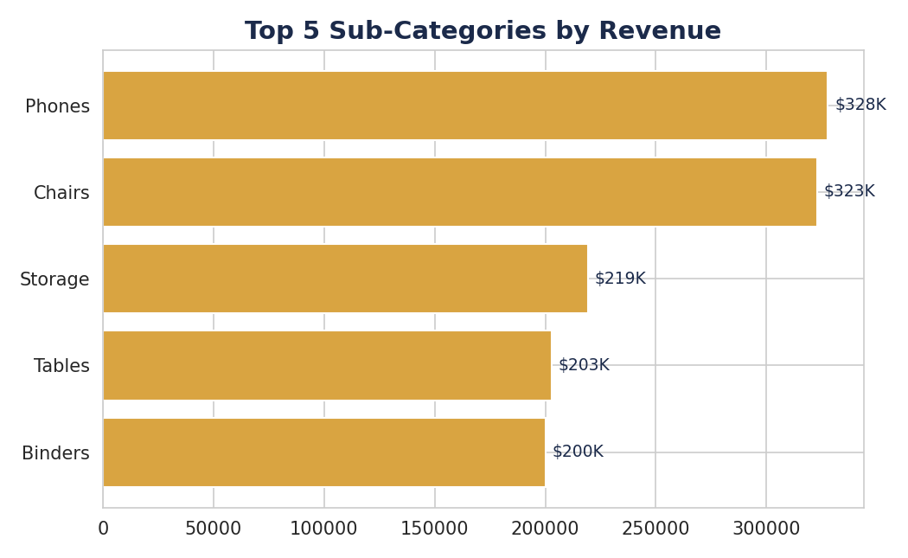
TASK 2
SQL for Business Questions
Answered via SQL queries with filtering, aggregation, and window functions
Top 5 products by revenue
GROUP BY + ORDER BY + LIMIT
Monthly sales trend (2015–2018)
Date functions + GROUP BY
Top sub-category within each category
RANK() OVER (PARTITION BY …)
Revenue & AOV by region
Aggregation (SUM, AVG)
Ship mode usage by region
Multi-column GROUP BY
6

Slide 7
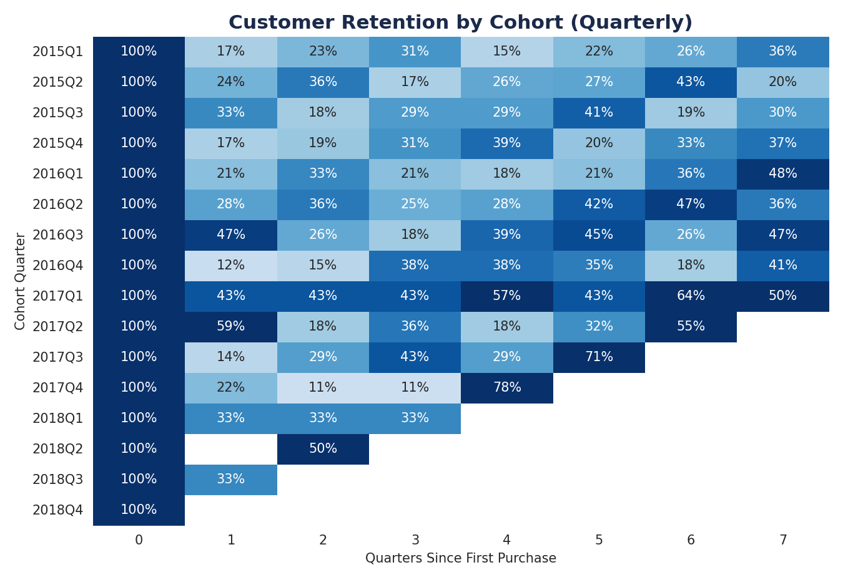
TASK 3
Deep-Dive: Customer Retention by Cohort
Explains WHY revenue concentrates where it does — through repeat-purchase behavior
REPEAT PURCHASE RATE
98.4%
AVG CUSTOMER LTV
$2,852
MEDIAN CUSTOMER LTV
$2,215
Nearly all customers return — growth depends more on acquisition volume than retention risk.
7

Slide 8
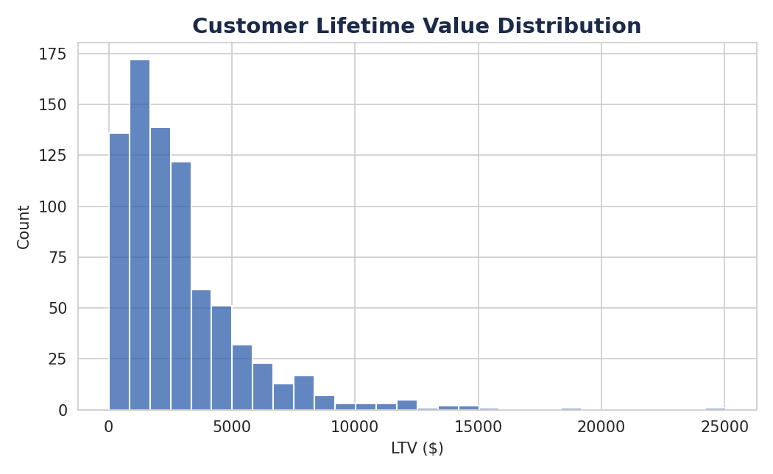
TASK 3
Customer Lifetime Value Concentration
●
Average LTV per customer ($2,852) sits well above the median ($2,215) — a small group of high-value customers pulls the average up
●
793 customers generated $2.26M over 4 years — roughly $2,850 in lifetime revenue per customer on average
●
This concentration suggests an account-based approach for top-decile customers could protect a disproportionate share of revenue
8

Slide 9
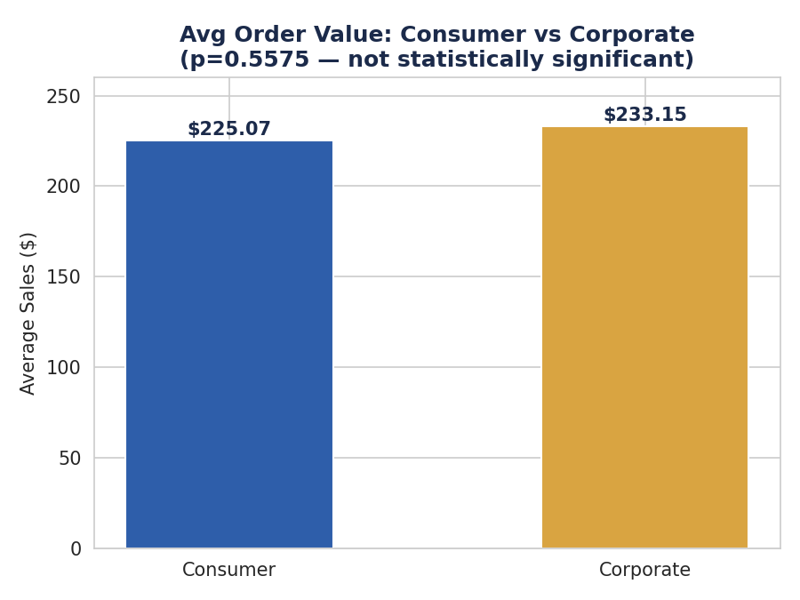
TASK 4
Statistical Validation: Segment Spending
HYPOTHESIS (H₀)
TEST USED
There is no difference in average order value between Consumer and Corporate customers.
Welch's independent two-sample t-test (unequal variance) on order-level Sales, Consumer (n=5,101) vs. Corporate (n=2,953).
Metric | Value
t-statistic | -0.587
p-value | 0.5575
Significance threshold (α) | 0.05
Result | Fail to reject H₀
BUSINESS CONCLUSION
No statistically significant difference in spending per order between segments (p=0.56). Consumer's revenue lead comes from order volume, not higher-value transactions — growth strategy should target acquisition/frequency, not average basket size.
9

Slide 10
TASK 4
Bringing It All Together
How each task builds on the last to form one continuous argument
Task 1 asked:
Is the data trustworthy enough to analyze?
Yes — cleaned & structured 9,800 orders.
Task 2 asked:
Where does revenue concentrate?
West/East regions, Consumer segment, Phones & Chairs.
Task 3 asked:
Why does it concentrate there?
Near-universal repeat buying (98.4%), not new-customer spikes.
Task 4 asked:
Is the Consumer-segment lead just bigger baskets?
No (p=0.56) — it's driven by order volume, not order size.
10

Slide 11
RECOMMENDATIONS
What Superstore Should Do Next
1
Invest in South region
Lowest-performing region ($389K) — test targeted marketing to close the gap with East/West
2
Prioritize acquisition over retention tactics
98.4% repeat rate shows retention isn't the bottleneck — growth = more new customers
3
Double down on Phones & Chairs
Top two sub-categories by revenue — expand assortment or bundle promotions here
4
Don't over-index on segment-based pricing
AOV difference between Consumer/Corporate is not statistically significant (p=0.56)
11

Slide 12
Thank You
Full analysis, notebooks, and dashboards available on GitHub
ApexPlanet Software Pvt. Ltd. — Data Analytics Internship
12

