Slide 1
WORKOOPOLIS
Continuous Integration with Jenkins

Slide 2
Continuous Integration with Jenkins
Jenkins Management
Introduction to Jenkins (With Architecture)
Building Delivery Pipeline
Pipeline as a Code
Implementation of Jenkins in the Project

Slide 3
Jenkins Overview
Jenkins is an open source continues integration tool written in Java. The project was forked from Husdon.
Jenkins build and test our software continuesly and monitor the execution of jobs.
Contineous integration is a development practice in which developer are required to commit changes to source code in shared repository several times a day.
Everyone can see what is happening.
Automates the build.

Slide 4
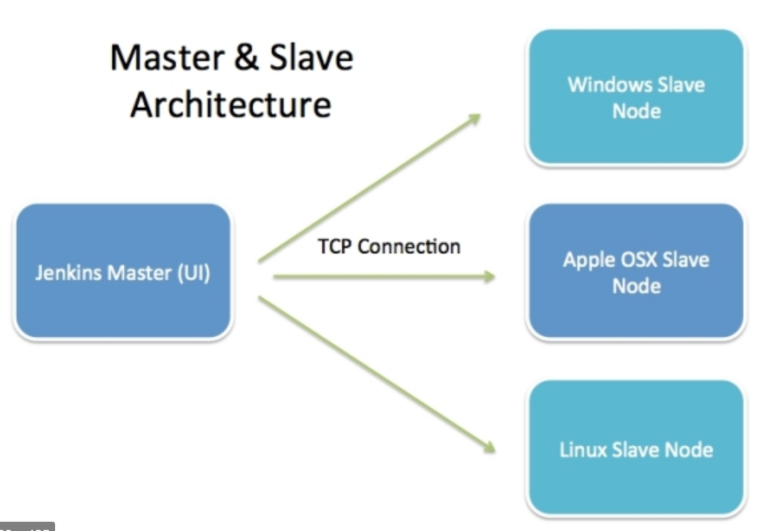
Introduction to Jenkins (With Architecture)

Slide 5
AWS (Amazon web service)
https://console.aws.amazon.com/console/home

Slide 6
Installing Jenkins
Prerequisites : Java
https://jenkins.io/download/
To start the jenkins
java –jar jenkins.war
To check the Jenkins dashboard
http://localhost:8080/
To restart the Jenkins
http://localhost:8080/restart

Slide 7
Install Java in AWS
Install OpenJDK
sudo apt-get install openjdk-8-jdk
java –version
Add inbound rule all TCP port range anywhere

Slide 8
Building Delivery Pipeline
Maven Project
spring-boot:run

Slide 9
Implementation of Jenkins in the Project
Configure the webhook
https://<HOST URL>/github-webhook/
Content type as application/json
Select “Let me select indivisual event”
Pushes
Pull request review
Branch or tag creation
In the Jenkins
GitHub hook trigger for GITScm polling

Slide 10
Pipeline as a Code
pipeline {
agent { label 'master' }
stages {
stage('build') {
steps {
echo "Hello World!"
}
}
}
}

Slide 11
Hands on
Build the pipeline of jobs using Jenkins
Create a pipeline script to deploy an application over the tomcat server

