Slide 1
WORKOOPOLIS
Continuous Integration with Google Cloud Platform.

Slide 2
Continuous Integration with Google Cloud Platform.
Introduction GCP
Cloud Service Model
Cloud Deployment Models
IBM Cloud

Slide 3
Introduction GCP
Login to https://console.cloud.google.com
Create a project using the google cloud dashboard
Create a VM (say jenkins) in compute engine.
All the http access options.
Access VM instance using the SSH.
Install OpenJDK
sudo apt-get install openjdk-8-jdk

Slide 4
Introduction GCP
Download the Jenkins
wget -q -O - https://pkg.jenkins.io/debian-stable/jenkins.io.key | sudo apt-key add -
sudo sh -c 'echo deb https://pkg.jenkins.io/debian-stable binary/ > /etc/apt/sources.list.d/jenkins.list'
sudo apt install apt-transport-https
sudo apt update
sudo apt install jenkins
sudo service jenkins status
Credential Path
sudo cat /var/lib/jenkins/secrets/initialAdminPassword

Slide 5
Configure Google App Engine
Update the pom file <plugin>
<groupId>com.google.cloud.tools</groupId>
<artifactId>appengine-maven-plugin</artifactId>
<version>1.9.76</version>
</plugin>

Slide 6
Configure Google App Engine
Add app.yaml file in the path src/main/appengine/
runtime: java
env: flex
runtime_config: # Optional
jdk: openjdk8
handlers:
- url: /.*
script: this field is required, but ignored
manual_scaling:
instances: 1

Slide 7
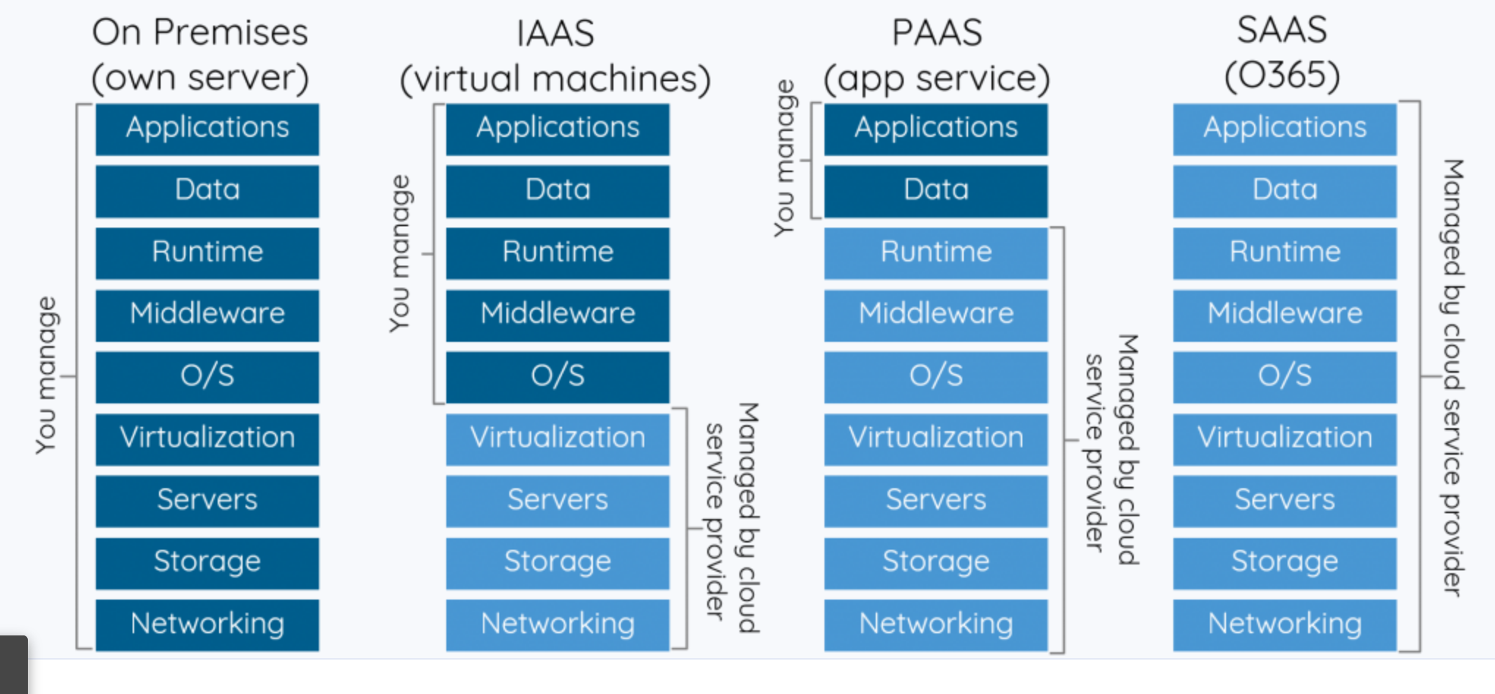
Cloud Service Model

Slide 8
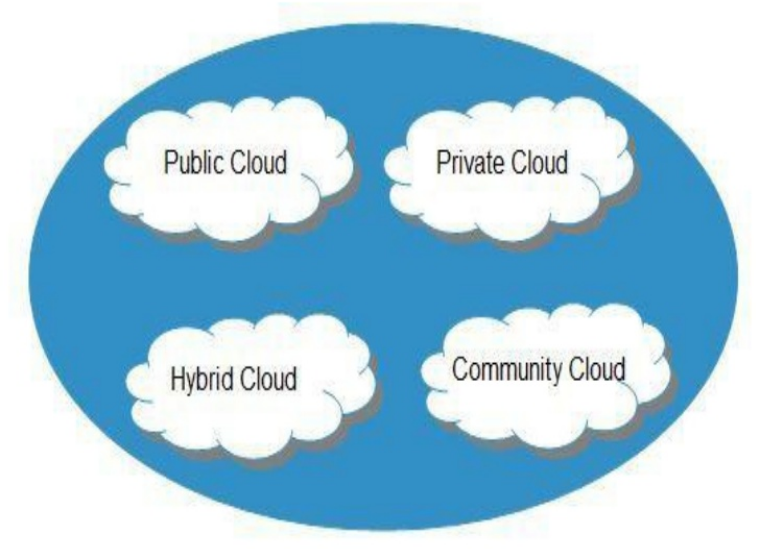
Cloud Deployment Models

Slide 9
IBM Cloud
Create an Account
https://cloud.ibm.com
Create an Account

Slide 10
Cloud Service
Heroku – will configure as PAAS
Amazon – will configure as IAAS and PAAS
Google – will configure as IAAS and PAAS
IBM – will configure as only PAAS as for IAAS is a paid service.

Slide 11
IBM Cloud Deployment
Configure in .travis.yml file
deploy:
- provider: cloudfoundry
api: https://api.ng.bluemix.net
username: apikey
password: $FUNC_ID_BLUEMIX_API_KEY_PUBLIC
organization: devops
space: dev
manifest: ./manifest.yaml
on:
branch: master

Slide 12
IBM Cloud PASS manifest.yaml
applications:
- name: java-micro-services
buildpack: https://github.com/cloudfoundry/java-buildpack.git
instances: 1
memory: 256M
path: target/demoapp-0.0.1-SNAPSHOT.jar

Slide 13
Hands on
Create a pipeline for https://github.com/sudhirkthakur/spring-boot-microservice in the following cloud provider
Heroku
Amazon
Google Cloud
IBM Cloud

