Slide 1


Slide 2
Admin Functionalities:
Can Create a New User
Can Edit an Existing User
Can Delete an Existing User

Slide 3
Use Case Diagram:
List all users
Create a user
Manages Users
Delete a user
Edit a user
Admin

Slide 4
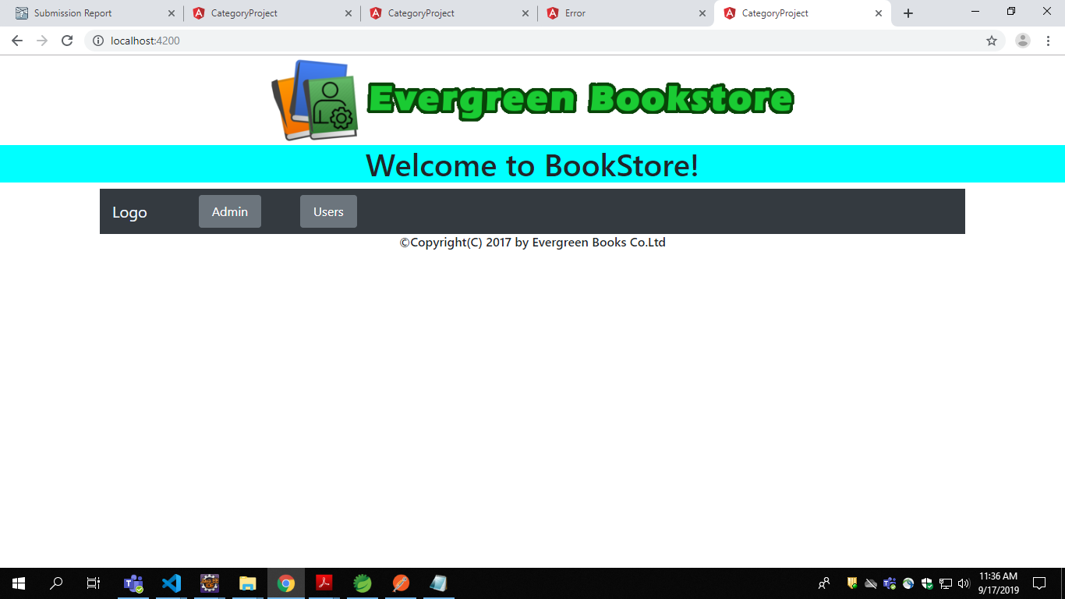
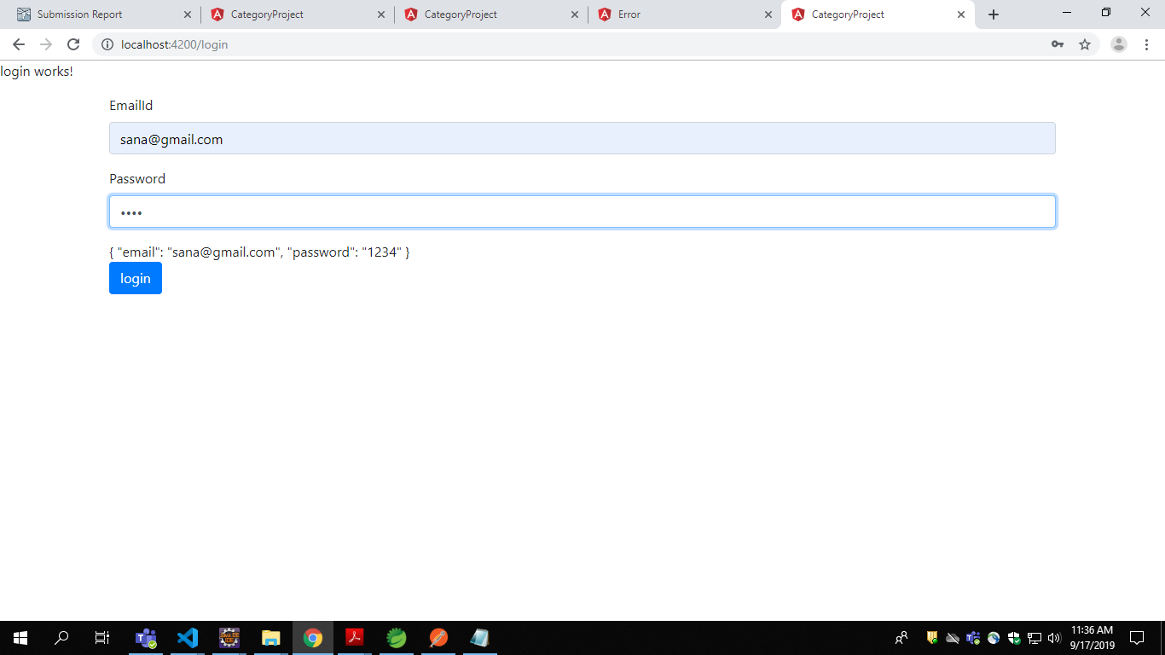
Fig1.Welcome Page
Fig2.Admin Login Page

Slide 5
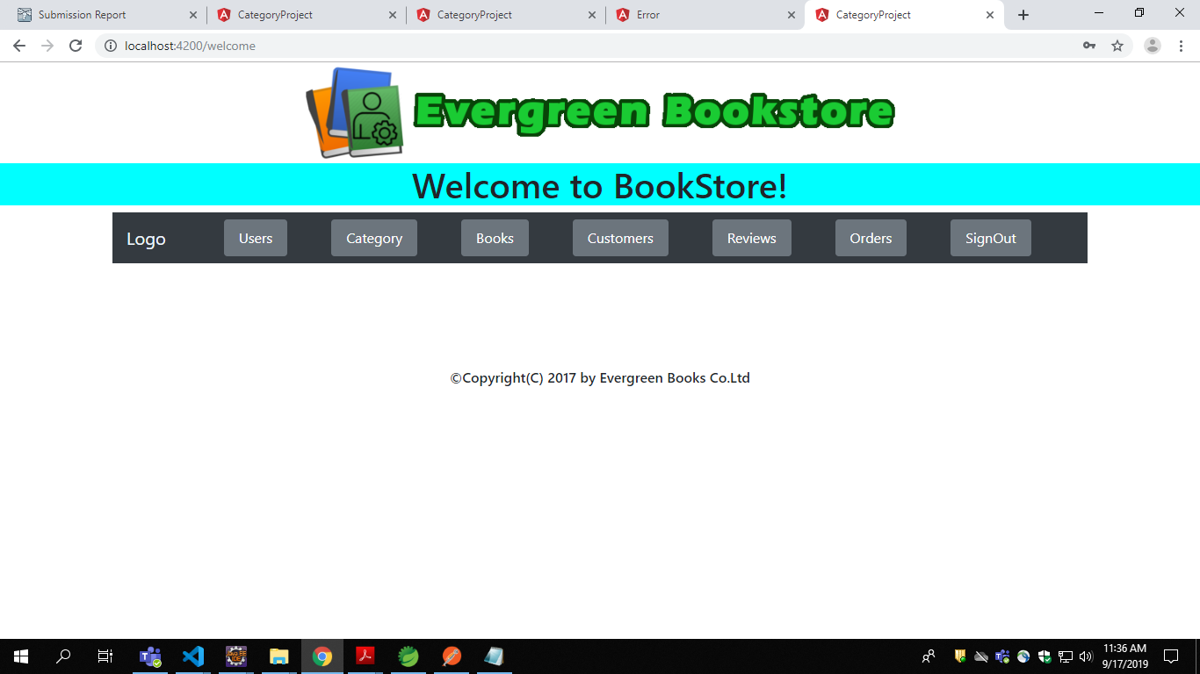
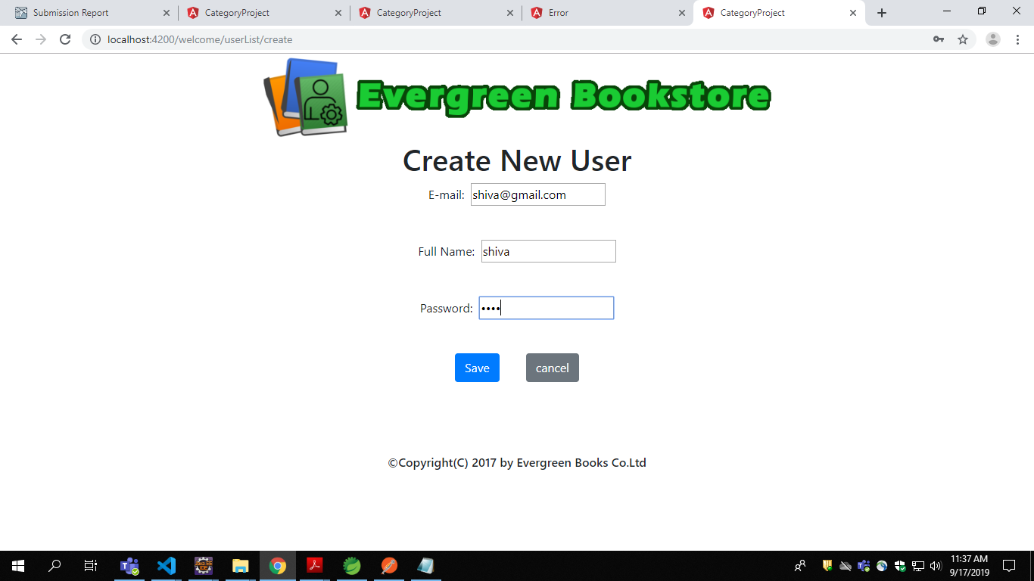
Fig4.Creating A New User
Fig3.Admin Interface

Slide 6
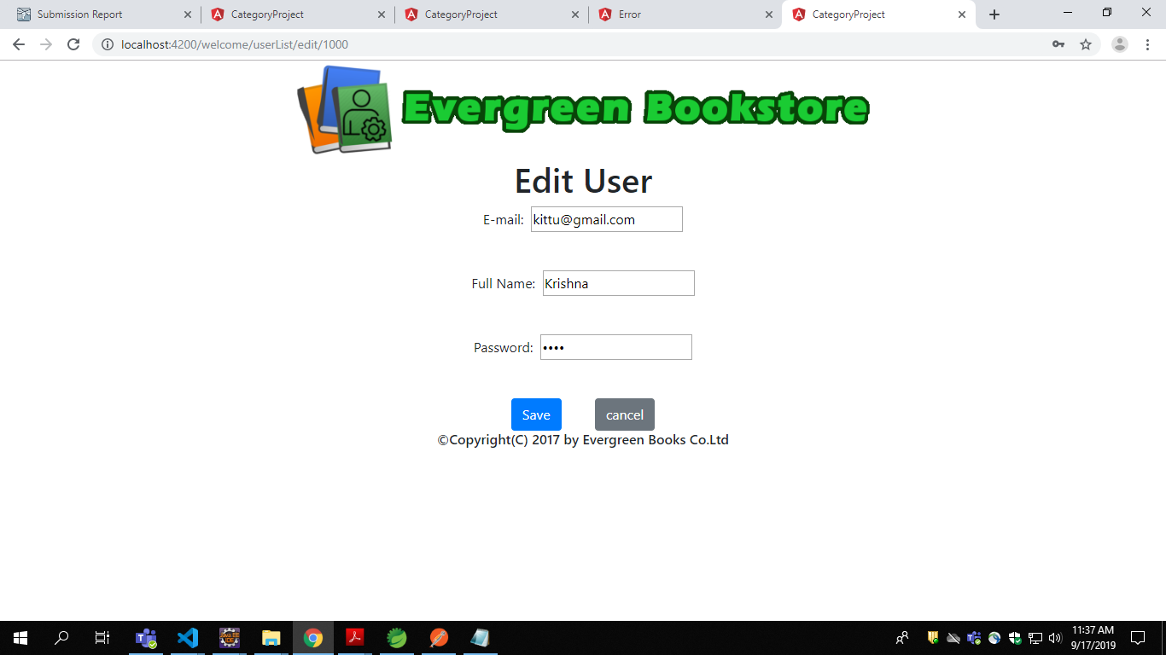
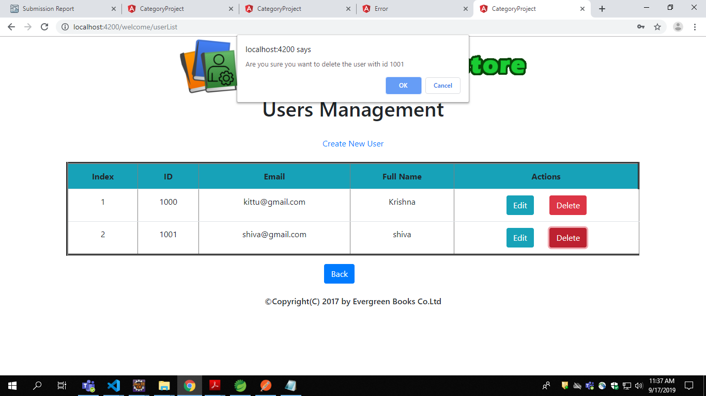
Fig5. Editing Existing User Details
Fig6. Deleting an Existing User

