Slide 1

Smart Hospital Bed Monitoring System
Patient Occupancy, Vital Sign Observation, and Emergency Assistance
Real-time IoT-enabled monitoring for enhanced patient safety and hospital efficiency
SARAGADAM SIVA MANI KANTA
323129520116

Slide 2
Problem Statement
Manual Supervision
Monitoring Delays
Undetected Emergencies
Traditional hospital bed management relies heavily on manual supervision and periodic checks, creating gaps in continuous care.
Continuous monitoring of patient occupancy and vital signs is labor-intensive and prone to delays that can compromise patient safety.
Emergency situations may go undetected without real-time observation, increasing risk of adverse patient outcomes.
Fragmented Information
Delayed Intervention
Lack of centralized patient information leads to inefficient resource allocation and poor coordination among healthcare teams.
Healthcare professionals need immediate alerts for abnormal conditions to enable timely, life-saving intervention.

Slide 3
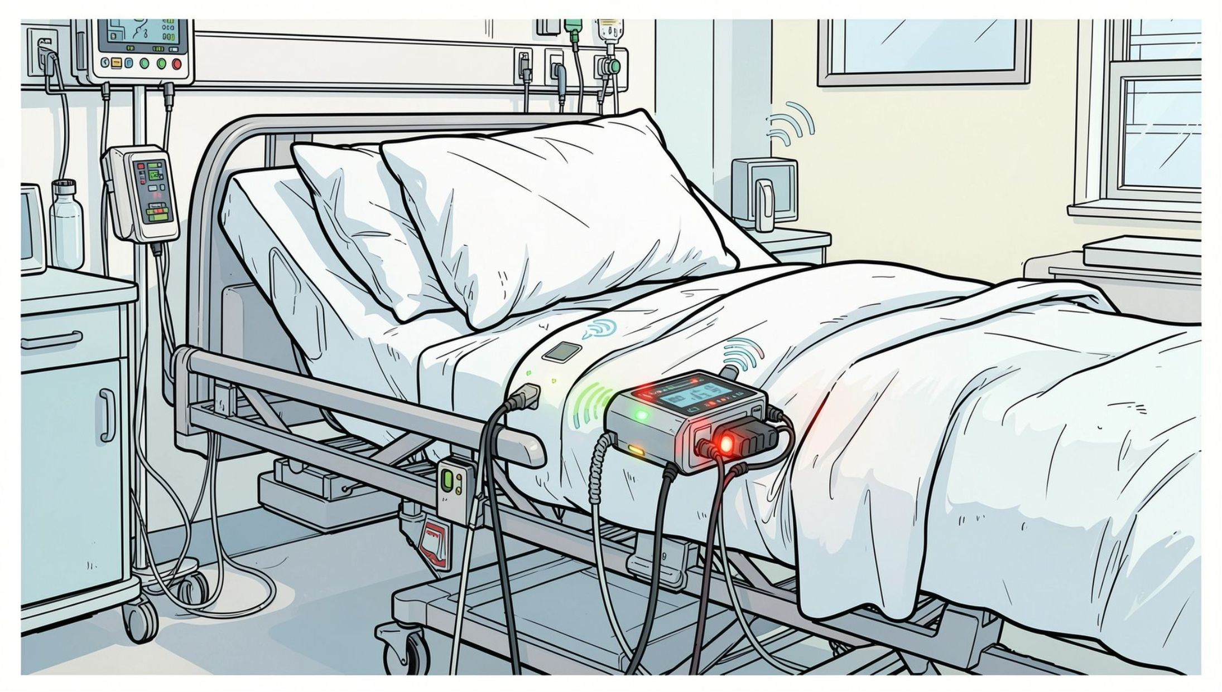
Proposed Solution
IoT-Enabled Automation
Continuous, automated patient observation through an integrated Smart Hospital Bed Monitoring System.
Real-Time Sensor Integration
Integrated sensors detect occupancy and collect vital sign data in real-time at the bedside.
Cloud Connectivity
Centralized storage and analysis of patient information via secure cloud infrastructure.
Automated Alerts
Automated alert system notifies healthcare professionals immediately of abnormal conditions.
Unified Dashboard
User-friendly monitoring dashboard provides secure access to patient data across the hospital network.

Slide 4
Objectives
Occupancy Monitoring
Vital Sign Observation
Enable continuous patient occupancy monitoring on hospital beds.
Provide real-time vital sign observation and data collection for every patient.
Automated Analysis
Emergency Alerts
Detect abnormal health conditions through automated threshold-based analysis.
Identify emergency situations and generate immediate alerts to clinical staff.
Centralized Monitoring
Safety & Efficiency
Establish centralized monitoring of patient and bed information across the facility.
Improve overall patient safety and hospital operational efficiency.

Slide 5

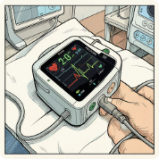
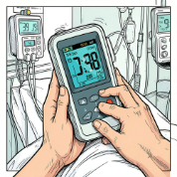
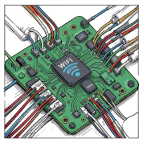

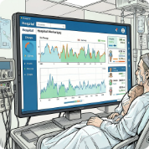
System Components
Pressure Sensors
Heart Rate Sensors
Temperature Sensors
IoT Communication Modules
Detect patient occupancy and bed status in real-time, providing accurate presence detection.
Monitor cardiac activity continuously and detect arrhythmias or irregular rhythms.
Continuously measure body temperature for fever or hypothermia detection.
Enable wireless transmission of sensor data from bedside to the central system.
Cloud Connectivity
Monitoring Dashboard
Facilitate secure data transfer, storage, and backup of all patient information.
Provide healthcare professionals with unified access to real-time patient and bed data.

Slide 6

Working Principle
Occupancy
Vitals
Transmit
Cloud Store
Analyze
The system operates as a seamless end-to-end pipeline — from bedside sensor detection through cloud-based analysis to real-time dashboard display — ensuring no critical event goes unnoticed.

Slide 7
Monitoring Dashboard
Patient Status
Bed Occupancy
Current health condition and vital sign summary for each monitored patient.
Real-time occupancy detection and bed availability across the entire ward.
Vital Trends
Emergency Alerts
Heart rate, temperature readings, and historical data visualization over time.
Active alerts and critical condition notifications displayed prominently for immediate action.
Alert History
Device Status
Log of past alerts and patient incidents for clinical review and audit.
Sensor connectivity and system health monitoring to ensure uninterrupted operation.
Enables healthcare professionals to efficiently monitor multiple patients simultaneously from a single centralized location.

Slide 8
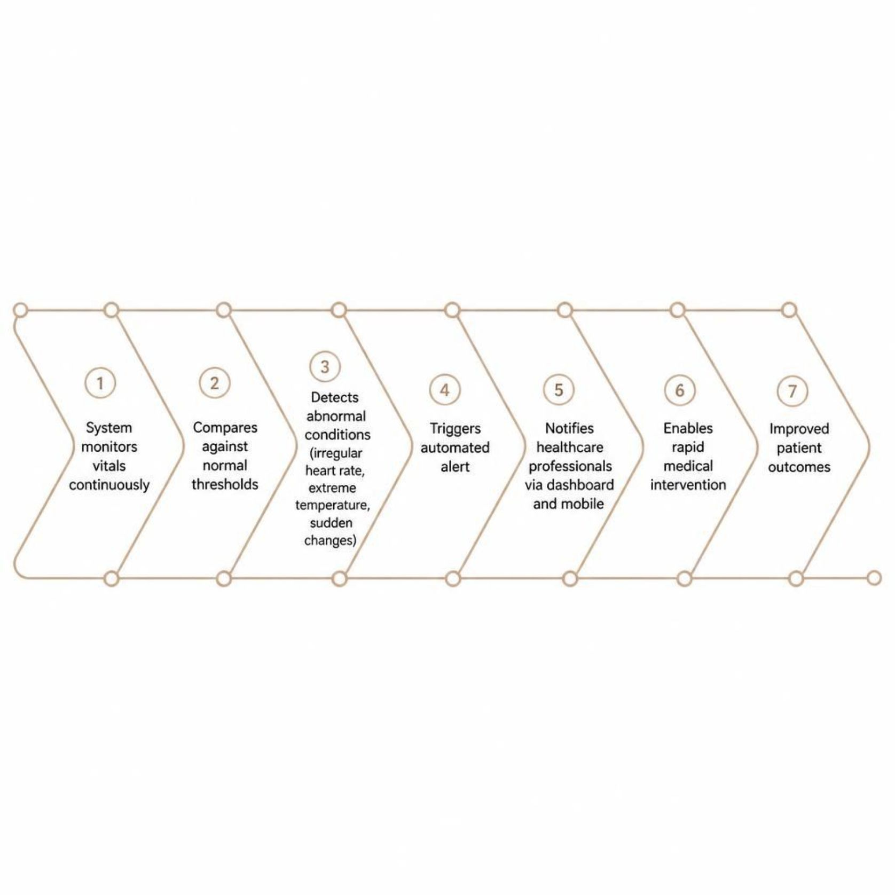
Emergency Detection and Alerts
How It Works
The system continuously compares vital sign readings against predefined normal ranges and thresholds. Abnormal conditions — such as irregular heart rate, extreme temperature, or sudden physiological changes — trigger emergency detection instantly.
Automated alerts sent immediately to healthcare professionals via dashboard and mobile notifications
Real-time alerts enable rapid medical intervention and reduce response time to critical situations
Timely emergency response significantly improves patient outcomes and reduces mortality risk
Eliminates delays associated with manual observation and periodic bed checks

Slide 9

Benefits and Applications
Key Benefits
Applications
Improved Patient Safety through continuous real-time clinical observation
General Wards
Routine patient monitoring across standard hospital beds
Reduced Manual Burden on nursing and clinical staff with automated monitoring
ICU
Efficient Bed Management and optimized healthcare resource allocation
Intensive care units requiring continuous high-acuity observation
Faster Emergency Response with automated, real-time critical condition alerts
Post-Operative
Recovery areas monitoring patients after surgical procedures
Long-Term Care
Nursing homes, rehabilitation centers, and clinics

Slide 10

Conclusion and Future Potential
The Smart Hospital Bed Monitoring System unifies pressure sensors, heart rate sensors, temperature sensors, IoT communication, and cloud connectivity into a single intelligent healthcare solution.
Current System
1
Centralized dashboard with real-time vitals, occupancy detection, and automated emergency alerts across hospital wards.
2
Near-Term
Scalable and secure architecture supporting deployment across multiple healthcare facilities simultaneously.
Future Enhancements
3
Advanced analytics and predictive health monitoring to anticipate deterioration before emergencies occur.
4
Long-Term Vision
Full integration with Electronic Health Records (EHR) for comprehensive, data-driven patient care management.
This system delivers enhanced patient safety, improved clinical observation, reduced manual workload, and intelligent hospital bed management — transforming how healthcare facilities operate.

