Slide 1

19AIE312
DEEP LEARNING FOR SIGNAL AND IMAGE PROCESSING
SINGLE IMAGE DEHAZING using CycleGAN
TEAM 3
CB.EN.U4AIE19003 Adhithan P
CB.EN.U4AIE19011 Anuvarshini S P
CB.EN.U4AIE19033 Kabilan N
CB.EN.U4AIE19061 Sivamaran M A C

Slide 2
OBJECTIVE
The objective of this project is to perform
Single Image Dehazing using CycleGAN (Generative Adversarial Network)
19AIE312|Deep Learning for Signal and Image Processing|Image Dehazing

Slide 3
WORKFLOW
CODE
INTRODUCTION to GAN
CONCLUSION
THEORY
OUTPUT
19AIE312|Deep Learning for Signal and Image Processing|Image Dehazing

Slide 4
INTRODUCTION
To
Generative Adversarial Network
19AIE312|Deep Learning for Signal and Image Processing|Image Dehazing

Slide 5
GAN are deep neural network architectures comprised of two neural networks, competing one against the other, thus the name ‘adversarial’ which means ‘conflict or opposition’.
GAN is trained in a ‘adversarial’ manner to generate data mimicking some distribution.
GAN consists of a generative and a discriminative model:
Discriminative model: It is a model that discriminates between two different classes of data as fake or real.
Generative model: From a random distribution ‘Z’, this model tries to generate same distribution as close to the original distribution ‘X’ .
One is held constant while training the other.
19AIE312|Deep Learning for Signal and Image Processing|Image Dehazing

Slide 6

GAN
Discriminator tries to maximize the probability that it predicts correct, in other way, it tries to make D(G(z)) near to 0.
Real Sample ‘X’
Real Sample ‘X’
$x\text{\sim }$ X
$x\text{\sim }$ X
Discriminator
Real [1]/Fake[0]
Discriminator ‘D’
Latent Vector + Noise ‘Z’
Latent Vector + Noise ‘Z’
G(z)
Generator
G(z)
Generator ‘G’
Backpropagation
z~Z
z~Z
Generator tries to minimize the probability that the discriminator predicting correct, in other way, it tries to make D(G(z)) near to 1.
19AIE312|Deep Learning for Signal and Image Processing|Image Dehazing

Slide 7
MATH behind GAN
19AIE312|Deep Learning for Signal and Image Processing|Image Dehazing

Slide 8
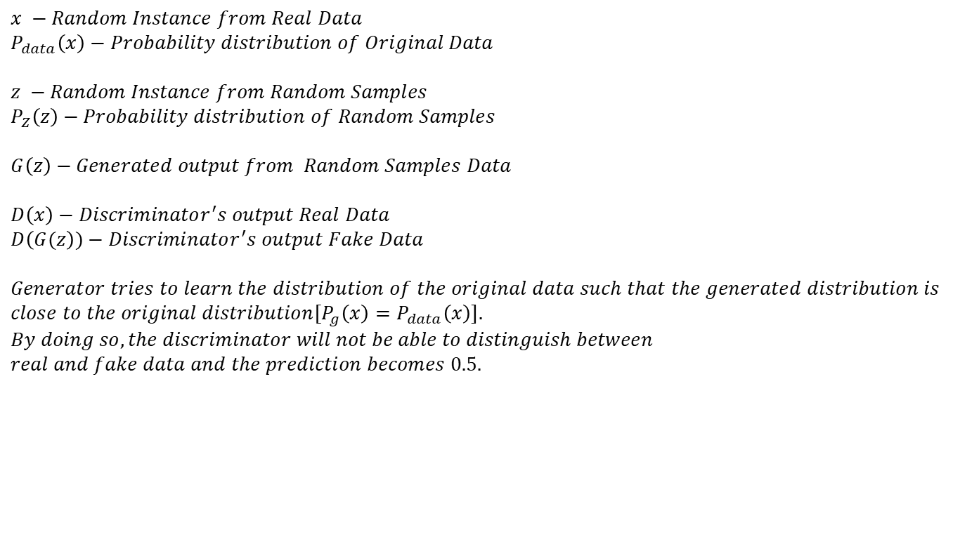
BASIC CONVENTIONS to understand Loss Function
$$x −Random Instance from Real Data$$
$$P_{data}\left(x\right)−Probability distribution of Original Data$$
$$z −Random Instance from Random Samples$$
$$P_{Z}\left(z\right)−Probability distribution of Random Samples$$
$$G\left(z\right)−Generated output from Random Samples Data$$
$$D\left(x\right)−Discriminator^{′}s output Real Data$$
$$D\left(G(z\right))−Discriminator^{′}s output Fake Data$$
$$Generator tries to learn the distribution of the original data such that the generated distribution is$$
$$close to the original distribution{[P}_{g}\left(x\right)=P_{data}\left(x\right)].$$
$$By doing so, the discriminator will not be able to distinguish between$$
$$real and fake data and the prediction becomes 0.5.$$
19AIE312|Deep Learning for Signal and Image Processing|Image Dehazing

Slide 9
Loss Function Computation
Binary Cross Entropy (BCE):
Eq 1: The label coming from real data $P_{data}\left(x\right)$ is $y=1$ and $\hat{y}=D(x)$
Eq 2: The label coming from generator is $y=0$ and $\hat{y}=D(G\left(z\right))$
19AIE312|Deep Learning for Signal and Image Processing|Image Dehazing

Slide 10
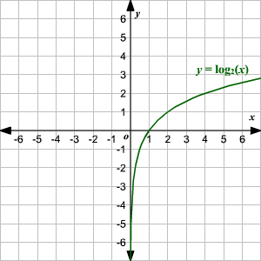
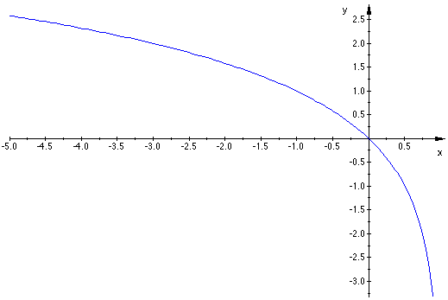
Objective of the discriminator is to correctly classify, i.e., D(x)=1 and D(G(z))=0.
So, from the plots we can say that, only if we maximize Eq 1 and 2, it will force D(x) = 1 and D(G(z)) = 0.
From the above plot, the region after 1 at x-axis is not required as it is a probability function. We can see that D(x) = 1 when log(D(x)) is maximized.
From the above plot, we can see that D(G(z)) = 0 when log(1-D(G(z))) is maximized.
19AIE312|Deep Learning for Signal and Image Processing|Image Dehazing

Slide 11
Objective of the Generator is to fool the discriminator, i.e., to make D(G(z))=1
From the above plot, we can see that D(G(z)) is 1 when log(1-D(G(z))) is minimized as the value tends to –∞.
19AIE312|Deep Learning for Signal and Image Processing|Image Dehazing

Slide 12
Discriminator objective function:
Generator objective function:
Clubbing the above objective functions:
19AIE312|Deep Learning for Signal and Image Processing|Image Dehazing

Slide 13
The above equation is for one instance of ‘X’. So, in order to consider all the instances of ‘X’,
we will be taking ‘Expectation’ for the above argument. Thus the equation can be written as:
D and G play the following two-player minimax game with value function V (G, D)
19AIE312|Deep Learning for Signal and Image Processing|Image Dehazing

Slide 14
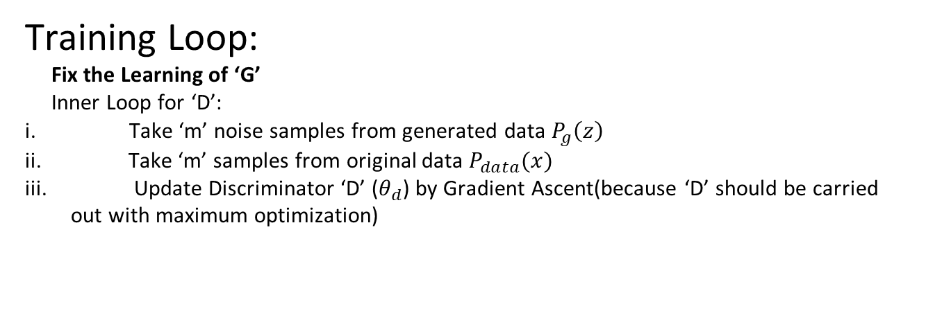
Optimization of Value Function
Optimization of Value Function
Training Loop:
Fix the Learning of ‘G’
Inner Loop for ‘D’:
Take ‘m’ noise samples from generated data $P_{g}\left(z\right)$
Take ‘m’ samples from original data $P_{data}(x)$
Update Discriminator ‘D’ ($θ_{d}$) by Gradient Ascent(because ‘D’ should be carried out with maximum optimization)
Parameters: Weights and Biases
Expectation operator is the averaging operator
19AIE312|Deep Learning for Signal and Image Processing|Image Dehazing

Slide 15
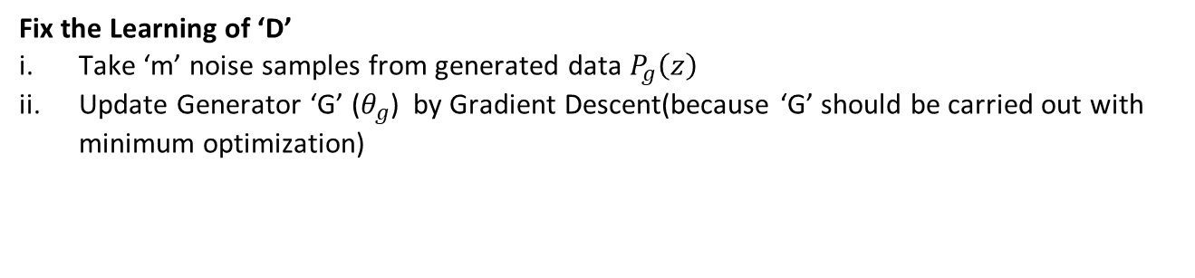
Fix the Learning of ‘D’
Take ‘m’ noise samples from generated data $P_{g}\left(z\right)$
Update Generator ‘G’ ($θ_{g}$) by Gradient Descent(because ‘G’ should be carried out with minimum optimization)
Parameters: Weights and Biases
Expectation operator is the averaging operator
We fix the learning of one network while training the other because, the discriminator will become smart by learning on how the generator is fooling the discriminator, and doing so the generator will never be able to be win the discriminator.
19AIE312|Deep Learning for Signal and Image Processing|Image Dehazing

Slide 16
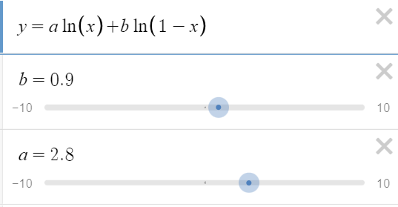
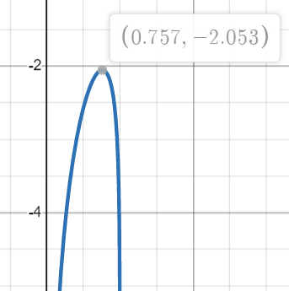
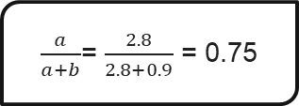
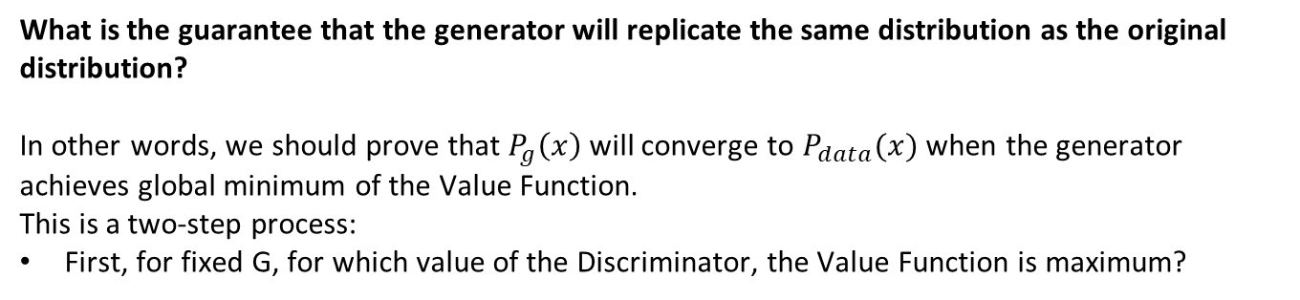
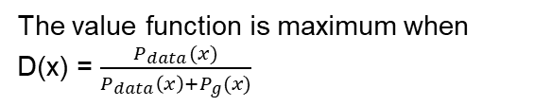
What is the guarantee that the generator will replicate the same distribution as the original distribution?
In other words, we should prove that $P_{g}\left(x\right)$ will converge to $P_{data}(x)$ when the generator achieves global minimum of the Value Function.
This is a two-step process:
First, for fixed G, for which value of the Discriminator, the Value Function is maximum?
$\frac{a}{a+b}$= $\frac{2.8}{2.8+0.9}$ = 0.75
The value function is maximum when D(x) = $\frac{P_{data}(x)}{P_{data}\left(x\right)+P_{g}(x)}$
19AIE312|Deep Learning for Signal and Image Processing|Image Dehazing

Slide 17
By substituting D(x) in value function, it becomes:
Since, we have to prove $P_{data}$ = $P_{g}$ , we use a method that measures the difference between two distributions called Jenson Shannon Divergence (JS Divergence).
19AIE312|Deep Learning for Signal and Image Processing|Image Dehazing

Slide 18
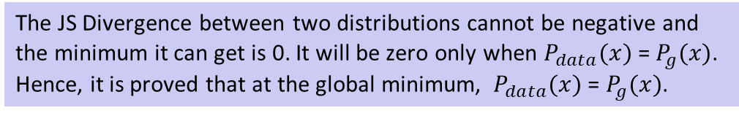
The JS Divergence between two distributions cannot be negative and the minimum it can get is 0. It will be zero only when $P_{data}(x)$ = $P_{g}(x)$. Hence, it is proved that at the global minimum, $P_{data}(x)$ = $P_{g}(x)$.
19AIE312|Deep Learning for Signal and Image Processing|Image Dehazing

Slide 19
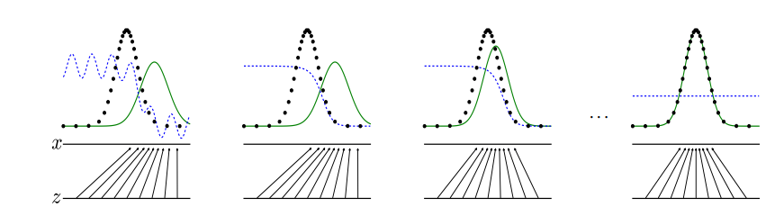





$$P_{data}$$
D(x)
$$P_{g}$$
At the beginning
After updating $θ_{d}$
After updating $θ_{g}$
Finally, when $P_{data}$= $P_{g}$
19AIE312|Deep Learning for Signal and Image Processing|Image Dehazing

Slide 20
Cycle GAN
CycleGAN is used to transfer characteristic of one image to another or can map the distribution of images to another.
The most important feature of this CycleGAN is that it can do this image translation on an unpaired image where there is no relation exists between the input image and output image.
Applications:
Style Transfer (Paintings to Photographs)
Object Transfiguration (Hazed to Dehazed)
Season Transfer (Winter to Summer)
19AIE312|Deep Learning for Signal and Image Processing|Image Dehazing

Slide 21
Cycle GAN
Real Image A(Hazed)
Generated A2B
Fake Image B(Dehazed)
Generated B2A
Reconstructed Image A(Hazed)
Real/Fake
Real/Fake
Discriminator B
Discriminator A
Real Image B(Dehazed)
Fake Image A(Hazed)
Reconstructed Image B(Dehazed)
Generated B2A
Generated A2B
19AIE312|Deep Learning for Signal and Image Processing|Image Dehazing

Slide 22
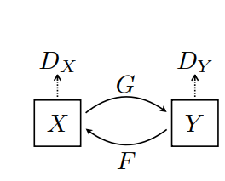
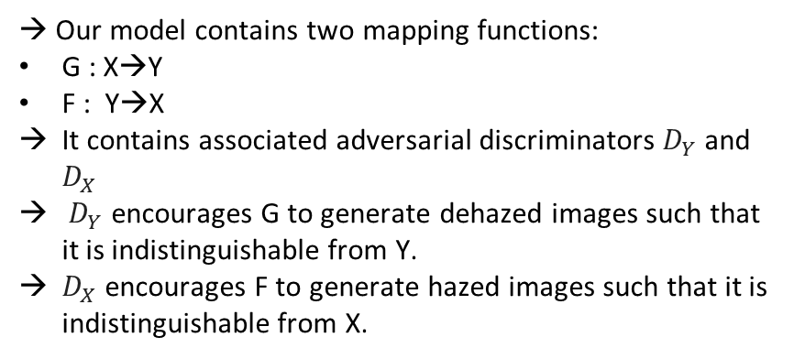
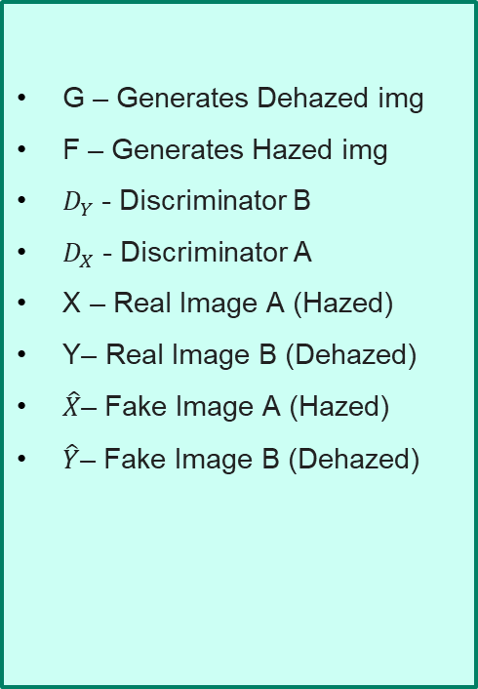
G – Generates Dehazed img
F – Generates Hazed img
$D_{Y}$- Discriminator B
$D_{X}$- Discriminator A
X – Real Image A (Hazed)
Y– Real Image B (Dehazed)
$\hat{X}$– Fake Image A (Hazed)
$\hat{Y}$– Fake Image B (Dehazed)
→ Our model contains two mapping functions:
G : X→Y
F : Y→X
It contains associated adversarial discriminators $D_{Y}$and $D_{X}$
$D_{Y}$ encourages G to generate dehazed images such that it is indistinguishable from Y.
$D_{X}$ encourages F to generate hazed images such that it is indistinguishable from X.
19AIE312|Deep Learning for Signal and Image Processing|Image Dehazing

Slide 23
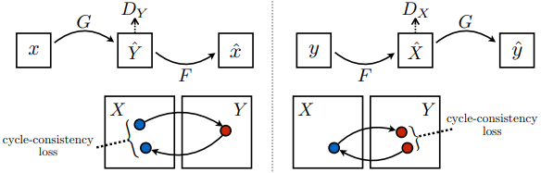
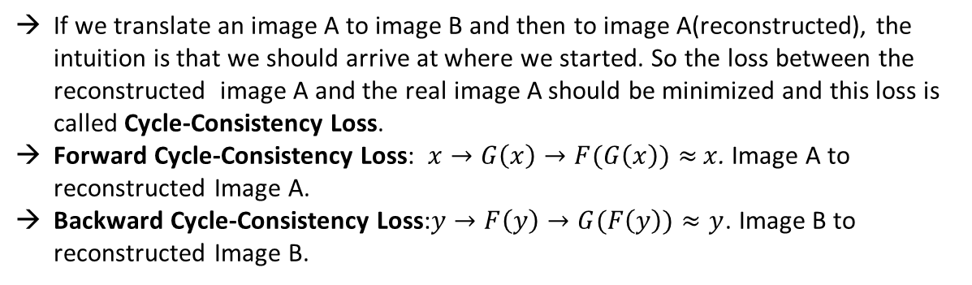
If we translate an image A to image B and then to image A(reconstructed), the intuition is that we should arrive at where we started. So the loss between the reconstructed image A and the real image A should be minimized and this loss is called Cycle-Consistency Loss.
Forward Cycle-Consistency Loss: $x→G\left(x\right)→F(G\left(x\right))≈$ $x$. Image A to reconstructed Image A.
Backward Cycle-Consistency Loss:$y→F\left(y\right)→G(F\left(y\right))≈y$. Image B to reconstructed Image B.
19AIE312|Deep Learning for Signal and Image Processing|Image Dehazing

Slide 24
Loss Functions:
Adversarial Loss and Forward Cycle-Consistency Loss for Hazed(X) to Dehazed(Y):
Adversarial Loss and Backward Cycle-Consistency Loss for Dehazed(Y) to Hazed(X):
19AIE312|Deep Learning for Signal and Image Processing|Image Dehazing

Slide 25
Combined objective function is:
Optimization:
19AIE312|Deep Learning for Signal and Image Processing|Image Dehazing

Slide 26
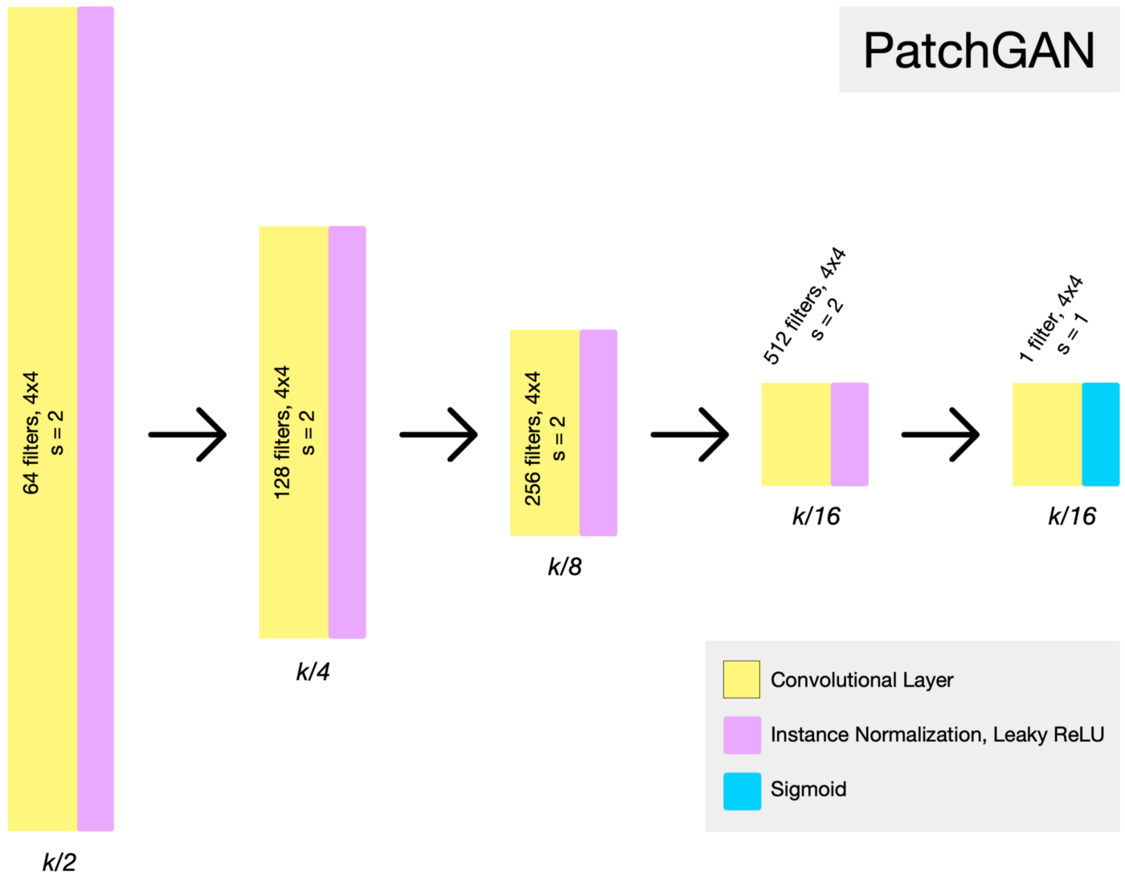
Discriminator Architecture
19AIE312|Deep Learning for Signal and Image Processing|Image Dehazing

Slide 27
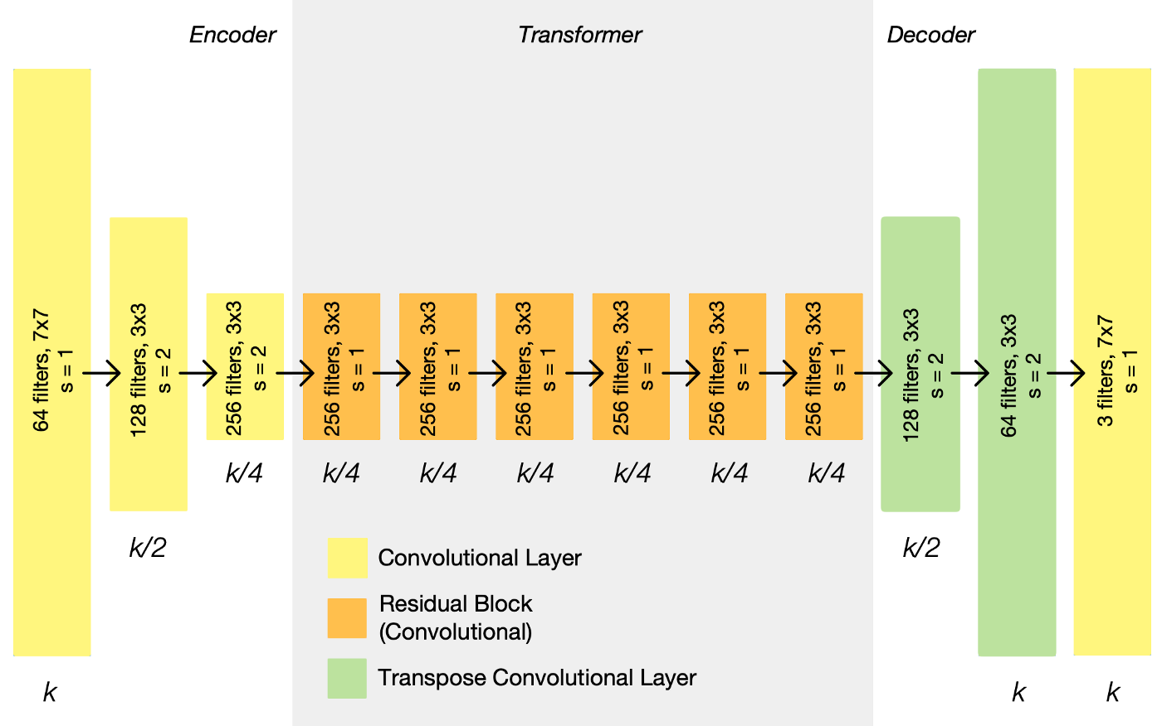
Generator Architecture
19AIE312|Deep Learning for Signal and Image Processing|Image Dehazing

Slide 28
CODE
19AIE312|Deep Learning for Signal and Image Processing|Image Dehazing

Slide 29
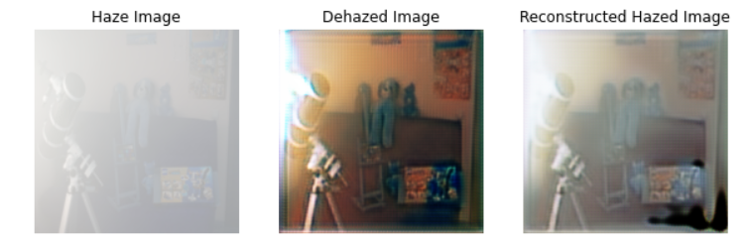

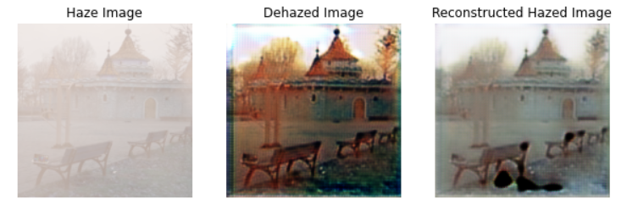

OUTPUT
19AIE312|Deep Learning for Signal and Image Processing|Image Dehazing

Slide 30
Evaluation Metrics
19AIE312|Deep Learning for Signal and Image Processing|Image Dehazing

Slide 31
PSNR and SSIM
 | PSNR | SSIM
0 | 48.921653 | 0.880655
1 | 49.252494 | 0.888642
2 | 49.371817 | 0.890013
3 | 49.802184 | 0.901209
4 | 50.192865 | 0.912729
5 | 49.371817 | 0.890013
6 | 49.371817 | 0.890013
7 | 48.921653 | 0.880655
8 | 49.371817 | 0.890013
9 | 49.374240 | 0.892475
Average | 49.395235 | 0.891641
A haze removal algorithm’s performance can be evaluated on several factors, among them, two of the most frequently used factors are the PSNR and SSIM.
Peak Signal to Noise Ratio (PSNR) measures the ability of the algorithm to remove noise from a noisy image. Two identical images will have a PSNR value of infinity.
Structural Similarity Index Measure (SSIM), measures how similar two images are. Two identical images will have a SSIM of 1.
19AIE312|Deep Learning for Signal and Image Processing|Image Dehazing

Slide 32
Conclusion
This project presented a Cycle generative adversarial network, that directly removes haze given a single image without any mapping.
We employed the usage of the Patch Discriminator, Cycle-Consistency Loss, L2 Loss instead of the classic Adversarial Loss (log likelihood) which reduced the presence of artefacts significantly.
Future Work
Can use this model for Remote Sensing Data along with Super Resolution GAN
Apply photo enhancement on Hyperspectral Images.
19AIE312|Deep Learning for Signal and Image Processing|Image Dehazing

Slide 33
THANK YOU!
19AIE312|Deep Learning for Signal and Image Processing|Image Dehazing

