Slide 1
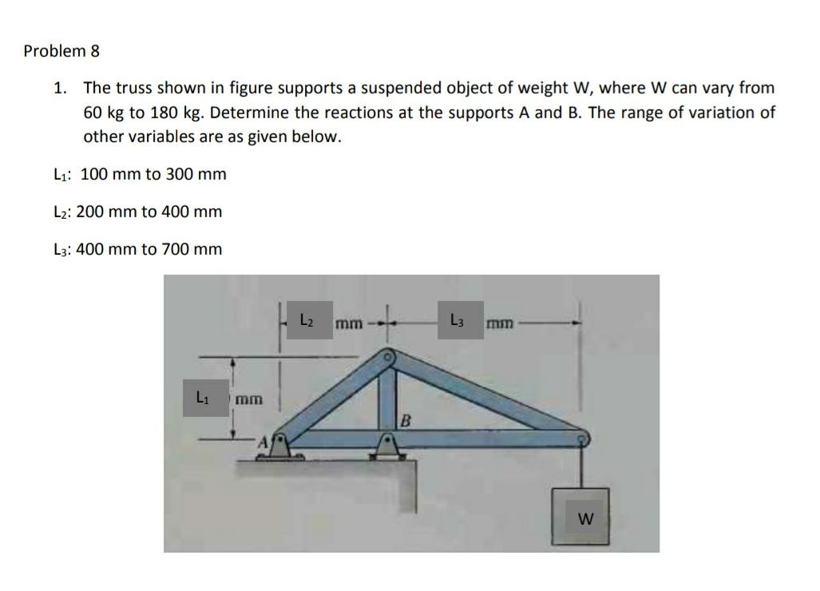
problem

Slide 2
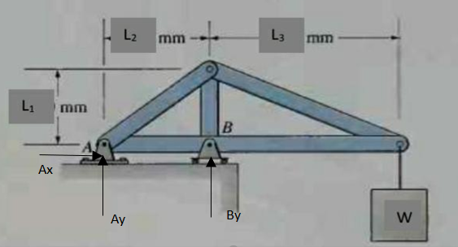
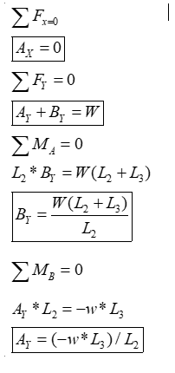
solution

Slide 3
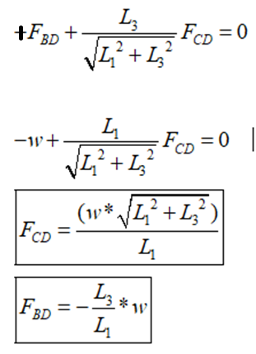
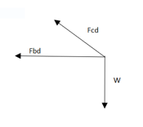
Finding member forces
Freebody diagram at D:

Slide 4
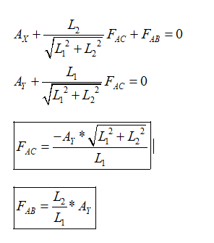
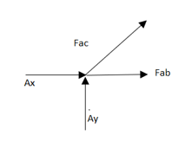
Freebody diagram at A:

Slide 5
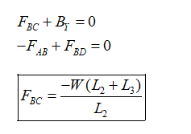
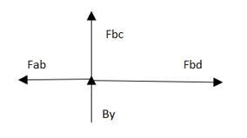
Freebody diagram at B:

Slide 6
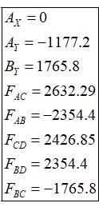
Substituting w=60*9.81, l1=100, l2=200, l3=400 we get,

Slide 7
Upgradability of the software
The model can be extended into a 3-d truss
By simply introducing the z component to force and joint

Slide 8
Thank you

