Slide 1
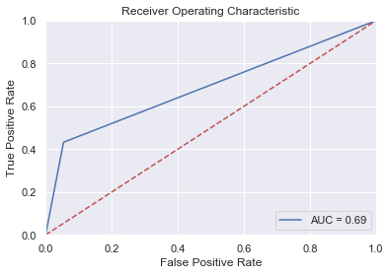

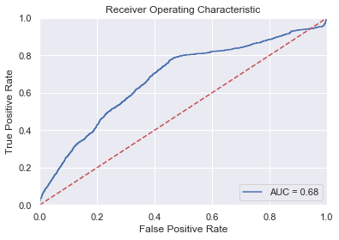
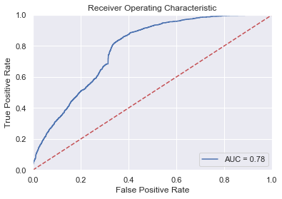
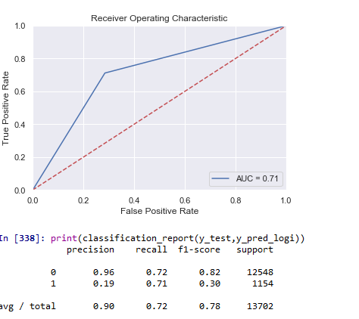
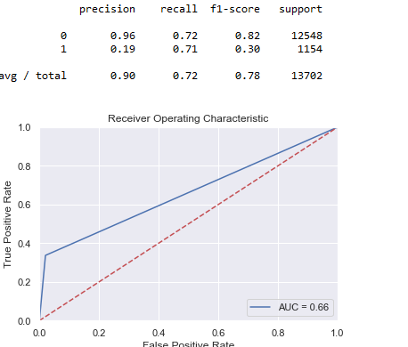
Class weight=“balanced”
precision recall f1-score support
0 0.97 0.68 0.80 12548
1 0.18 0.75 0.29 1154
avg / total 0.90 0.69 0.76 13702

