Slide 1
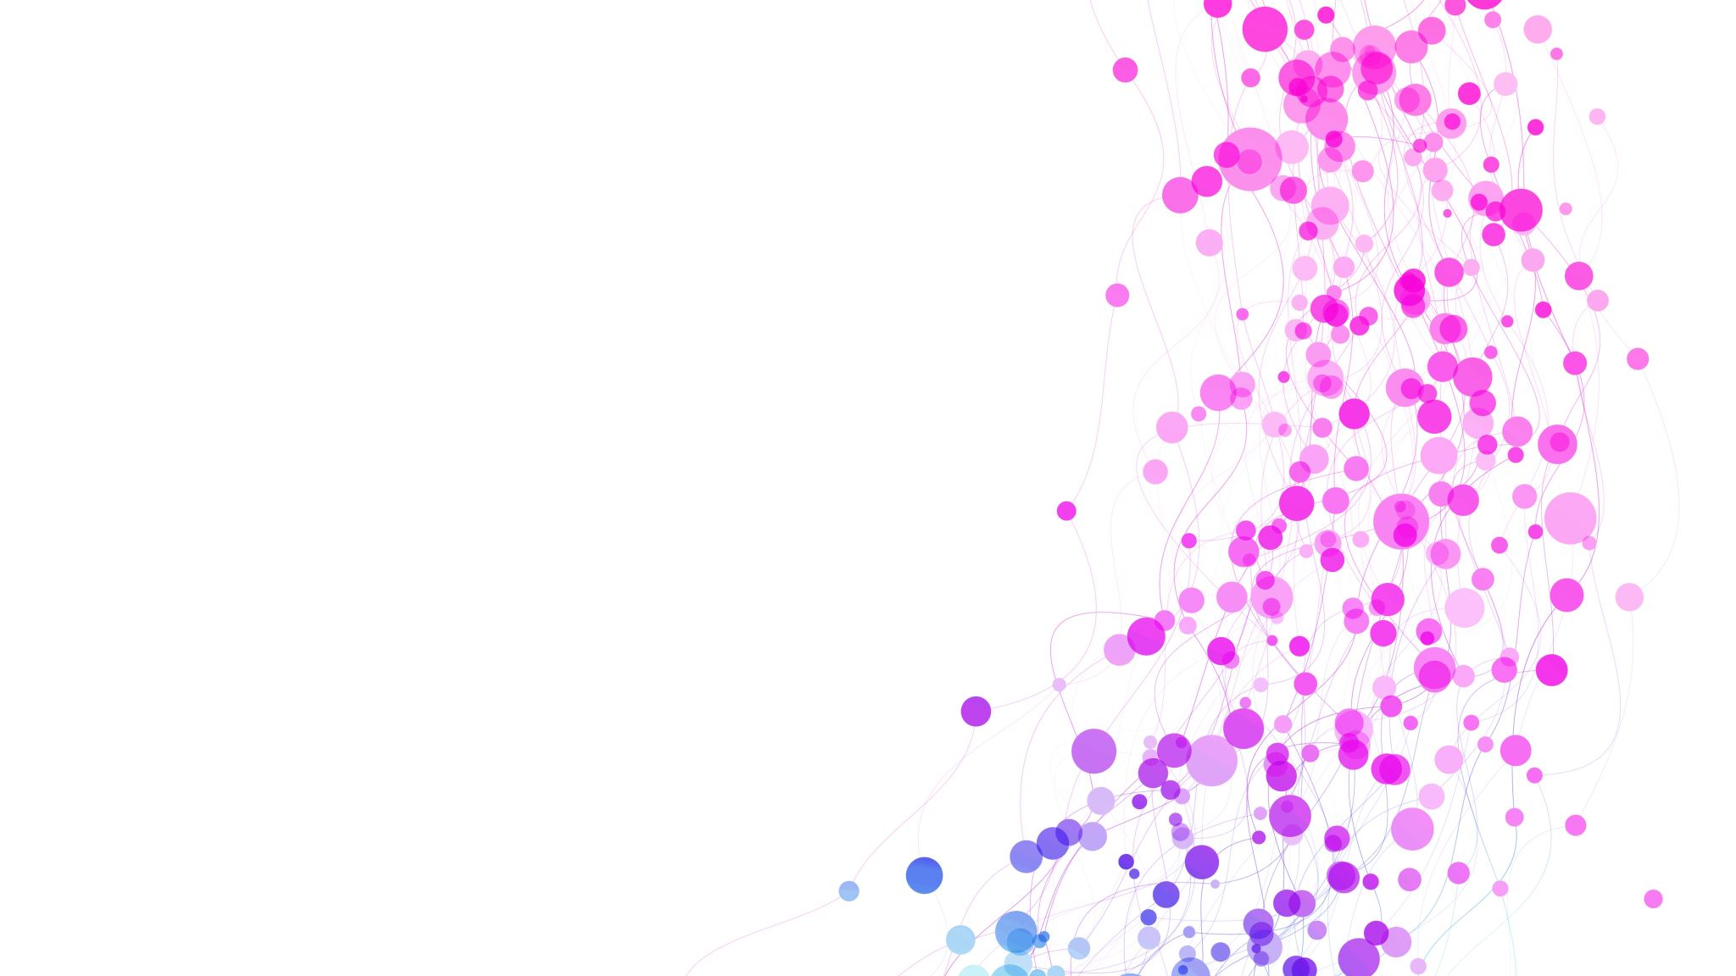
U.S. CHRONIC DISEASE INDICATORS
ANALYSIS
Name: Siva Mutukuri

Slide 2
INDEX
Introduction
Exploring the dataset
Data analyzing
Conclusion

Slide 3
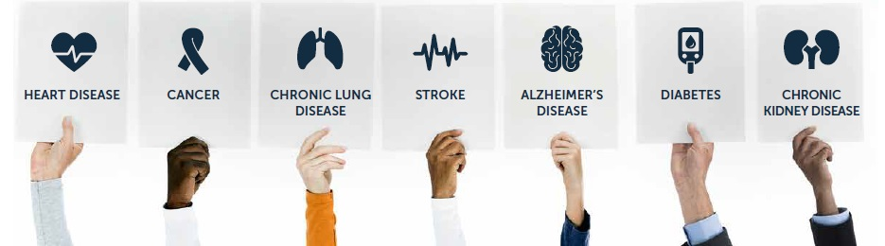
Introduction
What is chronic disease?
A chronic disease is a long-lasting medical condition that can be controlled but not cured. chronic diseases are non-communicable meaning they are not infectious and cannot be transmitted from one person to another.
Chronic diseases are a major public health concern in the United States. According to the Centers for Disease Control and Prevention (CDC), chronic diseases such as heart disease, stroke, cancer, and diabetes are the leading causes of death and disability in the US.

Slide 4

About U.S. Chronic Disease Indicators (CDI)
  U.S. Chronic Disease Indicators (CDI) is a database maintained by the Centers for Disease Control and Prevention (CDC) that provides access to state-level data on 20 over chronic disease indicators.
  The CDI program is a valuable tool for public health professionals, policymakers, and researchers to monitor and track chronic disease trends, identify disparities, and inform interventions and policies to improve population health.

Slide 5
Exploring the dataset
  The U.S. Chronic Disease Indicators dataset was created by the Centers for Disease Control and Prevention (CDC).
  The U.S. Chronic Disease Indicators (CDI) dataset includes data from the years 2001 to 2021.
  The sizes of the dataset is 342 MB
  Total number of rows: 1185676
  Total number of columns: 34

Slide 6
After Data Cleaning process
Total number of rows: 699340
Total number of columns: 14
Important columns
YearStart: the starting year of the data for a particular record (integer).
YearEnd: the ending year of the data for a particular record (integer).
LocationDesc: the full name of the state or territory where the data was collected (string).
Topic: the general topic area of the data, such as "Cancer" or "Diabetes" (string).
Question: the specific question or aspect of health being measured by the data (string)(e.g. Alcohol use among youth, Alcohol use before pregnancy)
DataValue: the actual data value for a particular record (double).
StratificationCategory1: a general category for the stratification variable (e.g. "Race/Ethnicity“)(string).
Stratification1: a specific category within the general stratification category (string).

Slide 7
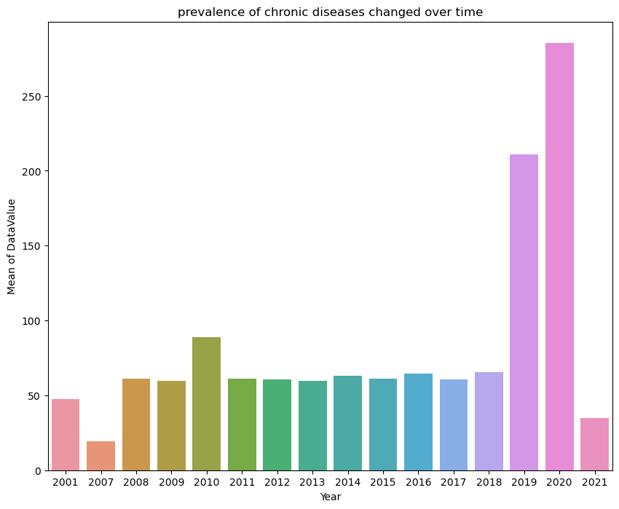
Data analyzing
How has the prevalence of chronic diseases changed over time?

Slide 8
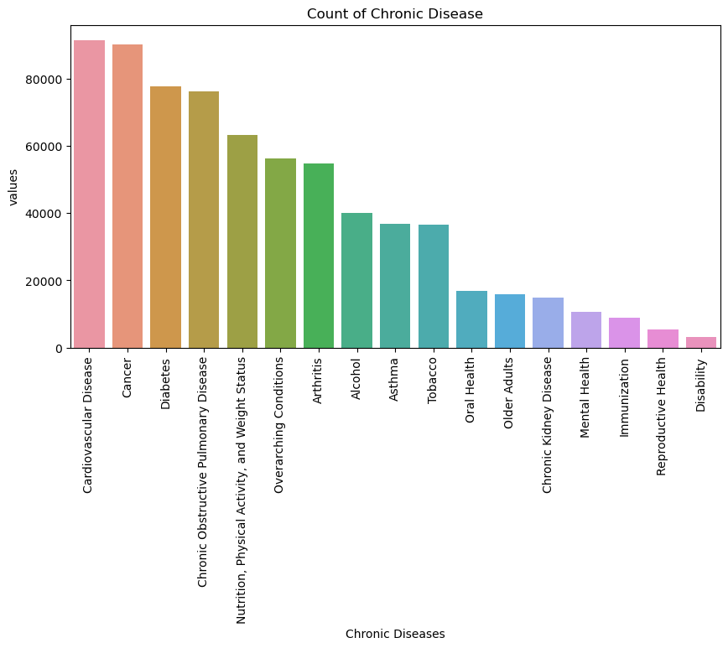
What is the most common chronic diseases?

Slide 9
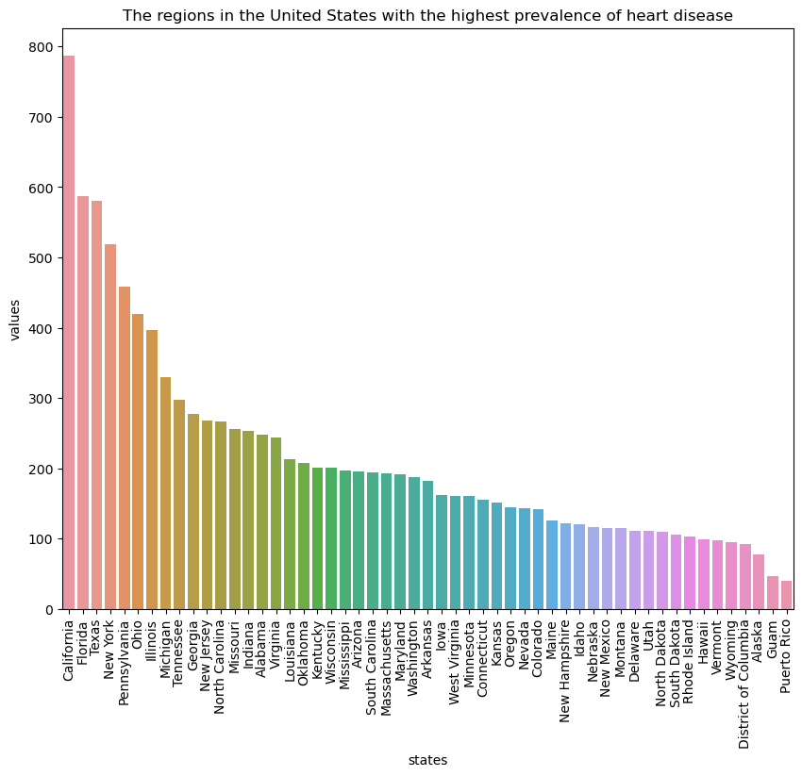
Which region has the highest prevalence of heart disease ?

Slide 10
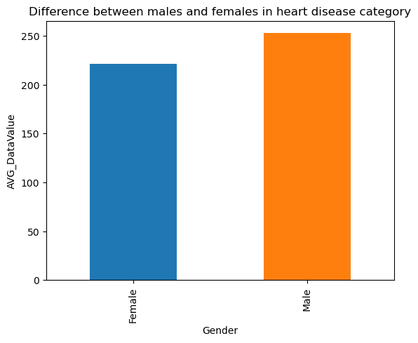
Is there any difference between males and females in heart disease categories?

Slide 11
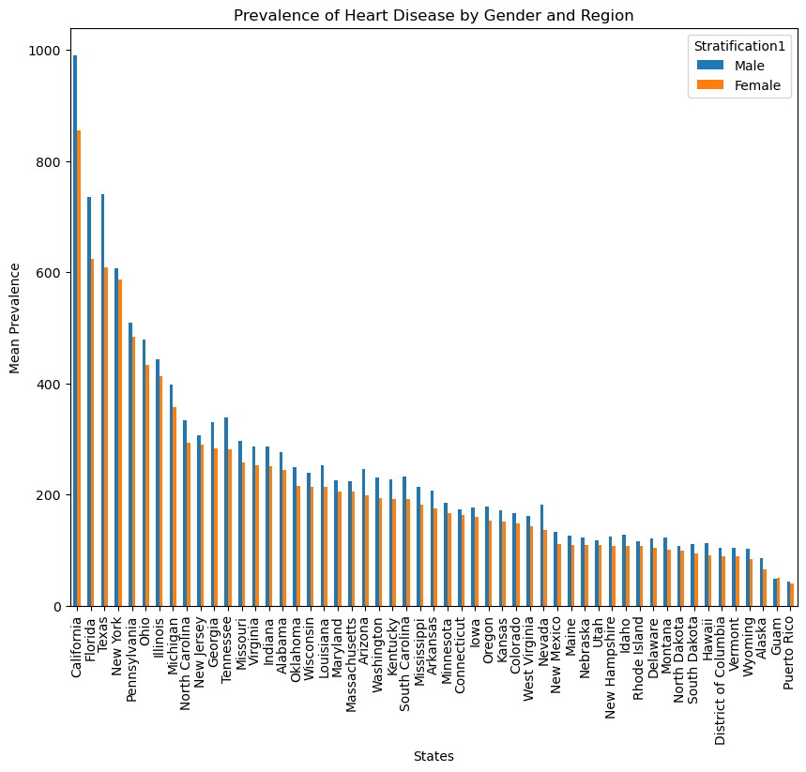
What is the prevalence of heart disease by gender and region in the United States? How does the prevalence vary across different states for males and females?

Slide 12
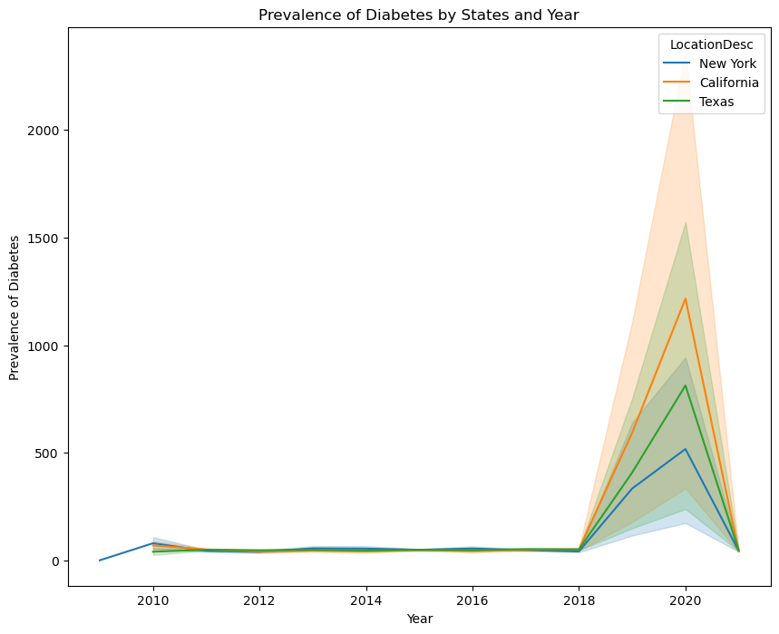
What is the trend in the mean percentage of individuals with diabetes in California, Texas, and New York from 2011 to 2018?

Slide 13
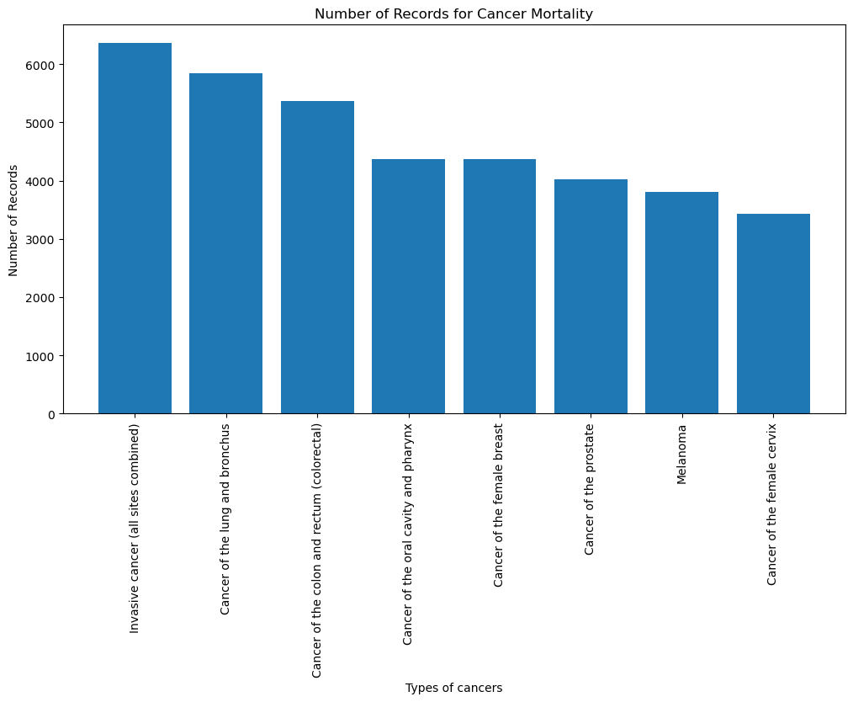
What are the top types of cancer mortality in the dataset?

Slide 14
Conclusion
  Chronic diseases are a significant public health challenge, but chronic disease indicators can help us better understand and address this issue. By tracking and monitoring chronic disease rates, we can develop targeted interventions to reduce the burden of chronic diseases on individuals and society.
  Ultimately, the goal is to improve health outcomes and enhance the quality of life for all individuals, regardless of their age, income, or ethnicity.

Slide 15
Reference
https://www.cdc.gov/chronicdisease/resources/infographic/chronic-diseases.htm
https://catalog.data.gov/dataset/u-s-chronic-disease-indicators-cdi

