Slide 1
Decision Support System for Hospital Management
Tracking Admission Rates, Doctor Availability, and Treatment Effectiveness
K. Siva Naga Manoj Kumar(192111630)
D. Nithin(192111631)

Slide 2
ABSTRACT
This project develops a Decision Support System (DSS) for Healthcare Administration to enhance hospital management by tracking admission rates, doctor availability, and treatment effectiveness. Using Business Intelligence, SQL, and predictive analytics, the system processes 10,000+ patient records to optimize resource allocation, reduce wait times, and improve patient care. The DSS integrates real-time dashboards, data-driven insights, and automated decision-making to enhance hospital efficiency

Slide 3
Introduction
• A Decision Support System (DSS) helps in managing hospital resources effectively.
• Analyzes data on patient admissions, doctor availability, and treatment outcomes.
• Supports hospital administration in making informed decisions.
• Enhances operational efficiency and patient satisfaction.

Slide 4
Challenges in Hospital Management
Hospitals face numerous challenges such as rising costs, increasing patient demands, and limited resources. Understanding these issues is essential for developing effective solutions that can lead to improved patient outcomes and operational efficiency.

Slide 5
SOFTWARE REQUIREMENTS
Database Management System (DBMS) – SQL, PostgreSQL, or MySQL for storing patient records.
Business Intelligence Tools – Tableau, Power BI, or Google Data Studio for data visualization.
Programming Languages – Python, Java, or R for data processing and analysis.
Machine Learning Frameworks – TensorFlow, Scikit-Learn, or PyTorch for predictive analytics.
Web Technologies – HTML, CSS, JavaScript, React for building dashboards.
Cloud Services – AWS, Azure, or Google Cloud for secure data storage and processing.

Slide 6
HARDWARE REQUIRMENTS
Servers – High-performance servers for hosting the DSS application and databases.
Storage Devices – SSDs or cloud storage for secure data management.
Workstations – Computers for doctors, nurses, and hospital administrators to access DSS.
Networking Equipment – Routers, switches, and high-speed internet for seamless data communication.
IoT Devices – Smart sensors and patient monitoring systems for real-time data collection.

Slide 7
Implementation Strategy
• Database setup using SQL for patient records.
• Integration with Business Intelligence tools for analysis.
• Real-time dashboards for monitoring hospital operations.
• Data analytics for improving treatment effectiveness.
• Automated alerts for resource shortages.
• Machine learning models for predictive healthcare analytics.

Slide 8
ADVANTAGES AND DISADVANTAGES
improves hospital efficiency
Reduces patient wait time
Enhances decision-making with data-driven insights
Optimizes resource allocation
Supports predictive analytics for better planning
High initial implementation cost
Requires training for healthcare staff
Dependency on data accuracy
Possible integration issues with existing hospital systems
Security and privacy concerns for patient data

Slide 9
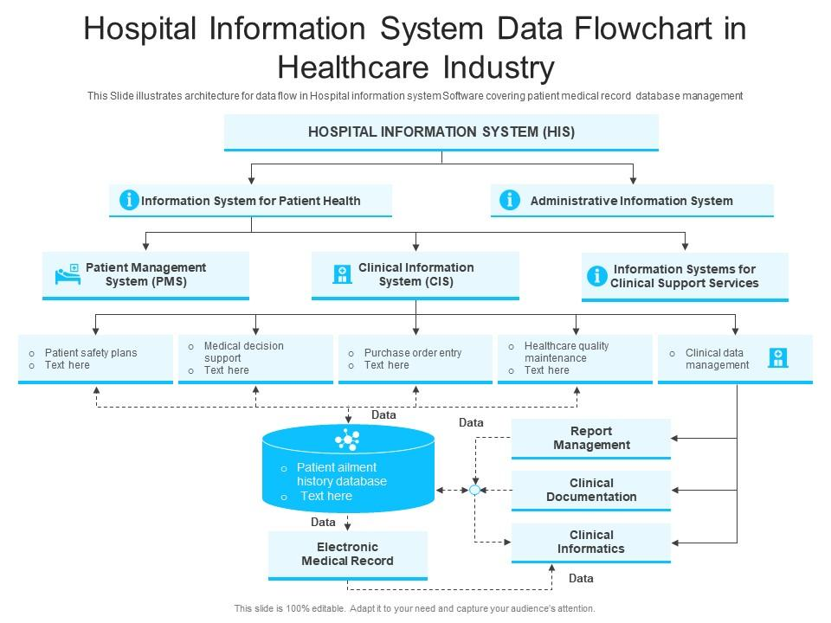

Slide 10
Data Management with SQL
• Patient admission data stored in relational databases.
• SQL queries for tracking bed occupancy and doctor schedules.
• Reports generated for decision-making.
• Secure storage of patient medical records.
• Data backup and recovery strategies for reliability.
• Optimized query performance for faster insights.

Slide 11
Benefits of DSS in Healthcare
• Efficient patient and resource management.
• Reduced wait times for patients.
• Enhanced decision-making for hospital administration.
• Improved treatment effectiveness based on data insights.
• Cost reduction through better resource utilization.
• Increased patient satisfaction and hospital reputation.

Slide 12
Conclusion
• A well-implemented DSS improves hospital efficiency.
• Optimizes resource allocation and enhances patient care.
• Helps hospitals make data-driven decisions for better outcomes.
• Supports scalability and future expansion.
• Ensures regulatory compliance and data security.
• Enhances collaboration between hospital departments.

Slide 13
THANK YOU

