Slide 1

INT 300 Internship
Prediction of Chronic kidney Disease using
Machine Learning Algorithm
Final review
Team Members
Sivane senthil( E0121027)
Marreddy Gayatri devi( E0421053)
Project Guide
1. Prof .Shiyamala Gowri

Slide 2
Introduction
Machine learning uses various algorithms for building mathematical models and making predictions using historical data or information.
Machine Learning is the field of study that gives computers the capability to learn without being explicitly programmed.
Currently, it is being used for various tasks such as image recognition, speech recognition, email filtering, Facebook auto-tagging, recommender system, and many more.

Slide 3
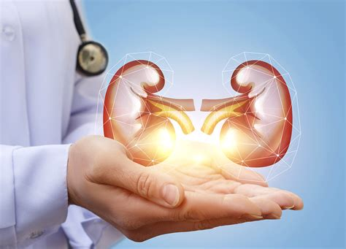
Problem statement
The objective of this project is to check whether the patient is to predict patients with Chronic Kidney Disease using attributes while maintaining a higher accuracy on time.
By using this dataset, we predict whether the patient can have a chronic kidney disease or not. To predict this, we use 24 attributes and 400 rows

Slide 4
Research survey
Datasets | Methodology | Accuracy | Researched by
Chronic kidney disease | Decision tree | 95.92%. | Saurabh Paul
Chronic kidney disease | SVM algorithm | 96.7 % | Siddheshwar Tekale, Pranjal Shingavi
Chronic kidney disease | Logistic regression | 98.8% | Salma Shaji, S R Ajina
Chronic kidney disease | Random forest | 0.975% | Levin A. Tonelli M

Slide 5
Work flow
Data collection
Data cleaning
Data-pre-processing
Future Reinforcement
Prediction
Algorithms

Slide 6
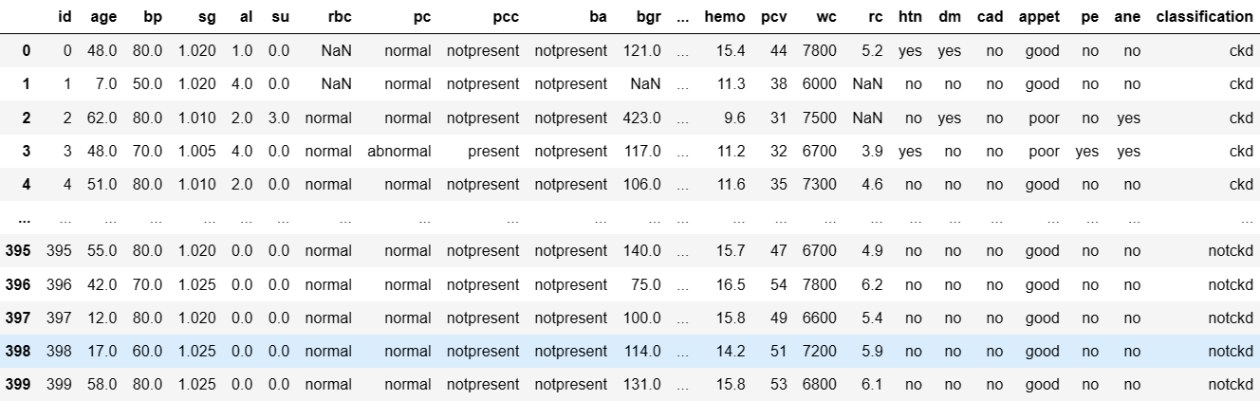
Dataset

Slide 7
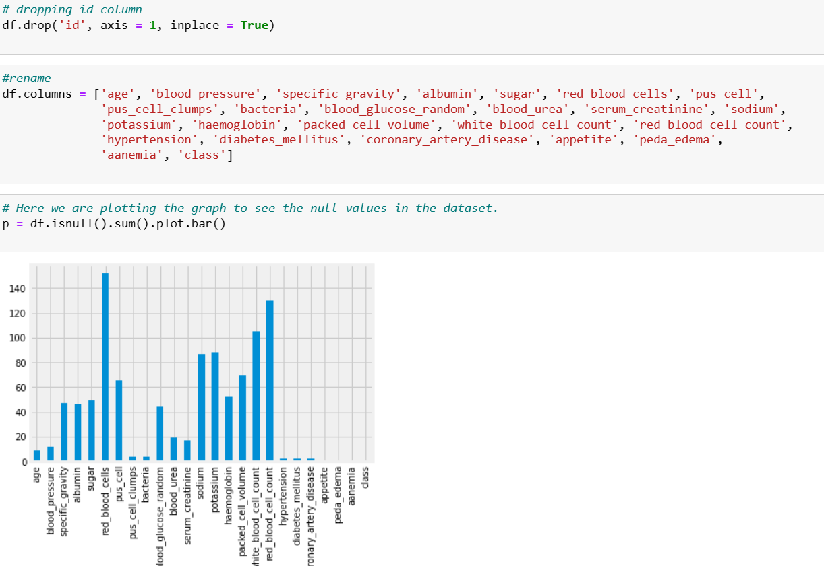
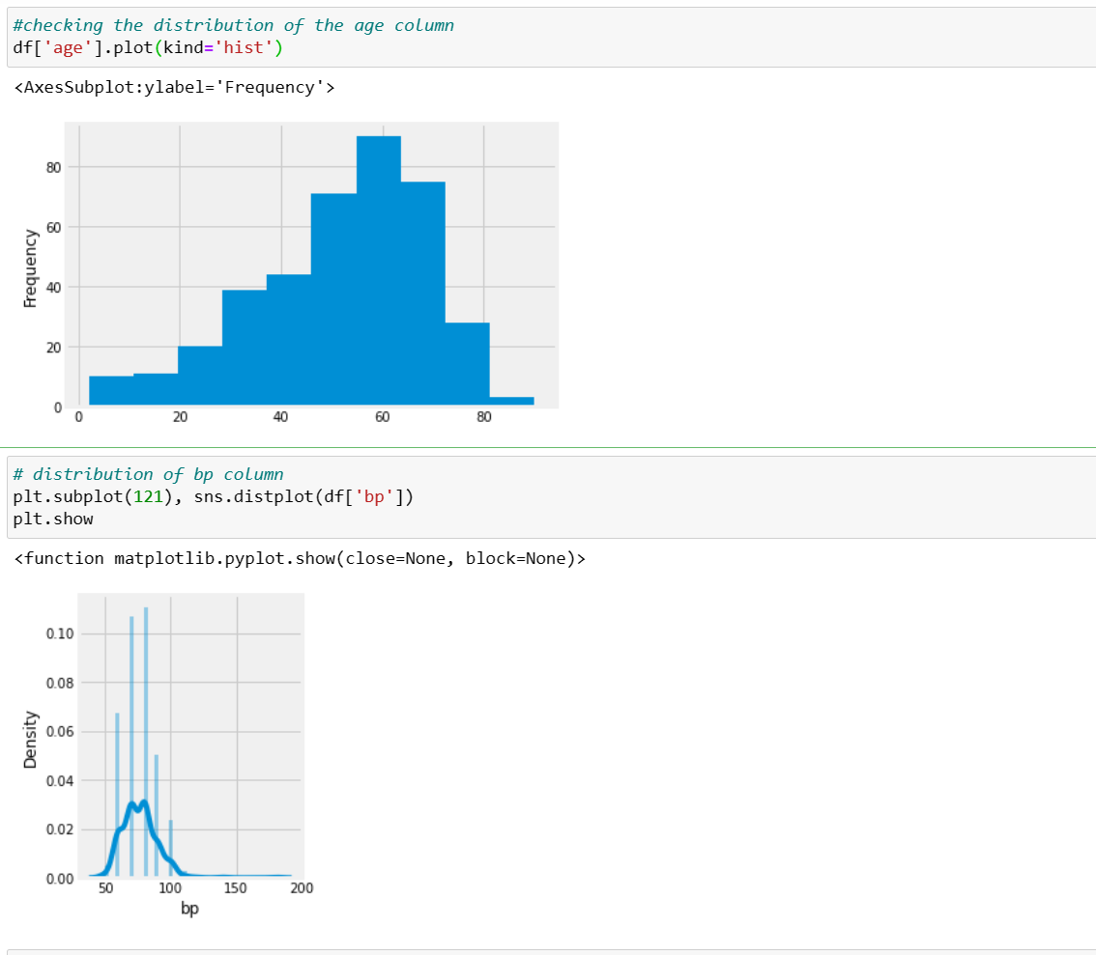
Data cleaning

Slide 8
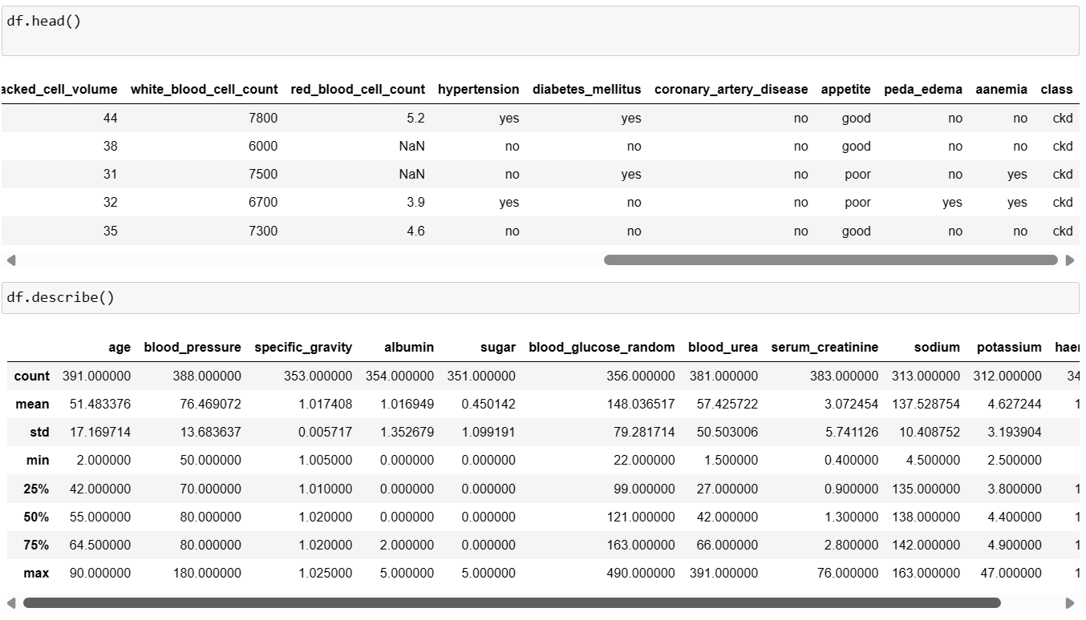
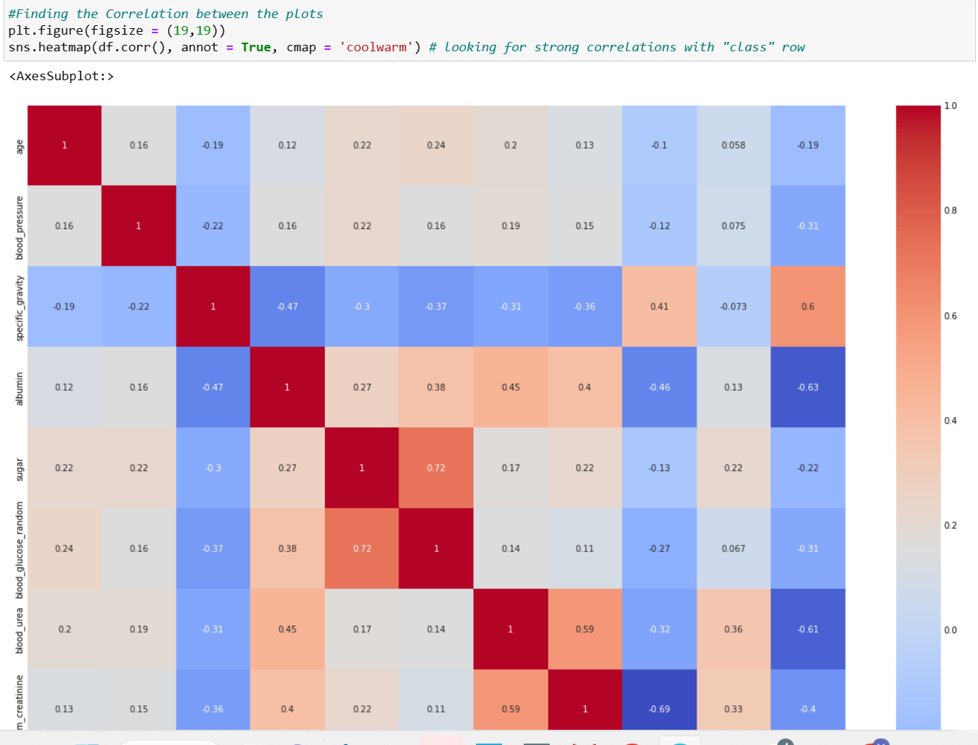

Slide 9
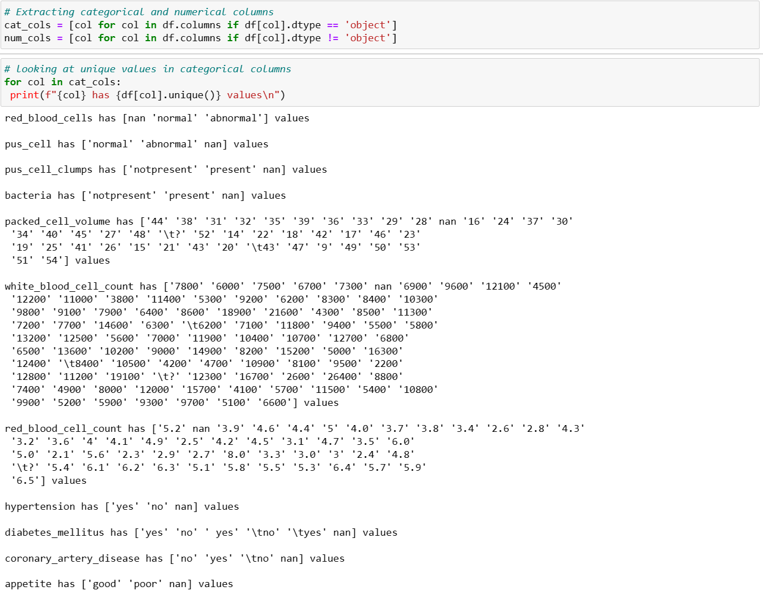
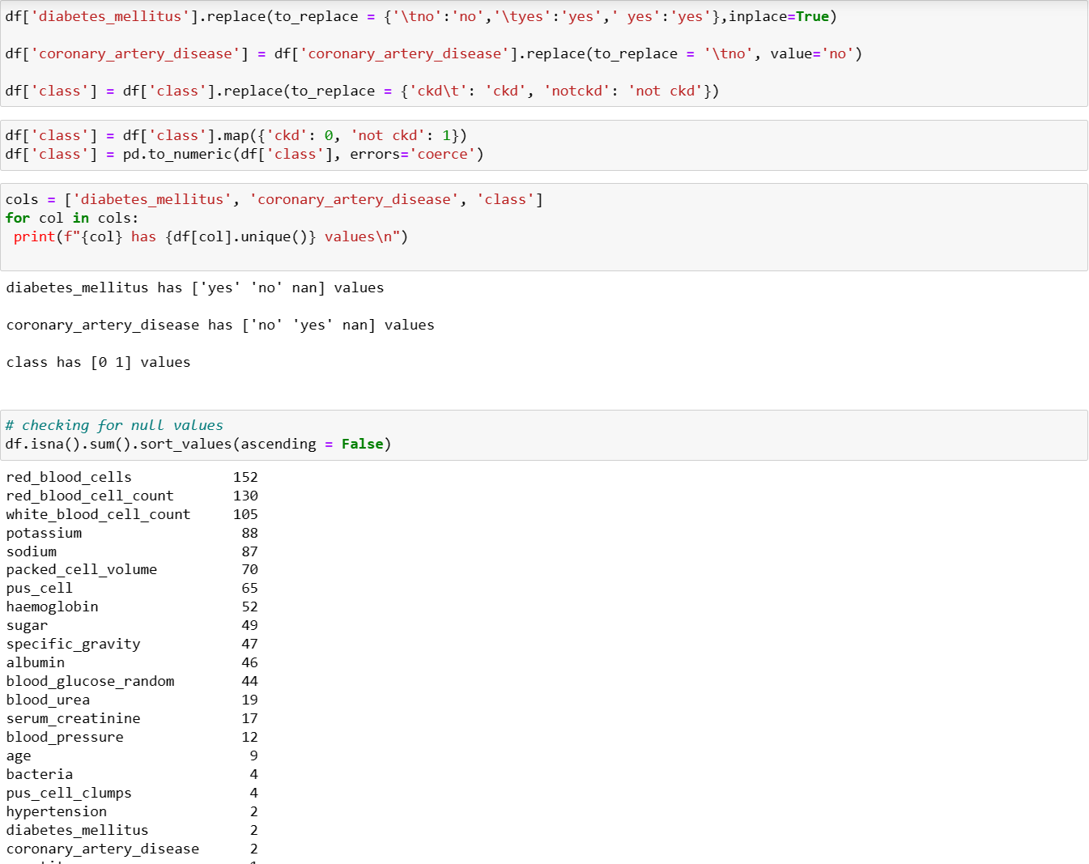

Slide 10
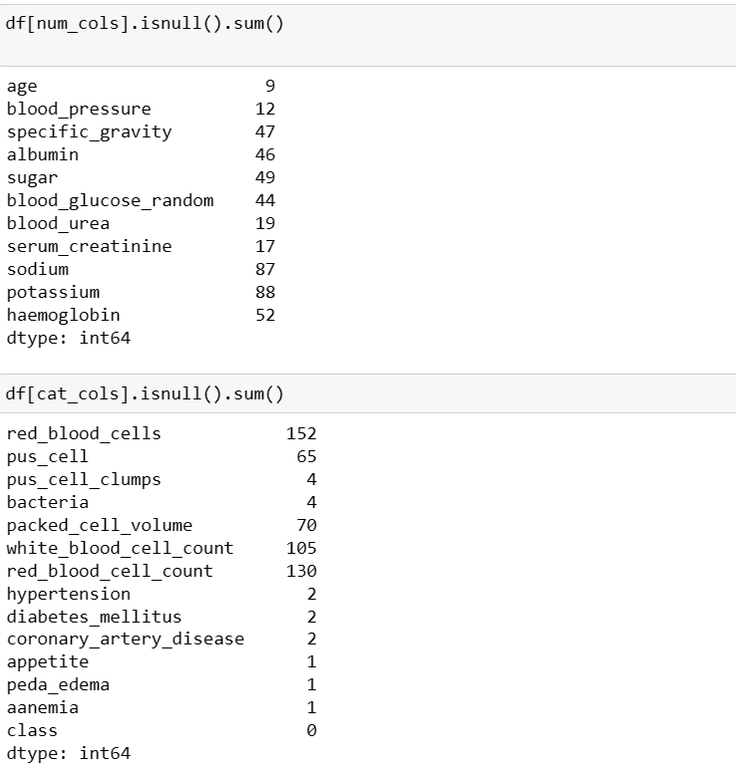
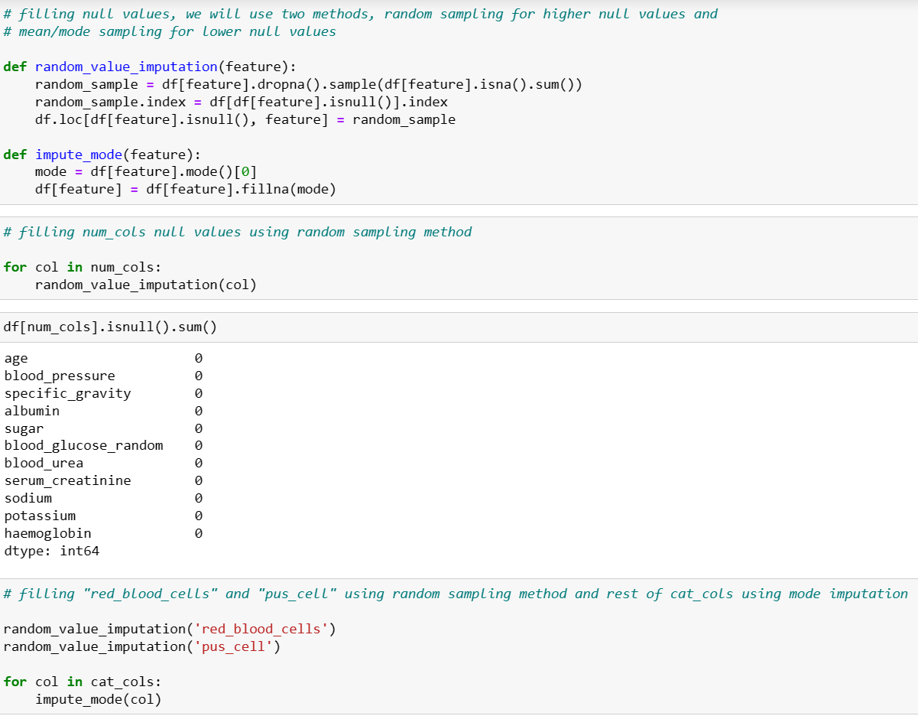

Slide 11
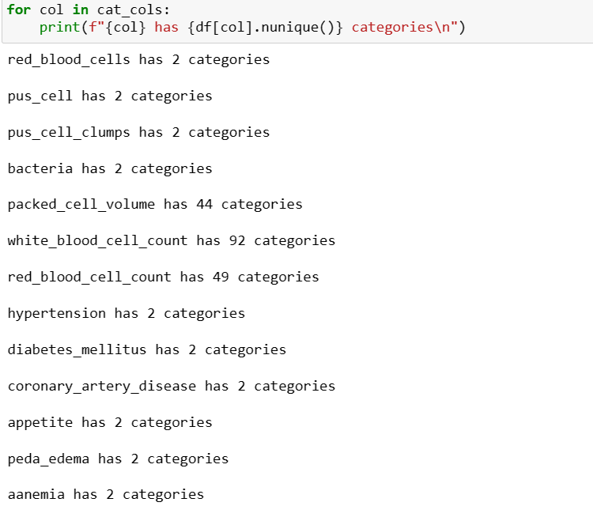

Slide 12
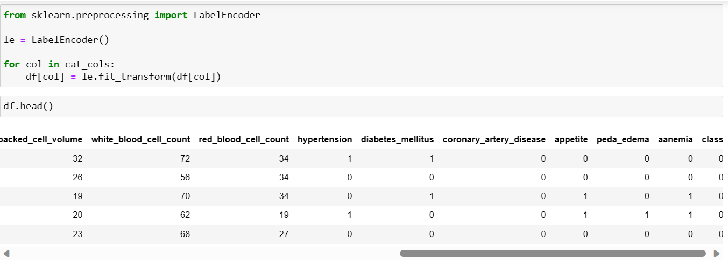
Data pre-processing

Slide 13
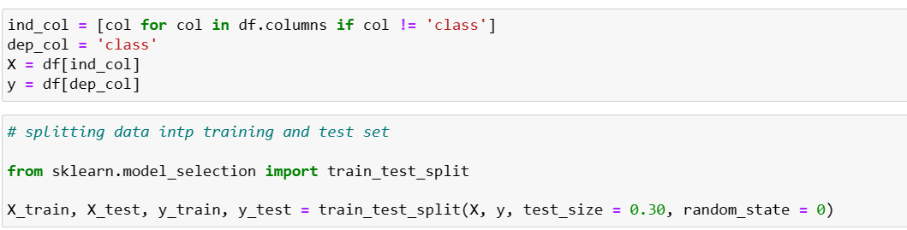
Train Test Splitting

Slide 14
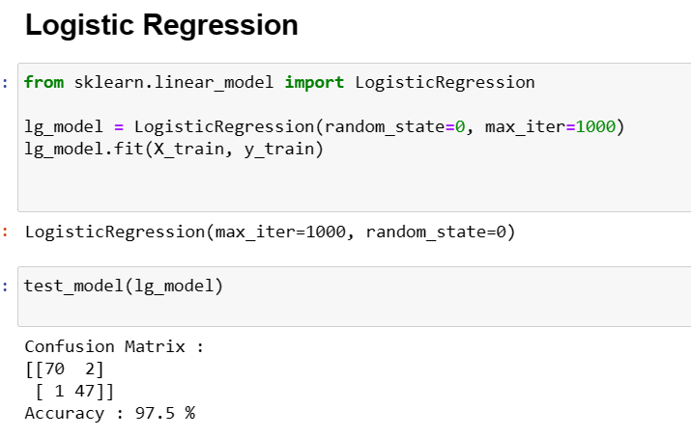
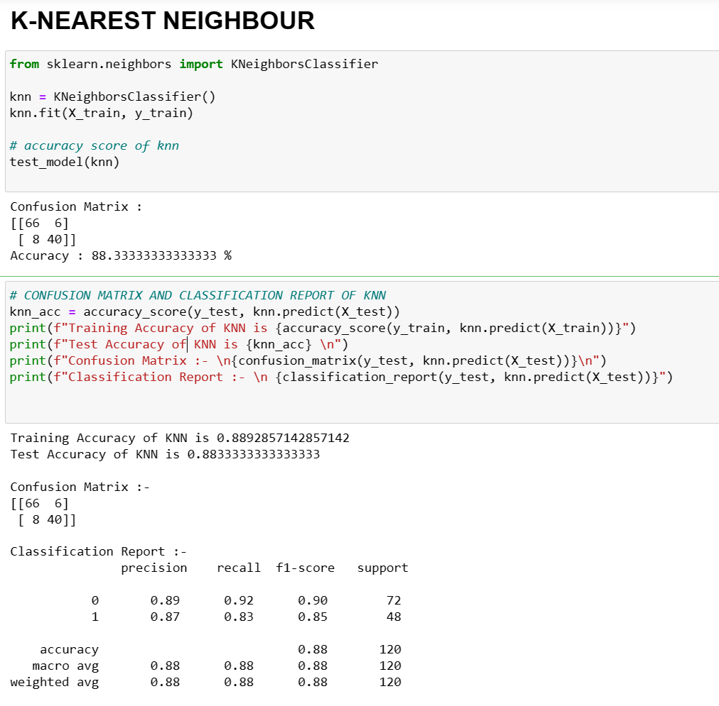
CLASSIFICATION

Slide 15
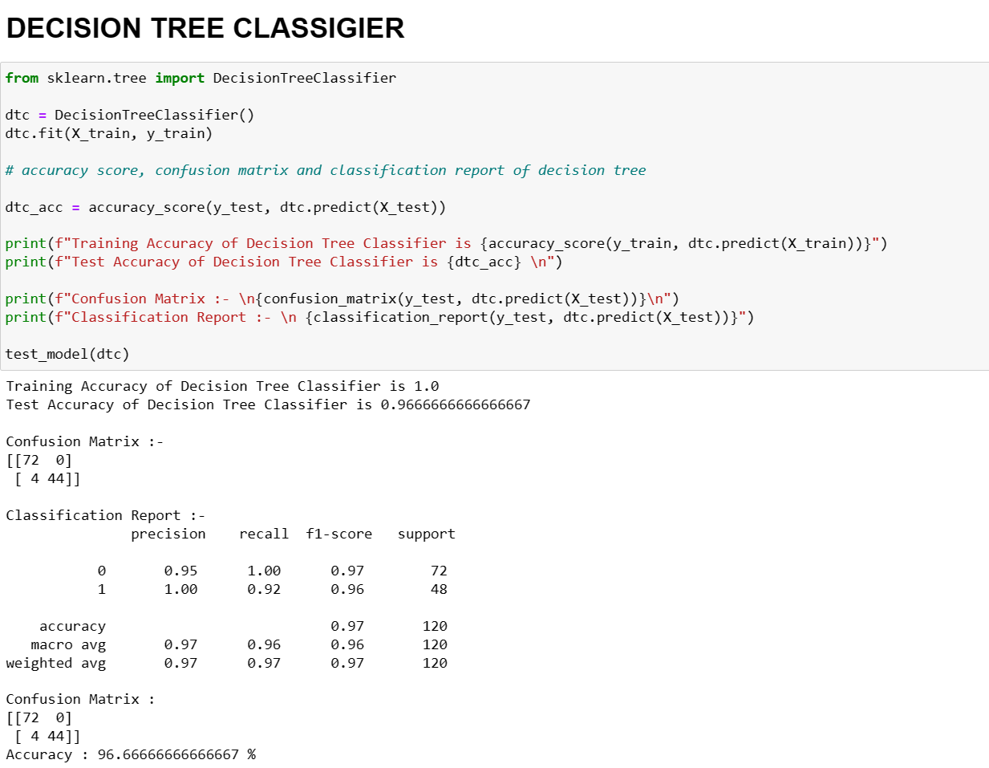
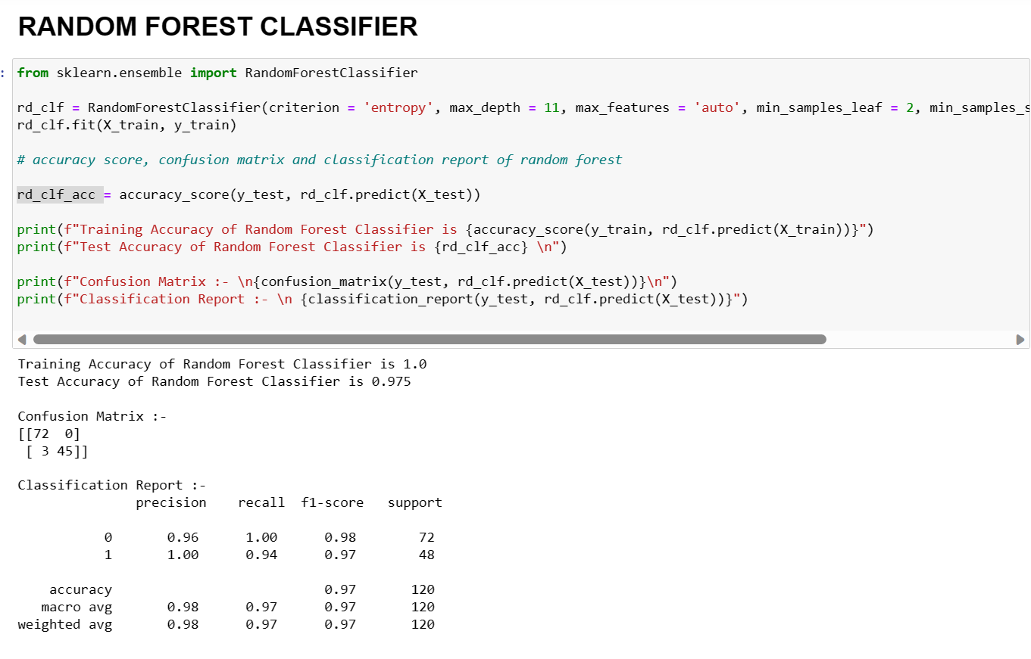

Slide 16
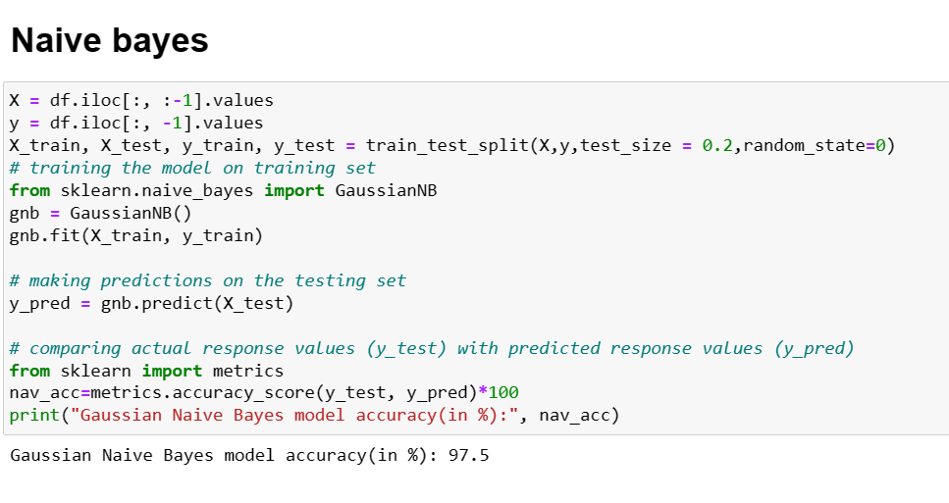
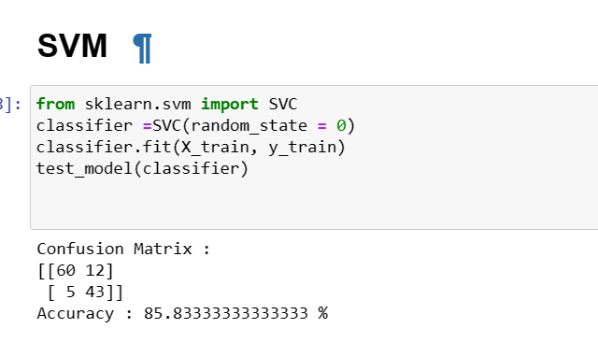

Slide 17
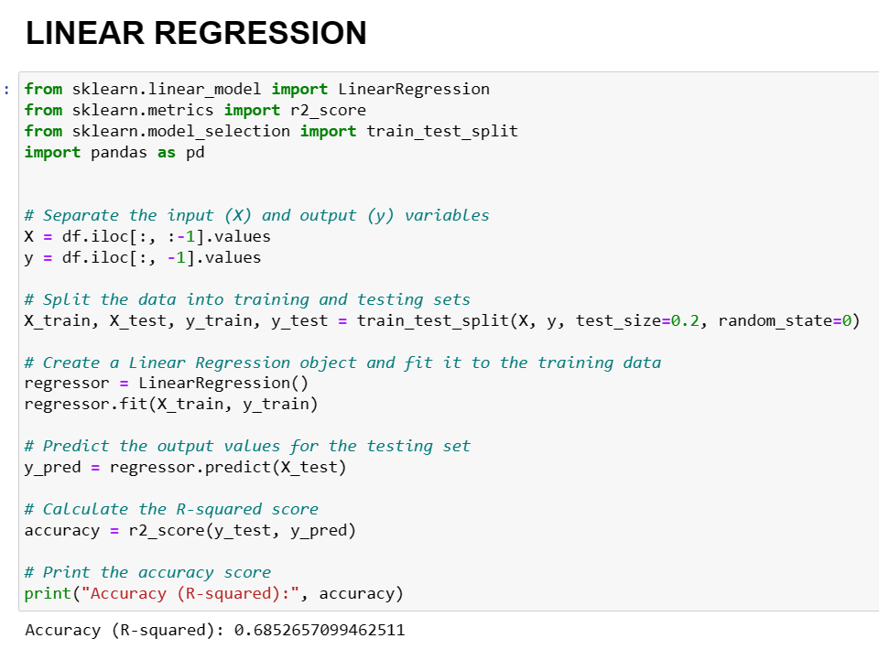
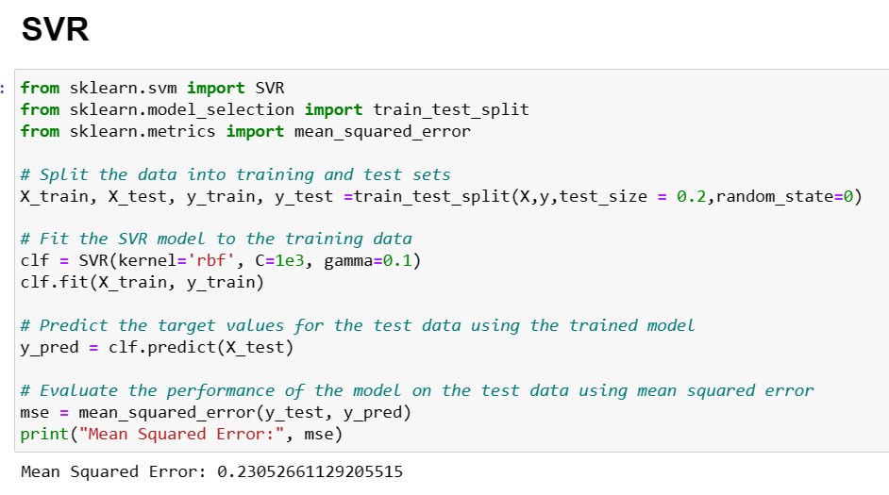
Regression

Slide 18
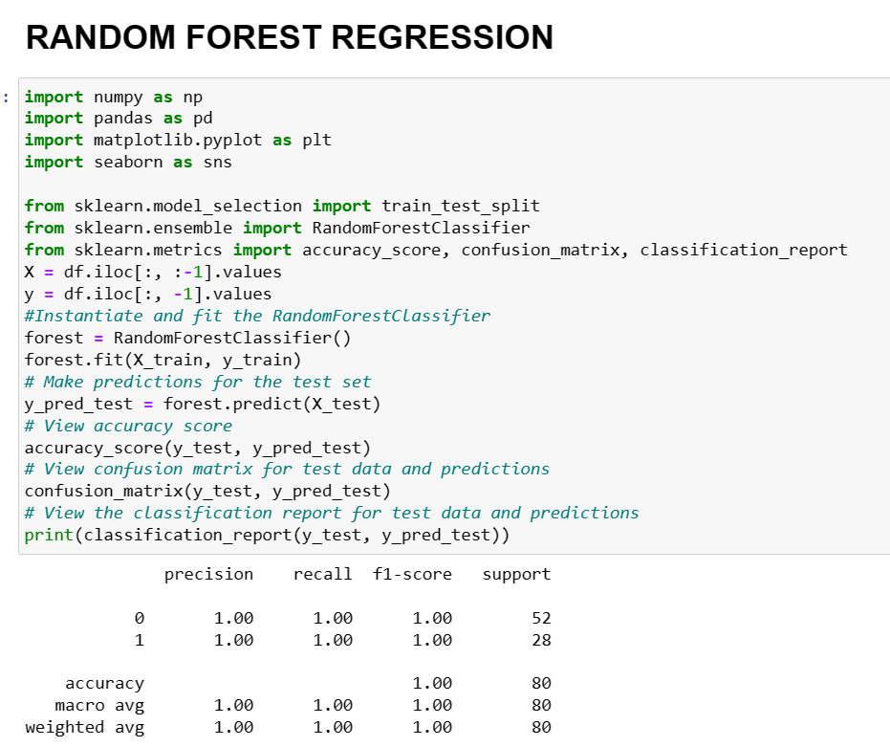
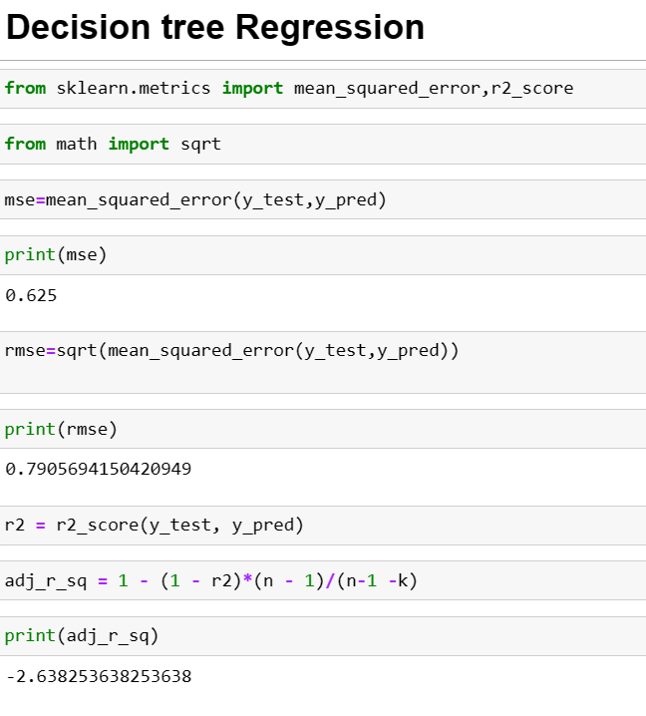

Slide 19
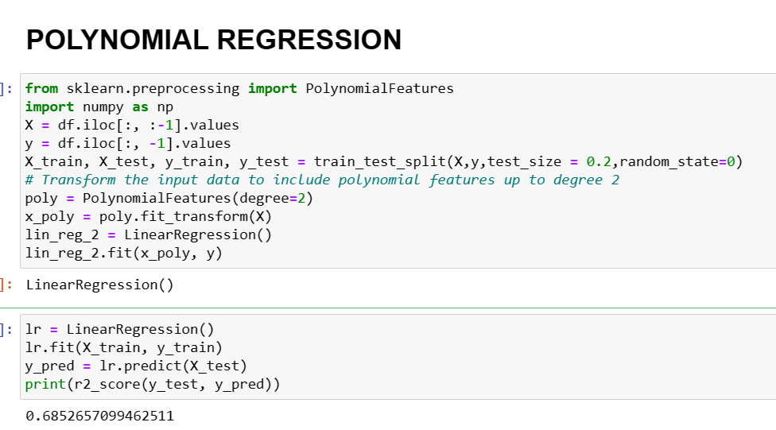

Slide 20
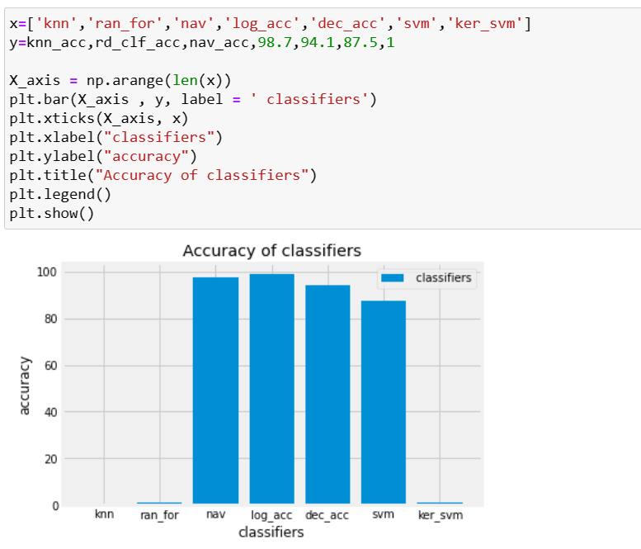
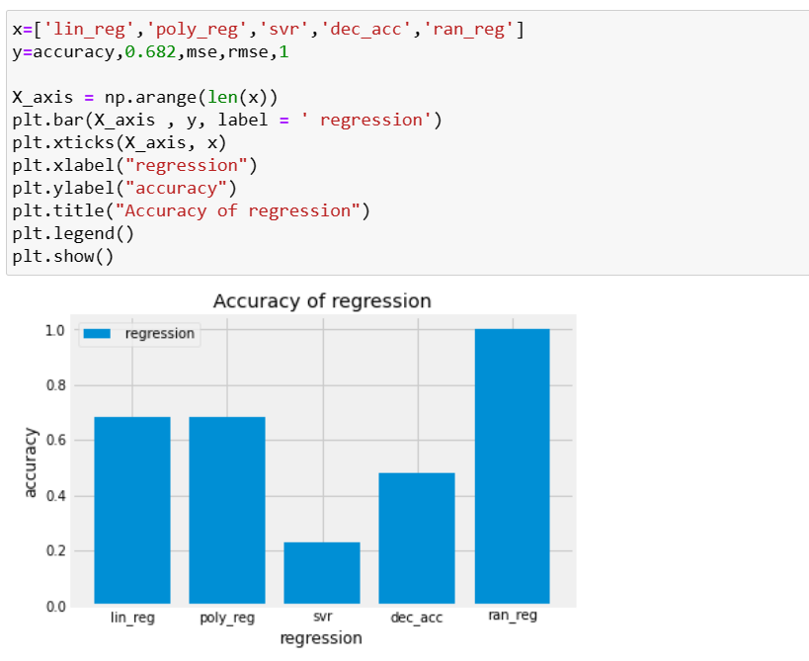
Comparing models

Slide 21
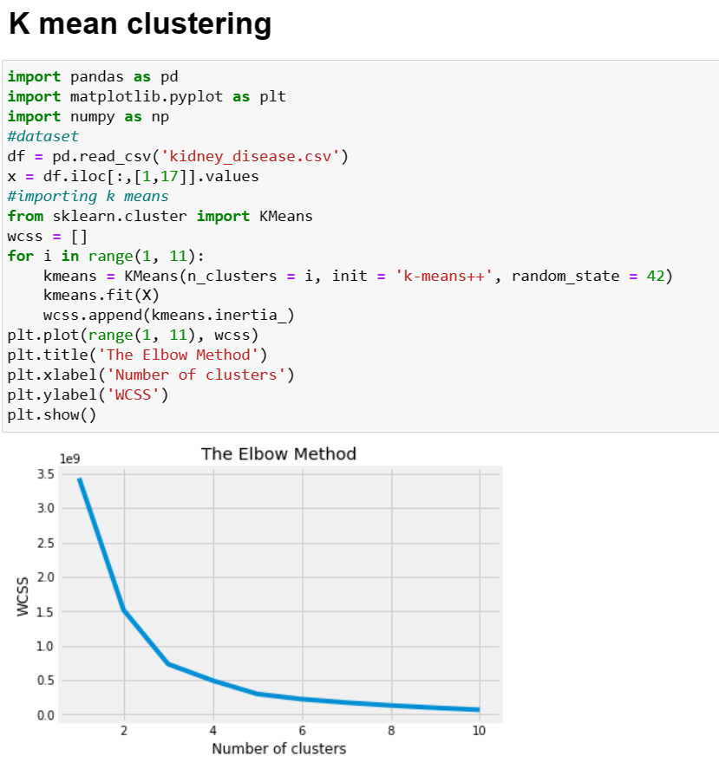
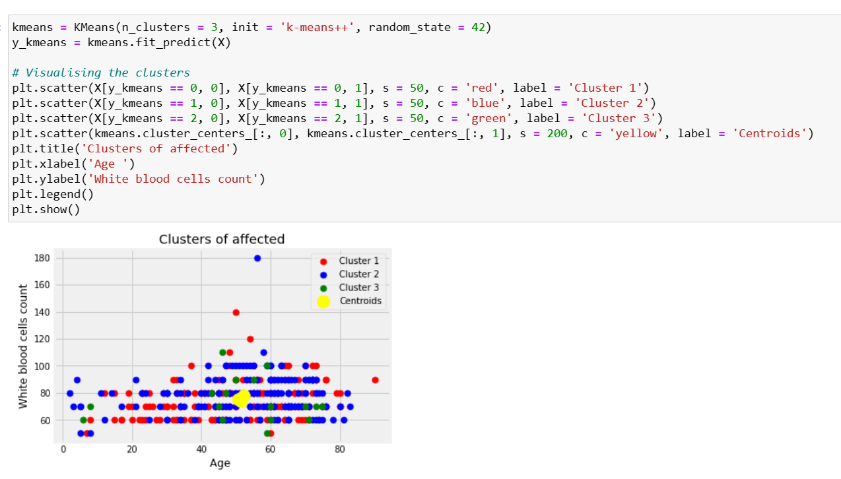
Clustering

Slide 22
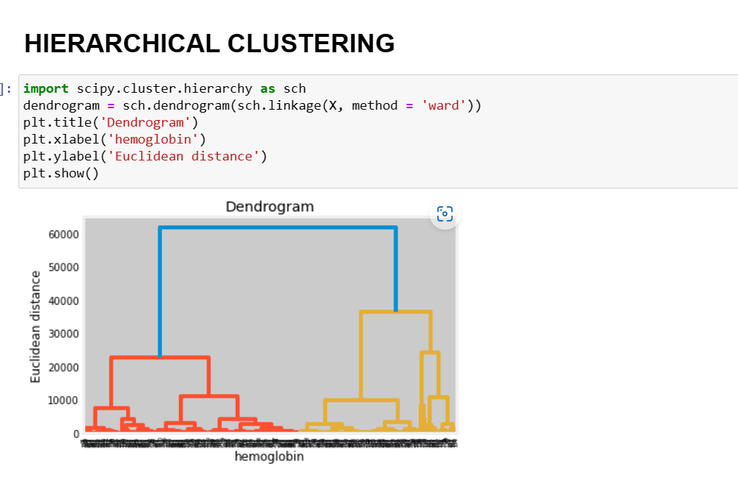
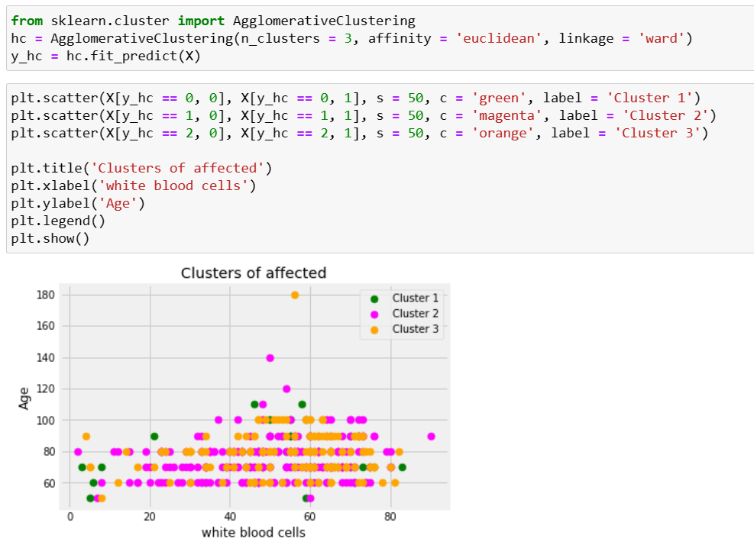

Slide 23
Work done
Collected dataset from Internet.
Worked on Data Cleaning and Data pre-processing.
Worked on Correlation and read some journals
Splitting the dataset into training set and test set,
Done Regression (Logistic Regression, Linear Regression, Polynomial Regression, Decision Tree ,Random Forest Regression).
Done Classification(KNN, Naive bayes, SVM, Decision Tree, Random Forest).
Done Clustering (K Mean, Hierarchical).
Comparing models

Slide 24
Timeline of the work
17-02-2023 - 23-03-2023 Learnt Machine Learning from Udemy videos.
24-03-2023 - 02-03-2023 Worked out with the given dataset in python.
03-03-2023 - 09-03-2023 Started working on out Chronic kidney disease dataset
10-03-2023 - 16-03-2023. Done data cleaning and correlation
17-03-2023 - 20-04-2023 Data Pre-processing and Splitting into training set and testing set
21-03-2023 - 30-04-2023 Worked on Classification.
31-03-2023 - 07-04-2023 Worked on Regression.
08-03-2023 - 15-04-2023 Worked on Clustering.
16-04-2023 - 22-04-2023. Comparison graph and corrections from second review
23-04-2023 - 26-04-2023 Worked on Project Report.

Slide 25
Conclusion
The performance of the model depends upon various performance matrices like sensitivity, precision, recall, f1-score, confusion matrix etc
Logistic regression has highest Accuracy rate among all the Classification types
Random Forest has highest Accuracy rate among all the Regressions type

Slide 26
Reference
https://journalofbigdata.springeropen.com/articles/10.1186/s40537-022-00657-5
https://link.springer.com/article/10.1007/s44174-022-00027-y
https://rn-journal.com/journal-of-nursing/innovation-for-chronic-kidney-disease

Slide 27
Thank you

