Slide 1
Principal Component Analysis
Team members :
E0121027 Sivane. S E0121057 Awf Bobber
E0121013 Sasank. K

Slide 2
Introduction
Principal Component Analysis (PCA) is a statistical method used for dimensionality reduction and data visualization. It identifies the directions (principal components) that capture the maximum variance in the data and projects the data onto these components, reducing the number of dimensions while retaining most of the variability. PCA is widely employed in various fields such as image processing, genetics, and finance to simplify complex datasets, uncover underlying patterns, and facilitate easier interpretation and visualization of high-dimensional data. Its application aids in understanding relationships between variables and identifying dominant features within the dataset, making it a valuable tool for exploratory data analysis and model building.

Slide 3
How it is done?
PCA helps in reducing the dimensionality of data while preserving its variance by identifying the directions, called principal components, that capture the maximum variance in the dataset. These principal components are orthogonal to each other, meaning they represent independent sources of variation in the data. By selecting a subset of these components that explain most of the variance, PCA effectively reduces the dimensionality of the dataset while retaining the essential information. This process allows for a more compact representation of the data, making it easier to analyze, visualize, and interpret, while still preserving the most significant sources of variation within the original dataset.

Slide 4
Benefits
Dimensionality Reduction: PCA simplifies complex datasets by reducing the number of dimensions while retaining most of the variability in the data.
Feature Selection: PCA identifies the most important features or variables in the dataset by ranking them based on their contribution to the overall variance.
Noise Reduction: PCA can help in filtering out noise and irrelevant information from the data by focusing on the components that capture the most significant sources of variation.
Collinearity Reduction: PCA can mitigate the effects of multicollinearity, where predictor variables in a dataset are highly correlated with each other.

Slide 5
Mathematical overview
Data Centering: Subtract the mean of each feature from the dataset to center the data around the origin.
Covariance Matrix Calculation: Compute the covariance matrix of the centered data.
Eigenvalue Decomposition: Perform eigenvalue decomposition (or singular value decomposition) on the covariance matrix to obtain the eigenvalues and corresponding eigenvectors.
Principal Component Selection: Sort the eigenvectors based on their corresponding eigenvalues in descending order. Choose the top k eigenvectors (principal components) that capture the most variance in the data.
Projection: Project the original data onto the selected principal components to obtain the reduced-dimensional representation of the dataset.

Slide 6
Mathematically, given a dataset X with n observations and m features, PCA aims to find the transformation matrix W such that the reduced-dimensional representation Y is given by:
Y=XW
where Y is an n×k matrix representing the reduced dataset, and W is an m×k matrix containing the selected eigenvectors as columns.
PCA is thus a linear transformation that maps the original high-dimensional data onto a lower-dimensional subspace spanned by the principal components, while preserving the maximum amount of variance in the data. This reduced representation can then be used for visualization, analysis, or as input to machine learning algorithms.

Slide 7
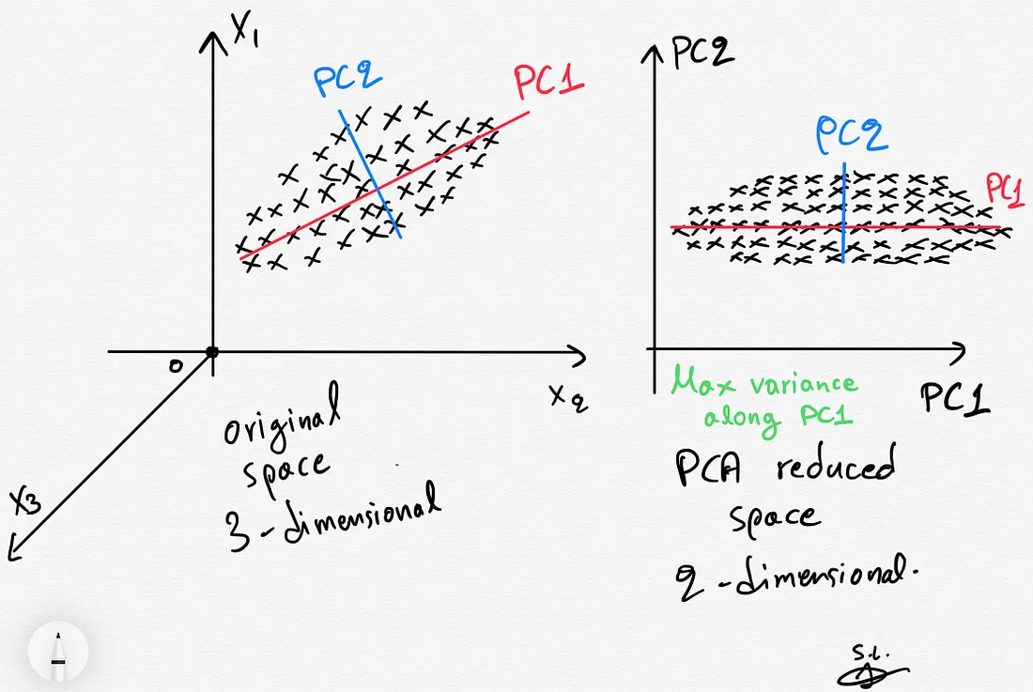
Visualization

Slide 8
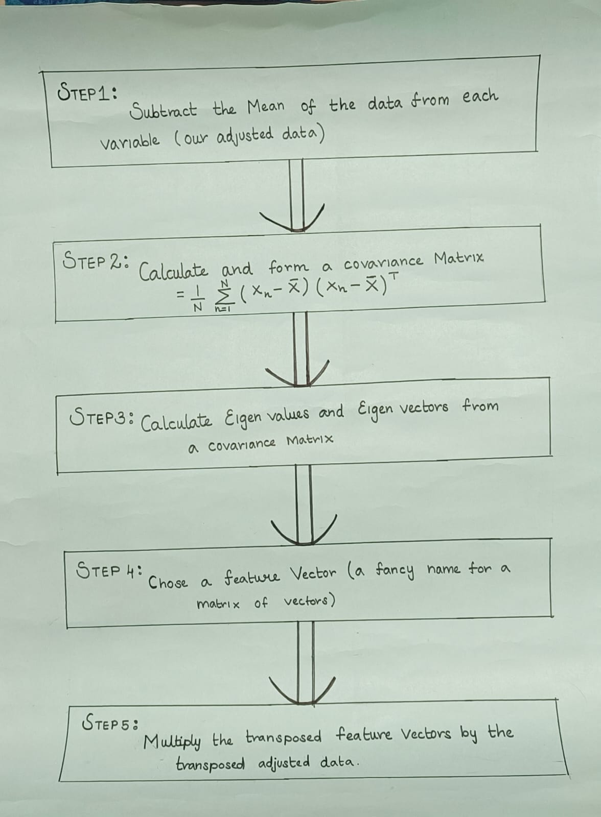
Chart

Slide 9
Real life applications
Image Compression: In image processing, PCA can be used to reduce the dimensionality of images while preserving important features.
Face Recognition: PCA is widely used in facial recognition systems to extract the most discriminative features from face images.
Market Research: In marketing and consumer research, PCA can be applied to analyze survey data containing multiple variables related to consumer preferences, behavior, and demographics.
Bioinformatics: In genetics and bioinformatics, PCA is used to analyze gene expression data and identify patterns of gene expression across different samples or conditions.
Spectral Analysis: In signal processing and spectroscopy, PCA is used to analyze complex spectral data from instruments such as spectrometers and mass spectrometers.

Slide 10
Conclusion
PCA plays a crucial role in various aspects of data analysis, offering a powerful framework for dimensionality reduction, feature extraction, and data visualization. Its importance stems from its ability to simplify complex datasets while preserving the essential information and capturing the underlying structure and patterns within the data. By reducing the dimensionality of high-dimensional datasets, PCA facilitates more efficient computation, storage, and analysis, leading to improved understanding, interpretation, and decision-making in diverse fields such as image processing, genetics, finance, and marketing. Additionally, PCA aids in mitigating issues like multicollinearity, noise, and overfitting, enhancing the robustness and generalization of statistical models and machine learning algorithms. Overall, PCA is a valuable tool for exploratory data analysis, pattern recognition, and knowledge discovery, contributing significantly to advancements in research, industry, and technology.

Slide 11
Thankyou

