Slide 1

Quantum Computer
- a step to next generation
Sivanesh.M,Msc(software system)
1st year(CT-PG),
Kongu engineering college,Erode,
E-mail:sivaflip@gmail.com.
Abstract— Quantum computer is basically
Quantum computing is a new and exciting field
that intersects mathematics, computer science and
physics. Computer systems built on the principles
of quantum mechanics are capable of performing
calculations deemed unachievable for classical
computers. This paper provides an overview and
history of quantum computing, discusses its
algorithmic mechanisms, and explores its
from a quantum technologies and in this
presentation we are going learn about what
is quantum computer
and difference between classical computer
and quantum computer and benefits of
quantum computer and how many
companies developed quantum
technologies
and how quantum will serve in future.
implications for cryptography, innovation, power
structures, and day-to-day life.
Keywords—Quantum,differences,benefits ,and its period
1.1Quantum Mechanics
1.INTRODUCTION
(In physics, a quantum (plural quanta) is the minimum
amount of any physical entity (physical property)
involved in an interaction.)
XXX-X-XXXX-XXXX-X/XX/$XX.00 ©20XX IEEE

Slide 2



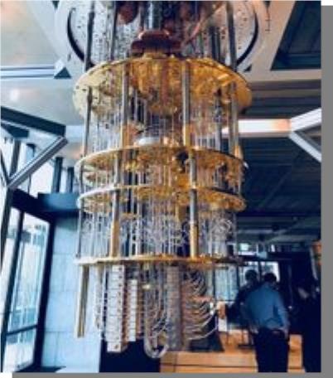
To understand how quantum computers work, we
must understand the underlying
that allows them to exist in more than one
state (i.e., a 1 and a 0 at the same time).
principles upon which quantum computing is
built. That is, quantum mechanics. Usually, when
people refer to the laws in physics, they are
referring to the laws in classical physics. Classical
physics describes nature at an ordinary or
macroscopic scale. Those laws are different from
the ones in the quantum realm. It is very important
to understand the differences in order to
understand how quantum computing works.
Quantum mechanics are the laws of physics that
are applied to elements in the quantum realm. The
quantum realm is the area in which atoms and
particles are at the smallest size they can be. This
size is typically around 100 nanometers (10−9
meters) or less. When observing particles at that
size, the particles defy the laws of classical
physics such that elements have the characteristics
of particles and waves. It is in this realm that the
fundamentals of quantum computing are built.
( In simple way quantum means
KEY TAKEAWAYS
•
Quantum computing is the study of
how to use phenomena in quantum
physics to create new ways of
computing.
•
•
Quantum computing is made up of
qubits.
Unlike a normal computer bit, which
can be 0 or 1, a qubit can be either of
those, or a superposition of both 0
and 1.
•
•
The power of quantum computers
grows exponentially with more
qubits.
•
This is unlike classical computers,
where adding more transistors only
adds power linearly.
The smallest amount of many forms of
energy (such as light)
•
•
•
•
Quantity , amount.
Portion , part.
Figure 2.01 shows the quantum computer
Gross quantity bulk.
Any of the very small increments or parcels
into which many forms of energy are
subdivided. )
2. What Is Quantum Computing?
Quantum computing is an area of
computing focused on developing computer
technology based on the principles of
quantum theory (which explains the
behavior of energy and material on the
atomic and subatomic levels). Computers
used today can only encode information in
bits that take the value of 1 or 0—
restricting their ability.
Quantum computing, on the other hand,
uses quantum bits or qubits. It harnesses
the unique ability of subatomic particles
Figure 2.01

Slide 3
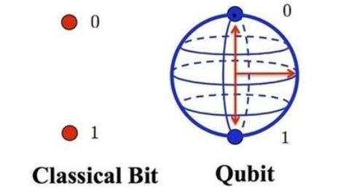
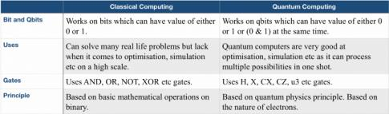
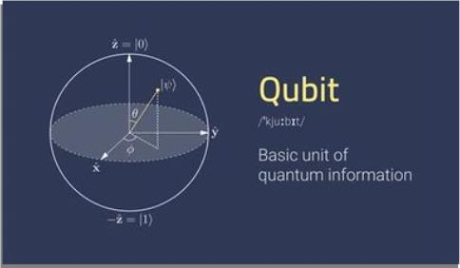
2.02 Bit
3.Difference between classical Computer
and Quantum computer
The main different between classical
computer and quantum computer is
classical computer use bits and quantum
computer use qubits.
Computer handles data in the form of ‘0’(zero) and
‘1’(one).Any kind of data like number,alphabet,special
character should be converted into ‘0’ and ‘1’ which
can be understood by computer. ‘0’ and ‘1’ that the
computer can understand is called Machine language.
‘0’ and ‘1’ are called Binary Digit
A bit is the short form of binary digit which can be
‘0’ and ‘1’ . it is the basic unit of data in
computer.
Figure 3.01 shows about the difference
between classical computer and quantum
computer.
2.03 Qubits
A qubit is a quantum bit, the counterpart in quantum
computing to the binary digit or bit of classical
computing. Just as a bit is the basic unit of information
in a classical computer, a qubit is the basic unit of
information in a quantum computer.
In a quantum computer, a number of elemental
particles such as electrons or photons can be used (in
practice, success has also been achieved with ions),
with either their charge or polarization acting as a
representation of 0 and/or 1. Each of these particles is
known as a qubit; the nature and behavior of these
particles (as expressed in quantum theory) form the
basis of quantum computing. The two most relevant
aspects of quantum physics are the principles
of superposition and Entanglement.
Figure 3.01
And also table 3.02 shows the main
differences
(In simple way
Qubit is the quantum bit .
Main difference between bit and qubit is bit can include or
transper the data using 1 or 0 not both but qubit includes
both 0 and 1 so only its faster.)
Figure 2.03.01 shows the structure of qubit in
diagramic representation
Table 3.02
4.BENEFITS OF QUANTUM COMPUTER
Quantum computing could contribute
greatly in the fields of finance, military
affairs and intelligence, drug design and
discovery, aerospace designing, utilities
(nuclear fusion), polymer design, machine
learning and artificial intelligence (AI) and
Big Data search, and digital manufacturing
Figure 2.03.01

Slide 4





1.Information storage pattern – Flexibility
on storage
2.speed - perform multiple task
simultaneously.
3.security - provides unbreakable security
features.
Another top quantum computing company is
Quantum Computing Inc. (QCI). QCI has a
unique vision for this technology, believing it will
never replace traditional computers but, rather,
complement them.
4.power efficient –quantum computer
reduces power consumption by 100 upto
1000 times because of quantum tunneling.
5.AI – Making exponentially fast
connection for mechine learning
operations.
3)Xanadu
Problem solving – Can solve unsolvable
problems such as travelling salesman
problem and bounded-error quantum
polynomial trial(BQP) which are decision
based problem.
Canadian startup Xanadu has an impressive
claim in the quantum computing world.
4)Microsoft Azure Quantum…..
5) D-Wave Systems……..
I. 5.COMPANIES THAT DEVELOPED QUANTUM
TECHNOLOGY
1) IBM
6.How it serves in future
It is envisioned that quantum computing
will accelerate us into the future by
impacting the landscape of artificial
intelligence and data analytics.
The quantum computing power and speed
will help us solve some of the biggest and
most complex challenges we face as
humans.
IBM has been one of the leading quantum
computing companies for some time. In 2016, it
became the first to offer cloud-based quantum
computing access, letting virtually anyone access
these once-prohibitive resources.
Quantum won’t entirely replace classical
computing-not in the foreseeable
future,anyways –for many computational
tasks it won’t offer any real advantage.
For the type of complex calculations that
it does excel at,though,we can expect to
2)QCI

Slide 5
see computers that operates hundreds of
millions of time more quickly.
Thank you
To contact:
E-mail:sivaflip7@gmail.com
Phone no:8838100846.
References
1. Ambainis, Andris. "What Can We Do with a
Quantum Computer?" Institute for
Advanced Study. 18 Mar. 2019
<https://www.ias.edu/ideas/2014/ambainis-quantum-
computing>.
2. American Affairs. "Winning the Race in Quantum
Computing." Medium. 06 June 2018.
Medium. 18 Mar. 2019
<https://medium.com/@americanaffairs/winning-
the-race-in-quantum-computing-9ec226
09398c>.
3. Berboucha, Meriame. "IBM's First Commercial
Quantum Computer." Forbes. 29 Jan.
2019. Forbes Magazine. 18 Mar. 2019
<https://www.forbes.com/sites/meriameberboucha/2
019/01/23/ibms-first-commercial-quantum-
computer/#57026a8941b2>.
4. Byrnes, Tim. "Exciton-polariton condensates
and new quantum technologies." Tim
Byrnes. 18 Mar. 2019
<http://nyu.timbyrnes.net/research/exciton-
polariton-condensates-and-new-quantum-tech
nologies/>.
5. Goswami, Debabrata. "Implementation
Aspects of Quantum Computing." Indian
Institute
of Technology.
<http://textofvideo.nptel.ac.in/104104082/lec42.
pdf>.
6. Greenemeier, Larry. "How Close Are We--
Really--to Building a Quantum Computer?"
Scientific American. 30 May 2018. 18 Mar. 2019
<https://www.scientificamerican.com/article/ho
w-close-are-we-really-to-building-a-quant
um-computer/>.

