Slide 1
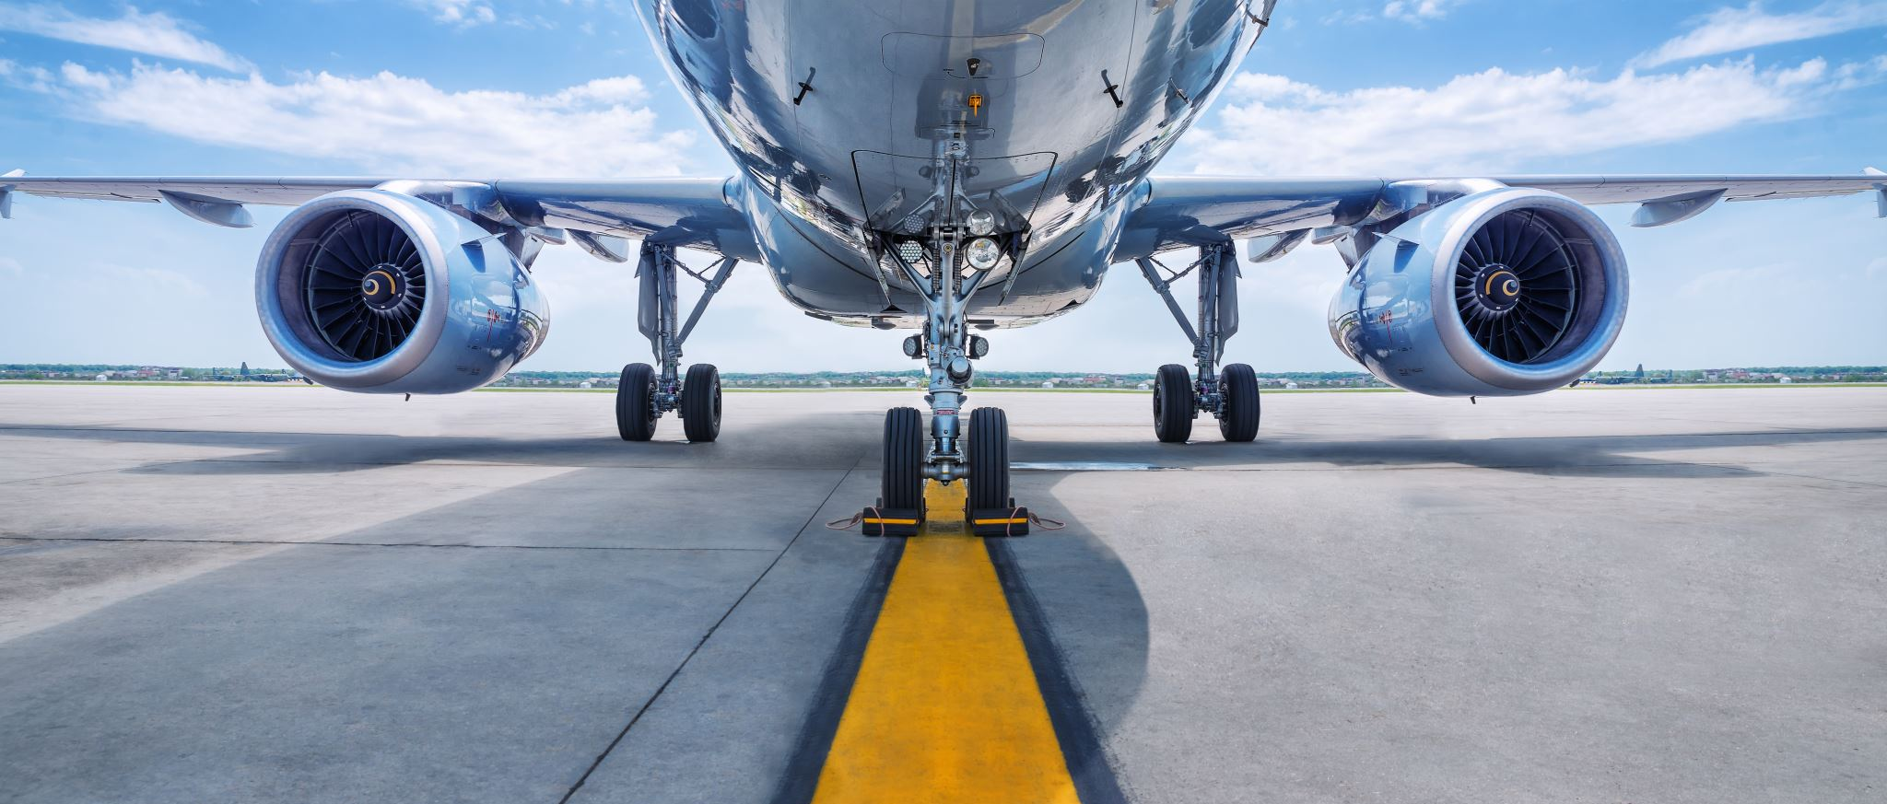
AI-Based Aircraft Predictive Maintenance System
Using Machine Learning for Failure Prediction & Fleet Optimization

Slide 2
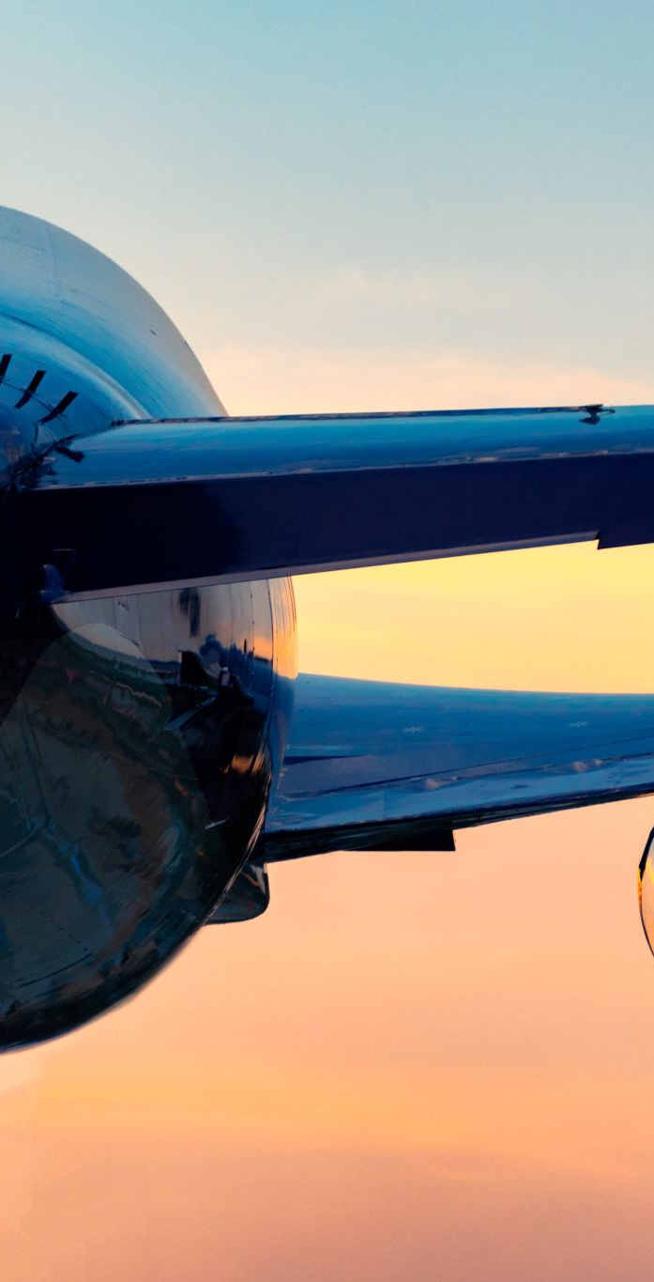
Problem Statement
Traditional aircraft maintenance is either reactive or schedule-based.
Unexpected failures cause operational delays and financial losses.
Lack of intelligent system to predict component failure in advance.

Slide 3
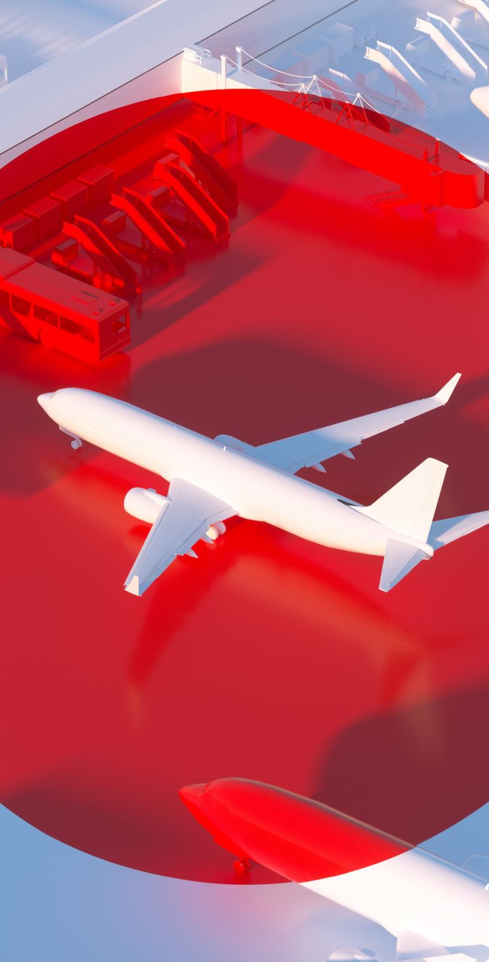
Project Objectives
Predict Remaining Useful Life (RUL) of aircraft components.
Detect anomalies in real-time sensor data.
Reduce downtime and maintenance cost.
Improve overall flight safety and reliability.

Slide 4

Dataset Used
NASA C-MAPSS Turbofan Engine Dataset (FD001).
Multi-sensor time-series data.
Includes engine cycles until failure.
Used for RUL prediction and anomaly detection.

Slide 5

System Architecture
Data Collection → Preprocessing → Feature Engineering.
Machine Learning Model (Random Forest + LSTM).
Anomaly Detection using Isolation Forest.
FastAPI Backend + Streamlit Dashboard.

Slide 6

Machine Learning Models
Random Forest (Baseline Model).
LSTM (Time-Series RUL Prediction).
Isolation Forest (Anomaly Detection).
SHAP for Explainable AI.

Slide 7
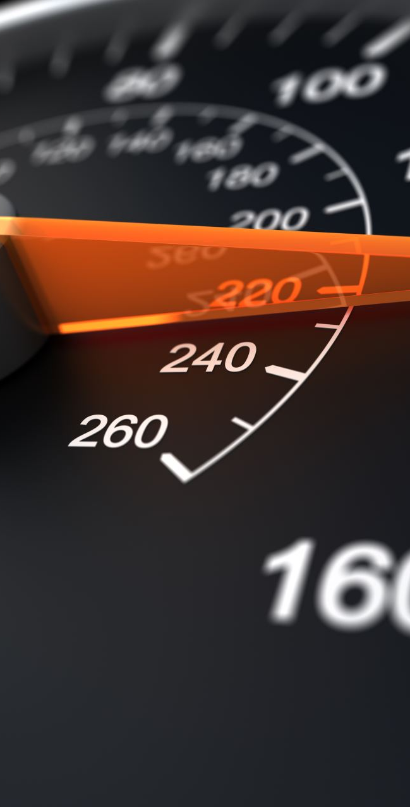
Dashboard Features
Auto-refresh every 5 seconds.
Fleet comparison dropdown.
Failure probability gauge.
Anomaly heatmap visualization.
Downloadable PDF maintenance report.

Slide 8
Key Results
Accurate RUL prediction using LSTM.
Early fault detection before breakdown.
Reduced maintenance cost.
Improved aircraft safety.

Slide 9
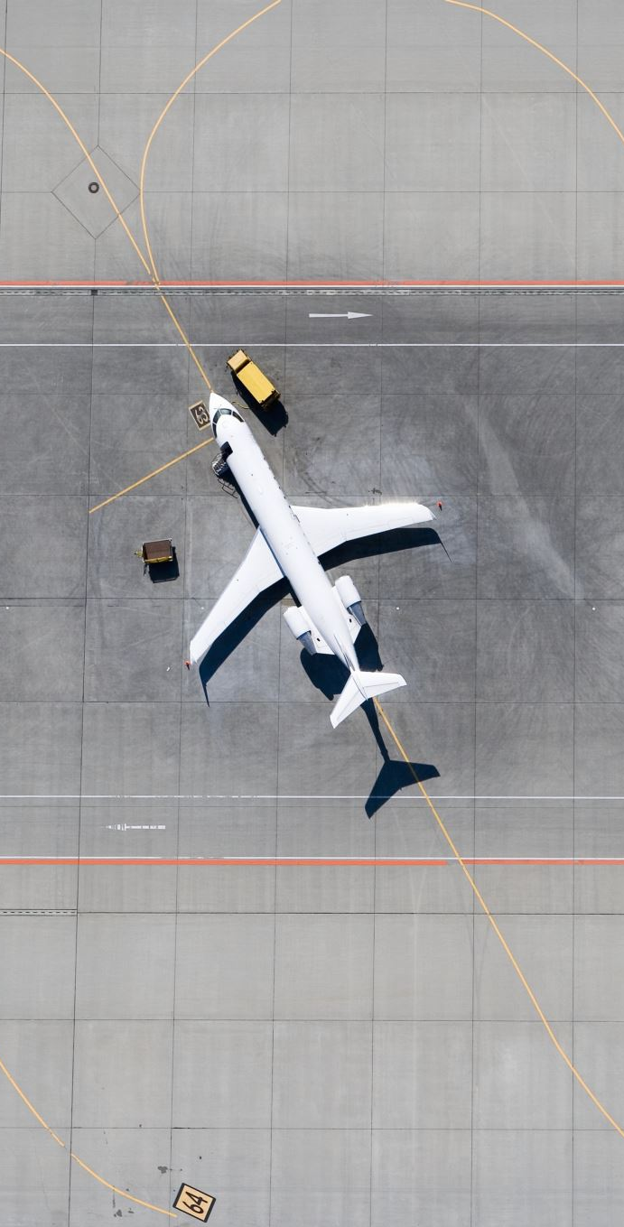
Advanced Enhancements
Digital Twin Simulation.
Fleet-wide predictive intelligence.
Weather-based degradation modeling.
Edge AI deployment on aircraft.

Slide 10
Conclusion & Future Scope
AI enables predictive and condition-based maintenance.
Scalable for commercial fleets and UAV systems.
Future: Real-time edge deployment & blockchain logging.

