Slide 1


Supply Chain Data Integration System
End-to-End Data Pipeline for Inventory and Vendor Performance. This system integrates disparate supply chain data, transforming it into actionable insights via dashboards and APIs.
Notes:
1

Slide 2



Project Mission: Unifying Supply Chain Visibility
Unify Disconnected Data
Simulate Inventory Behavior
Deliver Actionable KPIs
Integrate data from diverse sources, including static Excel files and dynamic APIs, to create a holistic view of operations.
Generate critical inventory Key Performance Indicators (KPIs) to empower supply chain professionals with data-driven decision-making capabilities.
Develop a custom inventory simulation module to model realistic stock fluctuations and demand patterns, providing deeper insights.
This project directly addresses the challenge of limited visibility in complex supply chain environments by simulating, modeling, and surfacing crucial metrics.
Notes:
2

Slide 3
Comprehensive Data Sources
Our system leverages a blend of static and real-time data sources to provide a comprehensive view of the supply chain.
Global Superstore Excel File
Flask API
Contains historical data for orders, returns, and customer information, providing a foundational dataset for analysis.
Provides real-time product data, enabling the system to react to current market conditions and inventory levels.
Orders: Detailed transaction records.
Real-time Product Data: Up-to-the-minute product availability and pricing.
Returns: Information on product returns and reasons.
Customers: Demographic and purchasing behavior data.
Dynamic Updates: Ensures the system reflects current operational status.
Additionally, a custom inventory simulation module introduces realistic stock fluctuations and demand patterns, enhancing the accuracy of predictive analytics.
Notes:
3

Slide 4

Technology Stack
Our solution is built upon a robust foundation of modern, open-source technologies, ensuring flexibility, scalability, and maintainability.
Python & Data Libraries
BigQuery
Python serves as the core development language, with Pandas and NumPy for efficient data manipulation and numerical operations.
Utilized as the data warehouse, providing scalable storage and a robust schema for efficient querying and data management.
Streamlit & Flask
Development Tools
Streamlit powers the interactive dashboards, while Flask (Sia) provides the API layer for programmatic access to data.
Git for version control and VS Code as the integrated development environment ensure collaborative and efficient development.
This selection of tools ensures a powerful and integrated system capable of handling complex supply chain data flows.
Notes:
4

Slide 5






Architecture Overview: The Data Pipeline
Extract Data
Calculate KPIs
Visualize & Serve
Simulate Inventory
Load BigQuery
Each stage of this pipeline is critical for transforming raw data into strategic intelligence, enabling real-time decision-making.
Notes:
5

Slide 6
Core Key Performance Indicators (KPIs)
We calculate essential supply chain metrics, transforming raw data into strategic insights for effective management.
Average Lead Time
Order Cycle Time
Fill Rate
Time from order placement to delivery, crucial for planning.
Time from order receipt to shipment, indicating processing efficiency.
Percentage of orders fulfilled from available stock, reflecting service levels.
Stockout Risk
Inventory Turnover
Days on hand
Probability of running out of stock, critical for inventory control.
Rate at which inventory is sold or used, indicating efficiency.
Number of days inventory will last, vital for cash flow management.
Return Rate
Percentage of products returned, indicating product quality or customer satisfaction issues.
Notes:
6

Slide 7
Data Model Design
Our data model is optimized for fast querying and clean data separation, supporting robust analytics and reporting.
Fact Tables
Orders, Inventory, Returns: Contain quantitative data and foreign keys to dimension tables.
Dimensions
Product, Customer, Time, Category: Provide descriptive attributes for analysis and filtering.
Partitioning
Implemented for performance optimization, especially for time-series data, enabling faster queries.
Data Marts
Specialized subsets of the data warehouse designed for specific analytical needs, enhancing user-friendliness.
This star schema design simplifies complex queries, making data accessible and meaningful for various analytical requirements.
Notes:
7

Slide 8
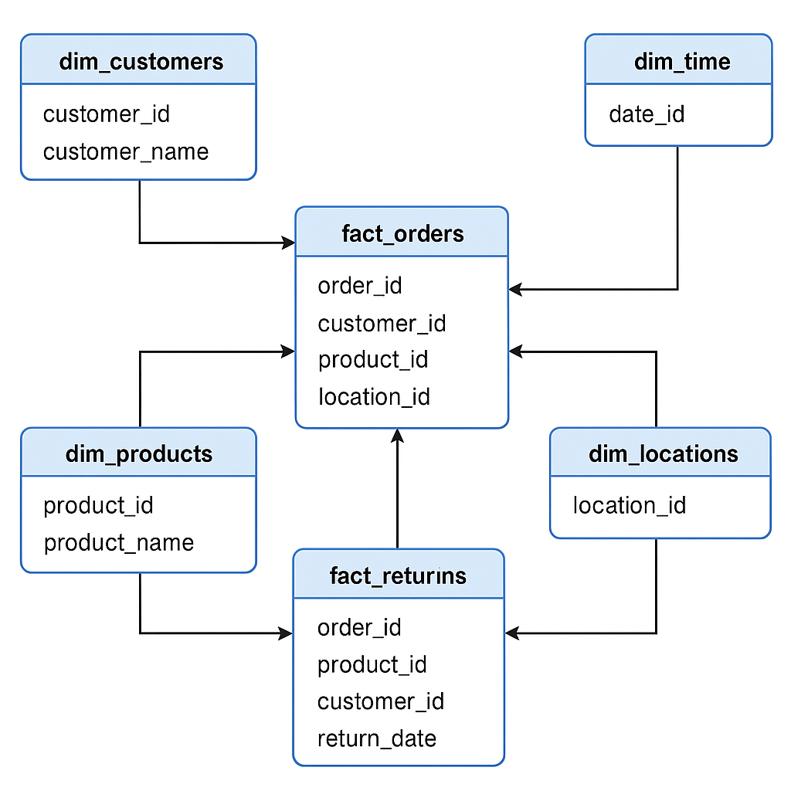
Data Model Design
Notes:
7

Slide 9
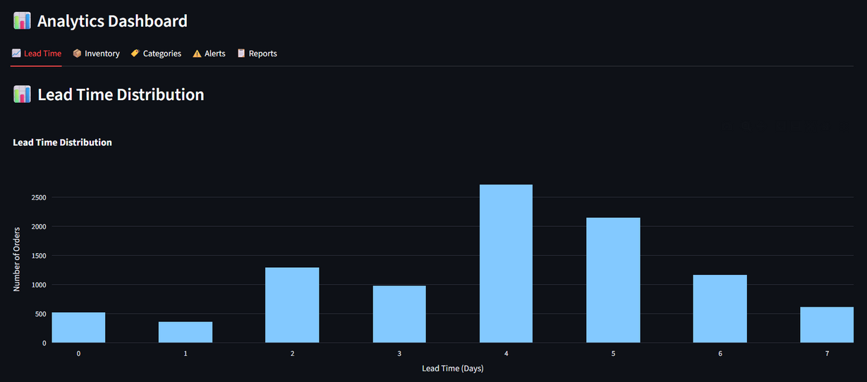
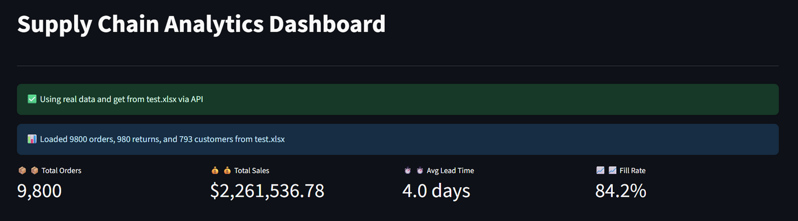
Real-time Monitoring & Dashboards
Our system provides dynamic monitoring and visualization capabilities, enabling users to act on data instantly.
Streamlit Dashboard
Offers a user-friendly interface for real-time visualization of supply chain metrics, including product and category-level insights.
Automated Alerts
Configurable alerts on critical thresholds, such as inventory risk and stockout predictions, ensuring proactive intervention.
API Endpoints
Programmatic access to data via Flask APIs, supporting integration with other systems and automated workflows.
This dual approach ensures both visual and programmatic access to insights, empowering users to make informed decisions and automate responses.
Notes:
8

Slide 10
Key Outcomes and Benefits
Our integrated system delivers tangible benefits, transforming raw data into a powerful tool for supply chain optimization.
End-to-End Working Pipeline: A fully functional data pipeline from ingestion to insights, ensuring continuous data flow.
Integrated Real & Simulated Data: Combines historical accuracy with predictive power, offering a comprehensive view.
Visual and Programmatic Access: Offers flexible access methods through intuitive dashboards and robust APIs, catering to diverse user needs.
This solution is production-ready and highly adaptable, providing a foundation for advanced supply chain management in any enterprise.
Notes:
9

