Slide 1
IBM University Engagement Project Submission
“Exploring the Power of Agentic AI with IBM Granite and IBM Bob”

Slide 2

Project Tile – Interview Trainer Agent
Domain of Project – Artificial Intelligence & Generative AI
Student Name | Recent Passport Photo | Email ID | Mobile number [WhatsApp]
Sivanesh K |  | sivaneshk23@gmail.com | +919789704674

Slide 3
Problem Statement -
Problem Statement : Interview Trainer Agent
The Challenge
Job seekers often struggle to prepare for interviews because questions, role expectations, technical topics, and HR guidance are scattered across different sources. Generic interview preparation does not consider a candidate's profile, experience level, resume, and target job role, making it difficult to practice effectively.
The Objective
Build an AI-powered Interview Trainer Agent using IBM Granite and RAG that provides personalized interview preparation. The solution should:
• Profile-Based Preparation – Generate interview preparation based on the candidate's experience, resume, and target job role.
• RAG-Based Retrieval – Retrieve relevant technical questions, behavioral scenarios, industry expectations, and HR guidance from a curated knowledge base.
• Personalized Question Generation – Create role-specific technical, HR, and behavioral interview questions.
• Model Answers & Feedback – Provide suitable sample answers, improvement suggestions, and response feedback.
• Multi-Role Support – Adapt preparation for different job roles and experience levels.
• Interview Assessment – Evaluate responses based on relevance, clarity, technical understanding, and communication.
• IBM Granite Integration – Use IBM Granite through IBM Cloud for AI-powered question generation and response analysis.
• Interactive Interview Practice – Allow users to practice interviews and receive personalized guidance for improving their performance.

Slide 4
Proposed Solution -
Proposed Solution: AI-Powered Interview Trainer Agent
The proposed solution is an AI-powered Interview Trainer Agent built using IBM Bob, IBM watsonx.ai, and IBM Granite to provide personalized and interactive interview preparation for different job roles.
The solution uses a Retrieval-Augmented Generation (RAG) pipeline to retrieve relevant interview questions, role expectations, behavioral scenarios, and interview guidance from a curated knowledge base, enabling the agent to generate accurate and context-aware responses.
The system provides personalized interview preparation based on the user's name, experience level, job role, skills, and resume/profile information. It supports preparation for both technical and non-technical roles.
The solution consists of four key capabilities:
Interview Question Agent generates role-specific technical, HR, behavioral, and situational questions.
Answer Evaluation Agent evaluates the user's responses and provides a score, strengths, weaknesses, and improvement suggestions.
Interview Guidance Agent provides model answers, preparation strategies, and tips based on the selected job role and experience level.
RAG Knowledge Agent retrieves relevant interview information from the curated knowledge base to improve the relevance and reliability of generated responses.
The solution includes an interactive web interface where users can enter their profile details, select a job role, practice interview questions, submit answers, and receive immediate AI-generated feedback.
IBM Bob is used to develop and orchestrate the agentic workflow, while IBM watsonx.ai and IBM Granite provide the generative AI capabilities for question generation, answer evaluation, reasoning, and personalized feedback.
The RAG architecture helps reduce generic responses by grounding the AI's output in relevant interview knowledge and role-specific information.
Overall, the solution delivers an end-to-end intelligent interview preparation assistant that helps users practice realistic interviews, identify weaknesses, improve their answers, and build confidence for competitive job interviews.

Slide 5
Technology Used
• IBM Bob platform - For developing, coding, and orchestrating the AI-powered Interview Trainer Agent and its workflow.
• IBM Granite model - For natural language understanding, reasoning, question generation, personalized interview responses, and improvement suggestions.
• IBM Cloud / watsonx.ai - Provides the IBM Cloud environment and AI services required to integrate and use IBM Granite models securely.
• RAG (Retrieval-Augmented Generation) - Retrieves relevant interview questions, role-specific knowledge, behavioral scenarios, and preparation guidance from the project knowledge base before generating responses.
• Python - Used for implementing the backend logic, RAG pipeline, agent workflow, interview evaluation, and application functionality.
• Vector Database (ChromaDB and SQLite) - Used to store and retrieve embedded interview-preparation documents efficiently for RAG-based contextual responses.
• Web Application Interface - Provides a user-friendly interface where candidates can enter their profile, experience level, job role, resume details, and interact with the Interview Trainer Agent.

Slide 6
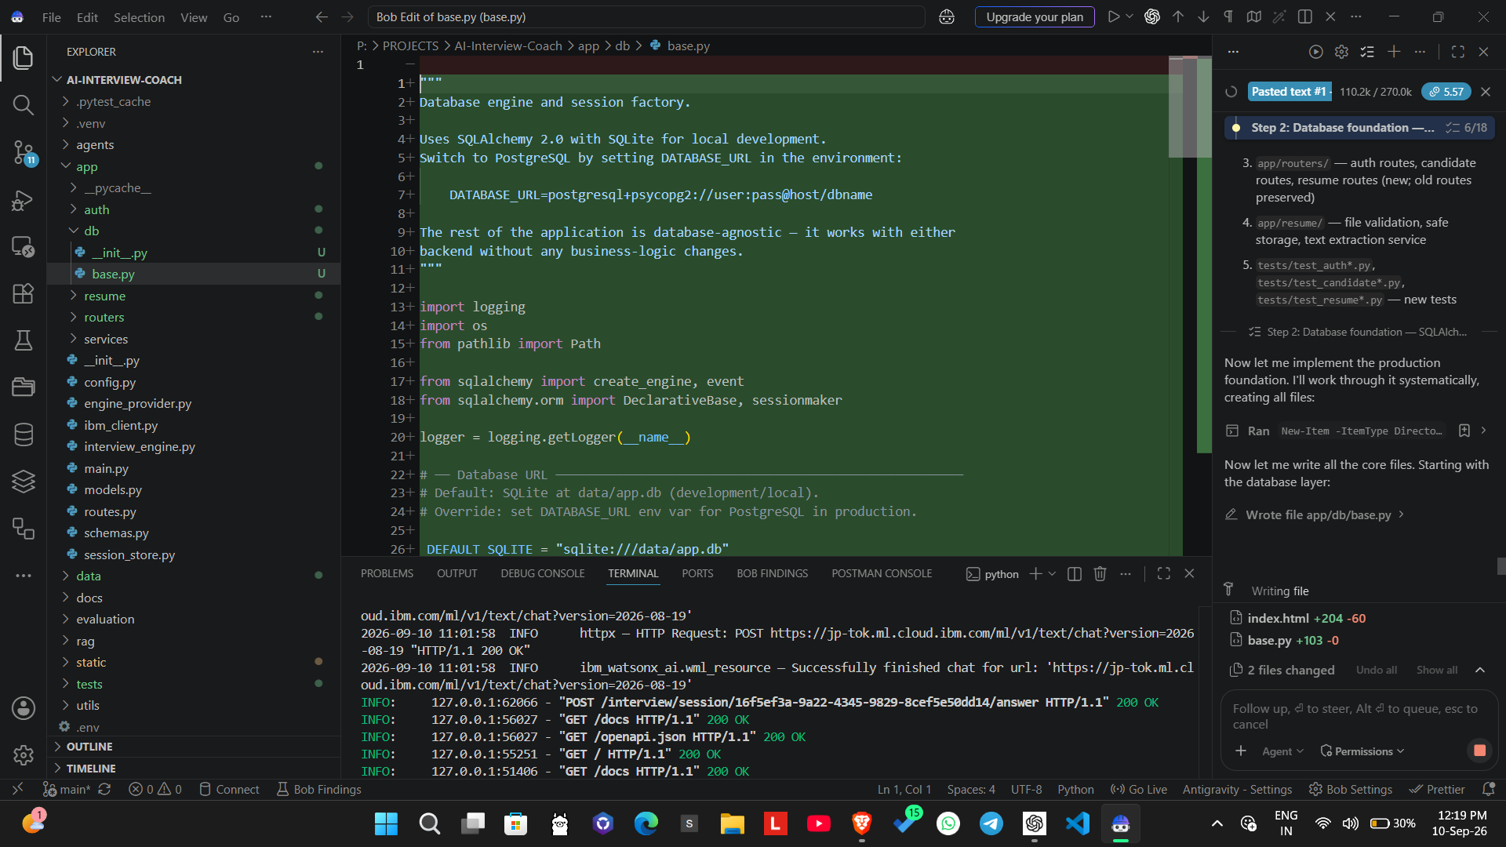
Required Files created using IBM bob -

Slide 7
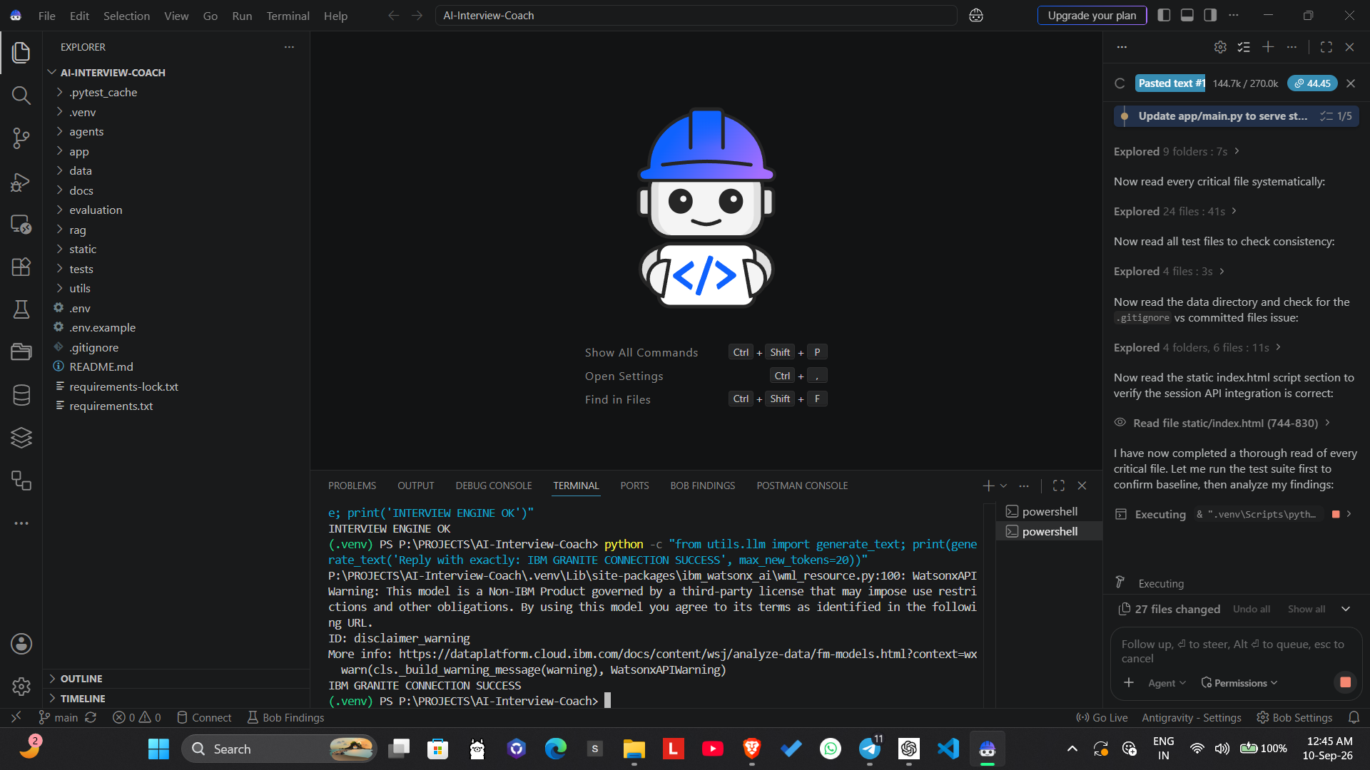
IBM Bob Screenshots:

Slide 8
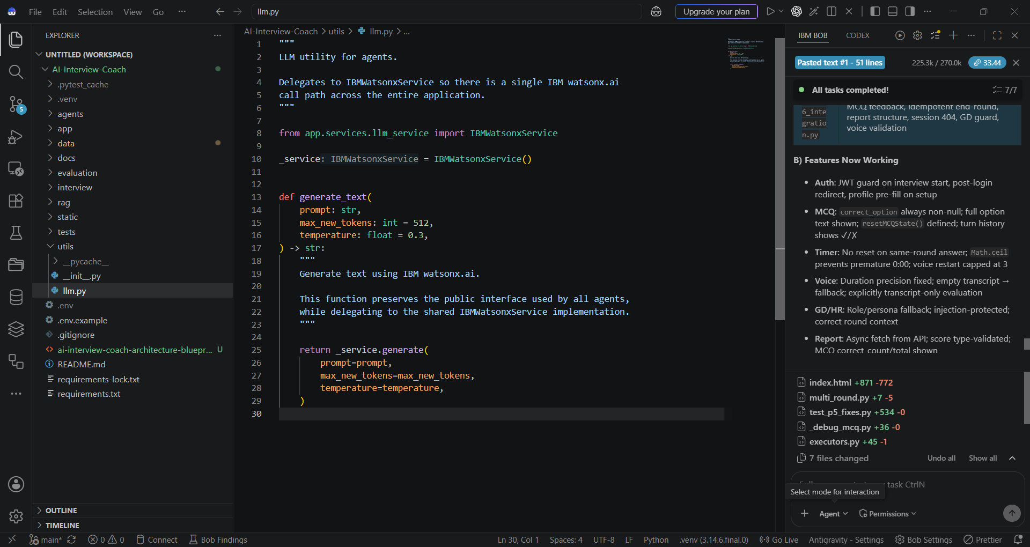

Slide 9
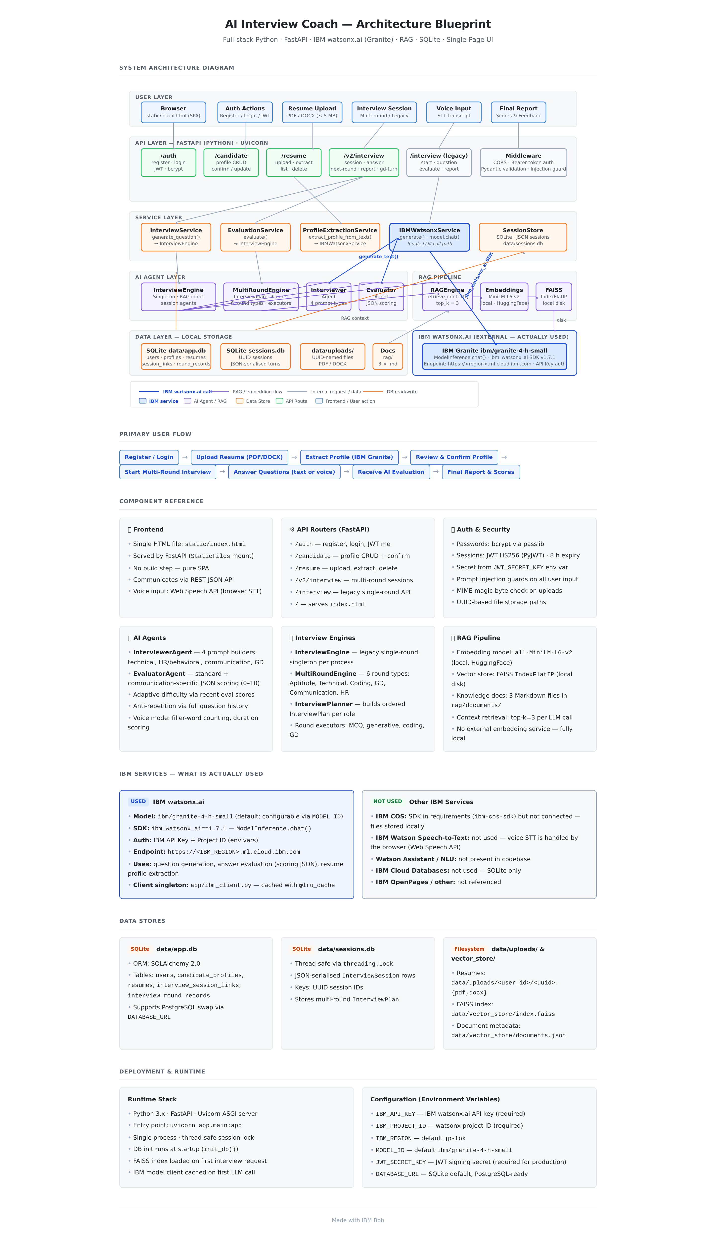
Architecture blueprint for IBM bob:

Slide 10

Role of Agentic AI in the Solution — AI Interview Trainer Agent
Role of Agentic AI in AI Interview Trainer Agent
Agentic AI enables the Interview Trainer Agent to work as an intelligent, goal-oriented system rather than a simple chatbot. Using IBM watsonx.ai and IBM Granite models, the solution coordinates different AI capabilities to provide personalized interview preparation.
The system uses a multi-agent approach where specialized agents handle tasks such as candidate profiling, RAG-based question retrieval, interview question generation, answer evaluation, and personalized feedback.
The RAG component retrieves relevant interview questions, role expectations, technical concepts, behavioral scenarios, and HR guidance from the project's knowledge base before generating responses. This helps the agent provide role-specific and context-aware preparation instead of generic questions.
The agent understands inputs such as the candidate's profile, experience level, job role, resume, and selected interview type. Based on this context, it dynamically creates suitable interview questions and preparation strategies.
During practice, the system evaluates the candidate's answers and provides model answers, strengths, weaknesses, improvement suggestions, and follow-up questions. It can support both technical and behavioral/HR interview preparation across different job roles.
Agentic AI also enables adaptive interview sessions, where the difficulty and type of questions can change according to the candidate's previous responses and performance.
Overall, Agentic AI transforms the solution into a personalized AI interview coach that can retrieve knowledge, reason over candidate context, conduct interview practice, evaluate responses, and continuously guide the user toward better interview performance.

Slide 11
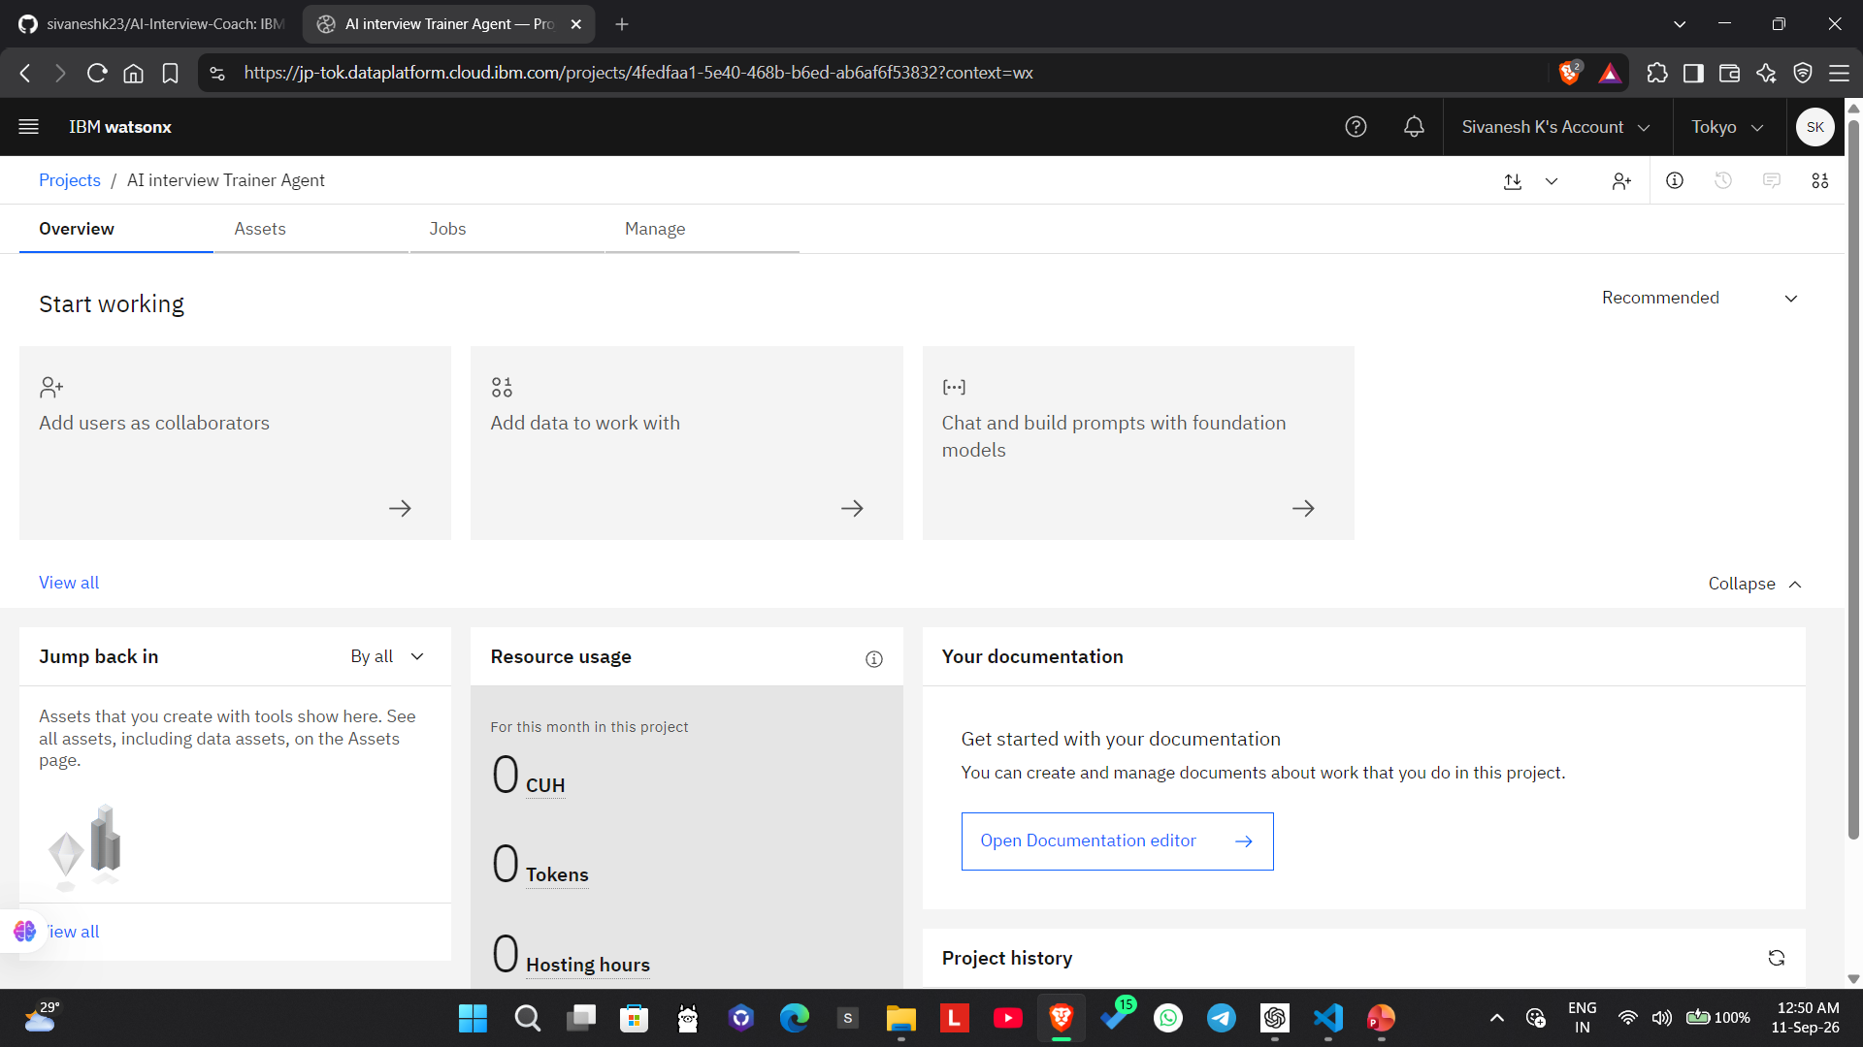
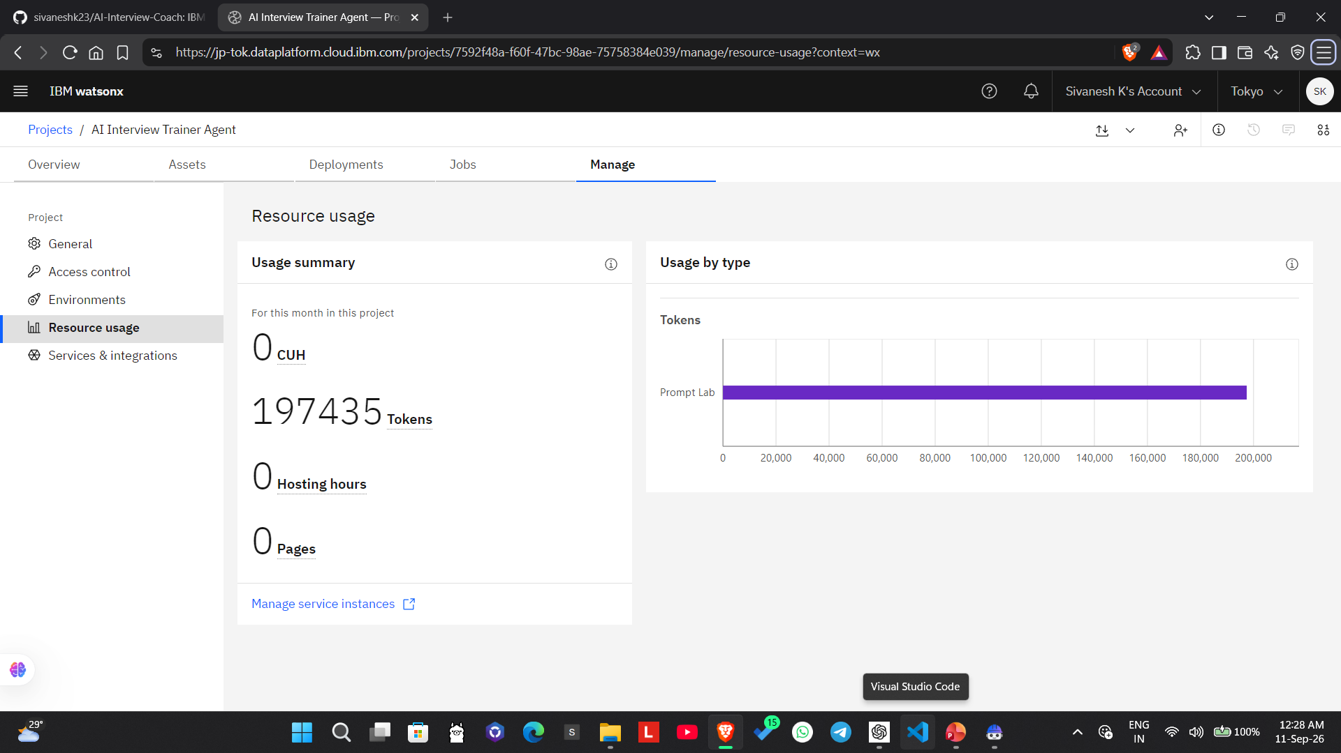
Token Usage
1,97,435 token are used
Before Prompt
After the Prompt
·
·
·

Slide 12
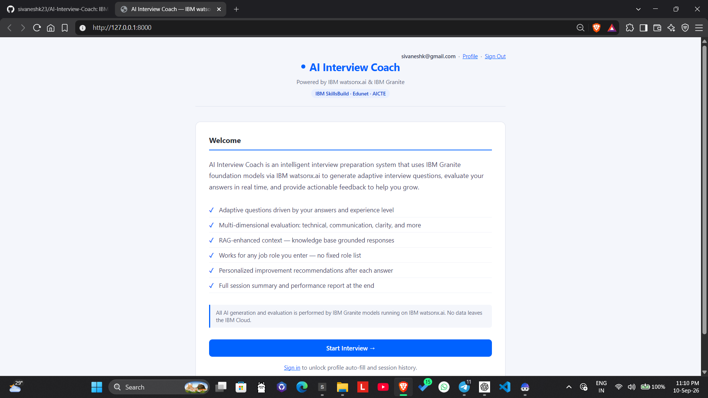
Project Output Screenshot
Please put IBM Bob output screenshots with 2-3 prompts.
You can take 2-3 more slides for each screenshot
·
·
·

Slide 13
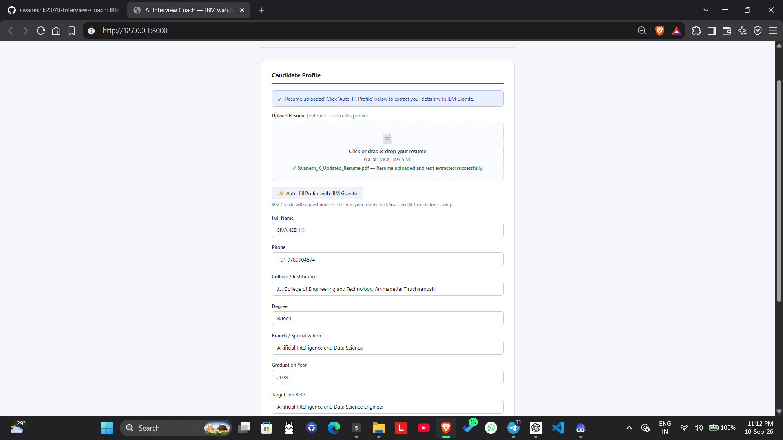
Project Output Screenshot
Please put IBM Bob output screenshots with 2-3 prompts.
You can take 2-3 more slides for each screenshot
·
·
·

Slide 14
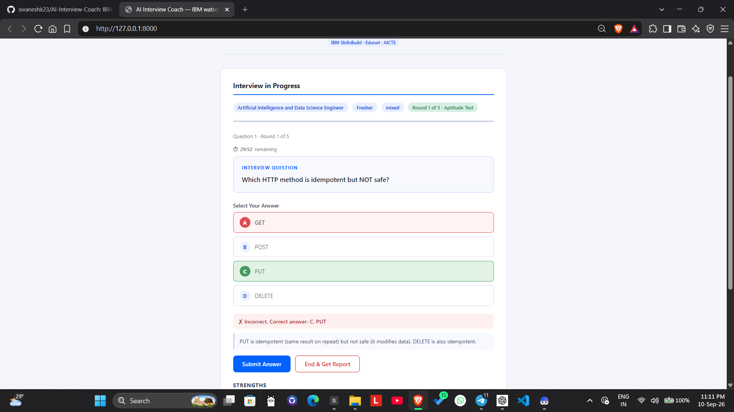
Project Output Screenshot
Please put IBM Bob output screenshots with 2-3 prompts.
You can take 2-3 more slides for each screenshot
·
·
·

Slide 15
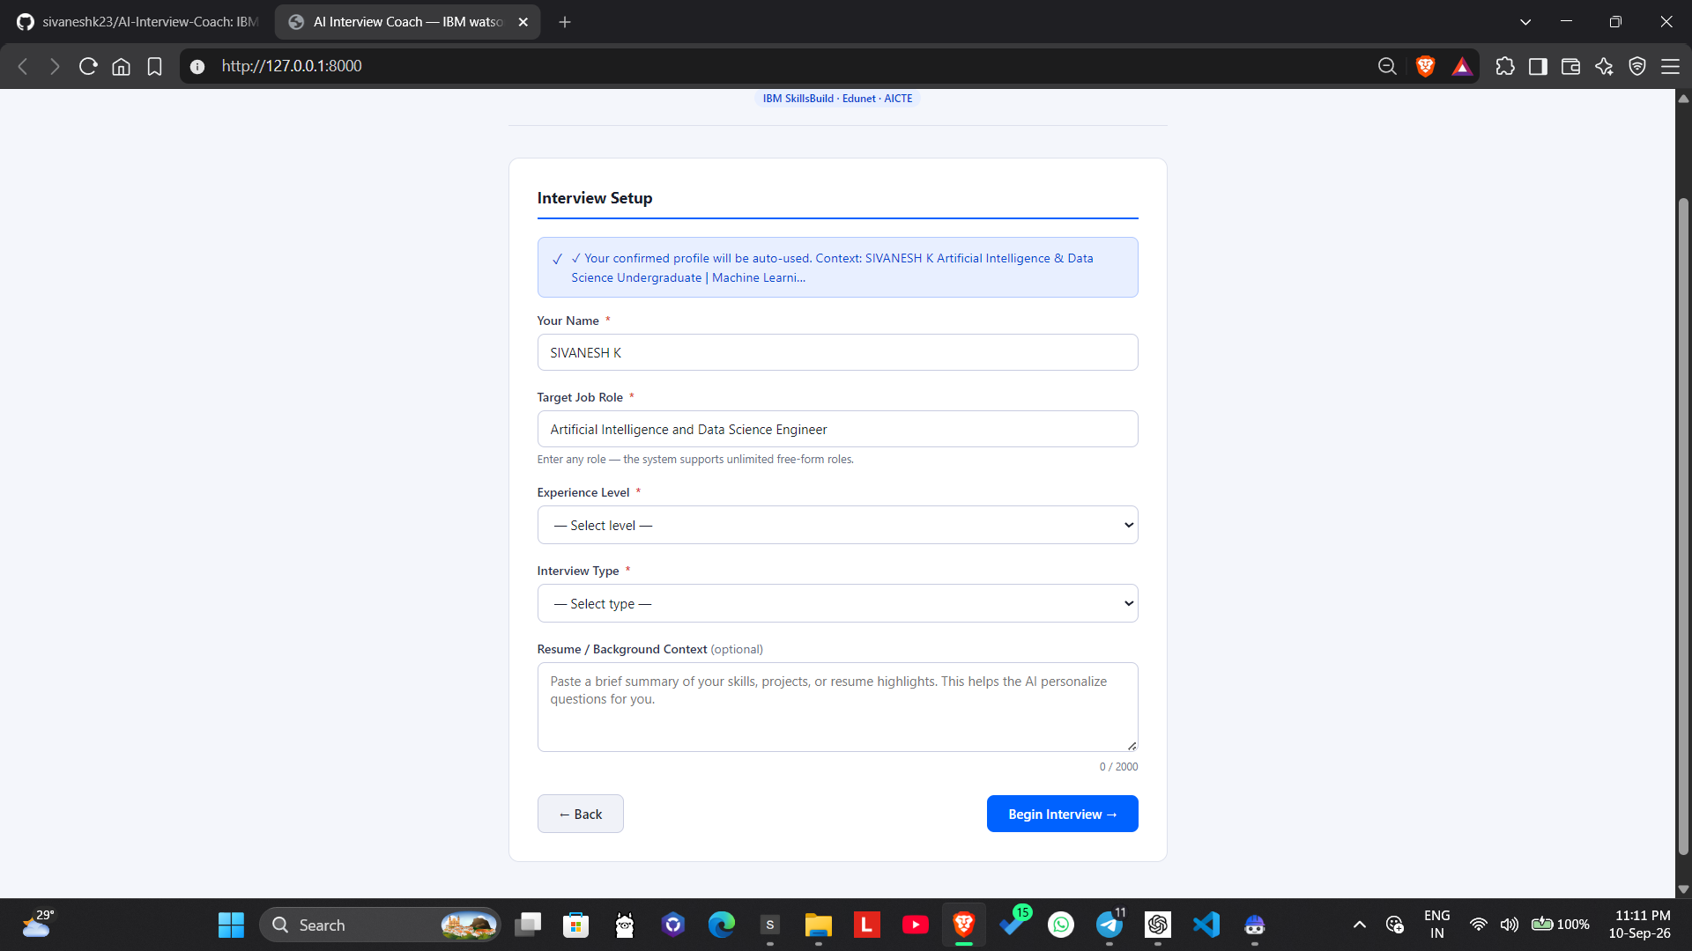
Project Output Screenshot

Slide 16
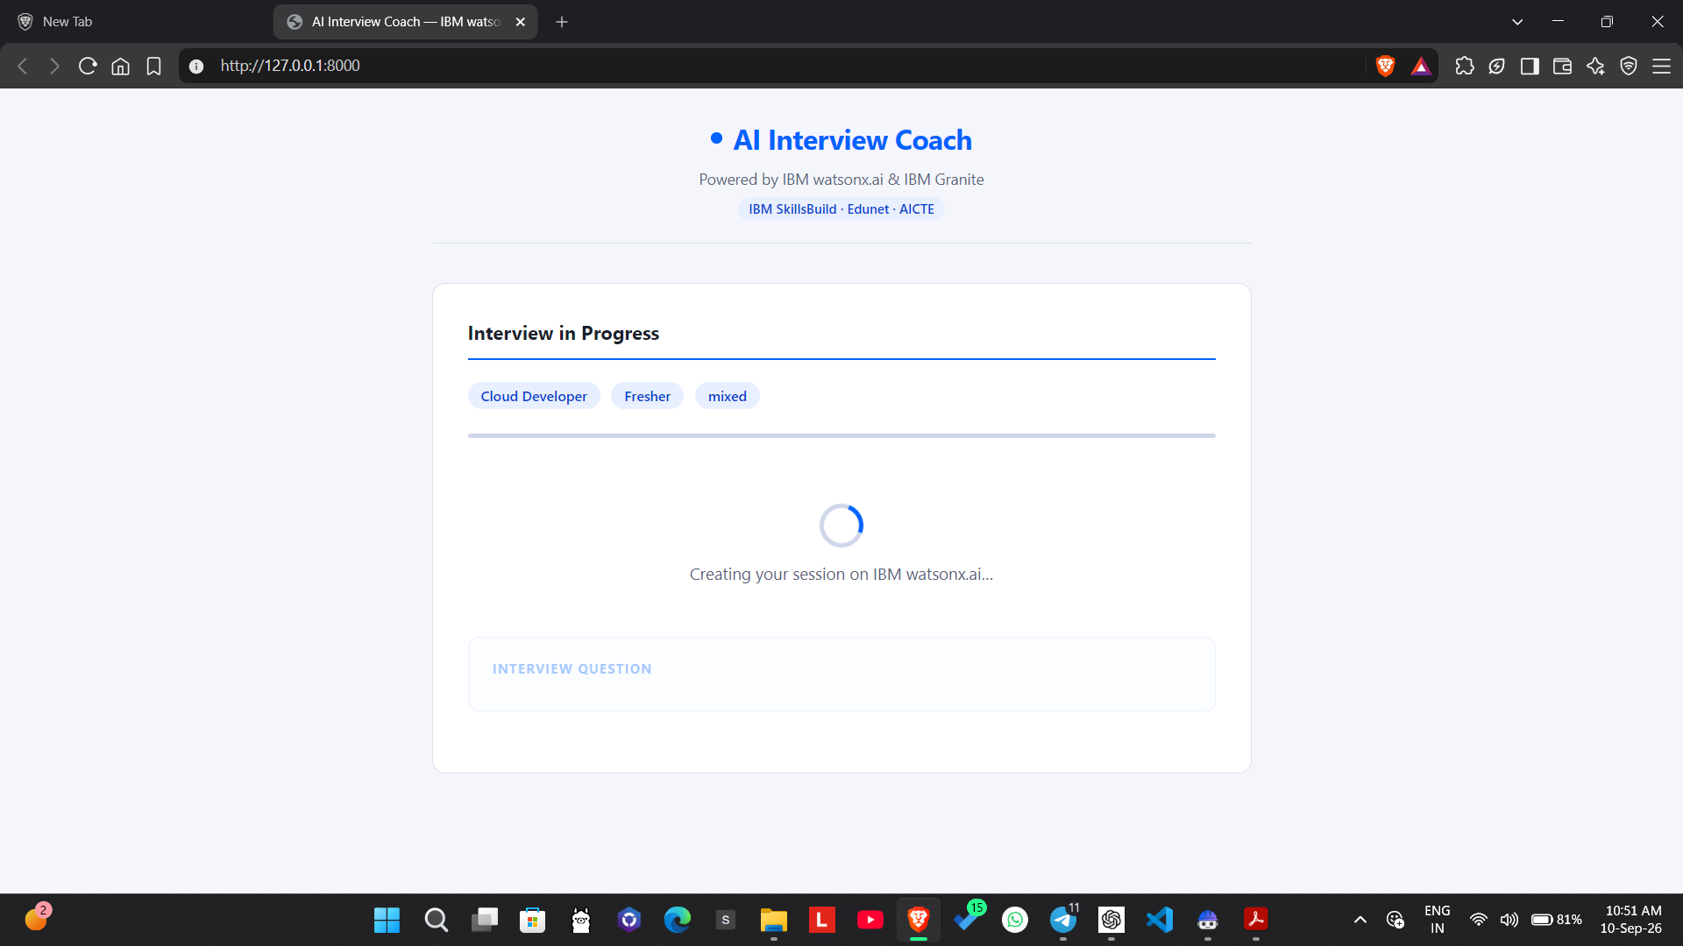
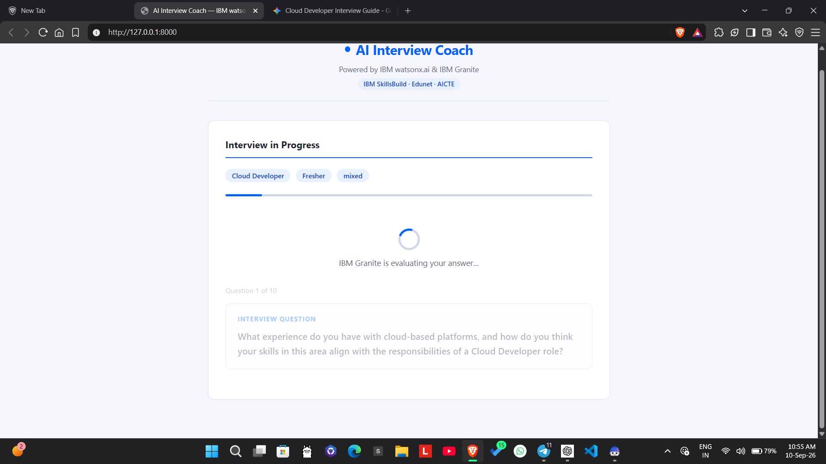
Project Output Screenshot

Slide 17
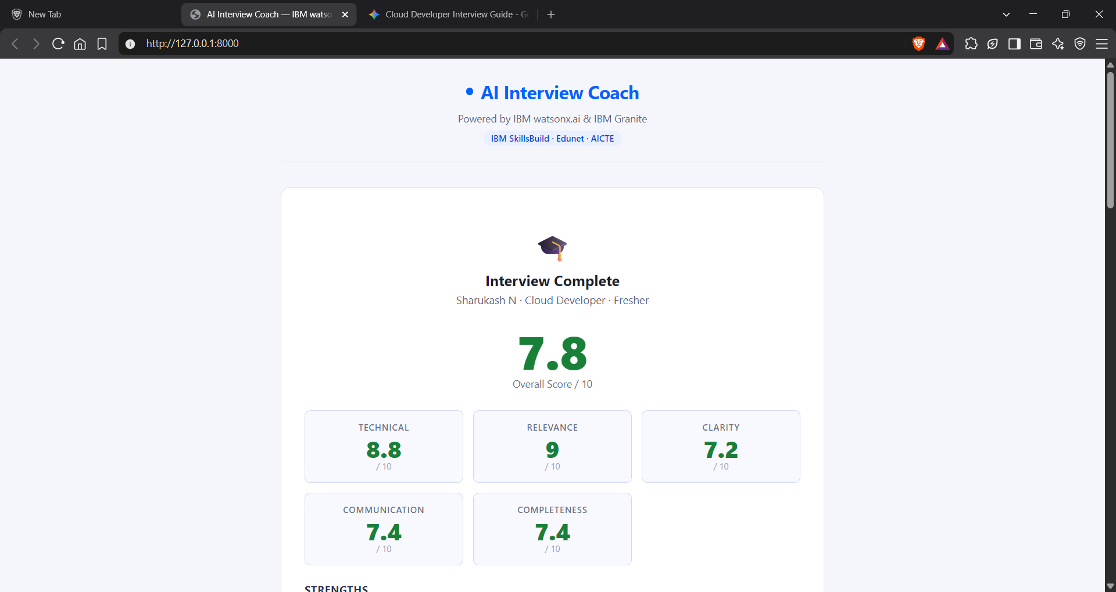
Project Output Screenshot

Slide 18
Novelty and Uniqueness
The proposed AI Interview Trainer Agent combines Agentic AI, RAG, IBM Granite, and personalized interview simulation into a single intelligent interview preparation system.
Multi-Agent Intelligence – Uses specialized agents for resume analysis, interview question generation, mock interviews, answer evaluation, and personalized feedback.
RAG-Based Accuracy – Retrieves relevant interview knowledge, role expectations, technical concepts, behavioral scenarios, and HR guidance before generating responses.
Resume & Role Personalization – Tailors interview questions and preparation strategies according to the candidate's resume, skills, experience level, and target job role.
Adaptive Mock Interviews – Dynamically conducts technical, HR, and behavioral interviews and adapts questions based on the candidate's responses.
Detailed Answer Evaluation – Evaluates answers using technical correctness, relevance, clarity, communication, and completeness, while identifying strengths and weaknesses.
Actionable Feedback Loop – Provides specific improvement suggestions after each response, helping candidates continuously improve their interview performance.
Multi-Role Support – Can prepare candidates for different job roles by changing the target role and interview context instead of being limited to a single profession.
IBM-Powered AI – Uses IBM watsonx.ai and IBM Granite models for intelligent question generation, reasoning, evaluation, and personalized interview guidance.
This makes the solution a smart, adaptive, and personalized AI interview coach, rather than a simple question-and-answer chatbot.

Slide 19
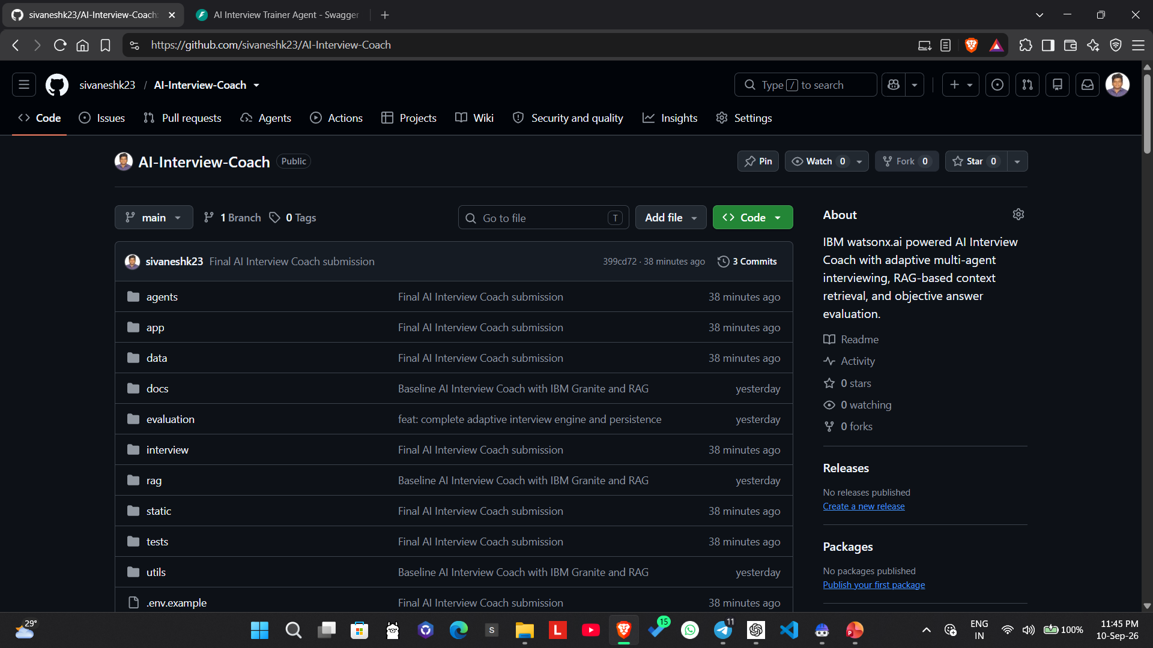
Git Hub Link
Github URL – https://github.com/sivaneshk23/AI-Interview-Coach

Slide 20
Future Scope
1. Advanced Resume & Job Description Analysis –
The system can be enhanced to perform deeper analysis of resumes and job descriptions to identify skill gaps, missing keywords, and role-specific requirements. This will help users understand exactly what they need to improve before applying for a position.
2. Personalized Interview Performance Tracking –
Future versions can maintain interview history and track performance across multiple sessions, including technical accuracy, confidence, communication quality, and weak areas. This will enable users to measure their improvement over time.
3. Multilingual & Voice-Based Interview Practice –
The agent can be extended with voice interaction and multilingual support, allowing users to answer questions verbally and practice interviews in their preferred language. Speech analysis can provide feedback on clarity, fluency, and communication.
4. Company-Specific Interview Preparation –
The system can integrate company-specific interview patterns, job requirements, and publicly available recruitment information to generate more targeted preparation plans for particular companies and roles.
5. Advanced AI Interview Simulation –
A future version can provide complete mock interviews where the AI dynamically selects follow-up questions based on the user's previous answers, creating a more realistic interview experience.
6. Continuous RAG Knowledge Updates –
The RAG knowledge base can be continuously updated with current interview questions, industry trends, technical requirements, and hiring expectations to keep the generated preparation content relevant.
·
·
·

Slide 21
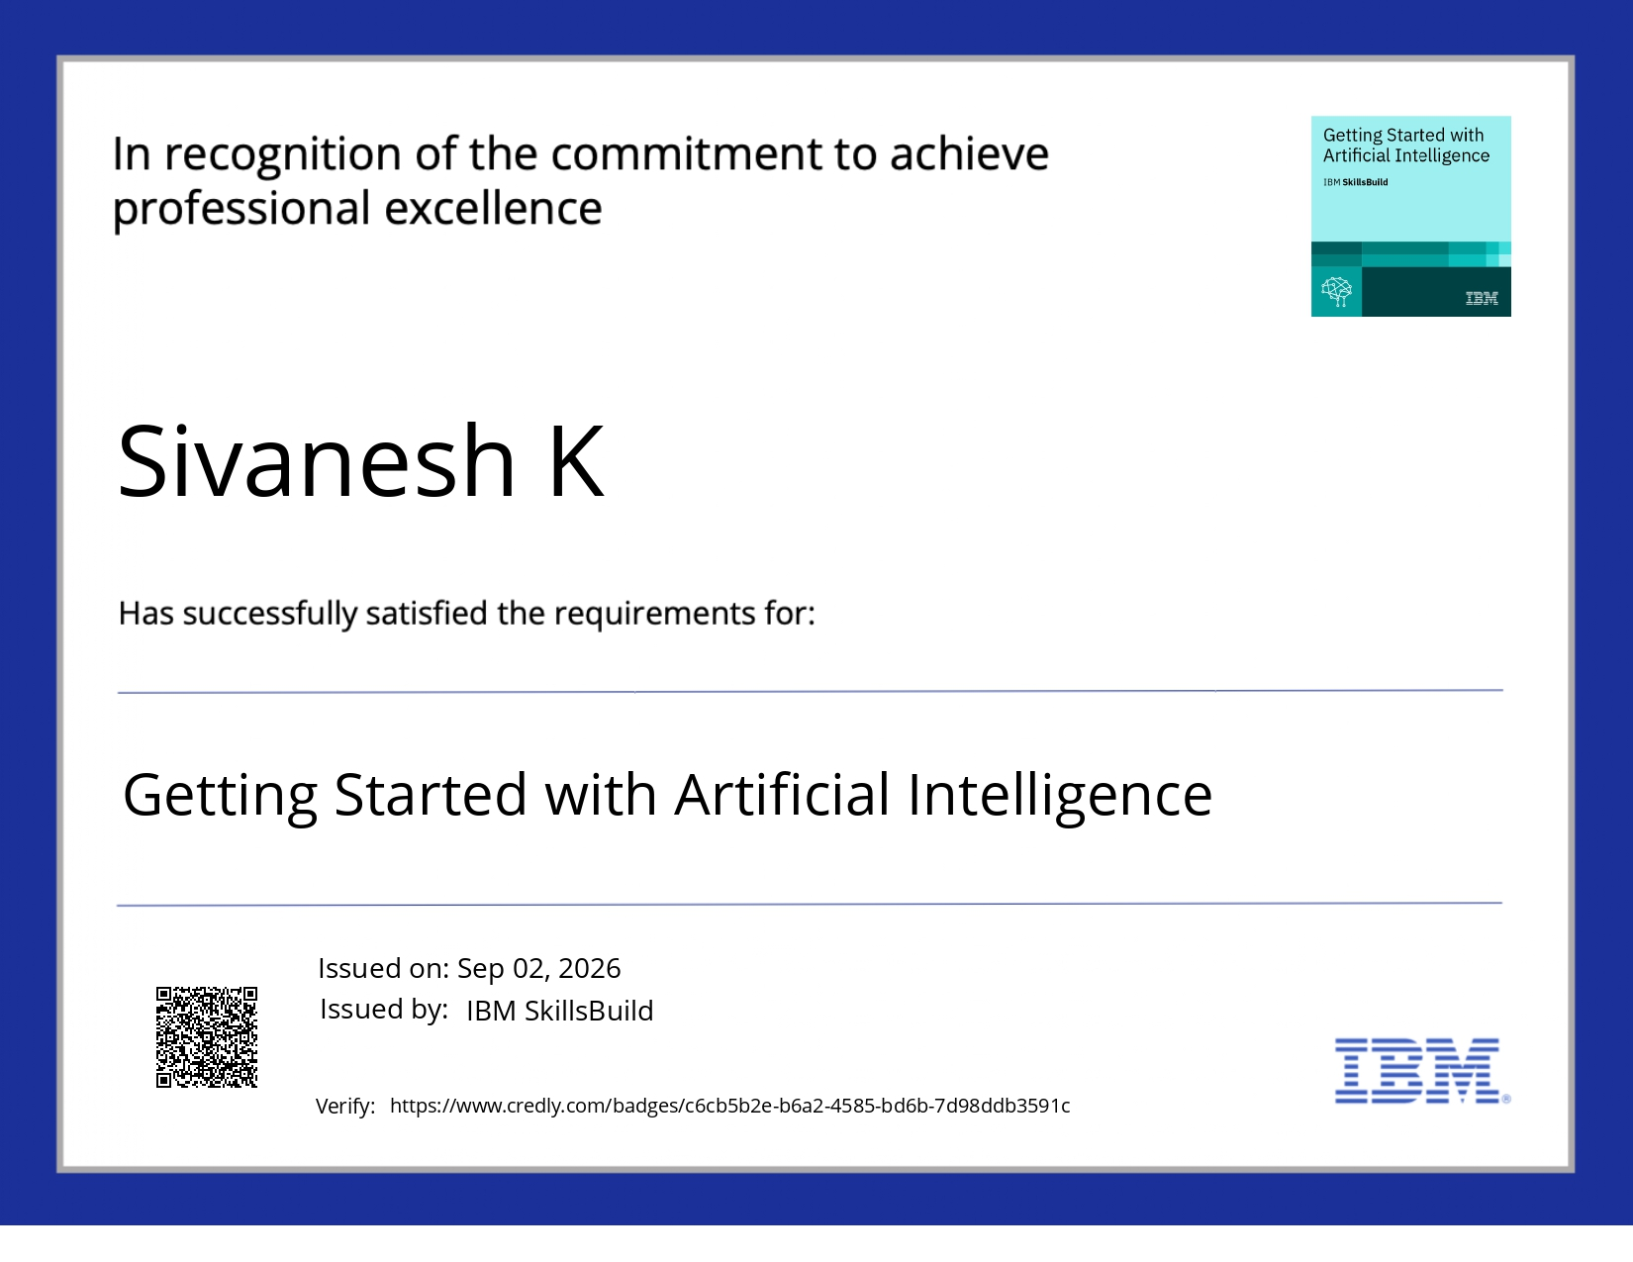
Certificates Earned:

Slide 22
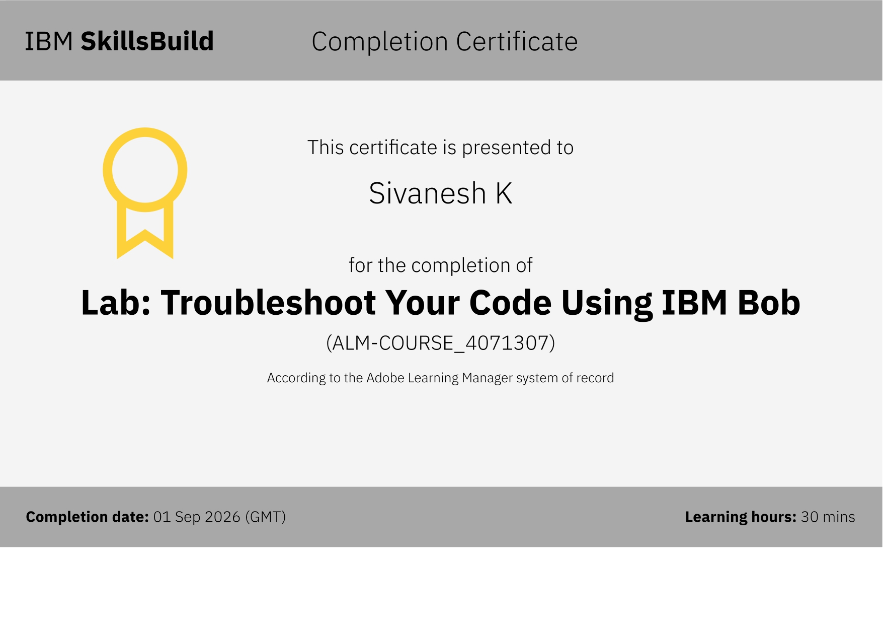
Certificates Earned:​

Slide 23


