Slide 1
Hotel Reservation Operations Analytics

Slide 2
About Me
NAME : SIVANI CHALLA
Background : B.Tech in Computer Science and Engineering
Why I want to learn Data Science? : I want to learn Data Science to build strong analytical skills, work with real-world data, and solve business problems using data-driven Insights and machine learning.
Experience : Fresher
LinkedIn : https://www.linkedin.com/in/challa-sivani-487803372
GitHub:

Slide 3
Table of Contents
1
Project Overview
7
Dashboard Overview
2
Project Workflow
8
Booking Trends & Demand
3
Business Scenario
9
Hotel & Guest Analysis
4
Business Objective
10
Key Findings
5
Data Model & Metrics
11
Business Recommendations
6
KPI Summary
12
Conclusion

Slide 4
Project Overview
Built an interactive Power BI dashboard to analyze reservation operations across the StayPoint hotel chain.
Modelled four linked tables — bookings, hotels, guests and stays — and created DAX measures for revenue, bookings, guests, stays, nights and average booking value.
Designed visuals for monthly demand, room-type mix, booking channels, hotel revenue, stay outcomes and loyalty tiers.
Added slicers for hotel, booking channel and booking date so managers can explore any slice of the business.
Converted the findings into business insights and recommendations for revenue and occupancy growth.
45.82M
Total revenue
2,800
Bookings analyzed
350
Guests

Slide 5
Project Workflow
1
2
3
4
Data sourcing
Data loading
Data cleaning
Data modelling
Collect booking, hotel, guest and stay data
Import tables into Power BI
Fix types, blanks and inconsistent values
Relate tables with keys
5
6
7
8
DAX measures
Visualization
Insights
Recommendations
Create revenue, booking and stay KPIs
Build charts, cards and slicers
Interpret trends and patterns
Turn insights into actions

Slide 6
Business Scenario
StayPoint operates multiple hotels across Indian cities, receiving bookings through the website, mobile app, travel agents, phone and walk-ins.
Managers need one place to see revenue, demand and guest behaviour instead of reviewing scattered reports.
Cancellations and no-shows leave rooms empty and reduce revenue, while the mix of channels and room types affects pricing and staffing.
A clear view of seasonality, top hotels and loyalty helps teams plan inventory, promotions and customer retention.

Slide 7
Business Objective
Measure performance
Understand demand
Compare hotels
Track revenue, bookings, guests, stays and nights
Find peak months, popular rooms and key channels
Identify top and under-performing properties
Reduce leakage
Grow loyalty
Support decisions
Quantify cancellations and no-shows
Study guest loyalty tiers for retention
Give managers actionable recommendations

Slide 8
Data Model & Metrics
Tables and key fields
DAX measures
Table | Used for
bookings | Booking date, channel, room type requested, revenue
hotels | Hotel name
guests | Loyalty tier
stays | Stay status and nights
Measure | Meaning
Total Revenue | Sum of booking revenue
Total Bookings | Number of reservations
Total Guests | Unique guests
Total Stays | Number of stays
Total Nights | Nights stayed
Avg Booking Value | Revenue per booking

Slide 9
KPI Summary
45.82M
2,800
350
Total Revenue
Total Bookings
Total Guests
3K
16.37K
7K
Total Stays
Average Booking Value
Total Nights Stayed

Slide 10
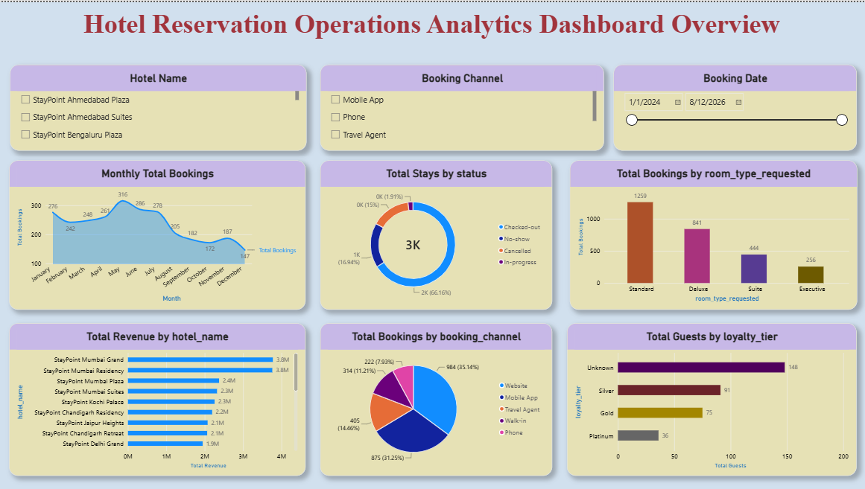
Power BI Dashboard
What the dashboard covers
Slicers: hotel, booking channel, booking date
Demand: monthly bookings, room types
Sales: revenue by hotel, channels
Guests: stay status, loyalty tiers

Slide 11
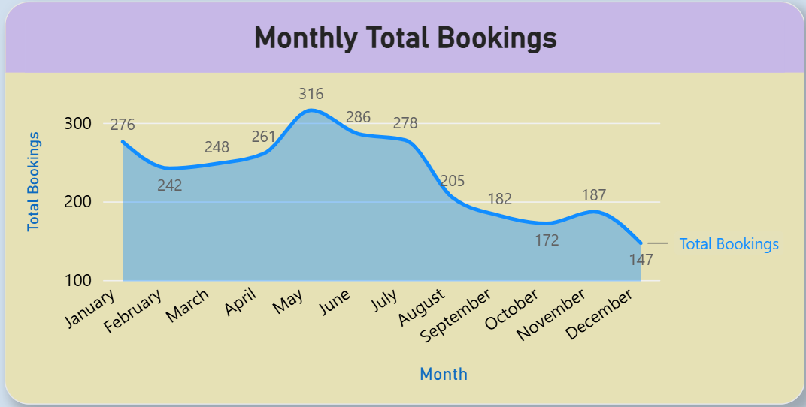
Booking Trends: Monthly Demand
Key observations
Demand peaks in May with 316 bookings.
The first half of the year is strongest, then bookings fall steadily.
December is lowest at 147 bookings, about half of the May peak.

Slide 12
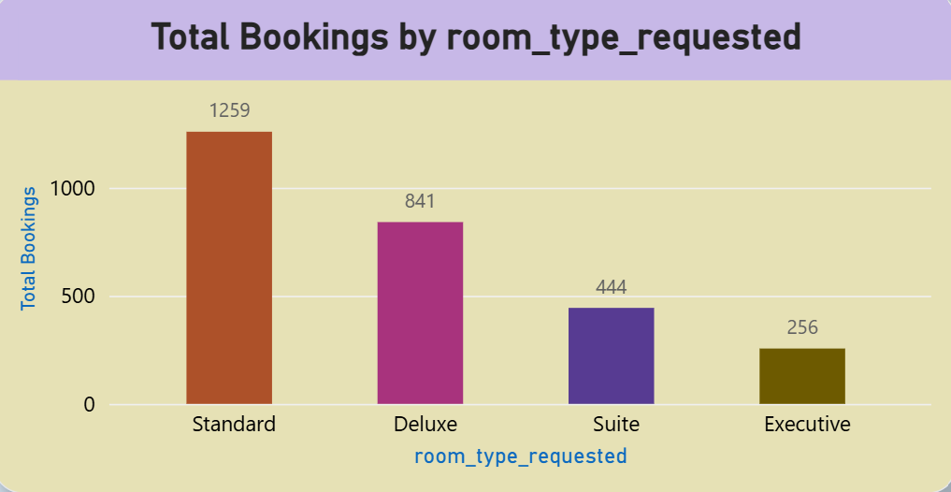
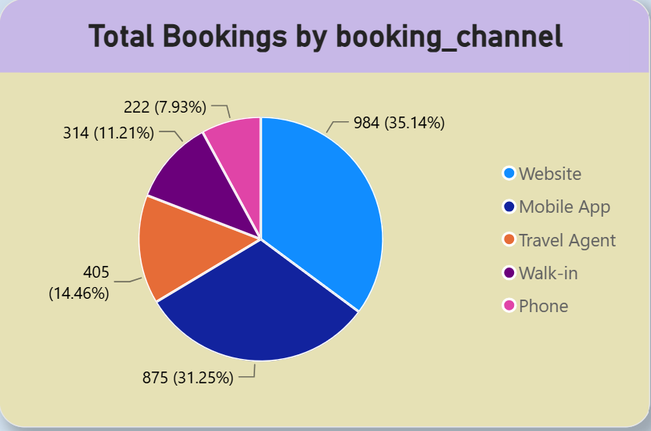
Room Types & Booking Channels
Standard rooms are 45% of requests; Executive only 9%.
Website leads with 35%; with the app, two-thirds of bookings are online.

Slide 13
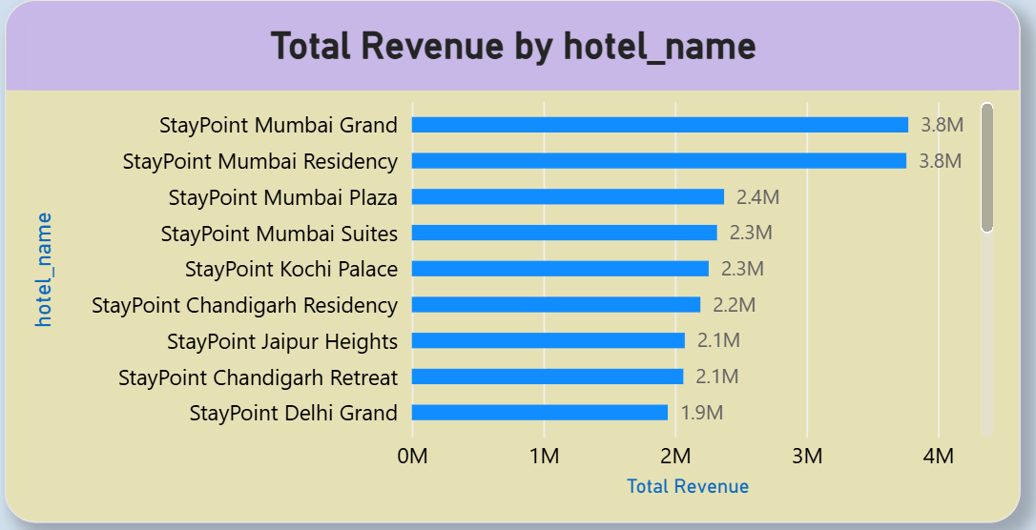
Revenue by Hotel
Key observations
Mumbai Grand and Mumbai Residency lead with 3.8M each.
Mumbai properties fill 4 of the top 4 places.
Other hotels earn 1.9M–2.3M, roughly half of the leaders.

Slide 14
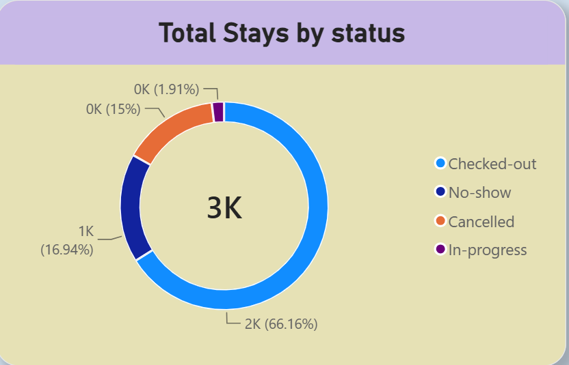
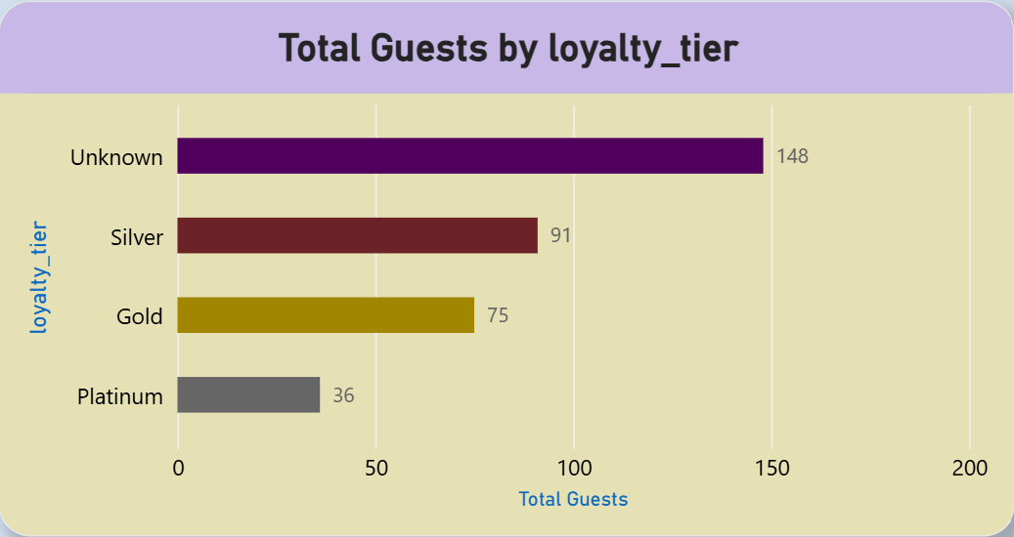
Stay Outcomes & Loyalty Tiers
66% checked out; cancellations + no-shows make up ~32%.
148 of 350 guests (42%) have an Unknown loyalty tier.

Slide 15
Overall Key Findings
The chain generated 45.82M revenue from 2,800 bookings, with an average booking value of 16.37K.
Demand is highest in the first half of the year, peaking in May (316 bookings).
Standard rooms are requested most; the Website is the leading channel (35%).
StayPoint Mumbai Grand and Mumbai Residency earn the most revenue (3.8M each).
About 66% of stays are checked out; cancellations and no-shows account for nearly one-third.
Many guests sit in the Unknown loyalty tier — a clear opportunity to grow the loyalty program.

Slide 16
Business Recommendations
1
Grow online bookings
2
Optimize pricing
3
Cut cancellations
Improve the website and offer exclusive digital promotions.
Use promotions to lift occupancy of premium room types.
Send booking reminders and confirmation notifications.
4
Replicate success
5
Expand loyalty
6
Plan for peaks
Apply top-hotel strategies to lower-performing properties.
Enroll more guests to improve retention and repeat bookings.
Align staff and room availability with seasonal demand.

Slide 17
Conclusion
This project turned StayPoint's reservation data into an interactive Power BI dashboard covering revenue, bookings, guests, stays and nights. The analysis showed strong online demand, a May peak, Mumbai hotels as top earners, and meaningful losses from cancellations and no-shows. Acting on these insights — better digital promotion, reminders, loyalty growth and seasonal planning — can improve occupancy, revenue and guest retention.

Slide 18

THANK YOU

