Slide 1
MaaS360 – DATA LAKE
NESARA B
VARSHA G

Slide 2
INDEX
Requirement & Objective
Data Flow & Architecture
Entities Used
Data Change Producer
Data Processing Technology - Spark Streaming
Data Lake Technology Option - Parquet
Data Lake Technology Option - Casandra
Parquet vs Casandra
Staging Repository Option - Db2 Event Store

Slide 3
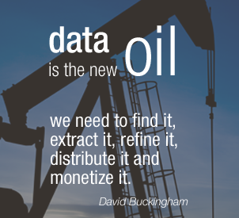
MaaS has data of thousands of clients and millions of devices. This data is not retained and processed for advanced analytics.

Slide 4
Objectives of the project
Goal
Goal of this project will be to evaluate technologies for data lake.
DATA
MaaS will Provide System data and this will be put in Data Lake.
DATA
LAKE
Data Lake will provide support to store historical data & ability to query data based on certain query parameters.

Slide 5
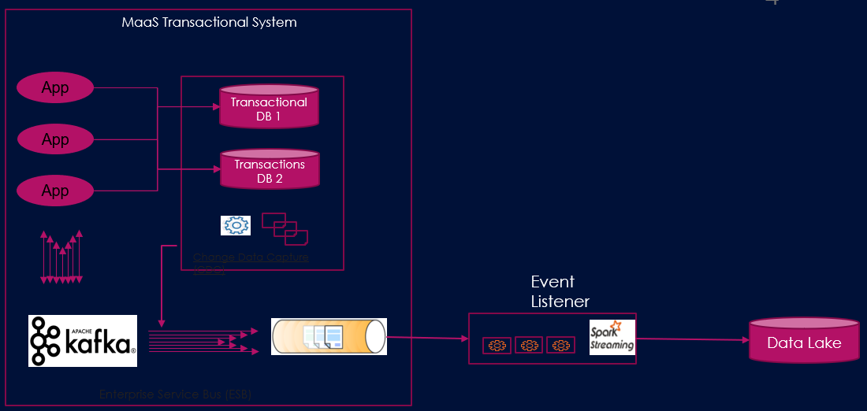
DATA FLOW

Slide 6
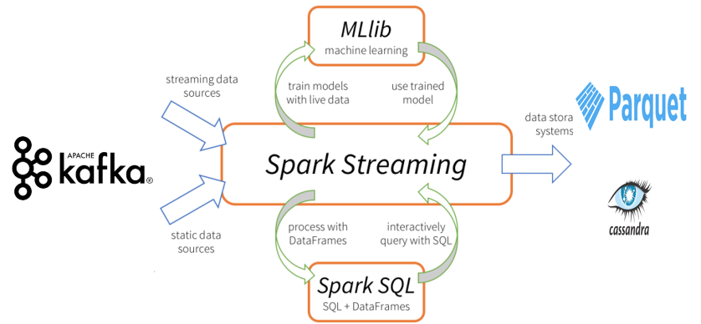
DATA ARCHITECTURE

Slide 7
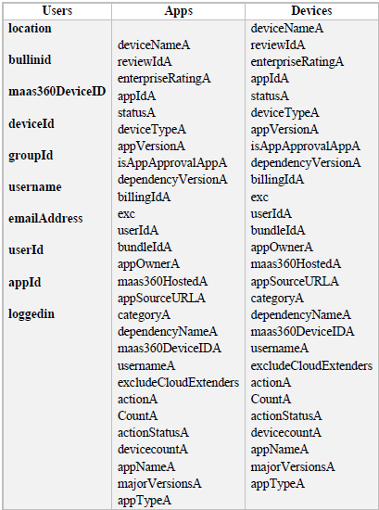
Entities

Slide 8
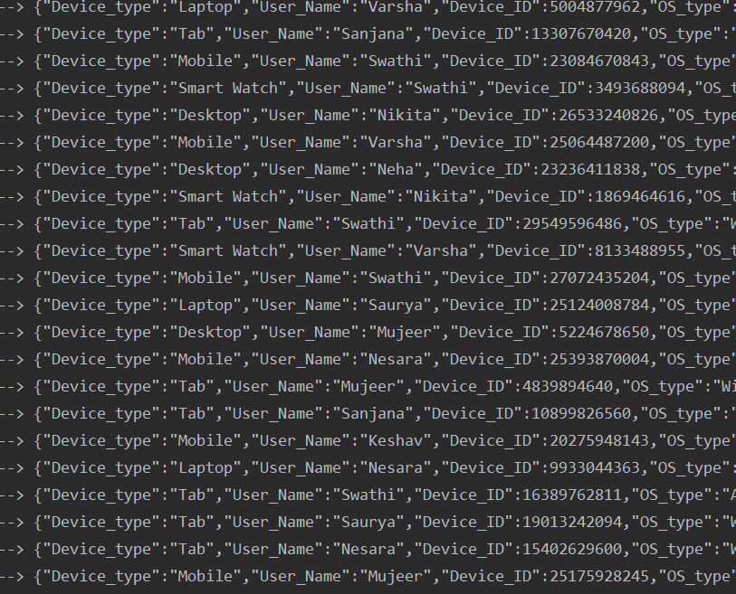
Custom Producer Code
For Internship Project, to mimic data coming from Transactional System, custom producer is written.

Slide 9
Spark Streaming
Apache Spark Streaming is a scalable fault-tolerant streaming processing system that natively supports both batch and streaming workloads.
Spark Streaming is an extension of the core Spark API that allows data engineers and data scientists to process real-time data from various sources including (but not limited to) Kafka, Flume, and Amazon Kinesis.
Four Major Aspects of Spark Streaming
Fast recovery from failures and stragglers
Better load balancing and resource usage
Combining of streaming data with static datasets and interactive queries
Native integration with advanced processing libraries (SQL, machine learning, graph processing

Slide 10
Data Lake Technology: Parquet
Parquet is a columnar format, supported by many data processing systems.
The advantages of having a columnar storage are as follows −
Columnar storage limits IO operations.
Columnar storage can fetch specific columns that you need to access.
Columnar storage consumes less space.
Columnar storage gives better-summarized data and follows type-specific encoding.
Spark SQL provides support for both reading and writing parquet files that automatically capture the schema of the original data.

Slide 11
Parquet(Technical details)
Spark Streaming API enables scalable, high-throughput, fault-tolerant stream processing of live data streams.
KafkaUtils API is used to connect the Kafka cluster to Spark streaming.
KafkaUtils API has method called createDirectStream, which is used to create an input stream that directly pulls messages from Kafka Brokers.
Single Spark Streaming which listens to all the kafka topics(users,apps,device).
Based one the attributes of single element of RDD, dataframe has been created and written into parquet files accordingly.
Separate Parquet files generated according to the data element in RDD.

Slide 12
Limitations for Parquet
Parquet format is computationally intensive on the write side.
Update or append operation of the same event has to be stored in a separate file and has to be persisted again.

Slide 13
Data Architecture

Slide 14
Data Lake Technology: CASSANDRA
Apache Cassandra is a free and open-source, distributed, wide column store, NoSQL database management system designed to handle large amounts of data across many commodity servers, providing high availability with no single point of failure.
Features :
Always on architecture
Fast linear-scale performance
Flexible data storage
Easy data distribution
Transaction support

Slide 15
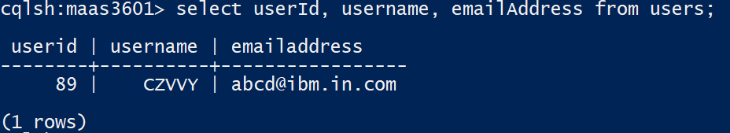
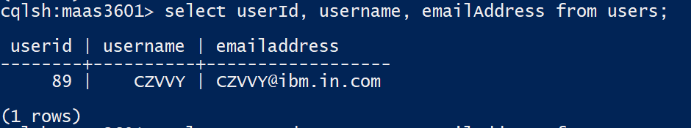
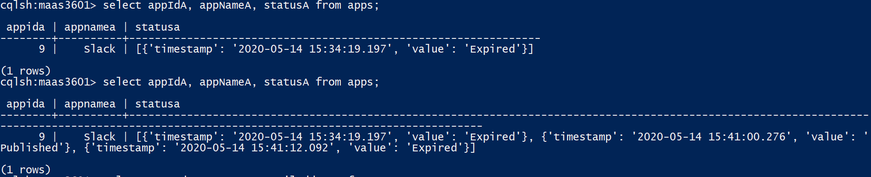
Data Structure
Let us consider device entity •Device:{ •Device_id :123, •Device_Name : “abc”, •OsVersion : “1.1”, •Type : “Mobile”, •Data_usage: [{timestamp:x1, value : 100},{timestamp:x2,value : 105}] •}

Slide 16
Parquet
Cassandra
Parquet is a columnar format, supported by many data processing systems.
Parquet files that automatically capture the schema of the original data.
Update or append operation of the same event has to be stored in a separate file.
Spark SQL provides support for both reading and writing parquet files that automatically capture the schema of the original data.
Cassandra is a distributed database from Apache that is highly scalable and designed to manage very large amounts of structured data.
Cassandra is a Schema less/schema-free database in its column family.
Cassandra makes it easier if you have to deal with updates, that is not only the new data going to be ingested in your data pipeline(e.g. logs) but you also have to take care about updates (e.g. system has to handle corrections of data).
Joins and subqueries are not supported because it uses CQL

Slide 17
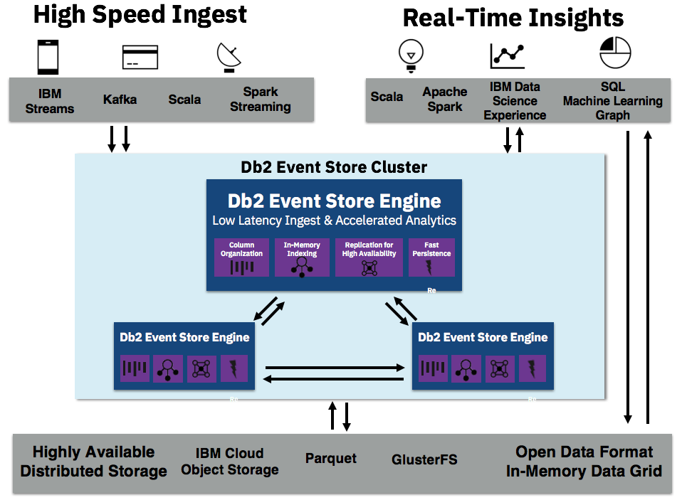
Db2 Event Store

Slide 18
These are few limitations for IBM Db2 event store
The IBM Db2 Event Store APIs for inserting data synchronously and asynchronously support only full-row inserts. You cannot insert partial rows. You must specify a value for every column in the table row.
You cannot purge individual entries from the database. If you want to purge data, you must drop the table that contains the entry.
So append and update method as we do in cassandra is not possible.
When we inject data with same id value, the new entry will be ignored.

Slide 19

THANK YOU

