Slide 1
CO2 Emission

Slide 2
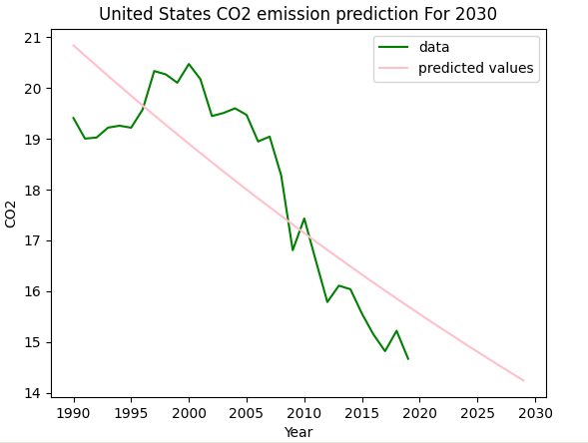
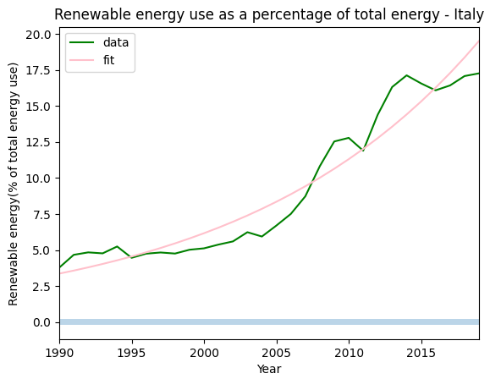
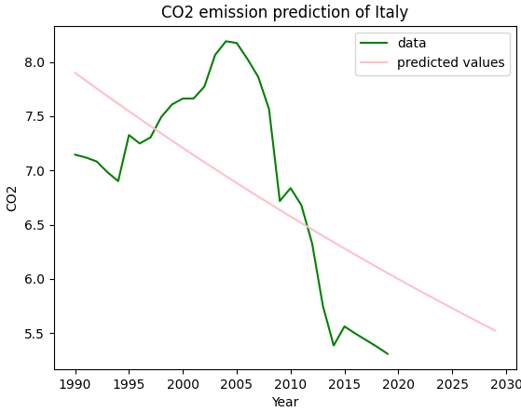
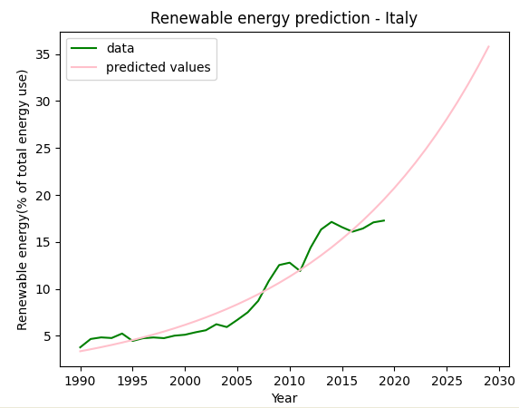
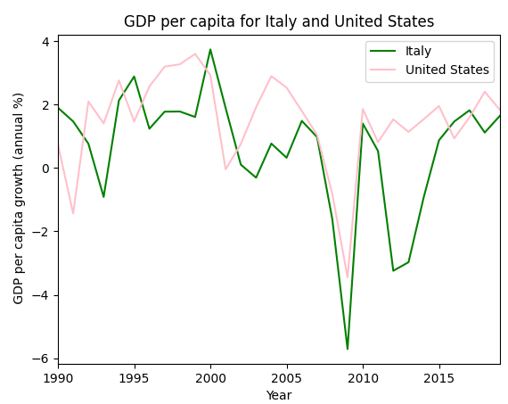
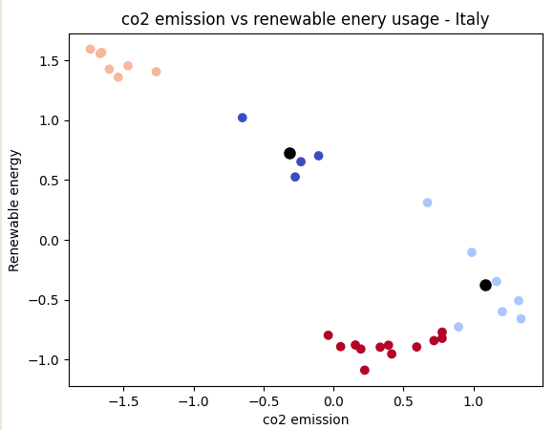
CO2 Emission
Student Name- SivanarayyaReddy Annapureddy
Student ID- 22102571
Abstract
Setting-up studying CO2 emission as main objective emphasizes to choose two developed nation to gain insight in the context of governmental strategies. The study shed lights on the types of resources which is consumed and Carbon dioxide emission is measured. United State and Italy both are developed countries and more inclined toward the utilization of renewable sources of energy.
Introduction
Developed nation s have been witnessed in maintaining the CO2 emission in the environment. The impact of CO2 emission over an environment increases the workload of government of nations by necessitating to take initiative. The purpose of this study is to highlight the beneficial aspects of using renewable sources of energy from the perspective of government.
CO2 Emission in Italy
Graph has been developed for CO2 emission in Italy from year 1990 to 2030. Subsequently, a future prediction is done along with past and present status of emission. It is learned that growing use of renewable sources of energy would decline the negative impact of CO2 emission in Italy.
CO2 Emission in United States
The CO2 emission has been measured in United States whose representation is accomplished by linear graph. It consistently declined with increasing years justifying more clean environment of US in coming future.
Utilization of Renewable Energy –Italy
It can be seen from the graph that the line is consistently increasing justifying the excessively high use of renewable sources of energy. It indicate that the use of renewable source of energy benefitted the nation to its environment as well as economy.
Renewable Energy Availability-Italy
An abrupt upward turn toward the use of renewable energy showcase the available renewable resources of energy. The range of years is given till 2030 present the future scenario of use of source.
GDP of Italy and United States
The visualization exhibit the variations in the GDP of Italy and United States. The GDP of these countries are deeply associated with utilization of renewable resources of energy. Both countries appeared to be synchronized in terms of maintaining its GDP also conveying same amount of consumption of renewable resources.
CO2 Emission Versus Renewable Energy
This scattered plot has been done for conducting comparison between CO2 emission and renewable energy in Italy. The critical analysis has been done by creating multiple clusters signifying each dot with coordinated values CO2 emission and renewable resources. It conveys that CO2 elements are still exists in the environment of Italy and need more inclination toward the use of renewable energy.
Brief about CO2 Emission of Italy and United States
United states alone produces more than 6 thousand million metric tons of CO2 gas in its environment. Likewise, Italy produces more than 300 million metric tons of carbon dioxide yearly. Based-on these nation’s geographical area, these datasets were prepared and have been opted for conducting this study. The excessive use of renewable sources of energies by these nations are resultants of excessive CO2 emission.
Analysis of Result
It is learned that both United States and Italy are heavily relied upon renewable sources of energy which consecutively increasing with years. The strategy of these nations also refers toward less available non-renewable sources. Subsequently, it emphasized the developed countries to use their renewable sources. Therefore, all the visualizations have given almost similar kind of attribute for both the countries. Hence, CO2 emission is consistently degrading in these countries.
Conclusion
From this study, it has been concluded that CO2 emission has been consistently declining from the environment of United States and Italy due to its dependency over the renewable resources of energy. It can be assume that the environment of these nations would be clearer than present situation. However, the past influence of CO2 emission still found in the environment and renewable sources of energy has been found as resolution.
Source: https://github.com/sivannarayanareddy/Applied-Data-Science-1--Assignment3.git

