Slide 1
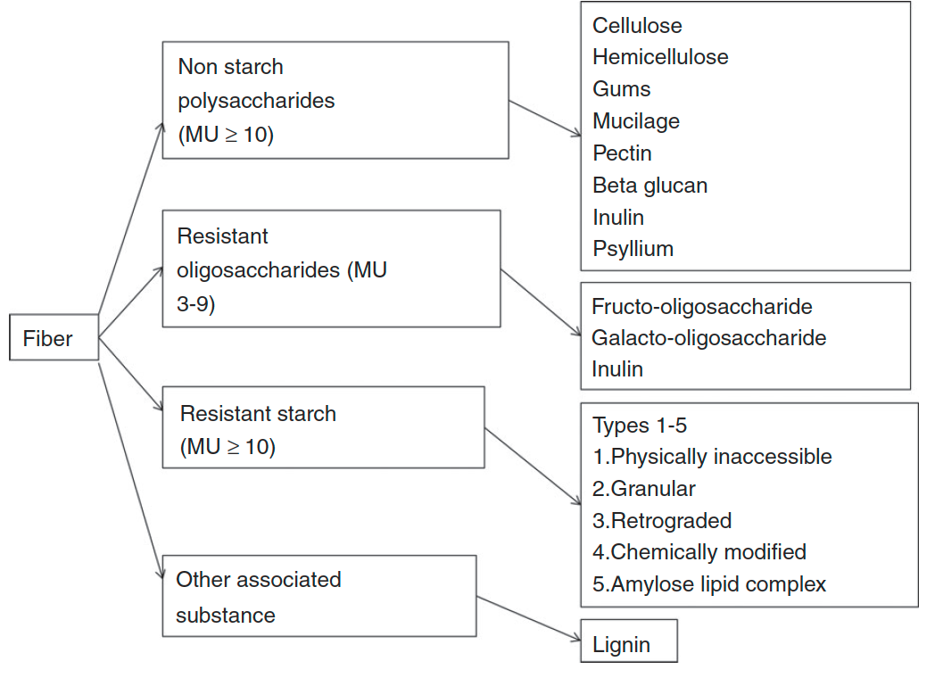
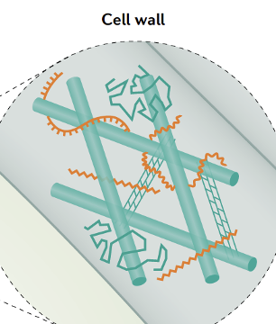
Fibers: all carbohydrates that are neither digested nor absorbed in the small intestine and have a degree of polymerization (DP) of 3 or more monomeric units
O’Grady et al, Aliment Pharmacol Ther. 2019
Notes:
Lets talk more about fibers, which are most favord by our gut microbes. Fibers are carbohydrates that are neither digested nor absorbed in the small intestine but will reach the large intestine to feed the gut bacteria. Fibers are sugar polymers with 3 or more monosugar units. Many of them also have side chains. There are different types of fibers. The most abundant one in our diet are non-starch polysaccharides, which are mainly derived from plant cell walls. Shown here is cartoon of major polysaccharides in plant cell walls, which includes celluloses, hemicelluloses, and pectins. In other type of fiber-rich foods, like sea weeds and mushroom, there are other types of polysaccharides in their cell walls. Then there are starches, including resistant ones and non-resistant ones. Non-resistant starch is not fibers because they are digested and absorbed before reach large intestine. Lastly, lignins and polyphenols, which are not carbohydrates but often chemically linked with fibers.

Slide 2
CAZymes are enzymes targeting glycosidic linkages
Examples of three disaccharides with different units (monosaccharides) and glycosidic linkages.
Maltose = glucose + glucose: ⍺-1,4 linkage
Lactose = glucose + galactose: β-1,4 linkage
Sucrose = glucose + fructose: ⍺-1,2 linkage
Source: https://www.sciencedirect.com/topics/nursing-and-health-professions/glycosidic-bond
Notes:
Now, lets talk about CAZymes, which are enzymes targeting glycosidic bonds in all polysaccharides and fibers. Shown on the left are three common disaccharides, which all have glucose as the unit, but have different glycosidic bonds that require different enzymes to build or break.

Slide 3
CAZymes are classified into 6 classes and 400+ families
GlycosylTransferases (GTs): 110
  formation of glycosidic bonds
Glycoside Hydrolases (GHs): 166
  hydrolysis and/or rearrangement of glycosidic bonds
Polysaccharide Lyases (PLs): 40
  non-hydrolytic cleavage of glycosidic bonds
Carbohydrate Esterases (CEs): 17
  hydrolysis of carbohydrate esters
Auxiliary Activities (AAs): 16
  ligninolytic enzymes and lytic polysaccharide mono-oxygenases
Carbohydrate-Binding Modules (CBMs): 86
  adhesion to carbohydrates
The CAZy database(Bernard Henrissat) (http://www.cazy.org/):
435 families of six classes. Many CAZymes are multi-domain proteins.
Cantarel B. et al. 2009, Nucleic Acids Res
Lombard V. et al. 2014, Nucleic Acids Res
Total citations: ~9,000 times
Notes:
CAZymes are found all living organisms and even viruses. They are classified into 400+ families of 6 classes. These include GTs, GHs, PLss, Ces, Aas, and CBMs. The CAZy database is the original database that defines these families and each family must contain some biochemically characterized proteins extracted from literature and then each family is populated by sequence homology search. Between different families, there is no sequence similarity. Many CAZymes are modular including multiple domains, some are catalytic others and structural modules.

Slide 4
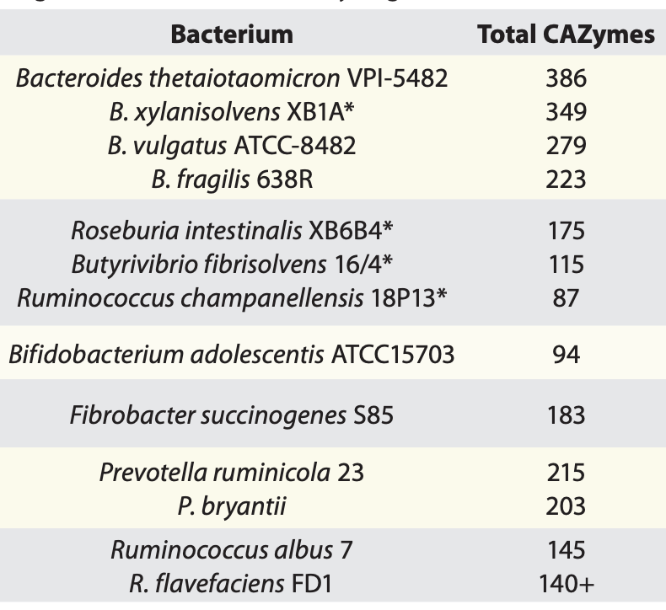
Gut bacteria dedicate > 6% of their genes to CAZymes
Human encodes 17 CAZymes
Gut microbiome encodes tens of thousands of CAZymes
Gut Microbes 3:4, 289-306; 2012
Notes:
CAZymes are extremely important for fiber degradation in human gut. They are produced by gut microbiome to fully digest complex fibers and produce beneficial metabolites. Shown on the right is a list of gut bacteria and the number CAZymes encoded in their genomes. Some of them encode more than 300 different CAZymes, which account for more than 6% of their genomes, As a comparison, our human genome only encode 17 CAZymes, which is less than 1 out of 1000. CAZymes are also very important for bioenergy and biomaterial production, plant disease and agriculture industries.

Slide 5
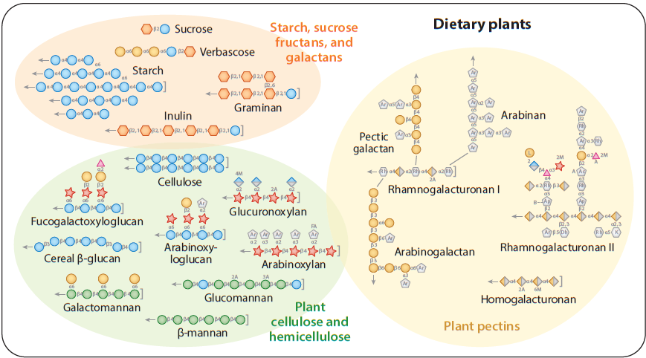
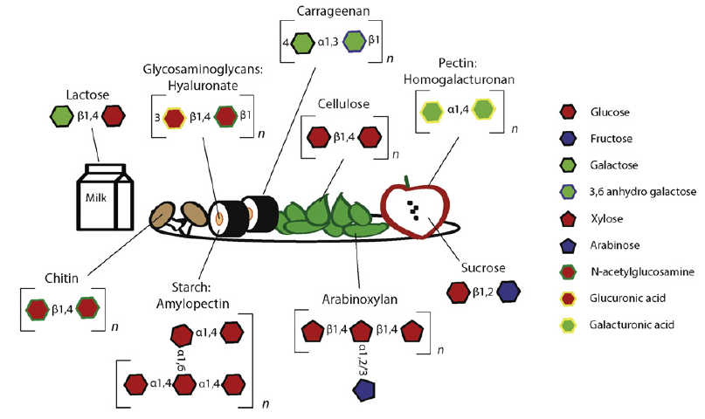
Complex carbohydrates in human diets
Annu. Rev. Microbiol (2017) 71:349–69
J Mol Biol (2016) 428, 3230–3252
Notes:
From biochemistry point of view, there are all kinds of glycosidic bonds in the dietary glycans of our everyday meal. It could be found fruits, veggies, sushi which has rice, meat and seaweeds, mushrooms, yogurts and even in milks and meat. As I mentioned, plant derived polysaccharides are the main component of dietary fibers. As we see, dozens of polymers contain dozens of different types of glycosidic bonds, which requires numerous CAZymes for complete degradation. This explains why our gut bacteria encode so many different CAZymes

Slide 6
2012: how do you automatically find (mine) CAZymes in genomes/metagenomes of microbiome?
A signature domain of each CAZyme family
An online server for automated CAZyme annotation of new genomes
dbCAN
dbCAN: database of automated CAZyme ANnotation
Yin et al, 2012, Nucleic acids research, W445-51
Notes:
I hope you’ved appreciated the importance of CAZymes and their abundance in our gut microbiome. With cheaper DNA sequencing, millions of microbial genomes and metagenomes have been sequenced. It will be very useful to have a way to automatically scan these genomes for CAZymes. Because CAZymes tend to be modular, we wanted to define a signature domain to represent each CAZyme, and also develop an online server to allow other researchers to annotate their genomes by a simple mouse click and get the result on the web. For this purpose, we developed dbCAN, as a database of automated CAZyme annotation and a web server.

Slide 7
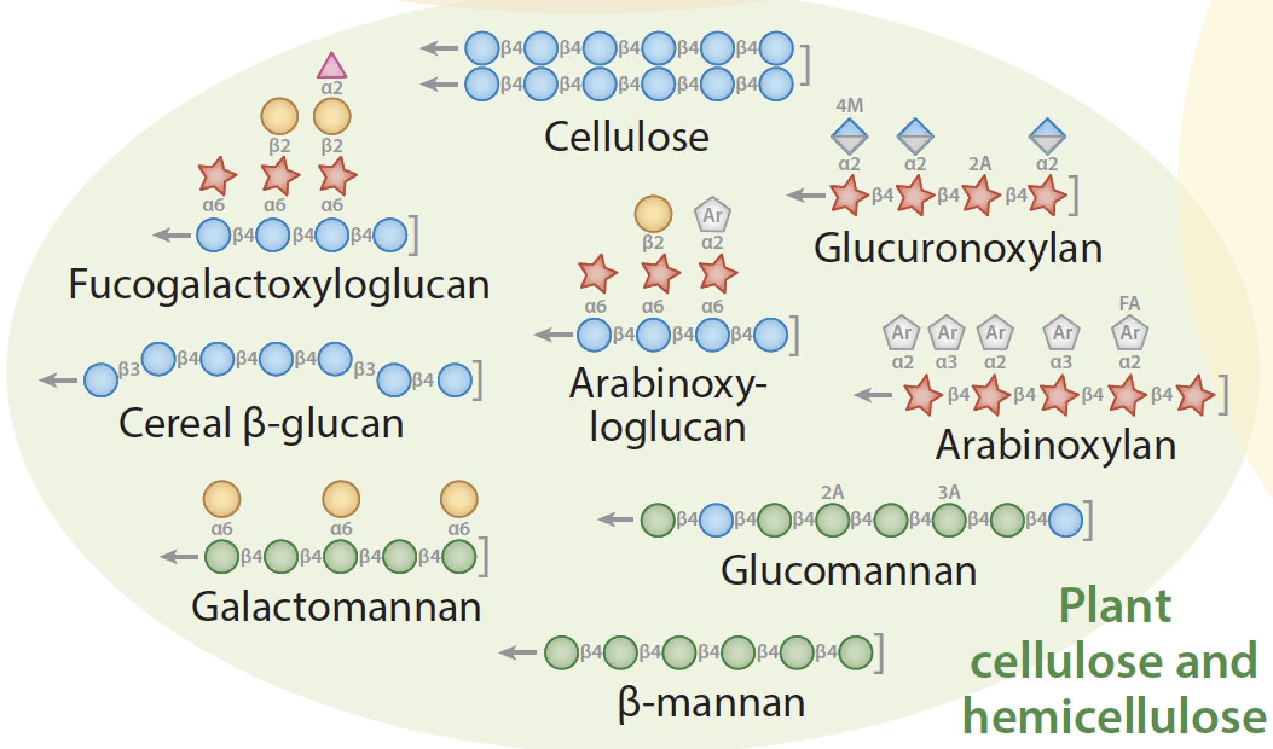
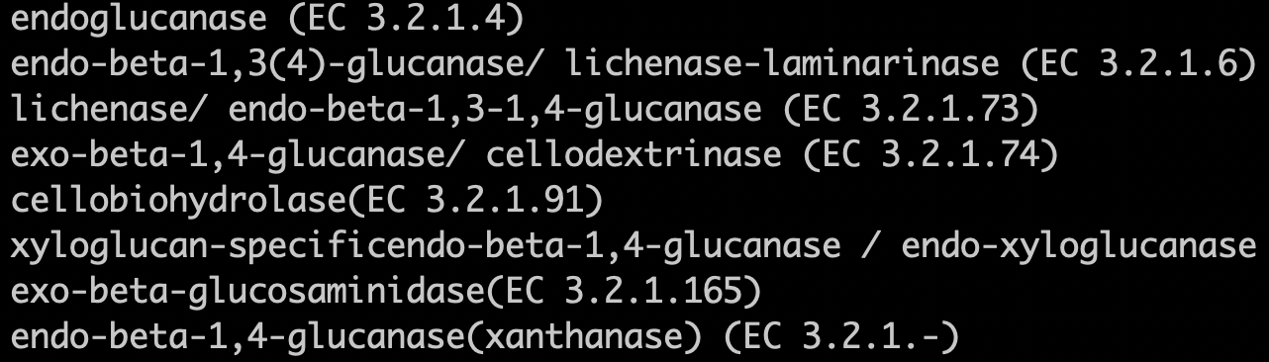
Challenge in CAZyme annotation: how to predict substrate? polyspecificity (one family -> multi-substrates)
Solution #1: classify a family into subfamilies/clusters and each cluster will have distinct sequence features/motifs/kmers for the specific substrates
Solution #2: use gene neighborhood information of CAZyme gene clusters with known substrates
GH9 ---> 8 EC numbers
Annu. Rev. Microbiol (2017) 71:349–69
cellulose
xyloglucan
beta-glucan
laminarin (algae)
chitosan (fungi)
xanthan (bacteria)
Notes:
Our NIH project attemps to address one major challenge in CAZyme annotation: how to predict substrates. Our dbCAN can only assign a given protein to an existing CAZyme family. For example, we can assign this protein into three CAZyme families: GH9, CBM3, and GH48. However, this is not enough for people who want to learn about the substrates that a CAZyme might target, e.g., in personalized nutrition. There is an issue called polyspecifitciy meaning proteins of one CAZyme family may have different biochemical activities or cleave different glycosidic linkages. For example, GH5 contains proteins with at least 27 EC numbers. These ECs together correspond to multiple substrates. So knowing a protein belongs to GH5 does not tell you what exact carbohydrate it might degrade. One solution is to classify a family into subfamilies, and each subfamily may contain just one EC and have distinct sequence features targeting a specific substrate. Another solution is to use gene neighborhood information of CAZyme gene cluster. We will explain both solutions in this talk but will spend more time to introduce the second solution, which is a work in progress.

Slide 8
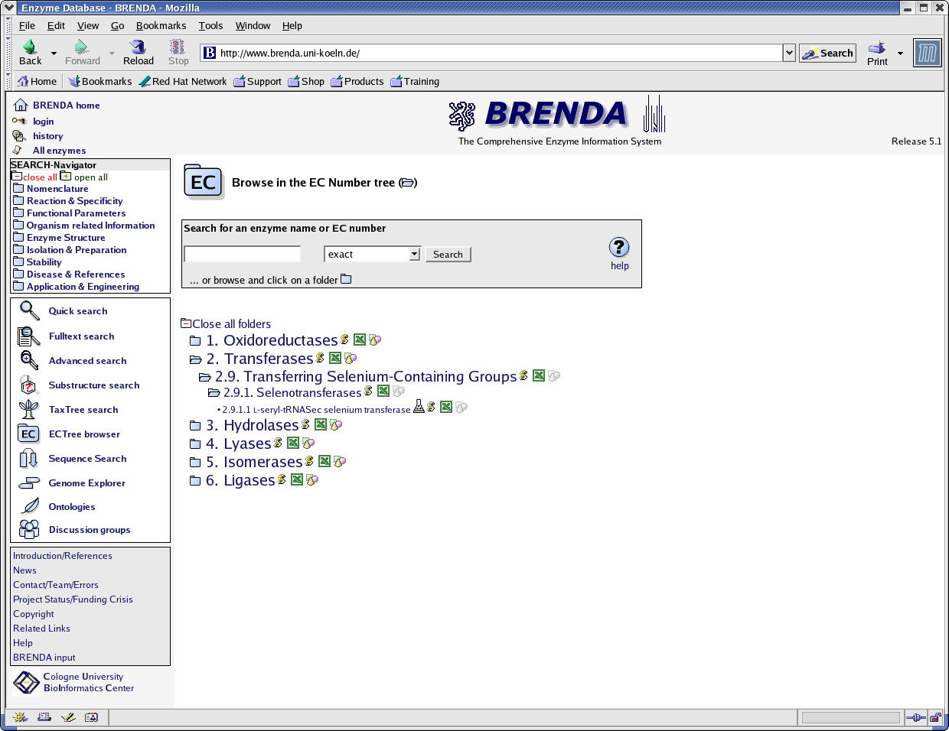
Enzyme database
Oxidoredutase
Trasferases
Hydrolases
Lyases
Isomerases
Ligases
  http://www.brenda.uni-koeln.de/
EC: a database of all known enzymes (~4,367 entries):
Classification of enzymes into classes, sub-classes, sub-sub-classes, and substrates

Slide 9
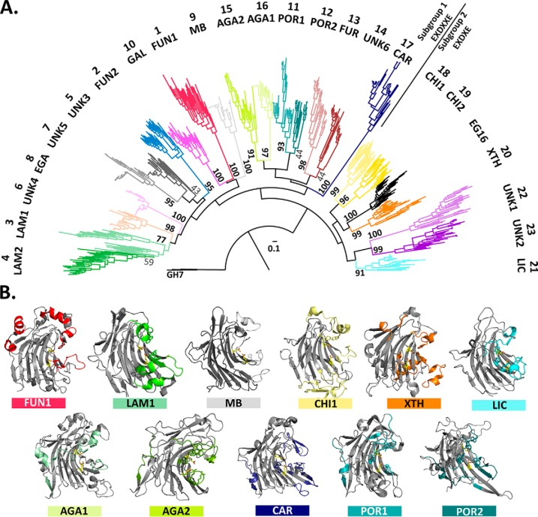
Use phylogeny to classify proteins in a family into subfamilies
Protein Eng. Des. Sel. 2006;19:555–562.
https://www.ncbi.nlm.nih.gov/pmc/articles/PMC6827312/

Slide 10
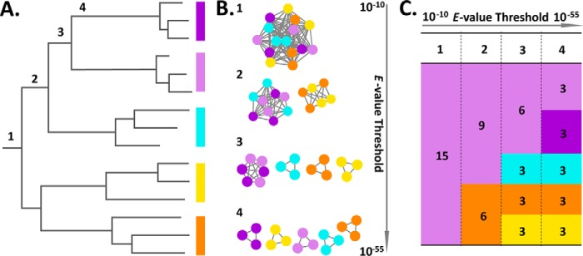
Use SSN to classify proteins in a family into subfamilies
https://www.ncbi.nlm.nih.gov/pmc/articles/PMC6827312/

