Slide 1
Topic 12
ADTS, Data Structures, Java Collections and Generic Data Structures
"Get your data structures correct first, and the rest of the program will write itself."
- David Jones
CS 307 Fundamentals of Computer Science
ADTS and Generic Data Structures

Slide 2
Abstract Data Types
Abstract Data Types (aka ADTs) are descriptions of how a data type will work without implementation details
Example, Stack at NIST DADS
  http://xw2k.nist.gov/dads/HTML/stack.html
Description can be a formal, mathematical description
Java interfaces are a form of ADTs
  some implementation details start to creep in
CS 307 Fundamentals of Computer Science
ADTS and Generic Data Structures

Slide 3
Data Structures
A Data Structure is:
  an implementation of an abstract data type and
  "An organization of information, usually in computer memory", for better algorithm efficiency."
List Object
aList
5
size
myElements
0 1 2 3 4 5 6 7 8 9 10
A C E B A
CS 307 Fundamentals of Computer Science
ADTs and Data Structures

Slide 4
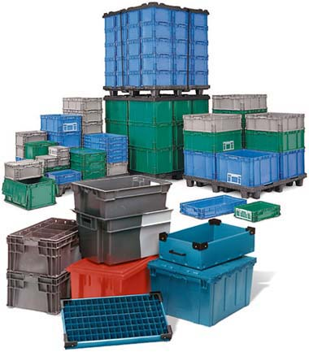
Data Structure Concepts
Data Structures are containers:
  they hold other data
  arrays are a data structure
  ... so are lists
Other types of data structures:
  stack, queue, tree,
  binary search tree, hash table,
  dictionary or map, set, and on and on
  www.nist.gov/dads/
  en.wikipedia.org/wiki/List_of_data_structures
Different types of data structures are optimized for certain types of operations
CS 307 Fundamentals of Computer Science
ADTs and Data Structures

Slide 5
Core Operations
Data Structures will have 3 core operations
  a way to add things
  a way to remove things
  a way to access things
Details of these operations depend on the data structure
  Example: List, add at the end, access by location, remove by location
More operations added depending on what data structure is designed to do
CS 307 Fundamentals of Computer Science
ADTs and Data Structures

Slide 6
ADTs and Data Structures in Programming Languages
Modern programming languages usually have a library of data structures
  Java collections framework
  C++ standard template library
  .Net framework (small portion of VERY large library)
  Python lists and tuples
  Lisp lists
CS 307 Fundamentals of Computer Science
ADTs and Data Structures

Slide 7
Data Structures in Java
Part of the Java Standard Library is the Collections Framework
  In class we will create our own data structures and discuss the data structures that exist in Java
A library of data structures
Built on two interfaces
  Collection
  Iterator
http://java.sun.com/j2se/1.5.0/docs/guide/collections/index.html
CS 307 Fundamentals of Computer Science
ADTs and Data Structures

Slide 8
The Java Collection interface
A generic collection
Can hold any object data type
Which type a particular collection will hold is specified when declaring an instance of a class that implements the Collection interface
Helps guarantee type safety at compile time
CS 307 Fundamentals of Computer Science
ADTs and Data Structures

Slide 9
Methods in the Collection interface
public interface Collection<E>
{ public boolean add(E o)
public boolean addAll(Collection<? extends E> c)
public void clear()
public boolean contains(Object o)
public boolean containsAll(Collection<?> c)
public boolean equals(Object o)
public int hashCode()
public boolean isEmpty()
public Iterator<E> iterator()
public boolean remove(Object o)
public boolean removeAll(Collection<?> c)
public boolean retainAll(Collection<?> c)
public int size()
public Object[] toArray()
public <T> T[] toArray(T[] a)
}
CS 307 Fundamentals of Computer Science
ADTs and Data Structures

Slide 10
The Java ArrayList Class
Implements the List interface and uses an array as its internal storage container
It is a list, not an array
The array that actual stores the elements of the list is hidden, not visible outside of the ArrayList class
all actions on ArrayList objects are via the methods
ArrayLists are generic.
  They can hold objects of any type!
CS 307 Fundamentals of Computer Science
ADTs and Data Structures

Slide 11
ArrayList's (Partial)
Class Diagram
Iterable
Object
Collection
AbstractCollection
List
AbstractList
ArrayList
CS 307 Fundamentals of Computer Science
ADTs and Data Structures

Slide 12
Back to our Array Based List
Started with a list of ints
Don't want to have to write a new list class for every data type we want to store in lists
Moved to an array of Objects to store the elements of the list
  // from array based list
  private Object[] myCon;
CS 307 Fundamentals of Computer Science
ADTS and Generic Data Structures

Slide 13
Using Object
In Java, all classes inherit from exactly one other class except Object which is at the top of the class hierarchy
Object variables can point at objects of their declared type and any descendants
  polymorphism
Thus, if the internal storage container is of type Object it can hold anything
  primitives handled by wrapping them in objects.
  int – Integer, char - Character
CS 307 Fundamentals of Computer Science
ADTS and Generic Data Structures

Slide 14
Difficulties with Object
Creating generic containers using the Object data type and polymorphism is relatively straight forward
Using these generic containers leads to some difficulties
  Casting
  Type checking
Code examples on the following slides
CS 307 Fundamentals of Computer Science
ADTS and Generic Data Structures

Slide 15
Attendance Question 1
What is output by the following code?
ArrayList list = new ArrayList();
String name = "Olivia";
list.add(name);
System.out.print( list.get(0).charAt(2) );
A. i
B. O
C. l
D. No output due to syntax error.
E. No output due to runtime error.
CS 307 Fundamentals of Computer Science
ADTS and Generic Data Structures

Slide 16
Code Example - Casting
Assume a list class
  ArrayList li = new ArrayList();
  li.add(“Hi”);
  System.out.println( li.get(0).charAt(0) );
  // previous line has syntax error
  // return type of get is Object
  // Object does not have a charAt method
  // compiler relies on declared type
  System.out.println(
  ((String)li.get(0)).charAt(0) );
  // must cast to a String
CS 307 Fundamentals of Computer Science
ADTS and Generic Data Structures

Slide 17
Code Example – type checking
//pre: all elements of li are Strings
public void printFirstChar(ArrayList li){
String temp;
for(int i = 0; i < li.size(); i++)
{ temp = (String)li.get(i);
if( temp.length() > 0 )
System.out.println(
temp.charAt(0) );
}
}
// what happens if pre condition not met?
CS 307 Fundamentals of Computer Science
ADTS and Generic Data Structures

Slide 18
Too Generic?
Does the compiler allow this?
ArrayList list = new ArrayList();
list.add( "Olivia" );
list.add( new Integer(12) );
list.add( new Rectangle() );
list.add( new ArrayList() );
Yes
No
CS 307 Fundamentals of Computer Science
ADTS and Generic Data Structures

Slide 19
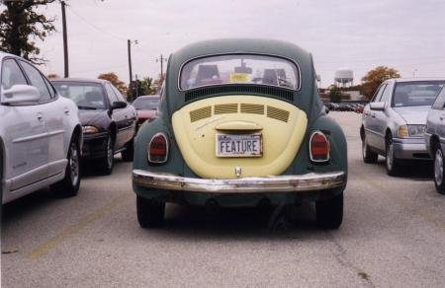
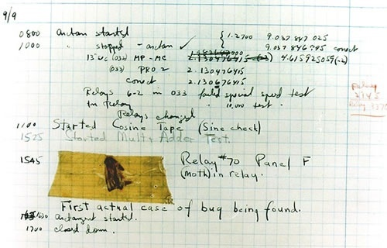
Is this a bug or a feature?
CS 307 Fundamentals of Computer Science
ADTS and Generic Data Structures

Slide 20
"Fixing" the Method
//pre: all elements of li are Strings
public void printFirstChar(ArrayList li){
String temp;
for(int i = 0; i < li.size(); i++){
if( li.get(i) instanceof String ){
temp = (String)li.get(i);
if( temp.length() > 0 )
System.out.println(
temp.charAt(0) );
}
}
}
CS 307 Fundamentals of Computer Science
ADTS and Generic Data Structures

Slide 21
Generic Types
Java has syntax for
parameterized data types
Referred to as Generic Types in most of the literature
A traditional parameter has a data type and can store various values just like a variable
public void foo(int x)
Generic Types are like parameters, but the data type for the parameter is data type
  like a variable that stores a data type
CS 307 Fundamentals of Computer Science
ADTS and Generic Data Structures

Slide 22
Making our Array List Generic
Data type variables declared in class header
public class GenericList<E> {
The <E> is the declaration of a data type parameter for the class
  any legal identifier: Foo, AnyType, Element, DataTypeThisListStores
  Sun style guide recommends terse identifiers
The value E stores will be filled in whenever a programmer creates a new GenericList
  GenericList<String> li =
  new GenericList<String>();
CS 307 Fundamentals of Computer Science
ADTS and Generic Data Structures

Slide 23
Modifications to GenericList
instance variable
  private E[] myCon;
Parameters on
  add, insert, remove, insertAll
Return type on
  get
Changes to creation of internal storage container
  myCon = (E[])new Object[DEFAULT_SIZE];
Constructor header does not change
CS 307 Fundamentals of Computer Science
ADTS and Generic Data Structures

Slide 24
Using Generic Types
Back to Java's ArrayList
ArrayList list1 = new ArrayList();
  still allowed, a "raw" ArrayList
  works just like our first pass at GenericList
  casting, lack of type safety
CS 307 Fundamentals of Computer Science
ADTS and Generic Data Structures

Slide 25
Using Generic Types
ArrayList<String> list2 =
new ArrayList<String>();
  for list2 E stores String
list2.add( "Isabelle" );
System.out.println( list2.get(0).charAt(2) ); //ok
list2.add( new Rectangle() );
// syntax error
CS 307 Fundamentals of Computer Science
ADTS and Generic Data Structures

Slide 26
Parameters and Generic Types
Old version
//pre: all elements of li are Strings
public void printFirstChar(ArrayList li){
New version
//pre: none
public void printFirstChar(ArrayList<String> li){
Elsewhere
ArrayList<String> list3 = new ArrayList<String>();
printFirstChar( list3 ); // ok
ArrayList<Integer> list4 = new ArrayList<Integer>();
printFirstChar( list4 ); // syntax error
CS 307 Fundamentals of Computer Science
ADTS and Generic Data Structures

Slide 27
Generic Types and Subclasses
ArrayList<ClosedShape> list5 =
new ArrayList<ClosedShape>();
list5.add( new Rectangle() );
list5.add( new Square() );
list5.add( new Circle() );
// all okay
list5 can store ClosedShapes and any descendants of ClosedShape
CS 307 Fundamentals of Computer Science
ADTS and Generic Data Structures

