Slide 1
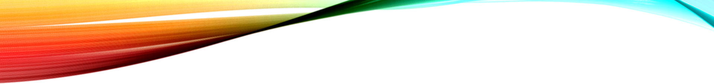
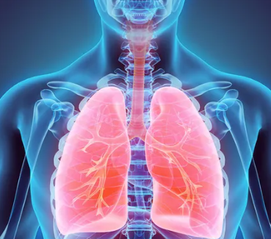
Capstone Project Pneumonia Detection
Sivasankar Vennala

Slide 2

CONTENTS
Introduction
Business Opportunity
Methodology
Data Collection
Data Pre-Processing
Modelling Road Map
Methods and Models
Model Metrics
Results
Improvements and Recommandations
Summary

Slide 3




Introduction
Radiology is a branch of medicine where the disease diagnosed by examining X-Ray Images.
To reduce the human eye error in diagnosing the disease computer aided system has evolve for better diagnosis.
Machine learning techniques has shown remarkable results in the recent years.
In this project trying to build an algorithm to detect a visual signal for pneumonia in medical images. Specifically, the algorithm needs to automatically locate lung opacities on chest radiographs

Slide 4
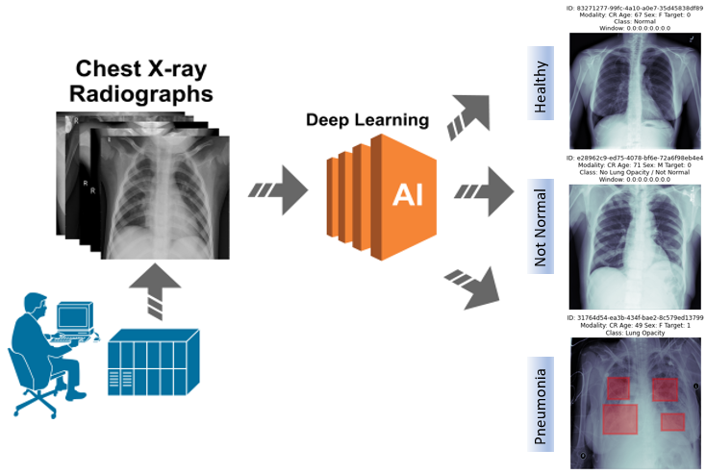
business opportunity
“Detecting pneumonia signs in chest radiography can be difficult for radiologists. Health workers, who often have low education levels, also lack the required knowledge to recognize pneumonia in time.”
“Automating Pneumonia screening using powerful AI/Machine learning techniques provides affected area details through a bounding box assist physicians to make better clinical decisions or even replace human judgement in certain functional areas of healthcare.”

Slide 5
Methodology
Modelling
Data Collection
Preprocessing
Evaluation & Comparative Analysis

Slide 6

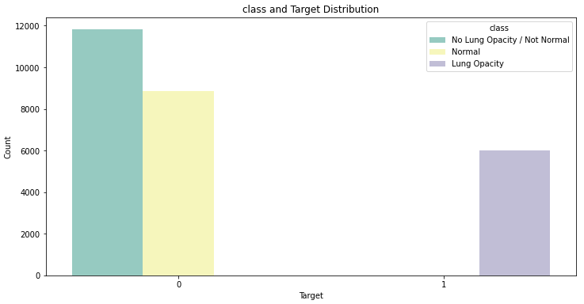

Data Collection
Data for this project is extracted from Kaggle.
https://www.kaggle.com/c/rsna-pneumonia-detection-challenge/data
It contains 20672 normal images of X- rays and 9555 pneumonia infected images. Image Class dataset contains 3 different classes which are No Lung Opacity / Not Normal, Lung Opacity and Normal
Images are in grayscale DICOM format and of varying sizes.

Slide 7
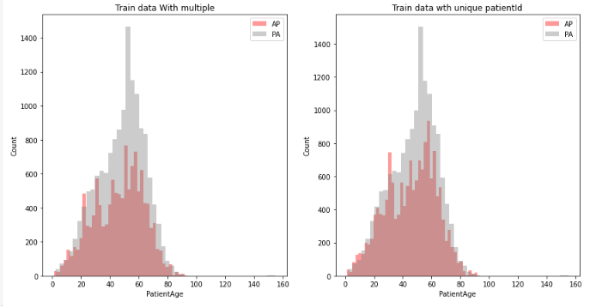
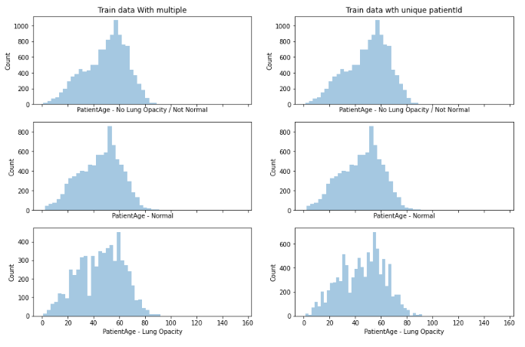
DATA DISTRIBUTION

Slide 8




Data Pre-processing
Missing data fix by filling NaN values with Zero
Images are resized based on model selected using Generator Helper function for the training purpose.
train images data split into train and validation sets in 80:20 ratio.
Image agumentation:
Width and height shifted by 0.5 fractions and with the input flipped horizontally.

Slide 9
MODELLING ROADMAP
Data Collection and preprocessing
Transfer Learning
Evaluation & Comparative Analysis
Future Scope: Real time object Detection
Image classification/
detetction
Object Localization
In Images

Slide 10
Methods and models
Customised CNN
UNET
InceptionV3
Detectron2, YOLO
(Future Scope)
Improved Customised CNN
VGG16
MASK_RCNN

Slide 11
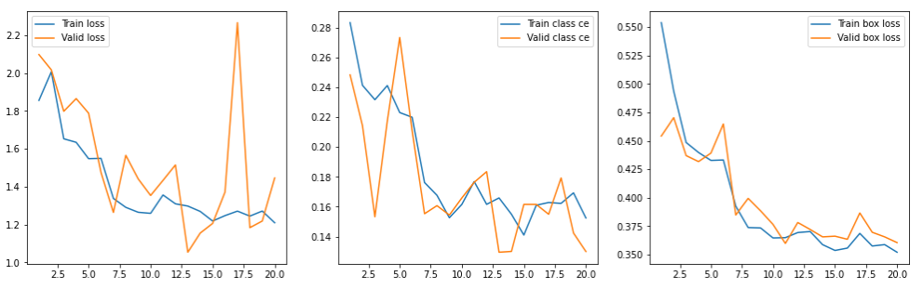
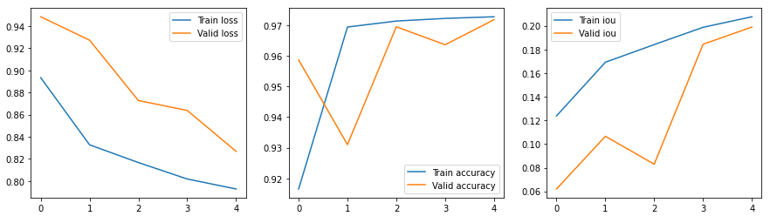
Model metrics
UNET MODEL
MASK_RCNN MODEL

Slide 12
results
Model | Image Resolution | Accuracy
Basic CNN with LeakyRelu | 256x256 | 0.9751
UNET | 224x224 | 0.9728
Basic CNN with Relu | 224x224 | 0.9271
Resnet50 (MASK_RCNN) | 256x256 | 0.88
VGG16 | 384x384 | 0.84
InceptionV3 | 224x224 | 0.68

Slide 13
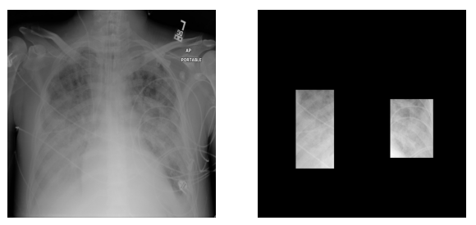
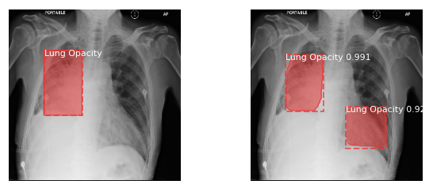
predections

Slide 14
Improvements and recommendations
There are several ways to improve model performance for the future scope. To name a few:
Optimizing the hypermeters using Grid/Random Search approach
01
02
Using other pretrained model Like AlexNet, Densnet, MobileNet using pretrained weights etc
Using Image segmentation models like Yolo and Detectron2 etc which are recent Instance segmentation approaches which gives faster and very good results
Hybrid model approach for example using yolo and detectron2 together can give more robustic and better results.
03
04
Sampling the data to get the equal amount of dataset
Using different augmentation parameters
Better computational environments to train for more epochs

Slide 15
summary
Adequate results were achieved through experimenting on different models and machine learning techniques
Deep learning technologies have opened paths to attempt to solve critical problems indifferent areas such as healthcare and medicine
Most noticeably, hardware and software limitations
With automation at the level of experts Machine Learning and Artificial Intelligence can improve healthcare delivery and increase access to medical imaging expertise in parts of the world where access to skilled radiologists are limited

