Slide 1
Form C Signup Project
Architecture and Workflow Demo
Node.js Express Backend + React Frontend
Hexaware | Slide 1 of 15

Slide 2
Agenda
1. Project Purpose and Scope
2. Solution Overview
3. System Architecture Diagram
4. Backend Architecture
5. Frontend Architecture
6. End-to-End Workflow Diagram
7. Quality and Testing Workflow
8. Demo Runbook, Limitations, and Next Steps
Hexaware | Slide 2 of 15

Slide 3
Purpose and Demo Objective
Explain architecture and runtime workflow of the Form C Signup solution.
Demonstrate an end-to-end signup journey from UI to backend service.
Show key engineering practices: validation, error handling, and testing.
Provide a ready script for technical and stakeholder demo conversations.
Demo Deck | Slide 3 of 15

Slide 4
Solution Overview
Full-stack JavaScript application with separated frontend and backend.
Backend API built using Node.js and Express.
Frontend web app built using React and Vite.
Signup flow integrated end to end with consistent JSON response envelope.
Layered backend and feature-oriented frontend organization.
Demo Deck | Slide 4 of 15

Slide 5
High-Level Architecture Diagram
Frontend ↔ Backend ↔ Validation/Service/Data
Demo Deck | Slide 5 of 15

Slide 6
Backend Architecture Layers
Entry/Boot: src/server.js
App Wiring and Middleware: src/app.js
Route Layer: src/features/auth/auth.routes.js
Validation Layer: src/features/auth/auth.validator.js
Controller Layer: src/features/auth/auth.controller.js
Service Layer: src/features/auth/auth.service.js
Error Middleware: src/middleware/error-handler.js and not-found.js
Demo Deck | Slide 6 of 15

Slide 7
Backend Technical Highlights
Security middleware via helmet and request logging via morgan.
CORS enabled for frontend-backend communication.
Passwords hashed using scrypt with per-user random salt.
Duplicate user id detection with explicit conflict response.
Demo data persistence currently uses in-memory Map storage.
Demo Deck | Slide 7 of 15

Slide 8
API Contract - Signup
Endpoint: POST /api/v1/auth/signup
Success Envelope: { success: true, data: { user }, error: null }
Validation Failure: 400 with structured error details.
Duplicate User ID: 409 with USER_ID_ALREADY_EXISTS code.
Consistent error payload supports predictable frontend handling.
Demo Deck | Slide 8 of 15

Slide 9
Frontend Architecture
App Entry: frontend/src/main.jsx
Routing: frontend/src/app/AppRoutes.jsx
Signup Feature: frontend/src/features/signup/SignupPage.jsx
Success Page: frontend/src/pages/SignupSuccessPage.jsx
Auth Context: frontend/src/context/AuthContext.jsx
API Client: frontend/src/services/authApi.js
Demo Deck | Slide 9 of 15

Slide 10
Frontend Design Decisions
Functional components and React Router-based page flow.
Local state for form handling + React Context for shared user state.
Client-side validation for immediate user feedback.
CSS Modules for scoped styling and maintainable UI structure.
Accessible labels and field/form error feedback patterns.
Demo Deck | Slide 10 of 15

Slide 11
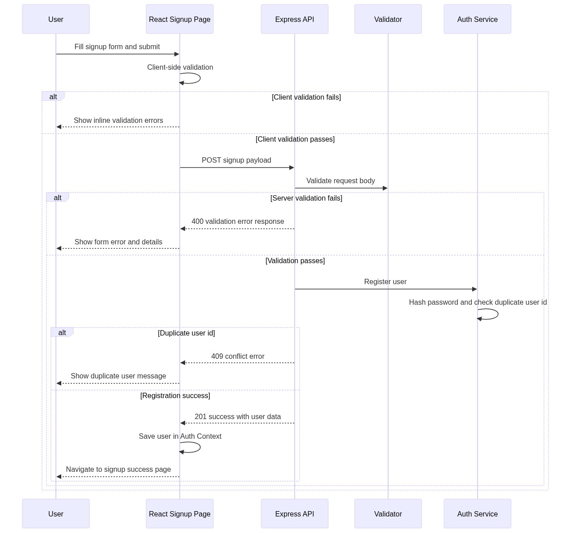
End-to-End Workflow Diagram
Signup journey across UI, API, validation, and service layers
Demo Deck | Slide 11 of 15

Slide 12
Quality and Testing Workflow
Backend checks: npm run lint and npm test.
Backend coverage includes health, signup success, validation, and duplicate conflict.
Frontend checks: lint, jest tests, and production build.
Frontend coverage includes form validation, successful signup, and API failure handling.
Verification pipeline executed successfully for demo readiness.
Demo Deck | Slide 12 of 15

Slide 13
Demo Runbook
Start backend: npm run start (project root).
Start frontend: cd frontend and npm run dev.
Open frontend at http://localhost:5173 and backend health at http://localhost:3000/health.
Demo steps: empty form validation, valid signup, success navigation, duplicate user conflict.
Demo Deck | Slide 13 of 15

Slide 14
Current Limitations (Demo Scope)
Data persistence is in-memory and resets on backend restart.
Database integration is not implemented yet.
Authentication token/session lifecycle is pending.
Production deployment pipeline documentation is pending.
Demo Deck | Slide 14 of 15

Slide 15
Next Phase and Q&A
Introduce persistent storage layer (SQL or NoSQL).
Add authentication and authorization flows.
Add observability: structured logs, metrics, and tracing.
Add CI quality gates for frontend and backend.
Add non-functional suites: security and performance testing.
Q&A
Demo Deck | Slide 15 of 15

