Slide 1
Form C Signup Solution
Stakeholder-Focused Architecture and Workflow
Stakeholder Deck | Slide 1 of 12

Slide 2
Business Objective
Enable reliable digital signup with clear user experience.
Reduce manual registration errors through validation at multiple layers.
Provide a reusable baseline for onboarding-related workflows.
Demonstrate scalable architecture foundation for future expansion.
Stakeholder Deck | Slide 2 of 12

Slide 3
What Was Delivered
Frontend registration application for Form C signup.
Backend API to process and validate signup requests.
End-to-end error handling with user-friendly feedback.
Automated quality checks for build confidence.
Stakeholder Deck | Slide 3 of 12

Slide 4
High-Level Architecture
Stakeholder Deck | Slide 4 of 12

Slide 5
How Value Is Created
Fast and guided signup flow reduces user drop-off.
Structured validations reduce downstream support effort.
Consistent API contracts simplify future integrations.
Clear modular separation lowers long-term change cost.
Stakeholder Deck | Slide 5 of 12

Slide 6
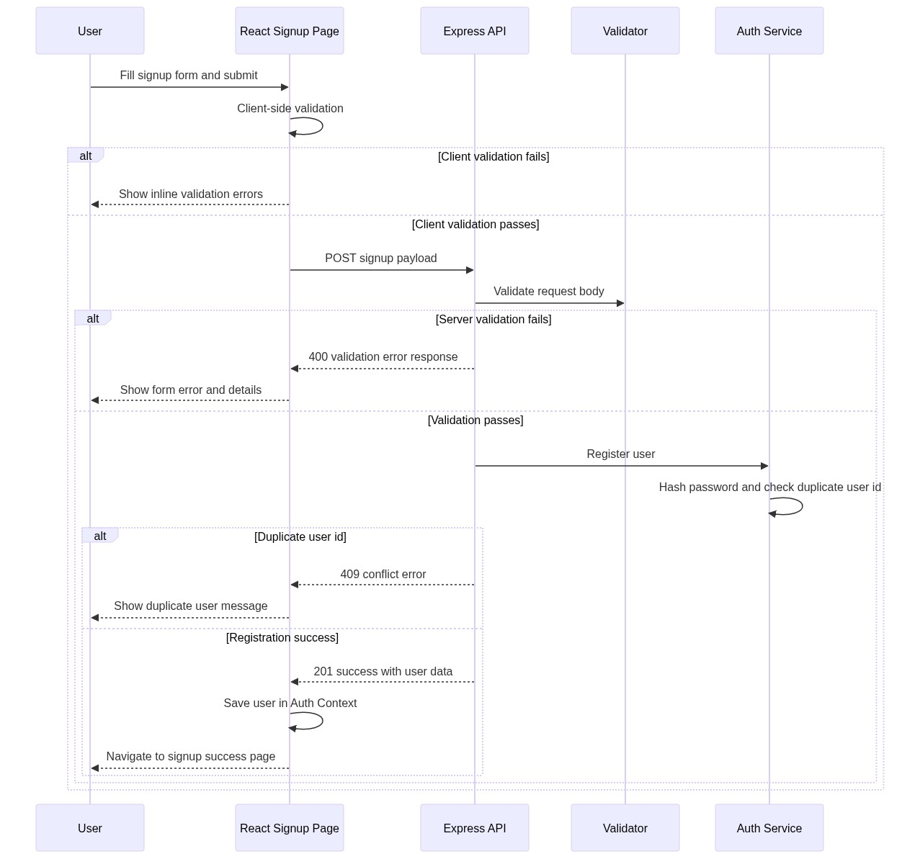
End-to-End Workflow
Stakeholder Deck | Slide 6 of 12

Slide 7
User Experience Outcomes
Field-level validations prevent invalid submissions early.
Clear success path gives confidence after registration.
Meaningful errors for conflicts such as duplicate user id.
Responsive, clean UI suitable for demos and pilot usage.
Stakeholder Deck | Slide 7 of 12

Slide 8
Quality and Reliability
Backend validation, conflict handling, and health checks tested.
Frontend functional behavior tested with automated UI tests.
Lint/test/build gates executed for technical confidence.
Structured responses improve monitoring and supportability.
Stakeholder Deck | Slide 8 of 12

Slide 9
Demo Walkthrough Plan
Start backend and frontend services.
Demonstrate empty form validation feedback.
Demonstrate successful user registration flow.
Demonstrate duplicate user conflict handling.
Show resulting success confirmation page.
Stakeholder Deck | Slide 9 of 12

Slide 10
Current Constraints
In-memory storage resets on restart (demo-oriented).
No persistent database yet.
Authentication token lifecycle not introduced yet.
No deployment pipeline for production hosting yet.
Stakeholder Deck | Slide 10 of 12

Slide 11
Roadmap and Business Impact
Add persistent data storage for production continuity.
Introduce secure authentication and authorization.
Implement CI/CD quality gates for rapid safe releases.
Scale architecture for additional onboarding use cases.
Stakeholder Deck | Slide 11 of 12

Slide 12
Decision and Ask
Approve next phase for persistence and production hardening.
Prioritize auth and deployment readiness in sprint planning.
Align demo success criteria with pilot rollout objectives.
Q&A
Stakeholder Deck | Slide 12 of 12

