Slide 1
Form C Signup
Technical Deep-Dive: Architecture and Workflow
Technical Deck | Slide 1 of 15

Slide 2
Tech Stack and Runtime
Backend: Node.js + Express (ES modules).
Frontend: React + Vite + React Router.
Testing: Vitest/Supertest (backend), Jest/RTL (frontend).
Styling: CSS Modules in frontend feature components.
Technical Deck | Slide 2 of 15

Slide 3
Repository Structure
Backend root hosts API runtime and tests.
Frontend isolated under frontend/ with independent scripts.
docs/ contains architecture, workflow, and generated collateral.
.github/ contains custom instruction and agent definitions.
Technical Deck | Slide 3 of 15

Slide 4
Architecture Diagram
User → React UI → Express API → Validation → Service → In-memory store
Technical Deck | Slide 4 of 15

Slide 5
Backend Request Pipeline
src/server.js starts HTTP process and environment config.
src/app.js wires helmet, cors, json parser, and morgan.
Route mounts at /api/v1/auth via auth.routes.js.
Global not-found and error middleware finalize pipeline.
Technical Deck | Slide 5 of 15

Slide 6
Backend Module Deep Dive
auth.validator.js enforces payload boundary validation.
auth.controller.js handles orchestration and response mapping.
auth.service.js handles business logic and password hashing.
utils/response.js enforces stable JSON envelope contract.
Technical Deck | Slide 6 of 15

Slide 7
Signup API Contract
POST /api/v1/auth/signup
201 on success with success/data/error envelope.
400 on validation errors with detail array.
409 USER_ID_ALREADY_EXISTS on duplicate conflicts.
Technical Deck | Slide 7 of 15

Slide 8
Frontend Composition
main.jsx bootstraps BrowserRouter + AuthProvider.
AppRoutes.jsx maps /signup and /signup/success routes.
SignupPage.jsx owns controlled form state and submit flow.
authApi.js integrates with backend API and normalizes failures.
Technical Deck | Slide 8 of 15

Slide 9
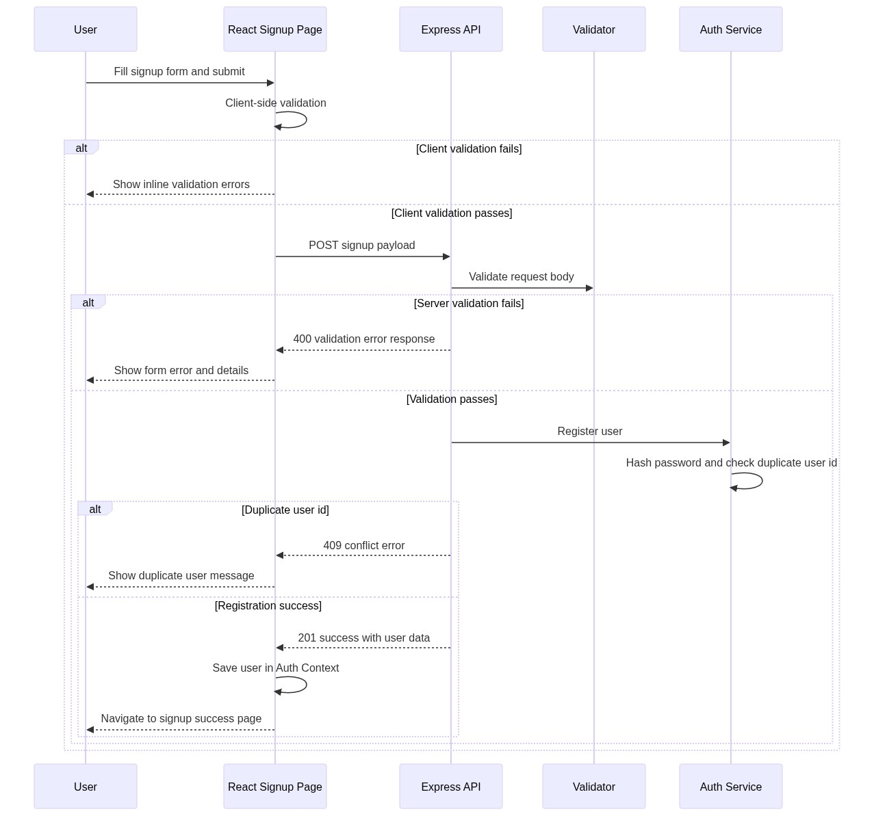
Workflow Diagram
Validation split across client and server with clear failure branches
Technical Deck | Slide 9 of 15

Slide 10
Validation and Error Strategy
Client validates format and required fields before network request.
Server re-validates payload to enforce trust boundaries.
Frontend displays field-level and form-level error messages.
Error middleware provides safe standardized API error payloads.
Technical Deck | Slide 10 of 15

Slide 11
Security and Reliability Notes
Password hashing uses scrypt with random salt per credential.
Helmet secures common HTTP headers.
CORS enables controlled cross-origin frontend calls.
Consistent response model simplifies API consumption and diagnostics.
Technical Deck | Slide 11 of 15

Slide 12
Test Strategy and Coverage
Backend tests: health, signup success, validation failure, duplicate conflict.
Frontend tests: invalid form, success navigation, API failure handling.
Quality gates include lint, test, and frontend build.
Current verification runs are passing for demo baseline.
Technical Deck | Slide 12 of 15

Slide 13
Known Gaps and Risks
In-memory store is non-persistent and non-distributed.
No auth token/session lifecycle yet.
No database migration/versioning model yet.
No deployment automation or environment promotion workflow yet.
Technical Deck | Slide 13 of 15

Slide 14
Technical Roadmap
Add persistent repository layer and durable storage.
Introduce authN/authZ and secure session strategy.
Add structured observability: logs, metrics, traces.
Automate CI/CD gates and production release pipeline.
Technical Deck | Slide 14 of 15

Slide 15
Q&A
Open topics: persistence approach, auth model, and deployment target.
Decisions needed for production-readiness timeline.
Technical Deck | Slide 15 of 15

