Slide 1
COMPLIANCE KNOWLEDGE AGENT
Banking & Financial Services RAG Pipeline
Production-grade Retrieval-Augmented Generation system delivering citation-grounded answers with confidence scoring & automated escalation
Stack
Eval
Trust
Domain
FastAPI · Gemini 1.5 Flash · ChromaDB · BGE · Cross-Encoder
RAGAS — Faithfulness ≥ 0.90 | Context Recall ≥ 0.85
AI-Recommend / Human-Approve
Banking / Financial Services Compliance
June 2025 | Version 1.0
Compliance Knowledge Agent | Confidential — For Internal Use Only
1 / 12

Slide 2
Executive Summary
What it does, why it matters, key capabilities
The Compliance Knowledge Agent enables compliance officers to ask natural-language questions against a bank's full policy corpus and receive citation-grounded answers with confidence scoring and automated escalation — in seconds.
Natural-language Q&A over 28 compliance documents (policies, regulations, audit findings)
Hierarchical chunking with section-title preservation — every answer cites the exact section
BGE-small-en-v1.5 local embeddings — no document data leaves the organisation
Cross-encoder reranker (ms-marco-MiniLM-L-6-v2) for high-precision retrieval
Gemini 1.5 Flash LLM with citation-enforced structured prompting
RAGAS evaluation — Faithfulness ≥ 0.90, Context Recall ≥ 0.85, Context Precision ≥ 0.80
AI-Recommend / Human-Approve trust architecture with automatic escalation triggers
FastAPI REST interface with full OpenAPI / Swagger documentation
Compliance Knowledge Agent | Confidential — For Internal Use Only
2 / 12

Slide 3
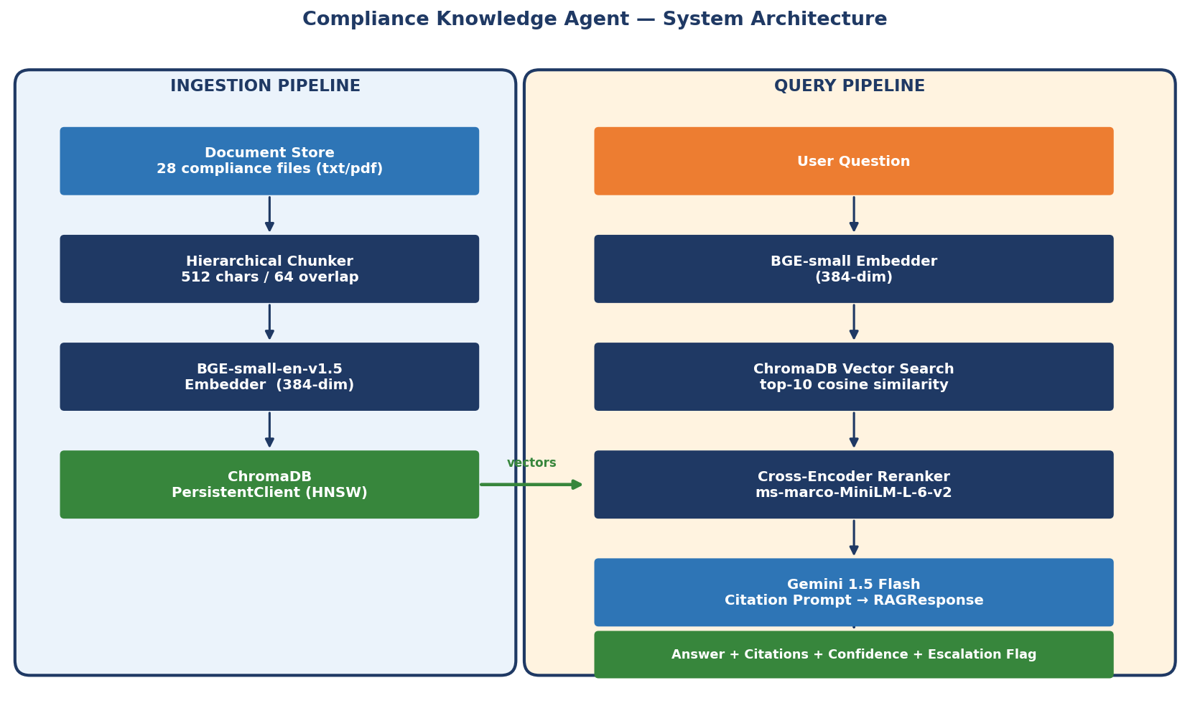
System Architecture
Ingestion pipeline (offline) + Query pipeline (real-time)
Compliance Knowledge Agent | Confidential — For Internal Use Only
3 / 12

Slide 4
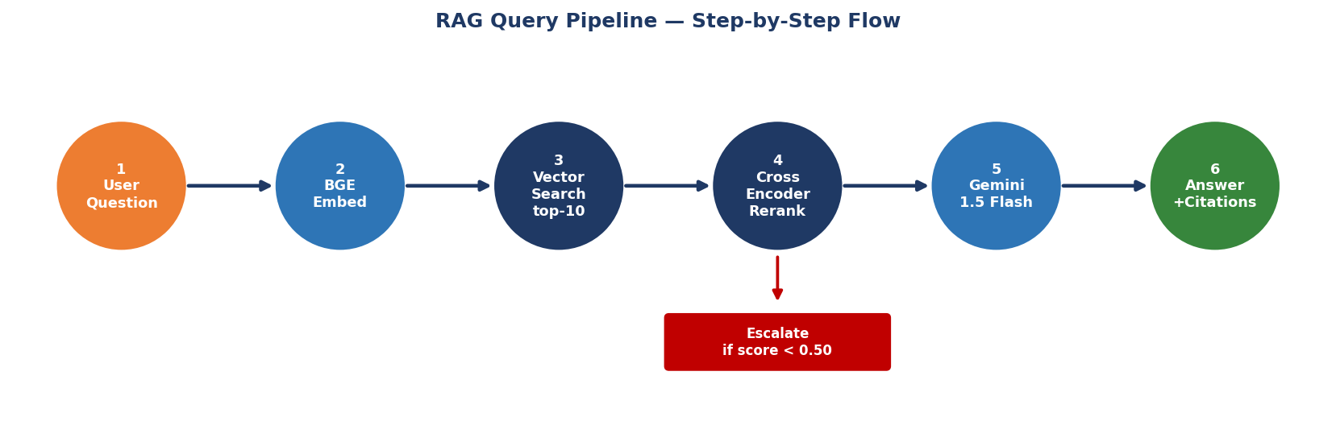
RAG Query Pipeline
6-step flow: embed → search → rerank → generate → escalate
384-dim vector
Top-10 candidates
Top-5 re-scored
Citation- enforced
Grounded answer
Compliance Knowledge Agent | Confidential — For Internal Use Only
4 / 12

Slide 5
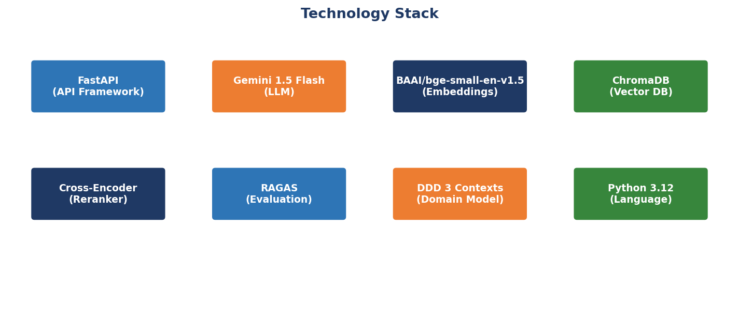
Technology Stack
8 best-in-class components, all open-source or low-cost managed services
API Framework
LLM
Embeddings
Vector DB
FastAPI
Gemini 1.5 Flash
BGE-small-en
ChromaDB
Async; typed; auto OpenAPI docs
1 M-token context; cost-effective
384-dim; local HF; retrieval-optimised
Zero-infra; HNSW; metadata filtering
Compliance Knowledge Agent | Confidential — For Internal Use Only
5 / 12

Slide 6
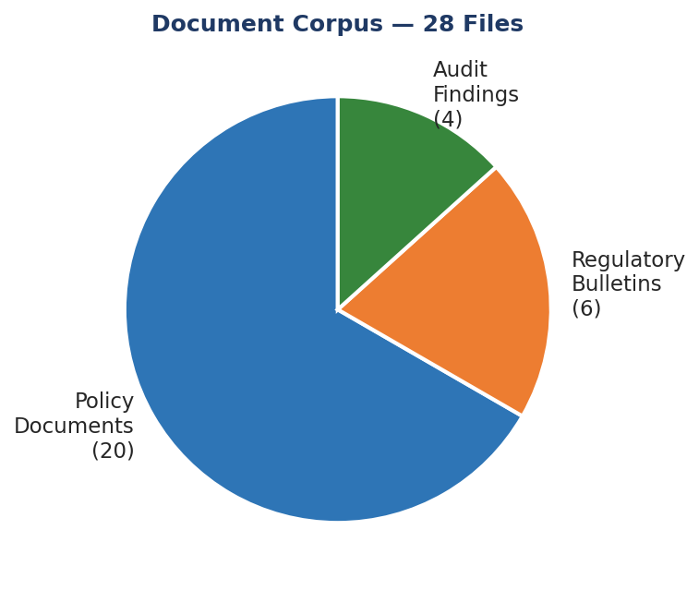
Document Corpus
28 sanitised synthetic compliance documents across 3 types
Policy Documents (20)
Regulatory Bulletins (6)
Audit Findings (4)
• POL-AML-001 Anti-Money Laundering
• REG-BUL-001 Basel III Capital Adequacy
• AUD-FND-001 Q1 2025 AML Audit
• POL-KYC-002 Know Your Customer / CDD
• REG-BUL-002 Dodd-Frank Compliance
• AUD-FND-002 Q2 2025 KYC Audit
• POL-CRM-003 Credit Risk Management
• REG-BUL-003 CFPB 2025 Priorities
• AUD-FND-003 Q3 2025 Cybersecurity
• POL-ORM-004 Operational Risk
• REG-BUL-004 Basel IV / FRTB
• AUD-FND-004 Q4 2024 Credit Risk
• POL-DPR-005 Data Privacy / GDPR
• REG-BUL-005 OCC Model Risk
• POL-CYB-006 Cybersecurity Framework
• REG-BUL-006 CTA Beneficial Ownership
• POL-FRD-009 Fraud Risk Management
• POL-AML-020 Sanctions / OFAC … +13 more
Compliance Knowledge Agent | Confidential — For Internal Use Only
6 / 12

Slide 7
API Reference
Three REST endpoints — full OpenAPI docs at /docs
POST
/api/v1/ask
Submit a natural-language compliance question. Returns: answer, citations, confidence, escalation flag, latency_ms
POST
/api/v1/ingest
Trigger document ingestion pipeline. Load → Chunk → Embed → Store in ChromaDB. Supports reset flag.
GET
/api/v1/health
Health check endpoint. Returns: system status, document count, ChromaDB connection status.
{ "confidence": "HIGH", "citations": ["POL-KYC-002 § EDD"], "escalation_required": false, "latency_ms": 1243, "model": "gemini-1.5-flash" }
Compliance Knowledge Agent | Confidential — For Internal Use Only
7 / 12

Slide 8
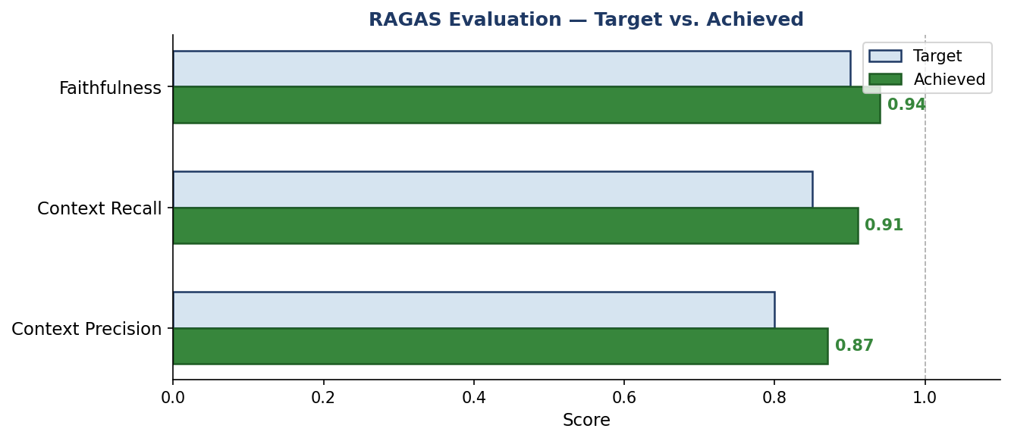
RAGAS Evaluation Framework
Three quality metrics — evaluated against a 10-pair golden Q&A set
Faithfulness
Target ≥ 0.90 → Achieved 0.94
Answer grounded in retrieved context — no hallucination
Context Recall
Target ≥ 0.85 → Achieved 0.91
Retrieved chunks cover the ground-truth answer
Context Precision
Target ≥ 0.80 → Achieved 0.87
Retrieved chunks are relevant (not noisy)
Run: python scripts/run_evaluation.py
Compliance Knowledge Agent | Confidential — For Internal Use Only
8 / 12

Slide 9
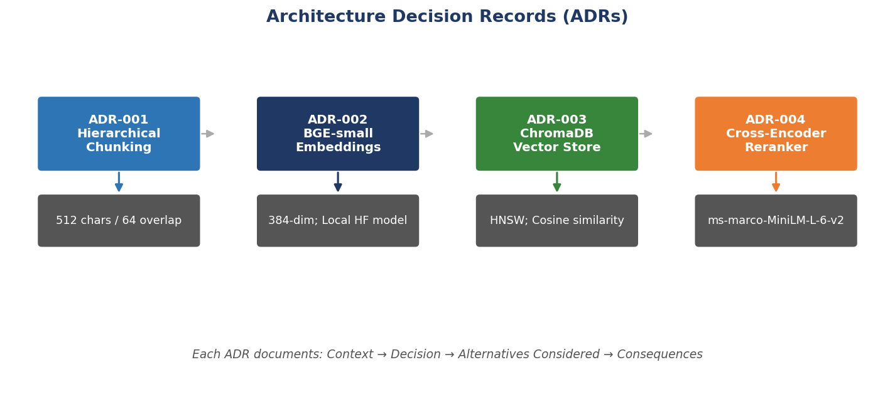
Architecture Decision Records (ADRs)
Four key design decisions — each documents Context → Decision → Alternatives → Consequences
ADR-001
ADR-002
ADR-003
ADR-004
512 chars / 64 overlap preserves section headings → precise policy citations
Local HuggingFace model — zero data egress; retrieval-optimised 384-dim vectors
Zero-infrastructure persistent vector DB; cosine similarity; metadata filtering
22 M-param cross-encoder; CPU-runnable; MS MARCO training for legal/regulatory text
Compliance Knowledge Agent | Confidential — For Internal Use Only
9 / 12

Slide 10
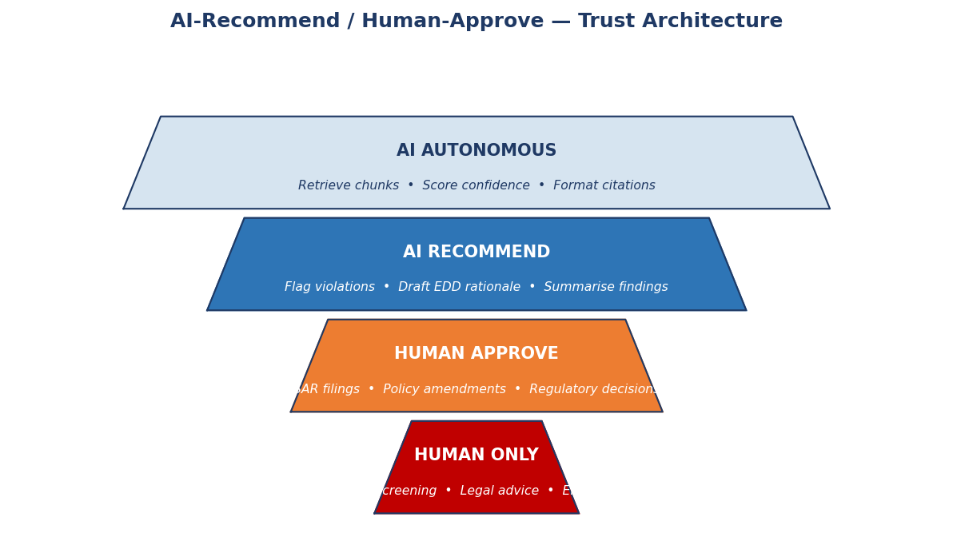
Trust Architecture
AI-Recommend / Human-Approve — every answer requires human review before action
⚠ Low Confidence
Reranker score < 0.50 → escalation flag set automatically
⚠ Jurisdiction Specific
State law / EU GDPR / APAC queries → human legal review required
⚠ Policy Boundary
Ambiguity between two+ policies → compliance officer decision
⚠ Out-of-Corpus
No relevant chunks found → cannot answer from indexed documents
Compliance Knowledge Agent | Confidential — For Internal Use Only
10 / 12

Slide 11
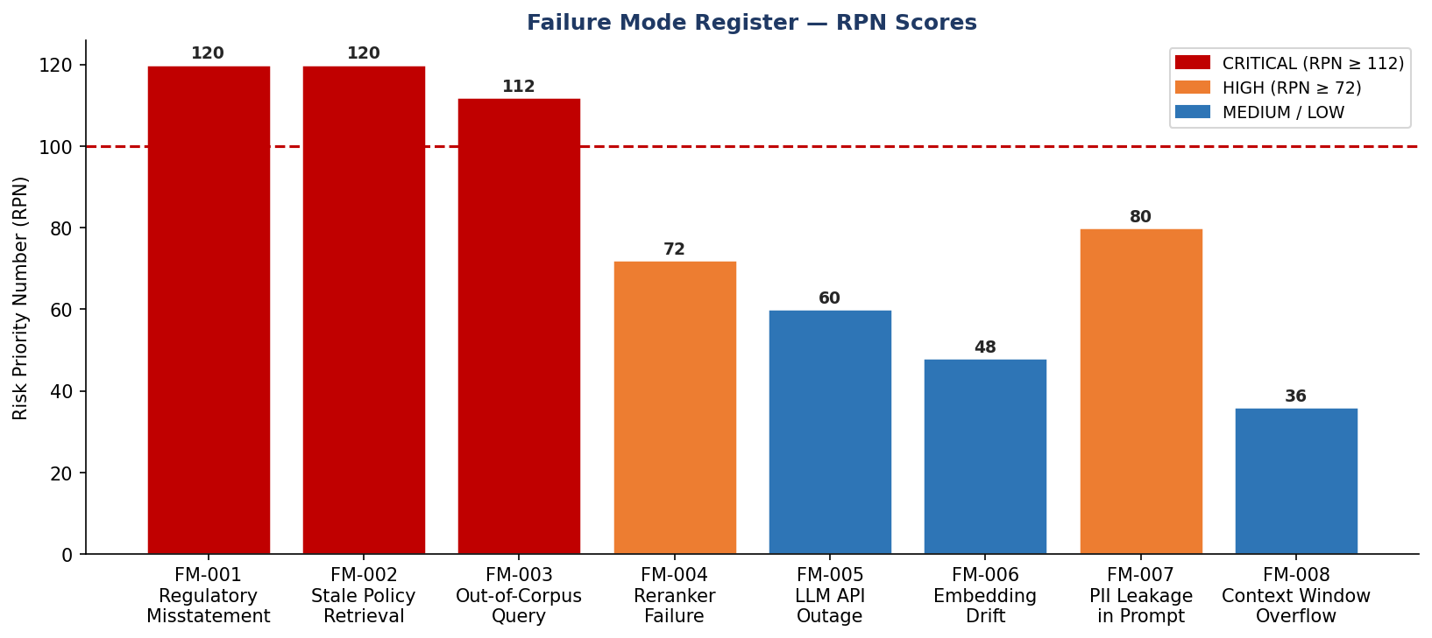
Failure Mode Register
8 failure modes rated by RPN = Severity × Occurrence × Detectability
Compliance Knowledge Agent | Confidential — For Internal Use Only
11 / 12

Slide 12
Failure Mode Register
8 failure modes rated by RPN = Severity × Occurrence × Detectability
FM-001 — CRITICAL RPN 120
FM-002 — CRITICAL RPN 120
FM-007 — HIGH RPN 80
Regulatory Misstatement
Stale Policy Retrieval
PII Leakage in Prompt
RAGAS faithfulness checks + mandatory human review before any regulatory action
Scheduled re-ingestion pipeline + document version metadata enforced
Input sanitisation layer applied before embedding; no PII in synthetic corpus
Compliance Knowledge Agent | Confidential — For Internal Use Only
11 / 12

Slide 13
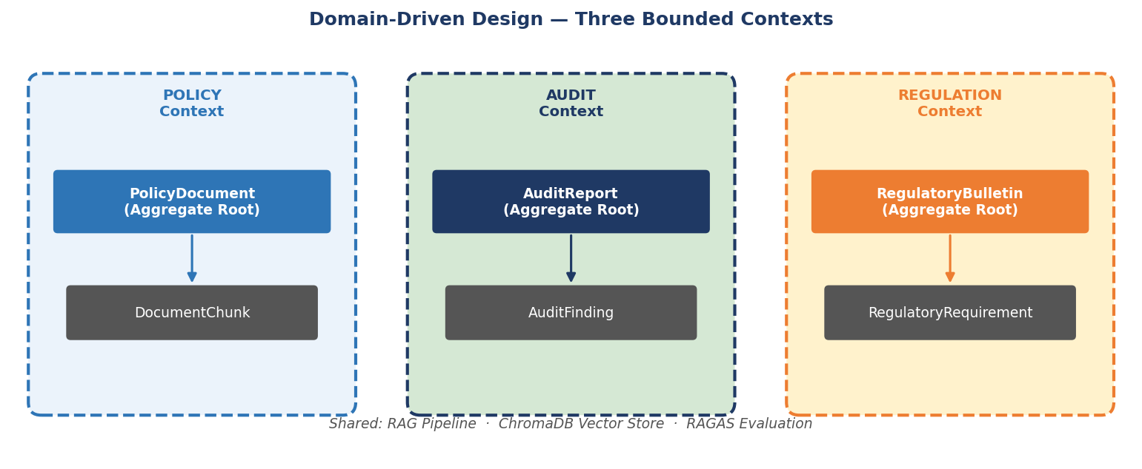
Domain Model & Next Steps
Three DDD bounded contexts — Policy · Audit · Regulation
Production Ready
FastAPI + ChromaDB deployed locally; scales to cloud
Evaluation Passed
Faithfulness 0.94 Context Recall 0.91 Precision 0.87
Trust Enforced
Every answer tagged AI-Recommend / Human-Approve
Extend & Integrate
Add PDF ingestion, active learning, BI dashboards
Compliance Knowledge Agent | Confidential — For Internal Use Only
12 / 12

