Slide 1
FOOD RECOGNITION AND CALORIE ESTIMATION

Slide 2
INTRODUCTION
With the prevalence of smartphones and digital cameras, there has been an increase in the sharing of food images on social media platforms and dietary tracking applications.
Manual logging of dietary intake is prone to errors and can be time-consuming. Automated methods using computer vision offer a promising solution to this problem.
This project focuses on developing a system that utilizes deep learning techniques to recognize various food items from images and estimate their calorie content, aiding in dietary tracking and promoting healthier eating habits.
Introduction

Slide 3
ABSTRACT
Project is splitted into three parts. Each part connected to others so that reach the target.
Food Recognition
Recognize food in a photo
Return food’s information in summary
Ingredient Detection
Detect food’s ingredients in a photo one by one.
Return exactly nutrition value and predict its taste.
Mobile app
Take a photo
Put it into models and get return results.
Show result to user.
Introduction

Slide 4
Requirements
TensorFlow: ML/DL Framework developed by Google
Python Programming Language
Anaconda

Slide 5
Overview
Mobile App
Take a photo
Food Recognition
Ingredient Detection
Calculate and show information

Slide 6
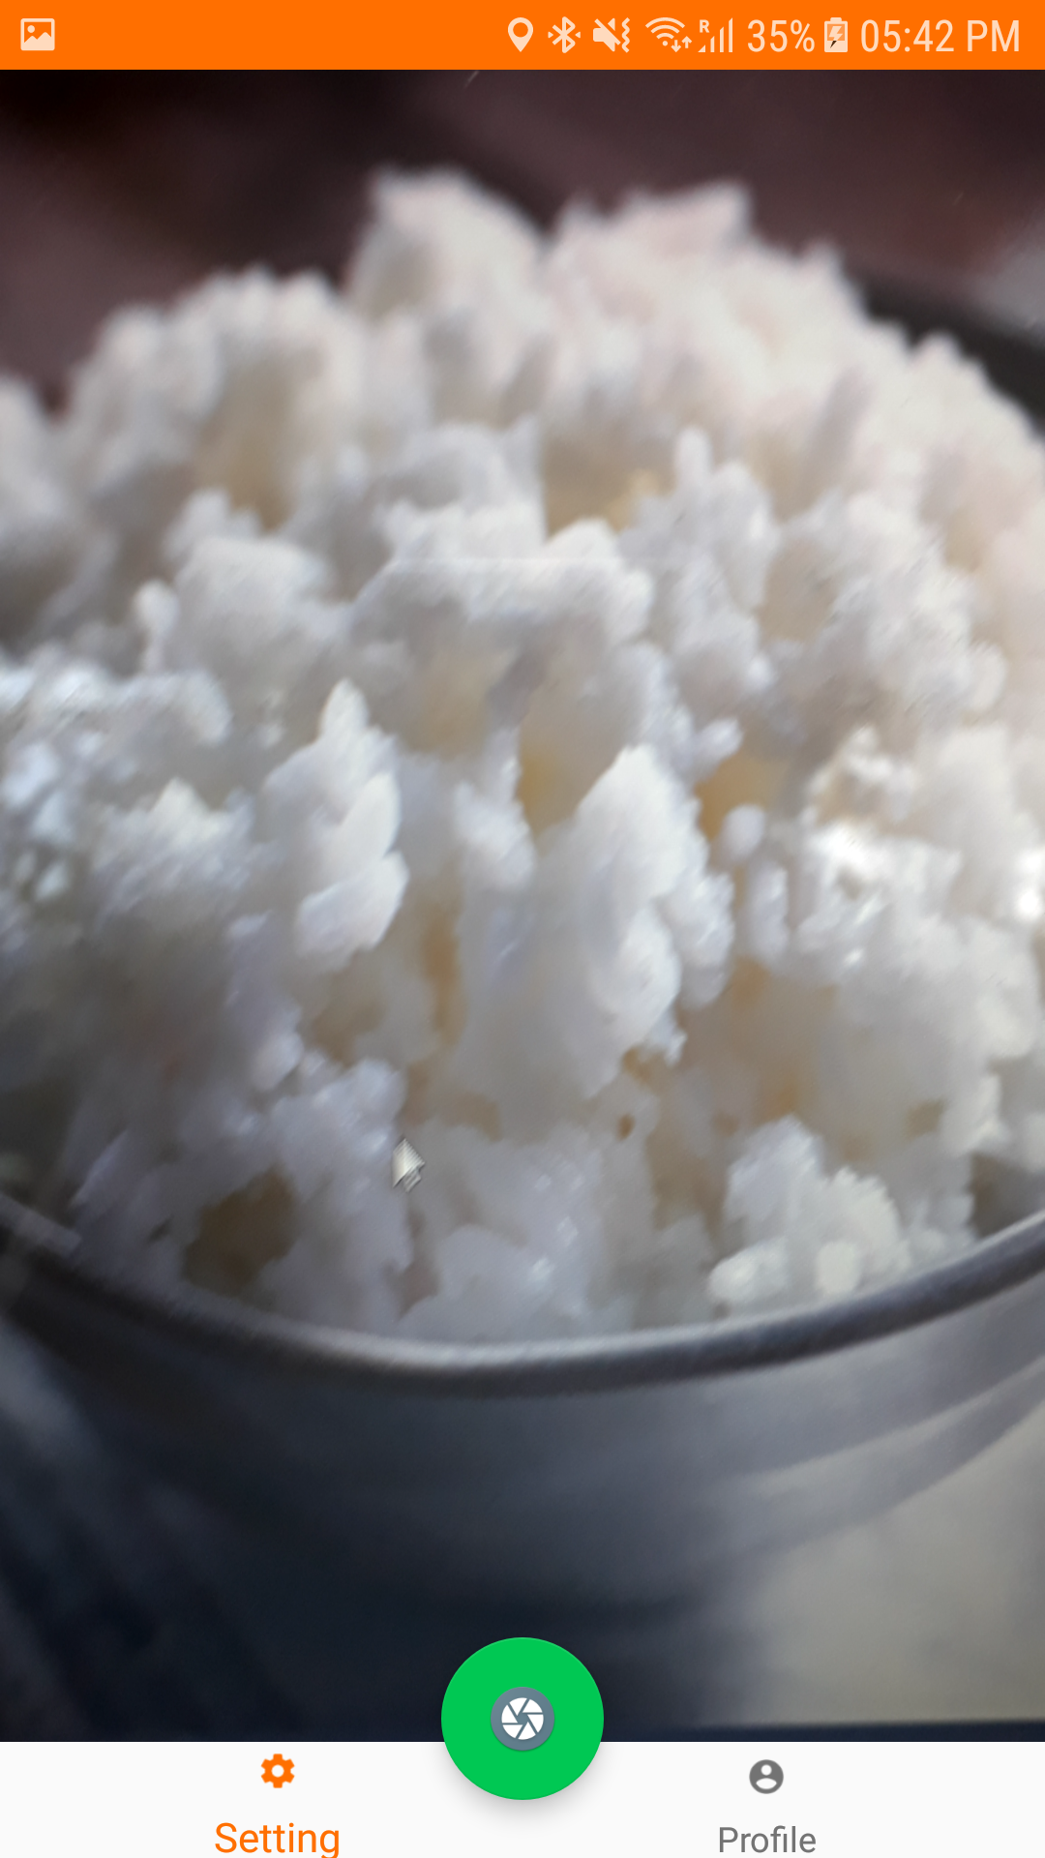
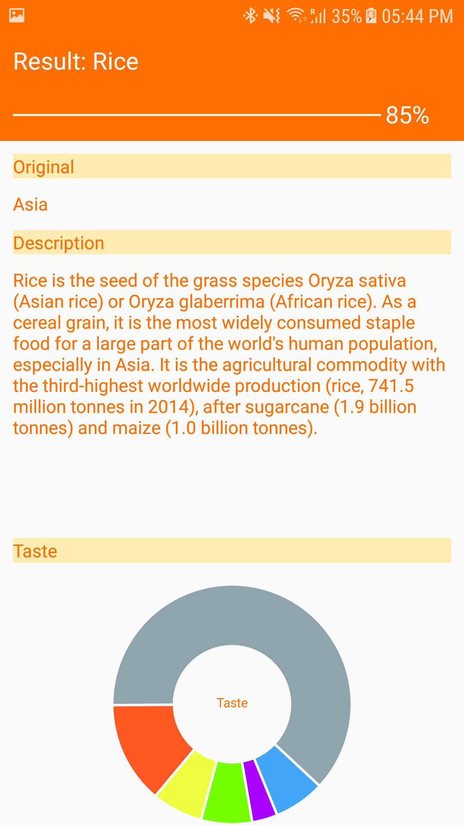
Mobile app (Android)

Slide 7
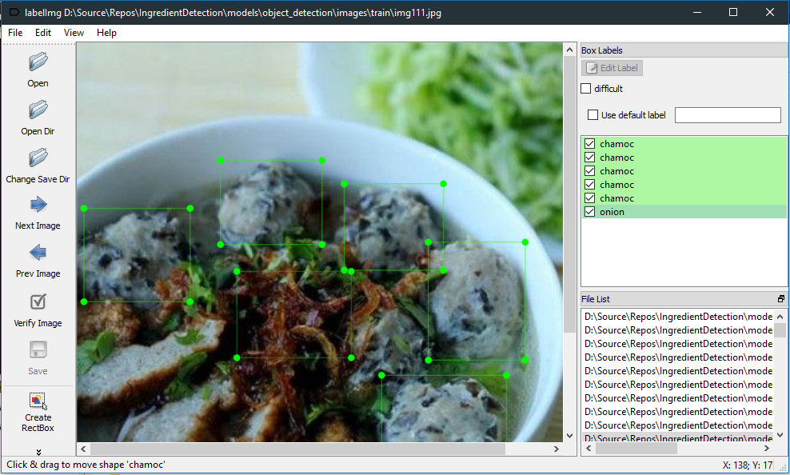
Prepare dataset
Use LabelImg tool

Slide 8
MATERIALS & METHODS
Utilize deep learning techniques, specifically convolutional neural networks (CNNs), for food image recognition.
Pre-trained CNN models such as VGG16, ResNet, or MobileNet are fine-tuned on a labeled dataset of food images to extract relevant features.
Develop a calorie estimation module that integrates nutritional databases or APIs to retrieve calorie information for recognized food items.
Consider additional visual characteristics such as portion size and food composition to refine the calorie estimation process.

Slide 9
DISCUSSION
Prepare more data for Food Recognition. Not only 10 Vietnamese food, but also more food.
Prepare more data for Ingredient Detection. I will classify these food into a lot of subclass. I will collect 1000 photos per subclass.
Try anothor models such as mobilenet v2,...
Finish food tracking function in Android app.
Create app for iOS platform.
Improve accuracy and performance. I would like to serve as a service via Web API, so these model will be stored and ran on server.

Slide 10
RESULT
Present the performance metrics of the proposed system, including accuracy, precision, and recall, obtained through experimentation and evaluation.
Display sample images of recognized food items along with their estimated calorie content to illustrate the system's capabilities.
Discuss any challenges encountered during the development and evaluation of the system and how they were addressed.

Slide 11
References
Image recogntion: https://www.tensorflow.org/hub/tutorials/image_retraining
Object detection: https://github.com/EdjeElectronics/TensorFlow-Object-Detection-API-Tutorial-Train-Multiple-Objects-Windows-10
NutriNet: A Deep Learning Food and Drink Image Recognition System for Dietary Assessment (Simon Mezgec 1,* and Barbara Koroušic´ Seljak 2)
Deep Learning Based Food Recognition (Qian Yu Stanford University qiany@stanford.edu, Dongyuan Mao, Stanford University dmao@stanford.edu, Jingfan Wang Stanford University jingfan@stanford.edu)
FOODIMAGERECOGNITIONUSINGDEEPCONVOLUTIONALNETWORK WITHPRE-TRAININGANDFINE-TUNING (Keiji Yanai, Yoshiyuki Kawano)

Slide 12
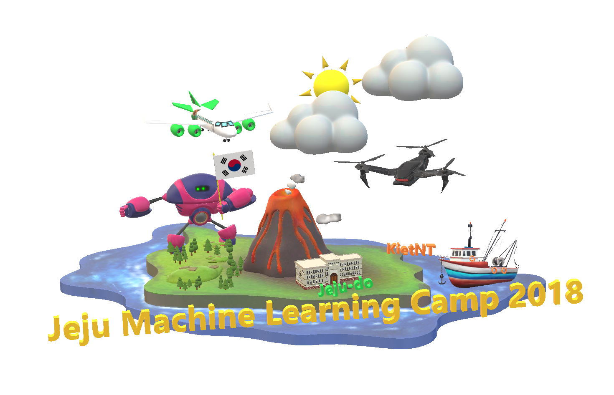
THANK YOU

