Slide 1
Deeper, Broader and Artier Domain Generalization
Dinesh Kumar R, 2019102027
Pranoy J, 2019115004
Sivaprasad S, 2019102007

Slide 2
Objective of the paper
Classify a given image into a class irrespective of what domain the image given belongs to.
Dataset used: Images of various classes (eg: horse, house, guitar) depicting various images of a single kind of object from various domains (cartoons, photographs, paintings) are used for training.

Slide 3
Theory Involved

Slide 4

ϴ₁,ϴ₂,....., ϴ_{n} represent parameters trained to represent each domain
y_{j}^ represents the prediction made
y_{j} is the ground truth
S is the number of domains considered
N_{i} is the number of images contained within the ith domain
l is the loss function

Slide 5
For each domain, the values of the parameters are optimised such that the loss is minimal.
The objective is to find an agnostic model ϴ* that works uniformly for all domains.
Using Undo-bias, as shown in [1], the parameter for each domain can be written as:
Here, ϴ₀ is the domain agnostic model
ϴ₀ is the collection of parameters used for the final model used to evaluate the test set.

Slide 6


Now the previous equation can be expressed as:
Where
Note that the length of this vector is (S + 1)

Slide 7
Algorithm used

Slide 8


This will only work if ϴ is a linear vector. In the case it is of a higher order,
Dimensions of W: (h x c x S+1);
h : no of neurons in input, c: no of neurons in output
This represents the inner product along the third axis for a connected layer.
For a CNN layer, this becomes
Dimensions of W: (h x w x d x F_{n} x S+1);
h : height of convolution layer, w: width, d: depth, F_{n} : No of filters

Slide 9

To further reduce the number of trainable parameters, we can use higher order tensor decomposition methods such as tucker decomposition
Here we decompose the tensor into the following form :

Slide 10

Now the prediction for the ith domain can be written as:
Where
Here z^{i} is a binary vector of size (S + 1)
While training the i^{th} model, i^{th} and the last value in the vector will be 1 and all other values will be 0.

Slide 11
Results

Slide 12
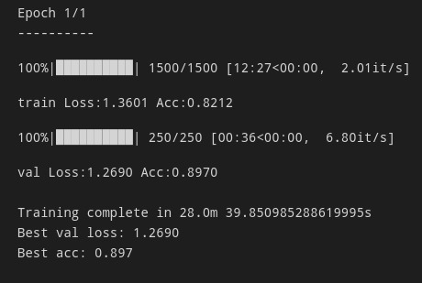
ResNet18 architecture for normal classification
Batch size: 4, Epochs: 2, Accuracy on test : 0.8963557481765747

Slide 13
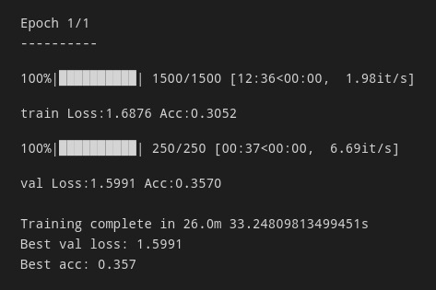
AlexNet architecture
Batch size: 4, Epochs: 2, Accuracy on test: 0.3443664312362671

Slide 14
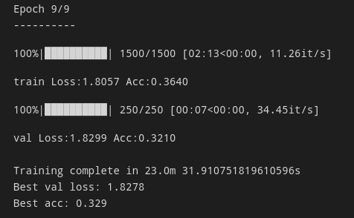
MLP
Layers: 7500 -> (2048 -> 1024) -> 7, Epochs: 10
Accuracy on test: 0.32530924677848816

Slide 15
MLP with Undo Bias
Layers: 7500 -> (2048 -> 1024) -> 7, Epochs: 10
Accuracy on test: 0.21330657601356506

Slide 16
AlexNet with Undo Bias
Epochs: 2, Accuracy on test: 0.3095954358577728

Slide 17
Link to repo: https://github.com/sivaprasad2000/SMAI_Proj_Mathilile_theyyam

