Slide 1
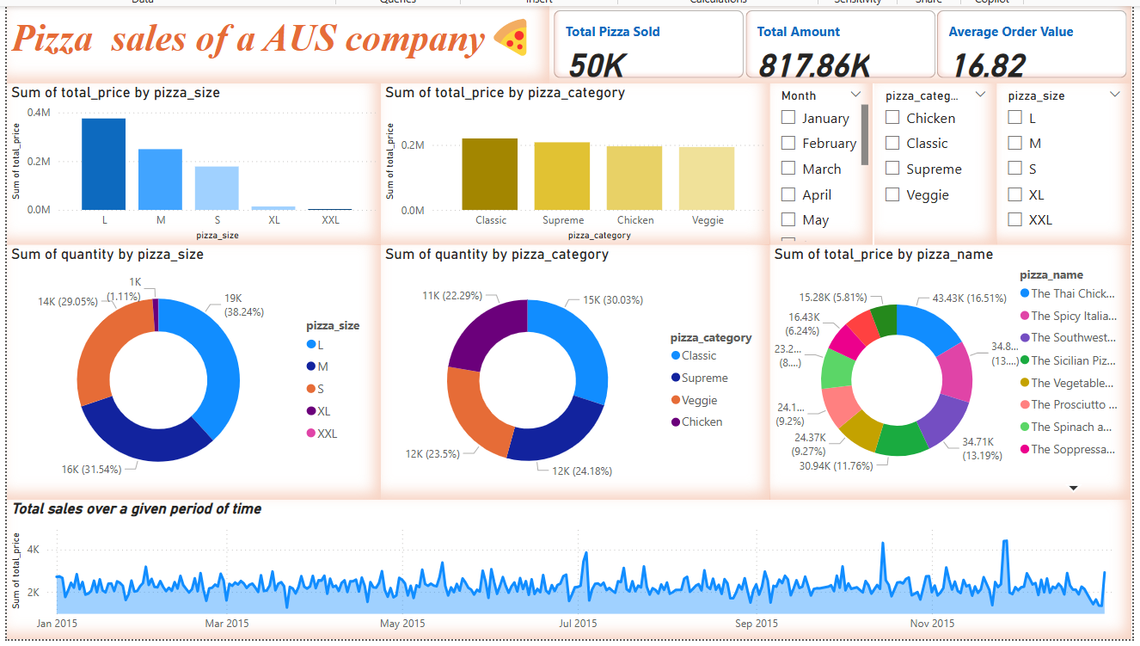
Pizza sales at AUS company

Slide 2
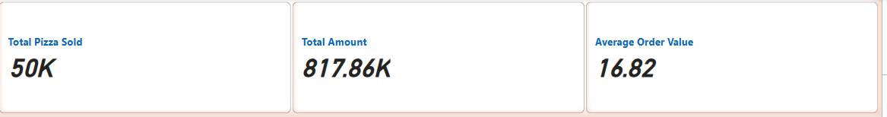
Card Plot The total pizzas sold is 50K The total revenue generated is 817.86k The average order value is 16.83

Slide 3
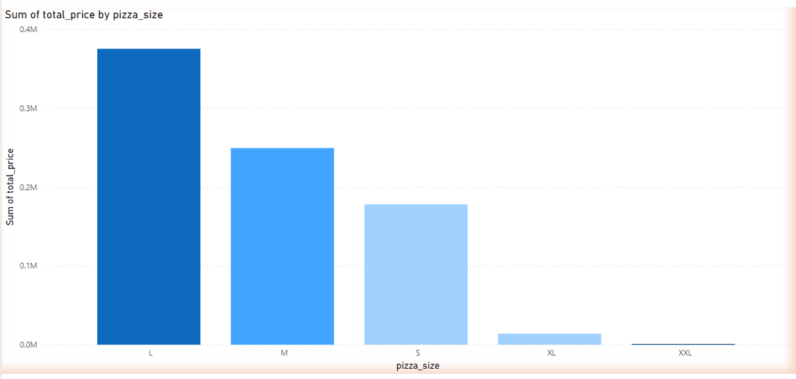
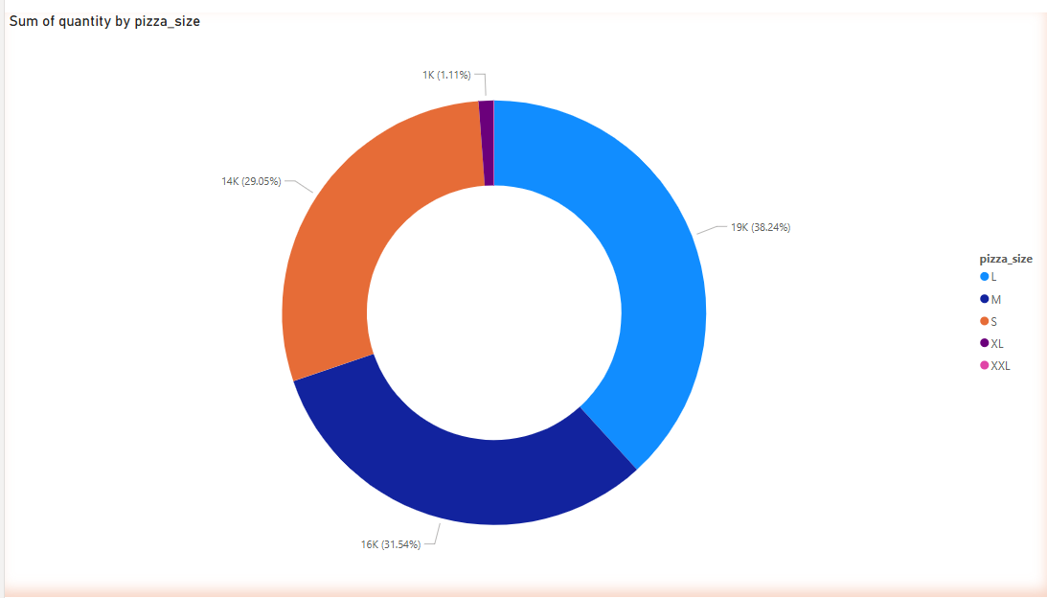
Sales by Pizza Size
Bar plot and Donut chart
Medium Pizzas in the second with 0.25M
Small pizzas at 3rd spot with 0.18M
The second lost sales comes on XL 14k
Least sold item was XXL 1k

Slide 4
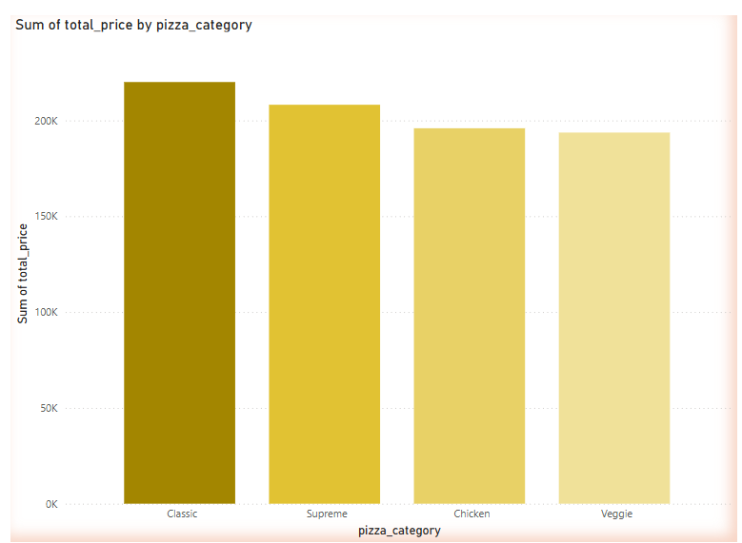
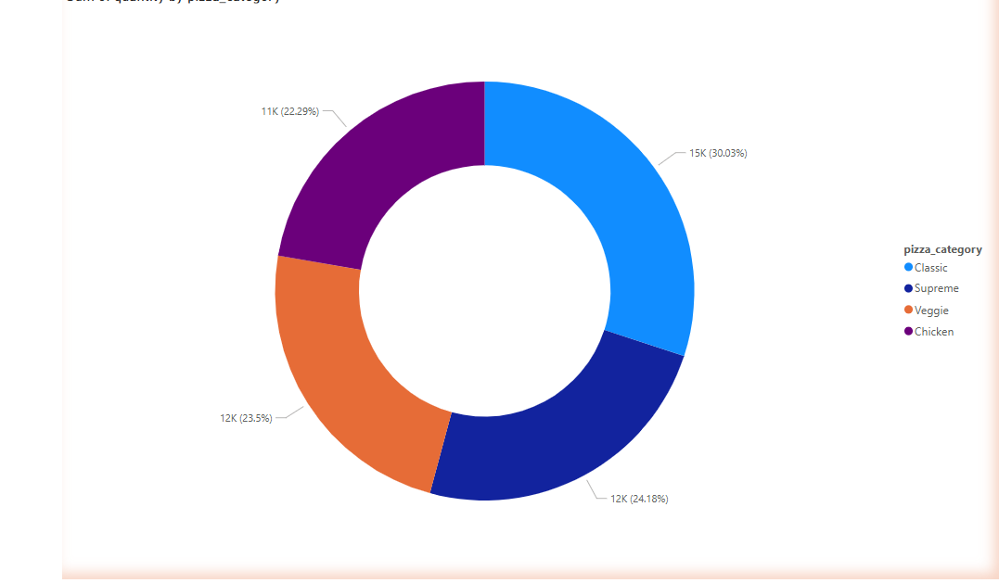
Sales by Pizza category
Bar plot and Donut chart
Classic pizzas sold the most with 0.22M
The supreme pizza sold the second-best with 0.21M
Chicken and veggies are almost similar in saws 0.20 and 0.16 respectively

Slide 5
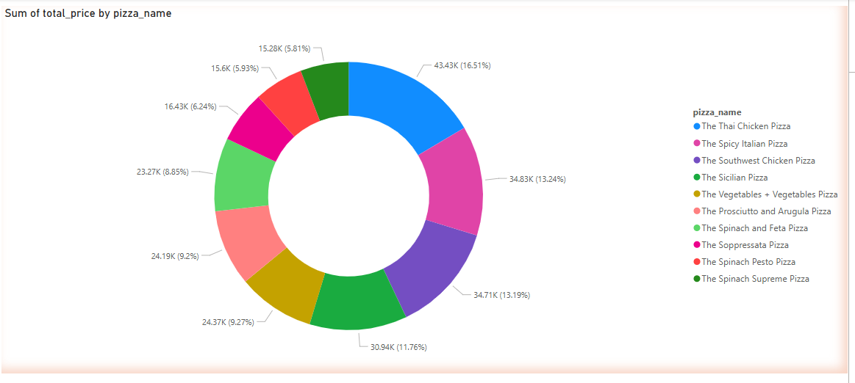
Top 10 Selling recipes
Donut chart
The Thai Chicken Pizza is
The best-selling product is with 43%
Share.

Slide 6
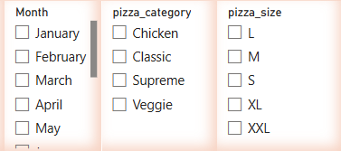
Slicers
Months January to December
Size L,M,S,XL,XXL
Category is the slicers we have

Slide 7
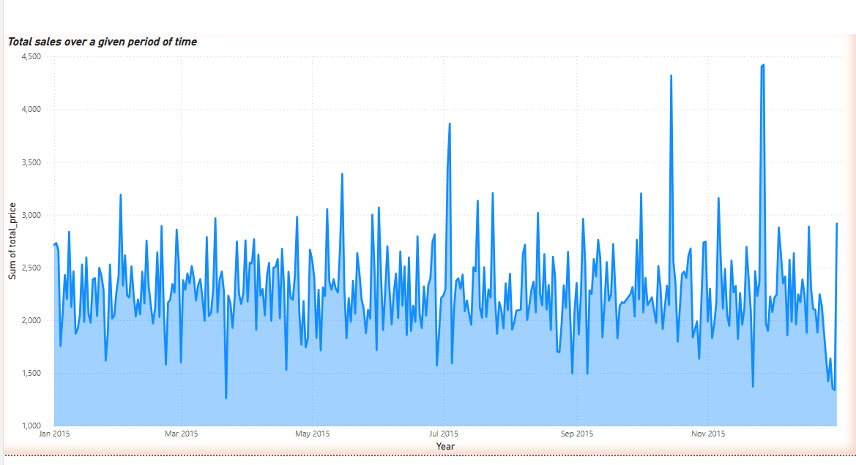
Time Series Analysis
Line Plot
A line plot that represents the sales of pizzas over a period of time

Slide 8
Thank You

