Slide 1
Lending Club Case Study
Siva Prasad Thota
Sukumar Moharana

Slide 2
Business Objective
- Lending Club is a marketplace for personal loans that matches borrowers who are seeking a loan with investors looking to lend money and make a return.
- When a person applies for a loan, there are two types of decisions that could be taken by the company.
Accepted or Rejected
- Two types of risks are associated with the company’s decision
If the applicant is likely to repay the loan, then not approving the loan results in a loss of business to the company
If the applicant is not likely to repay the loan, i.e. he/she is likely to default, then approving the loan may lead to a financial loss for the company
Business Objective: Company wants to understand the driving factors (or driver variables) behind loan default, i.e. the variables which are strong indicators of default.

Slide 3
Approach
Data Understanding & Assumptions
Data Cleaning (Missing values, Outliers, Dropping not required data, etc)
Variable & Visual Analysis (Univariate, Bivariate, Multivariate & Plotting)
Recommendations

Slide 4
Data Understanding & Assumptions
Data Understanding
Understanding features definition from Data dictionary and possible range of values from the dataset file
Assumptions
Outliers in Annual Income are omitted to eliminate bias in the analysis
Current loan status records are not considered
Income range for Employment Length feature is varying. Dropped rows with Employment Length as NA value as replacing them with Mode, Mean or Median may not match with Annual income.

Slide 5
Data Cleaning
Removal of columns with majority NA/Null values
Removal of columns with very few and very high Unique values (cross checked the importance of the variables before removal)
Removal of Current loan status records
Removing % from int_rate, revol_util and removing non numeric characters from emp_length
Data type conversion of Numeric Value columns (from object to numeric)
Outliers removal from annual_inc variable

Slide 6
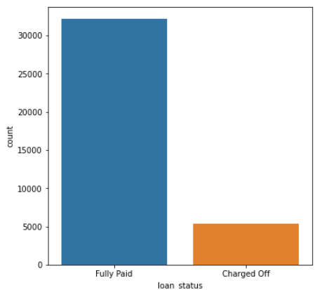
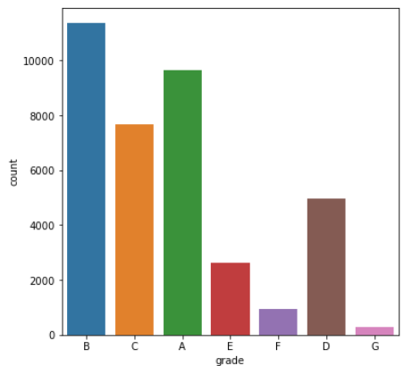
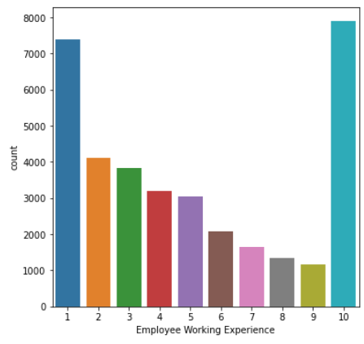
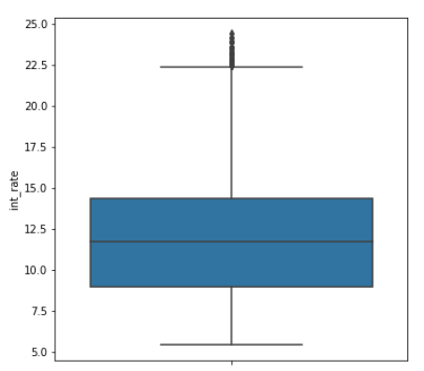
Univariate Analysis - Majority of the loans are Fully Paid. The charged off loan percentage is ~15% - Majority of the loans are A, B and C graded - People with 10 and above years of work experience applied for most of the loans. People with 0-1 years experience are the second most category of people applied for loans. - Average Interest rate is around 12%

Slide 7
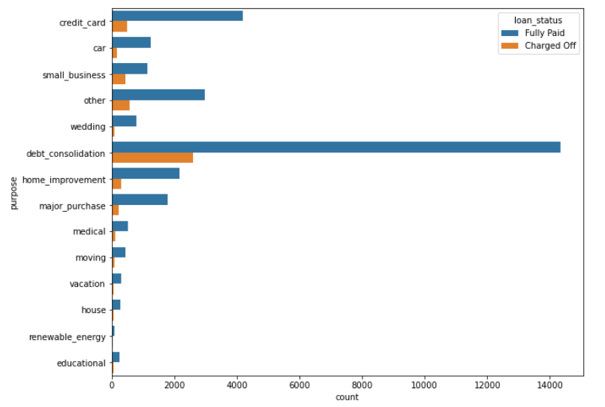
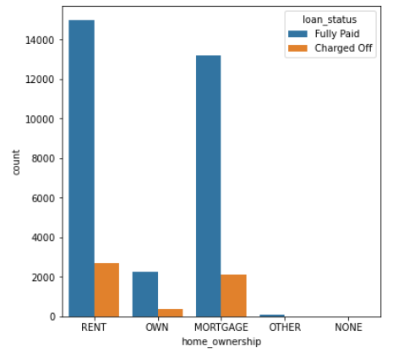
Univariate Analysis - Majority of the loans applied are for Debt Consolidation purpose - Majority of the loan applicants are living in rented or mortgaged homes

Slide 8
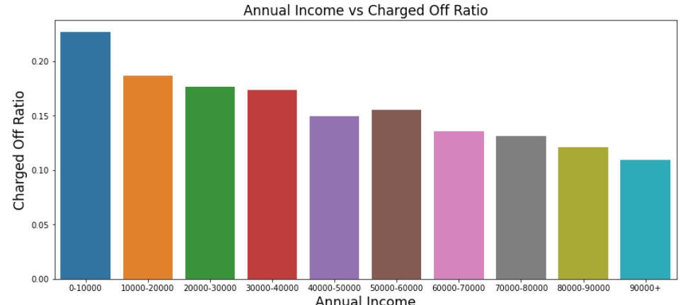
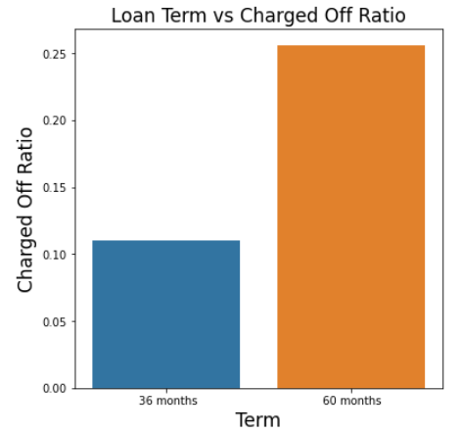
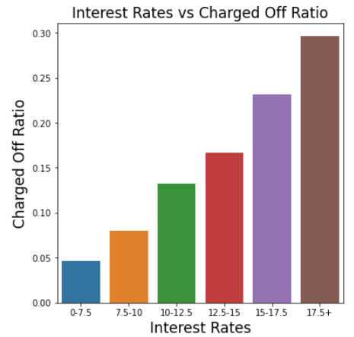
Segmented Univariate Analysis - People who are in the lower income range has a higher chance of defaulting when compared with people having higher income - People taking loan for 60 months has higher chance of defaulting when compared with 36 months - Loans given for high interest ratio has a higher chance of being charged off

Slide 9
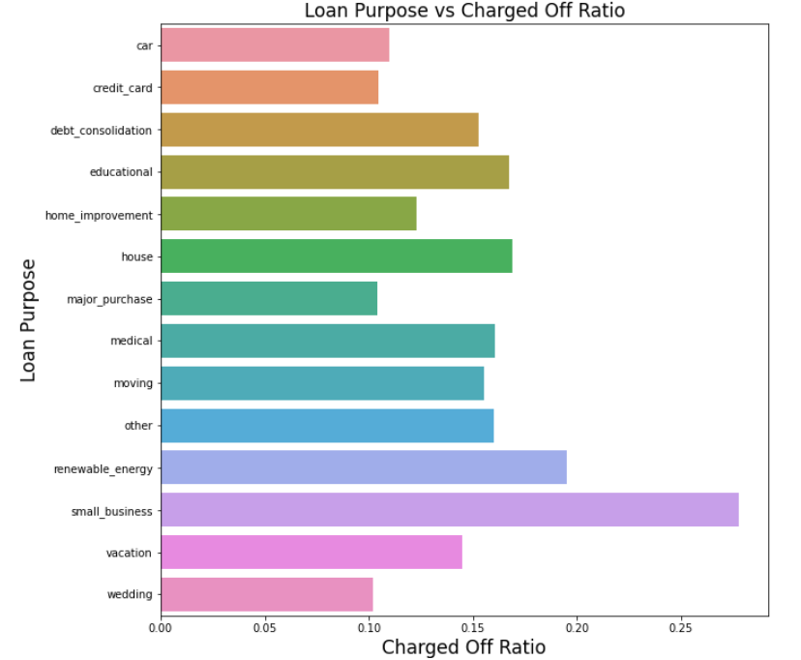
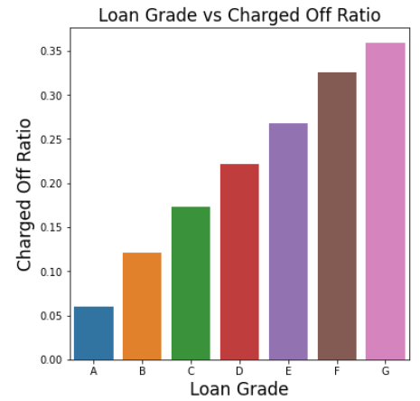
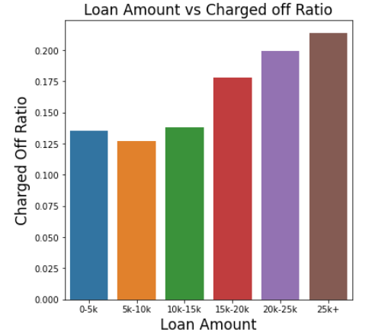
Segmented Univariate Analysis - People availing loan for Small Businesses has high chances of defaulting - Charged off scenarios are high for G, F and E grade loans - Charged off scenarios are increasing with the increase in loan amount

Slide 10
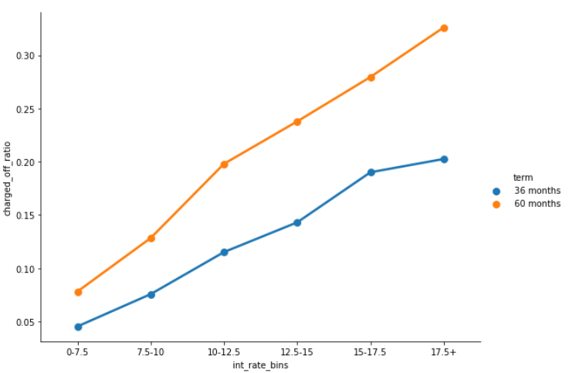
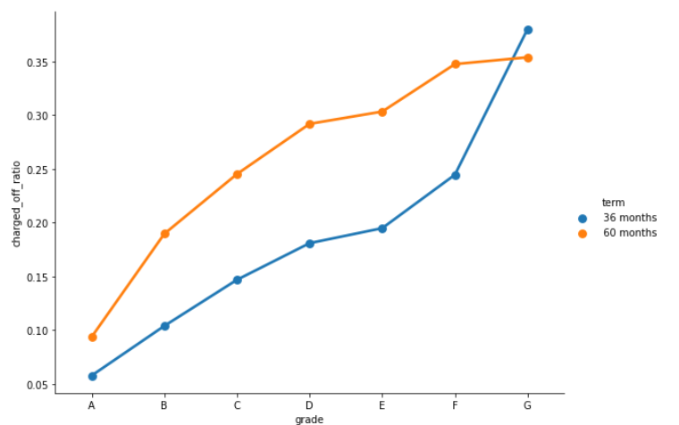
Bivariate Analysis - Charged off ratio increasing with increase in interest rates for both 36 and 60 terms - Charged off scenarios are increasing for increase in term and for grades A to G

Slide 11
Final Observations
- ~15% of the loans are currently defaulted
- Highest number of loans approved are for Debt Consolidation category
- Majority of the people who are taking loans and defaulting are living in rented and mortgaged homes
- Average interest rate is around 12%
- People with 10+ years of work experience applied for most of the loans. And people with 0-1 years experience are the second most category of people applied for loans.
- Majority of the loans are A, B and C graded
- Majority of the loans funded are within 15k
- Highest loan amount was taken for small_business followed by debit_consolidation
- Loan taken for 60 months has higher interest rate
- Interest rate is in increasing order for grades A to G
- Interest rate increasing with increase in loan amount
- Max installment amount defined is around 32% of monthly income

Slide 12
Recommendations
Following factors needs to be reviewed thoroughly before approving the loan:
- High Interest rate loans
- G, F and E graded loans
- Loans applied for 60 months term
- People who are in the lower income range
- Higher loan amount requests
- Loans for Small Businesses
- People who have defaulted before

Slide 13
Thank You

