Slide 1
Docker
siva@way2learnonline.com

Slide 2
Differences between various os
What is Difference between Ubuntu, Fedora, Suse, redhat, centos ,etc?
They all contain same Linux os kernel which interacts with hardware and some extra software
These extra softwares make each os different
These software are
  Different ui
  Drivers, File Managers, Developer tools,
siva@way2learnonline.com

Slide 3
What are containers?
Containers are completely isolated environments.
They have their own processes, network interfaces, mounts ,etc just like vms except they all share same OS kernel.
Docker uses LXC Containers
siva@way2learnonline.com

Slide 4
Types of name spaces
PID
Mount
IPC
CGroup
network
siva@way2learnonline.com

Slide 5
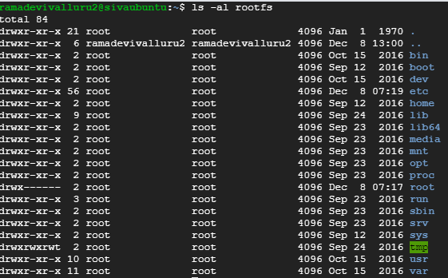
wget http://resources.way2learnonline.com/pcfadm/rootfs.tar.gz
sudo tar -zxf rootfs.tar.gz
siva@way2learnonline.com

Slide 6
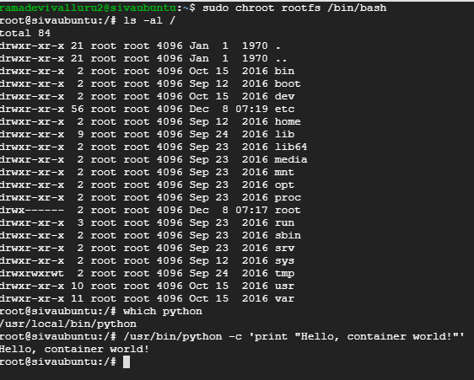
Using chroot
Chroot allows us to restrict a process’ view of the file system
siva@way2learnonline.com

Slide 7


We can see the process outside of chrooted process
siva@way2learnonline.com

Slide 8
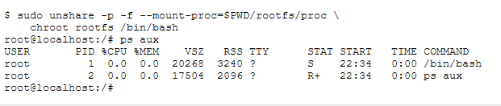
Running a process in separate namespace using unshare
siva@way2learnonline.com

Slide 9

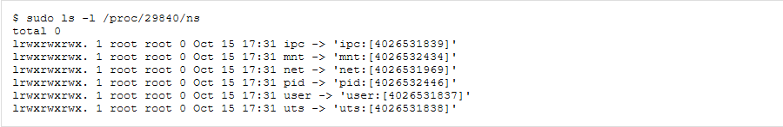
Running a new process inside existing namespace
The kernel exposes namespaces under /proc/(PID)/ns as files. In this case, /proc/29840/ns/pid is the process namespace we're hoping to join.
siva@way2learnonline.com

Slide 10
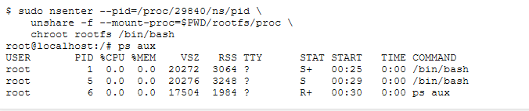
The nsenter command provides a wrapper around setns to enter a namespace.
We'll provide the namespace file, then run the unshare to remount /proc and chroot to setup a chroot.
This time, instead of creating a new namespace, our shell will join the existing one.
siva@way2learnonline.com

