Slide 1

Al-based tool for preliminary diagnosis of Dermatological manifestations
SMART INDIA HACKATHON 2023
Ministry/Organization Name/Student Innovation: Ministry of Ayush
PS Code: SIH1344
Team Name: New Rise
Team Leader Name: Mohamed Aslam K
Institute Code (AISHE): C-27058
Institute Name: Mepco Schlenk Engineering College, Sivakasi
Theme Name: MedTech / BioTech / HealthTech

Slide 2
Team Details
Team Leader Name: Mohamed Aslam K
Branch : BTech Stream : AI&DS Year : III
Team Member 1 : Asvita S
Branch : BTech Stream : AI&DS Year : III
Team Member 2 : Maal Subiksha
Branch : BTech Stream : AI&DS Year : III
Team Member 3 : Monica G
Branch : BTech Stream : AI&DS Year : III
Team Member 4 : Pushpa Rani S
Branch : BTech Stream : AI&DS Year : III
Team Member 5: Siva Prasanth M
Branch : BTech Stream : AI&DS Year : III
Team Mentor : Mrs. Prasika L Assitant Professor AI & DS

Slide 3
PROBLEM DESCRIPTION
The Global Burden of Disease project has shown that skin diseases continue to be the 4th leading cause of nonfatal disease burden worldwide. These conditions are often the presenting face of more severe systemic illnesses, including HIV and neglected tropical diseases (NTD). such as elephantiasis and other lymphedema-causing diseases. Additionally, skin disorders pose a significant threat to patients' well-being, mental health, ability to function, and social participation. However, it is very difficult to provide better dermatological care to under-served or resource-poor regions in a cost-effective manner owing to unavailability of efficient diagnostic tools, lack of connectivity, and poor laboratory infrastructure etc. Moreover, there is also a scarcity of physicians with dermatological training. Even, preliminary screening of a dermatological manifestation seems to be an arduous task. Thus, developing an Artificial intelligence-based tool (through Image processing technique) for preliminary diagnosis of numerous dermatological conditions will prove to be a boon in the health care system.

Slide 4
Abstract
Early diagnosis of skin diseases such as HIV and skin cancer is critical for improving patient outcomes. However, access to specialized healthcare providers can be limited, especially in rural and underserved areas. Our idea is to develop a mobile application for the preliminary diagnosis of skin diseases, with a focus on HIV, Elephantesis and skin cancer. The application uses MobileNet and Attention mechanism to analyze images of skin lesions and provide a diagnosis. The dataset used for the model is HAM10000.The preprocessed dataset is then fed to the model that is capable of predicting nearly 2 major classes(skin cancer and HIV) with 6 subclasses for skin cancer. In future, the number of disease predicted can be extended with improving the data and quality. Our application is a promising tool that can assist the doctors which can be used to improve patient outcomes and reduce healthcare disparities.

Slide 5
OBJECTIVE :
Offline Mobile Application – Anytime Anywhere
Easy Diagnosis
Inexpensive
No exposure to infections

Slide 6
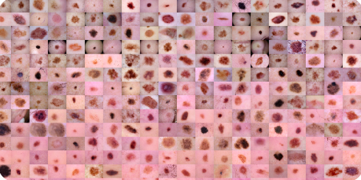
Dataset Description
HAM10000
The HAM10000 ("Human Against Machine with 10000 training images") dataset. The final dataset consists of 10015 dermatoscopic images which can serve as a training set. Cases include a representative collection of all important diagnostic categories in the realm of pigmented lesions: Actinic keratoses and intraepithelial carcinoma / Bowen's disease (akiec), basal cell carcinoma (bcc), benign keratosis-like lesions (solar lentigines / seborrheic keratoses and lichen-planus like keratoses, bkl), dermatofibroma (df), melanoma (mel), melanocytic nevi (nv) and vascular lesions (angiomas, angiokeratomas, pyogenic granulomas and hemorrhage, vasc).

Slide 7
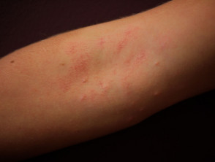
Dataset Description
Dermnet
The data consists of images of 23 types of skin diseases. The total number of images
are around 19,500, out of which approximately 15,500 have been split in the training
set and the remaining in the test set. The images are in JPEG format, consisting of 3
channels, i.e. RGB. The resolutions vary from image to image, and from category to
category, but overall these are not extremely high resolution imagery. The categories
include acne, melanoma, Eczema, Seborrheic Keratoses, Tinea Ringworm, Bullous
disease, Poison Ivy, Psoriasis, Vascular Tumours, etc.

Slide 8
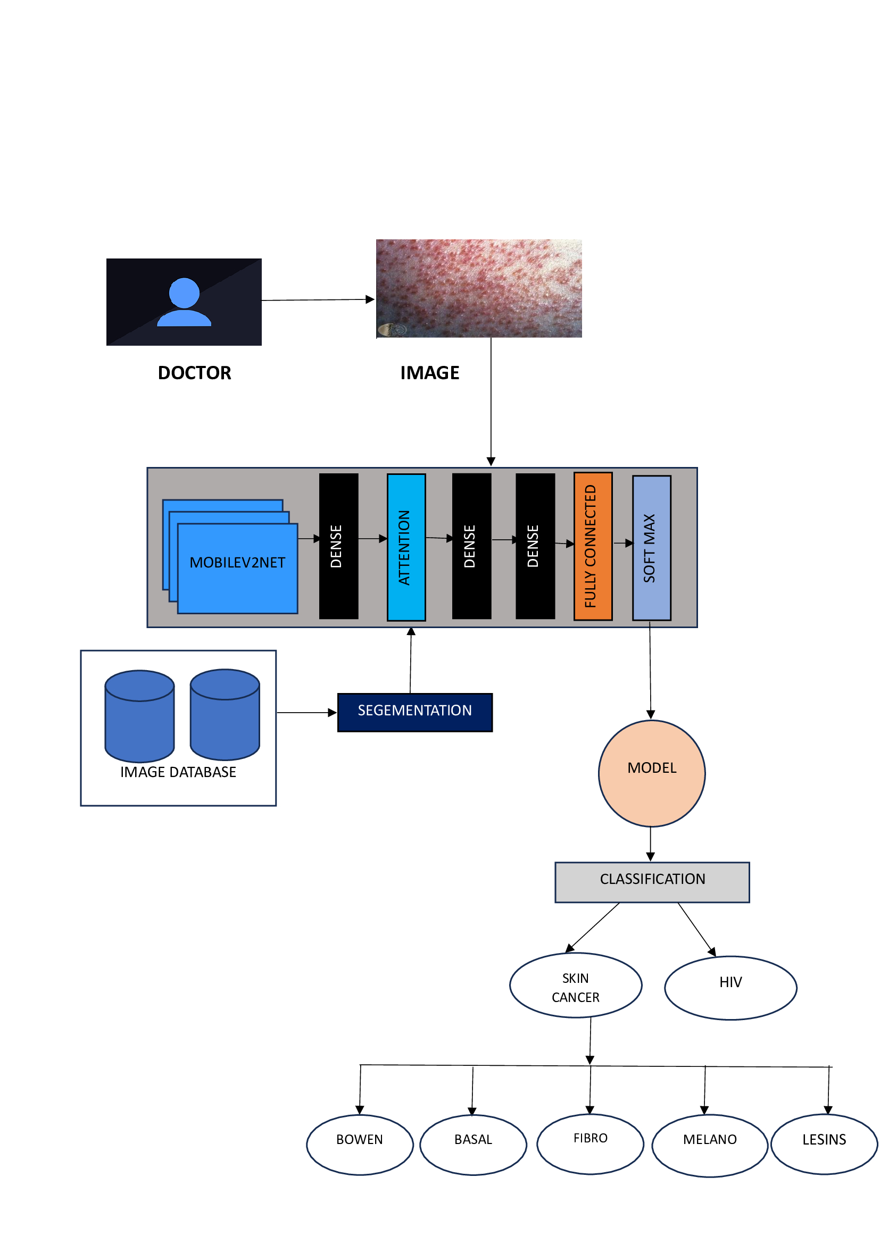
SYSTEM DESIGN
User

Slide 9
USER INTERFACE :
Dr.Derma
Insert Image
Dr.Derma
Search
Contact

Slide 10
USE CASE & DEPENDENCIES :
Clinical Decision Support
Skin disease assessment
Patient self assessment
Diagnosis and Management
Skin disease tracking and public health
Module | Used for
Kiwi | Frontend (python)
MobileNet | Image Classification
Attention | Vector based weightage to pixels
Image Database | Training Data

Slide 11
BUDGET:
COMPONENTS | COST
NVIDIA A40 96GB GPU (provided by our college) | FREE

Slide 12
FUTURE SCOPE
In future, we plan to integrate real time data collected from the hospitals to add on more number of diseases as well as provide recommendation to the best nearest hospitals based on the ratings and reviews. Including these features, an automated prescription can be generated that can be verified with the doctor for more reliability.

Slide 13
THANK YOU

