Slide 1

Al-based tool for preliminary diagnosis of Dermatological manifestations
SMART INDIA HACKATHON 2023
Ministry/Organization Name/Student Innovation: Ministry of Ayush
PS Code: SIH1344
Team Name: Cyber Creepers
Team Leader Name: Mohamed Aslam K
Institute Code (AISHE): C-27058
Institute Name: Mepco Schlenk Engineering College, Sivakasi
Theme Name: MedTech / BioTech / HealthTech

Slide 2
PROBLEM DESCRIPTION
The Global Burden of Disease project has shown that skin diseases continue to be the 4th leading cause of nonfatal disease burden worldwide. These conditions are often the presenting face of more severe systemic illnesses, including HIV and neglected tropical diseases (NTD) . such as elephantiasis and other lymphedema-causing diseases. Additionally, skin disorders pose a significant threat to patients' well-being, mental health, ability to function, and social participation. However, it is very difficult to provide better dermatological care to under-served or resource-poor regions in a cost-effective manner owing to unavailability of efficient diagnostic tools, lack of connectivity, and poor laboratory infrastructure etc. Moreover, there is also a scarcity of physicians with dermatological training. Even, preliminary screening of a dermatological manifestation seems to be an arduous task. Thus, developing an Artificial intelligence-based tool (through Image processing technique) for preliminary diagnosis of numerous dermatological conditions will prove to be a boon in the health care system.

Slide 3
ABSTRACT
Early diagnosis of skin diseases such as HIV and skin cancer is critical for improving patient outcomes. However, access to specialized healthcare providers can be limited, especially in rural and underserved areas. Our idea is to develop a mobile application for the preliminary diagnosis of skin diseases, with a focus on HIV, Elephantiasis, Skin disorder and skin cancer. Which predicts and identifies the diseased image along with its prescription .Our application is a promising tool that can assist the doctors which can be used to improve patient outcomes and reduce healthcare disparities.

Slide 4
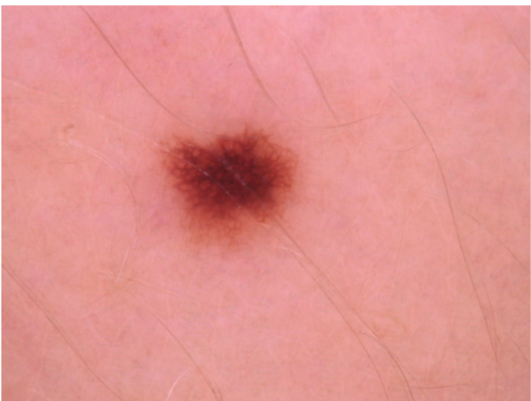


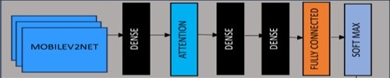





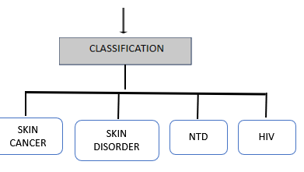
SYSTEM DESIGN
IMAGE PREPROCESSING
Size : 600*450
DOCTOR
Rescaling
Size : 224*224
MODEL
Segmentation
SEGMENTATION

Slide 5
DATASET DESCRIPTION
HAM10000 - 10015 X 7
Format - .jpg
Total images – 10015 images
Class values :
Bkl - benign keratosis-like lesions
Nv - melanocytic nev
Df – dermatofibroma
Mel – melanoma
Vasc - vascular lesions
Bcc - basal cell carcinoma
Akiec - Actinic keratoses & intraepithelial carcinoma / Bowen's disease

Slide 6

CUSTOMISED DATA
Images download from DERMNET
TYPE | TOTAL IMAGES | FORMAT
Elephantises | 26 | .jpg
Acute-HIV |  | .jpg
Warts | 394 | .jpg
Lichen planus | 101 | .jpg
Atypical nevi | 91 | .jpg
Actinic cheilitis | 55 | .jpg
angioedema | 17 | .jpg
vasculitis | 113 | .jpg
Pruritic urticarial papules and plaques of pregnancy (PUPPP) | 26 | .jpg
Leprosy |  | .jpg
Scabies |  | .jpg
Hives |  | .jpg
Rosacea |  | .jpg
Eczema |  | .jpg
Angloedema |  | .jpg
Prescription
S. THIRAVIYARAJ
Area Sales Manager
Pharmacist .
Village Kiler, PO. Saproon, Tehsil & Disitt Solan -173211,
Himachal Predesh
Visit us at : www.thesynergypharmaceuticals.com
e-mail : synergypharmaceuticals@gmail.com

Slide 7
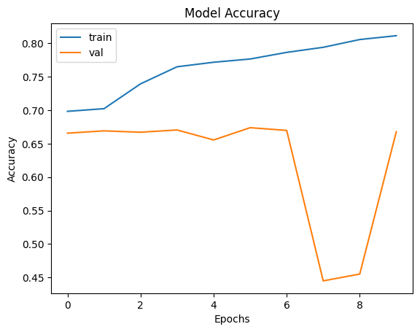
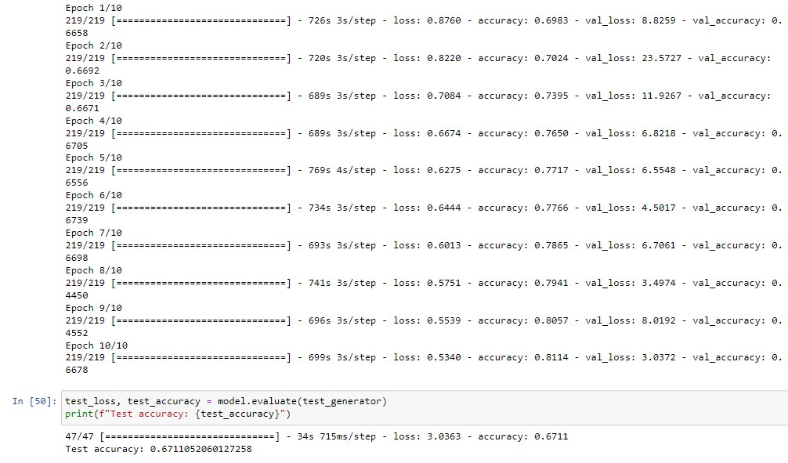
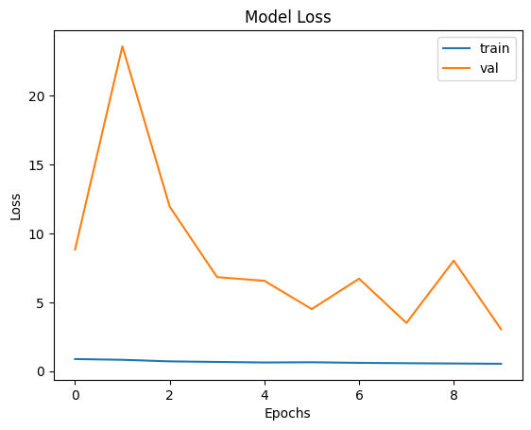
MobileNet MODEL
MODEL 3 – MOBILENET WITH ATTENTION LAYER

Slide 8
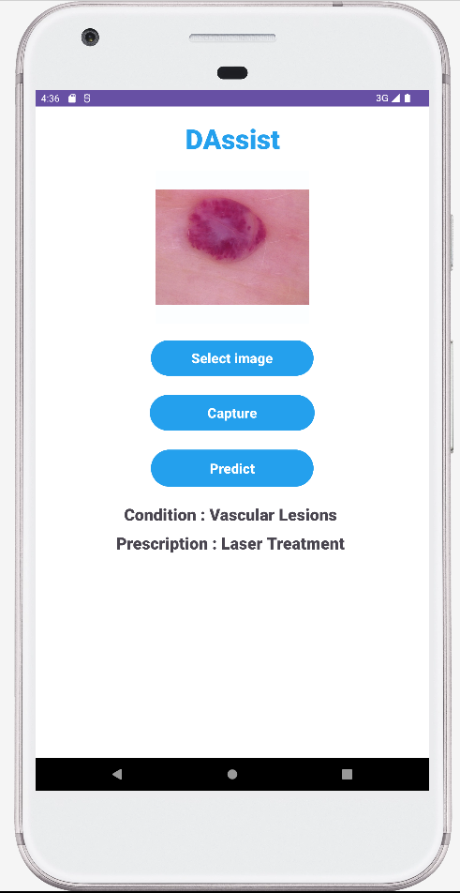
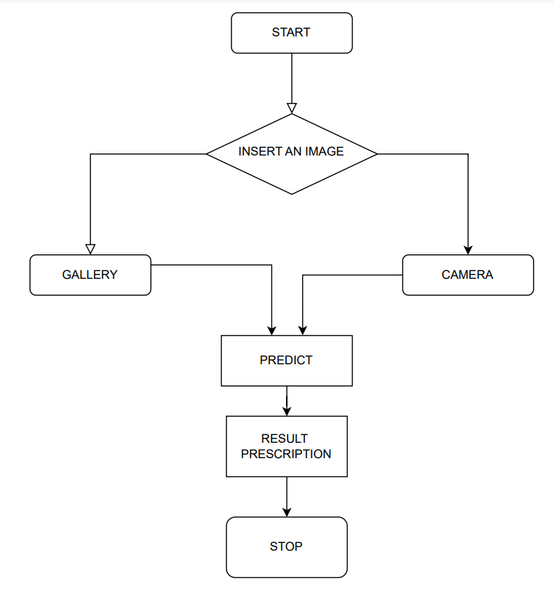

APP DESIGN

Slide 9
USE CASE & DEPENDENCIES :
Clinical Decision Support
Diagnosis and Management
Skin disease tracking and public health
Module | Used for
Android Studio | Frontend
MobileNet | Image Classification
Attention | Focus Mechanism
Image Database | Training Data
BUDGET
COMPONENTS | COST
DermNet – diseased images (New Zealand Trust) | $135
Consultant Fee | Rs.500

Slide 10
TEAM DETAILS
Team Leader Name: Mohamed Aslam K
Branch : BTech Stream : AI&DS Year : III
Team Member 1 : Asvita S
Branch : BTech Stream : AI&DS Year : III
Team Member 2 : Maal Subiksha
Branch : BTech Stream : AI&DS Year : III
Team Member 3 : Monica G
Branch : BTech Stream : AI&DS Year : III
Team Member 4 : Pushpa Rani S
Branch : BTech Stream : AI&DS Year : III
Team Member 5: Siva Prasanth M
Branch : BTech Stream : AI&DS Year : III
Team Mentor : Mrs. Prasika L Assistant Professor AI & DS
THANK YOU

