Slide 1


Slide 2
Warehouse Management System Barcode Automation for the Inventory Management System [BAIMS]

Slide 3
System Process
Gate Entry Material Receipt
Generate Barcode Tag
Quality Approval
Compare and Place the Materials to the corresponding locations
Route the Material locations as per the outward list( i.e. After Invoice)
Show the Available Quantity, Required Quantity and Locations in the rack
Generate the Barcode tag for the particular Invoice Number and date

Slide 4


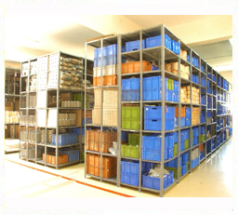





Supply Chain Process

Slide 5
Gate Entry & Barcode Label Print
In the Gate Entry, Generate the barcode and place the stickers to the corresponding Items.
Barcode sticker should have the following Details;
2.1. Part Number
2.2. Description
2.3. Quantity
2.4. Received Date
Barcode should be integrated with the Item Master.

Slide 6







Gate Entry & Barcode Label Print

Slide 7
Location & Put-Away
While placing the Items, Match the barcodes with the items and placed locations.
This Process is manual. Once Barcode matches, then gate entry status is closed otherwise the status is pending (i.e. Item placed in different locations.)

Slide 8
Outward Process
Once Performa Invoice Generated. We should generate the report for the particular Performa invoice. The report has the following details
1.1 Part Number
1.2 Description
1.3 Quantity
1.4 Available Quantity
1.5 Location
Generate one more barcode for the particular Performa invoice. It should contain the following details.
2.1 Performa Invoice Number
2.2 Date

Slide 9





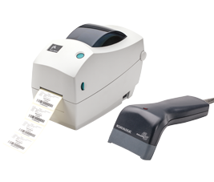

Outward Process

