Slide 1
Poultry Carcass Defect Detection
AI-Powered
Quality Control
for Poultry
Industry
System Design, Class Diagram & ER Diagram
Flask • YOLO26 • Python • OpenCV • HTML/JS

Slide 2
Project Overview
* Objective
Detect and classify defects in poultry carcasses using YOLOv26-based deep learning.
* Dataset
Merged YOLO dataset from multiple sources with train / valid / test splits.
* Model
YOLO26 nano model (yolo26n.pt) trained on poultry defect images; exports to ONNX.
* Web Application
Flask REST API + browser frontend supporting image upload, video upload & live camera.
* Outputs
Annotated images/videos with bounding boxes, confidence scores, and summary stats.

Slide 3
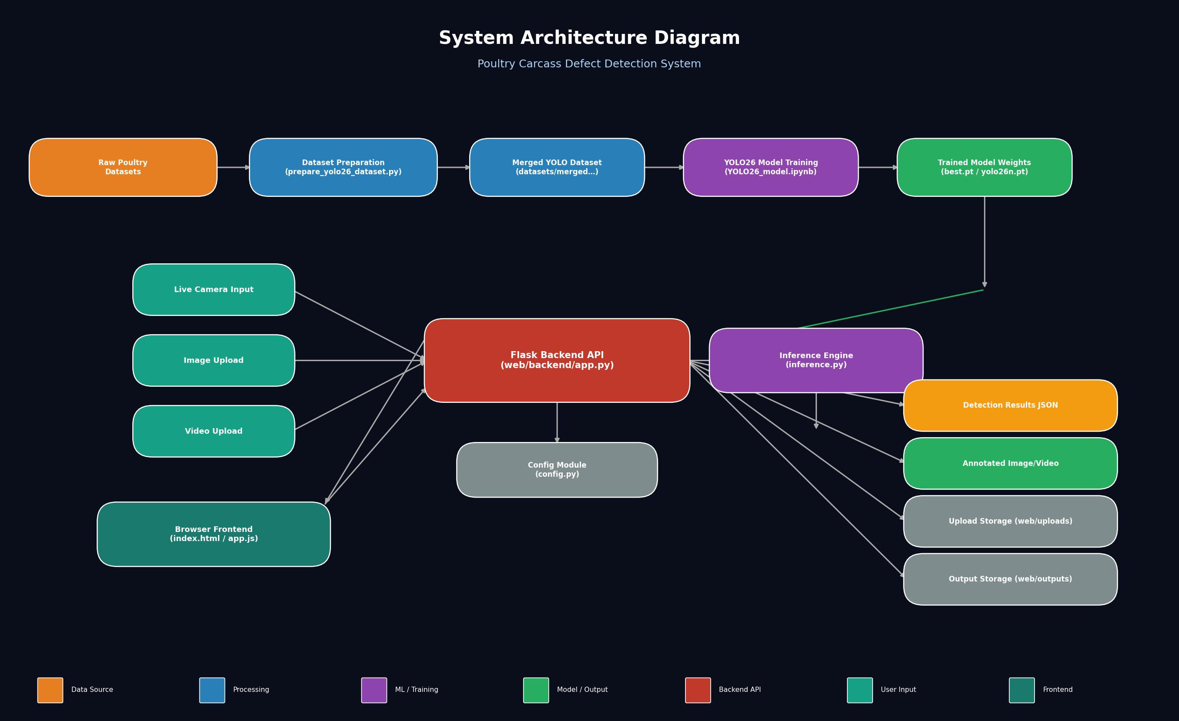
System Architecture Diagram
End-to-end pipeline: Dataset → Training → Model Weights → Flask API → Frontend

Slide 4
Module Decomposition
Dataset Preparation
Dataset Storage
Model Training
prepare_yolo26_dataset.py
datasets/merged_detection_yolo26/
YOLO26_model.ipynb
Model Artifacts
Backend API
Inference Engine
runs/…/weights/ (best.pt, best.onnx)
web/backend/app.py
web/backend/inference.py
Configuration
Frontend UI
Temporary Storage
web/backend/config.py
web/index.html + web/static/
web/uploads/ + web/outputs/

Slide 5
API Endpoints & Data Flow
/api/health
GET
Check model readiness & system health
/api/detect/image
POST
Upload image file or base64 → annotated JPEG + JSON detections
/api/detect/frame
POST
Send webcam frame (base64) → real-time detection JSON
/api/detect/video
POST
Upload video → processed MP4 + detection stats
/api/outputs/<filename>
GET
Stream processed output video to browser

Slide 6
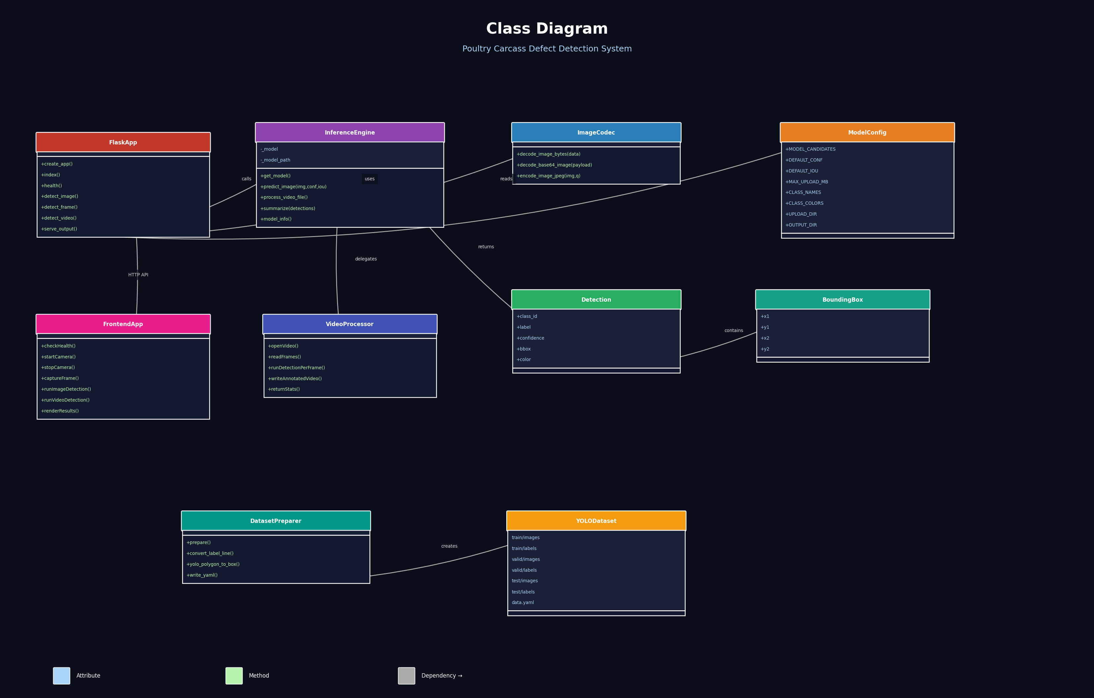
Class Diagram
Logical components and their relationships (function-based, modularized)

Slide 7
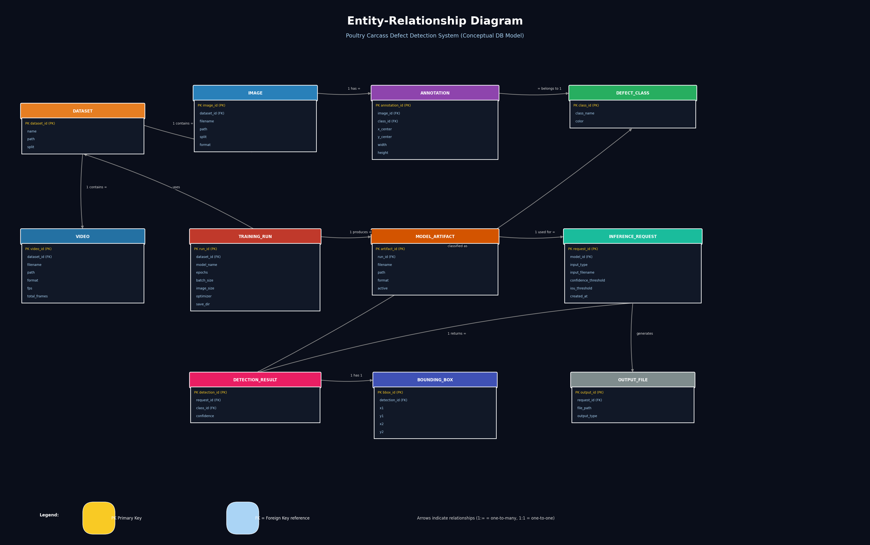
Entity-Relationship Diagram
Conceptual database model (3NF normalized) for future persistence layer

Slide 8
Database Normalization
The system currently uses file-based storage. This conceptual normalization shows how a database layer would be structured:
1NF – First Normal Form
2NF – Second Normal Form
Each field holds one atomic value.
Separate detections into individual rows instead of comma-separated strings.
Remove partial dependencies.
InferenceRequest stores request-level data separately from DetectionResult.
3NF – Third Normal Form
Final Tables
Remove transitive dependencies.
DefectClass (class_id, class_name, color) stored in its own table, referenced by FK.
DefectClass · Dataset · Image · Annotation · TrainingRun ·
ModelArtifact · InferenceRequest · DetectionResult · BoundingBox · OutputFile

Slide 9
Summary & Key Takeaways
>> End-to-End Pipeline
From raw dataset preparation through YOLO26 training to a live inference web app.
>> Modular Architecture
Clear separation: Dataset Prep → Training → Model Storage → Flask API → Frontend UI.
>> Real-Time Detection
Supports live camera feeds, image uploads, and full video processing with annotated output.
>> Extensible Design
Conceptual DB design follows 3NF; easy to add persistence, user auth, and reporting.
>> Production-Ready API
Flask REST API with CORS, file validation, error handling, and configurable thresholds.

