Slide 1
Poultry Carcass Defect Detection
System Design, Class Diagram & ER Diagram — Review Presentation
Review 1 - Phase I Assessment
Python 3.10 | Flask | YOLO26 (Ultralytics) | OpenCV | HTML/JS
Academic Year 2025-2026

Slide 2
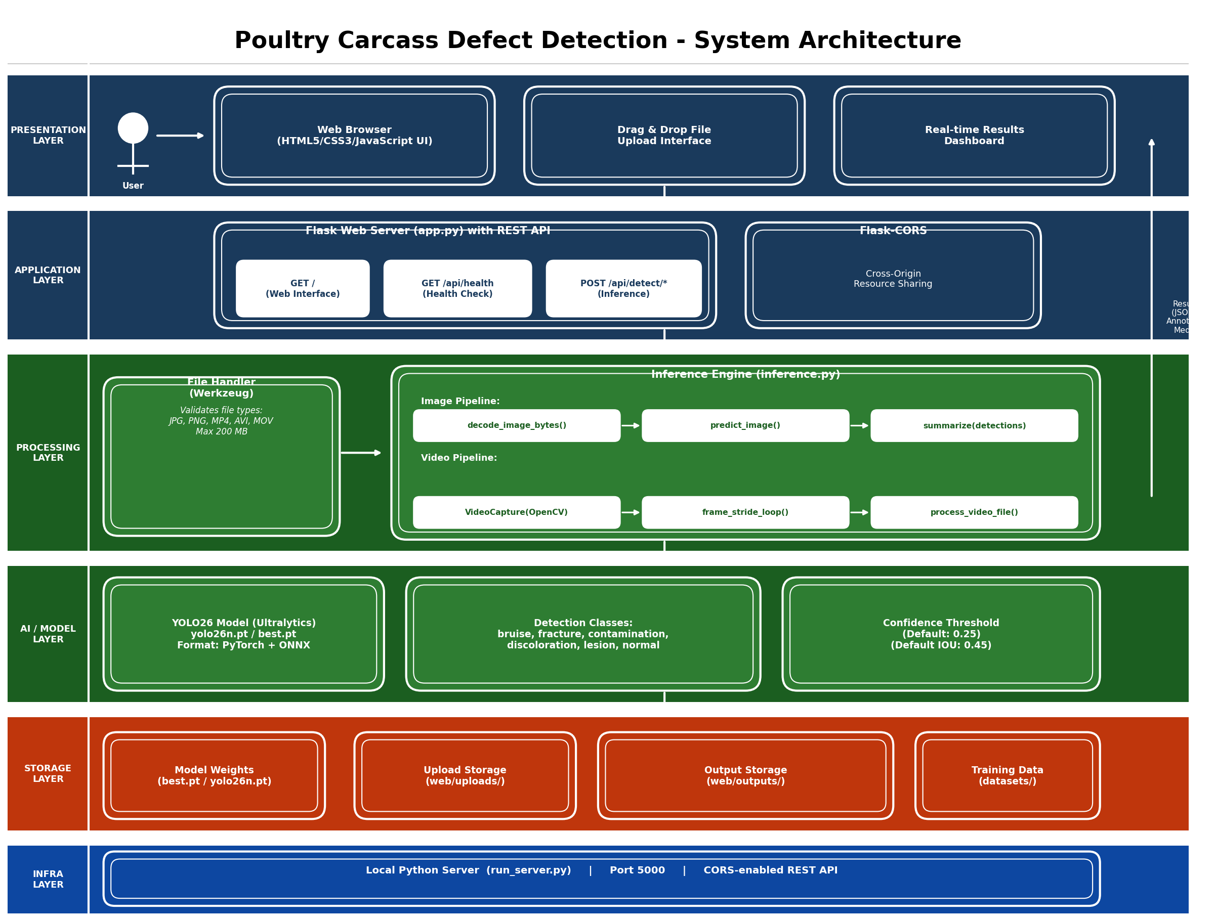
System Architecture Diagram
Layered architecture: Presentation > Application > Processing > AI/Model > Storage > Infrastructure

Slide 3
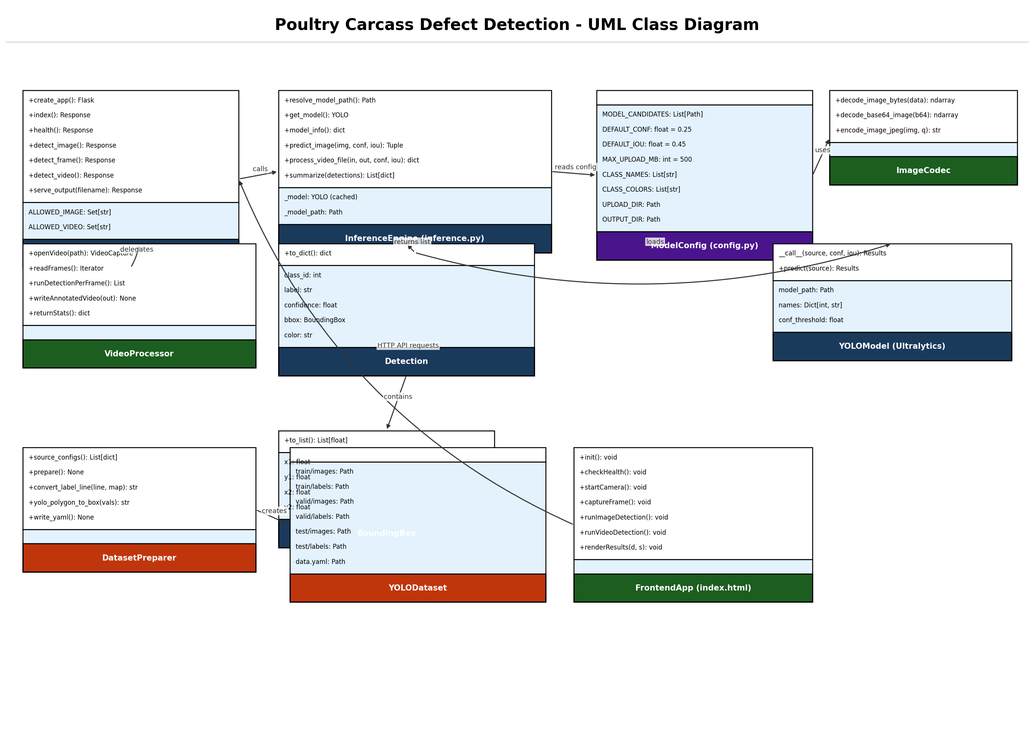
UML Class Diagram
10 core classes: FlaskApp, InferenceEngine, ModelConfig, ImageCodec, Detection, BoundingBox, VideoProcessor, DatasetPreparer, YOLODataset, FrontendApp

Slide 4
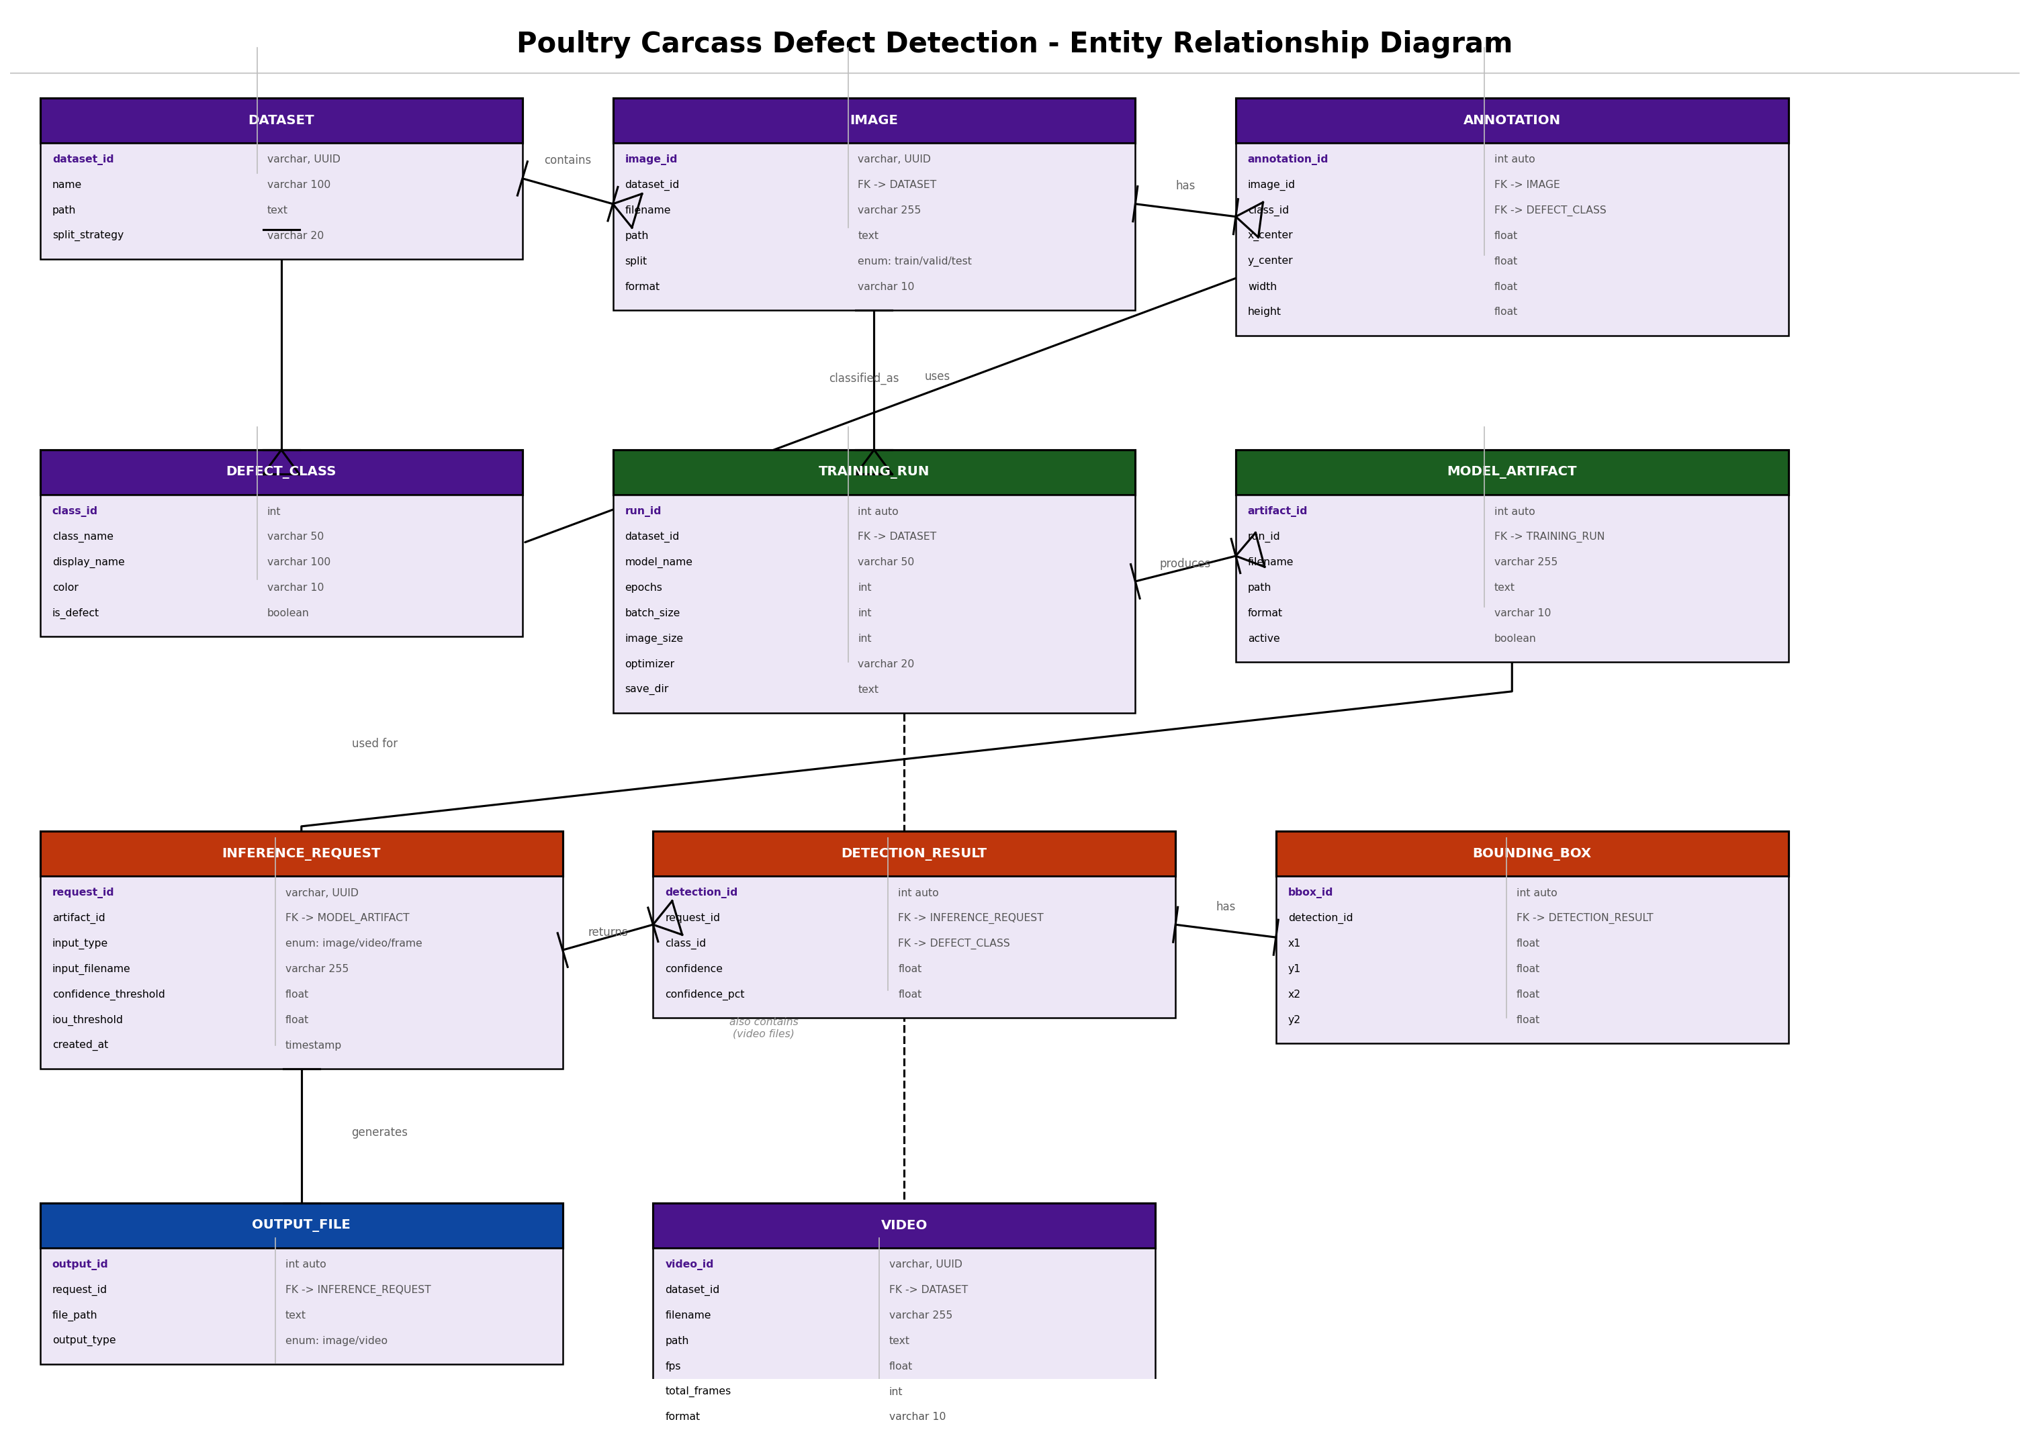
Entity Relationship (ER) Diagram
11 entities: DATASET, IMAGE, ANNOTATION, DEFECT_CLASS, TRAINING_RUN, MODEL_ARTIFACT, INFERENCE_REQUEST, DETECTION_RESULT, BOUNDING_BOX, OUTPUT_FILE, VIDEO

Slide 5
Thank You
Poultry Carcass Defect Detection System
System Design Presentation | YOLO26 | Flask REST API | Browser UI

