Slide 1
Internship Final Review
Sivaram M

Slide 2

CONTENTS
Skills acquired
Problem Statement
Project Scope
Data Flow
Implementation
Insights
Timeline

Slide 3
Skills Acquired
Understanding the UCDE Eco system
SQL & AWS Fundamentals
Databricks & PySpark
Basic of CDM
Understanding Printer Feature Usage
Learning Data Visualization Tool(Looker)

Slide 4
Problem Statement
HP does not have visibility on customer's usage of all device features of Enterprise printers due to which it incurs high cost for maintenance and development of firmware.
Currently, HP is taking a reactive approach to the customer feature usage based on defects rather than being proactive towards it.
For this reason, we are collaborating with Firmware team, analyze their enterprise data (CDM data packets which has the feature usage nodes) to enable data-driven decisions​ by tracking the customer usage of these printer features and manage HP resources and investment accordingly.

Slide 5
Project Scope
•Currently we are working with Test data for Jedi-Jolt fleet of printers.
•We are trying to analyze the instrumentation coverage of all the features as part of test data which provides the Firmware development team visibility on the features that are yet to be instrumented.
•We are also trying to identify any test gaps in the already instrumented features which will help the Firmware test team in their testing.
•Access request to the Enterprise field data to analyze and provide insights on the actual customer usage is in progress.

Slide 6









Data flow
Databricks ETL pipeline
HP Test Lab data
Local Network Folder
Condensing Json file
Condensed
CDM packets on S3
Databricks ETL pipeline
Data OS
Redshift
Dashboard creation
Data visualization on Looker
Not started (No access to Field data)
Business analyst

Slide 7
Implementation
Onboarding Data and condensing JSON files:
The test data from local network folder is condensed using a python script and uploaded onto S3.
Creating the schema:
Individual schema definition are manually created for each pillar as each pillar follow a different structure. This is also done because without a standard schema definition in place we can miss out on few Json nodes, if we read the data as it is.
Data Processing and Transformation:
Utilizing PySpark, data product is created by processing the condensed JSON data, according to the defined schema, and effectively managing nested JSON structures. Ultimately, the JSON data is transformed into structured tables, facilitating easy querying and analysis.

Slide 8
CDM Data Packet structure
ModelNumber
version
Originator
SerialNumber
jobId
applicationName
Firmware version
eventCategory
Data
events
eventDetail
featureName

Slide 9
Implementation(contd..)
Loading data to redshift:
Now these tables are loaded into redshift, to seamlessly integrate with Looker for enhanced data visualization and analysis.
Data Visualization on Looker:
This involved understanding basics of looker and importing the final data product from Redshift and creation of dashboards on Looker for the following pillars:
Pillars
Workflow
Framework
Solution API
Solution Detail

Slide 10
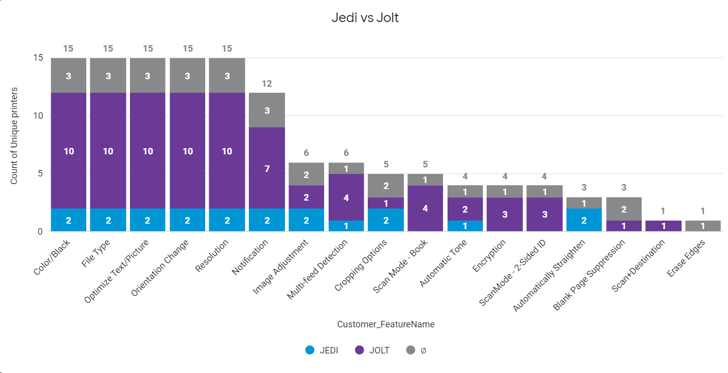
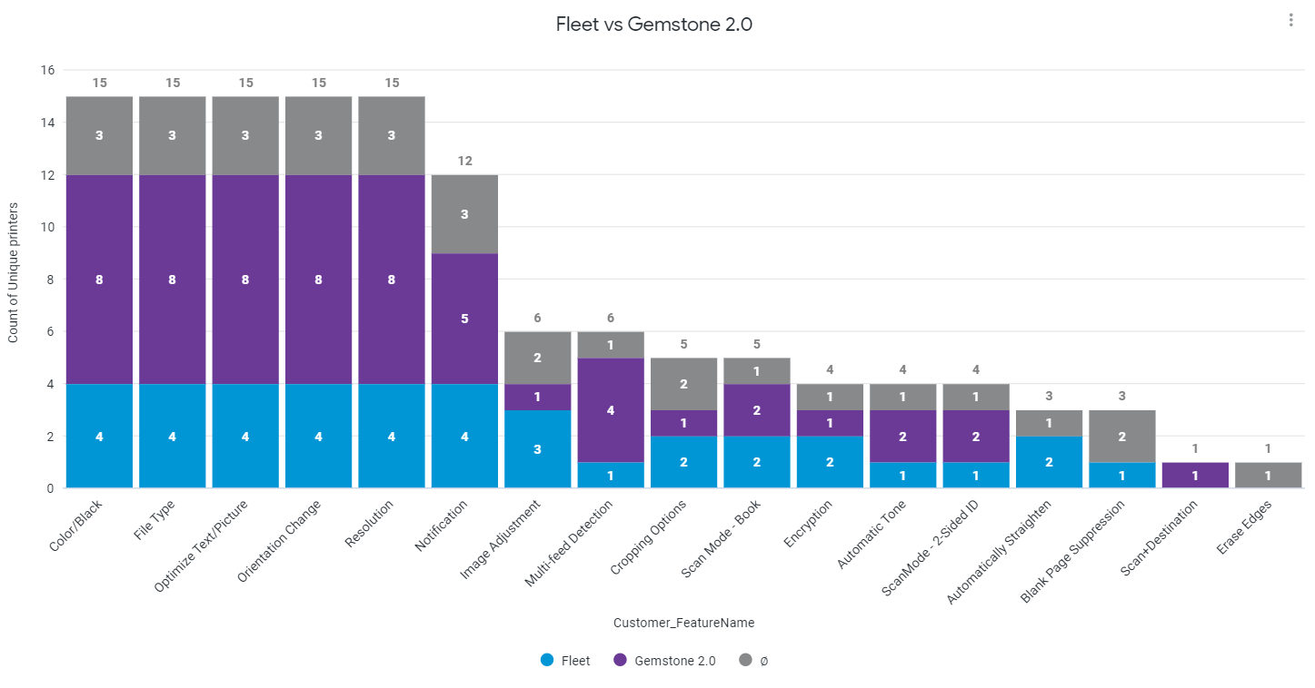
Insights
Testing is focused more on ‘Color/Black ‘ feature and least one is ‘Erase Edge’
Testing is focused more on ‘Color/Black’ feature and least one is ‘Erase Edge’

Slide 11
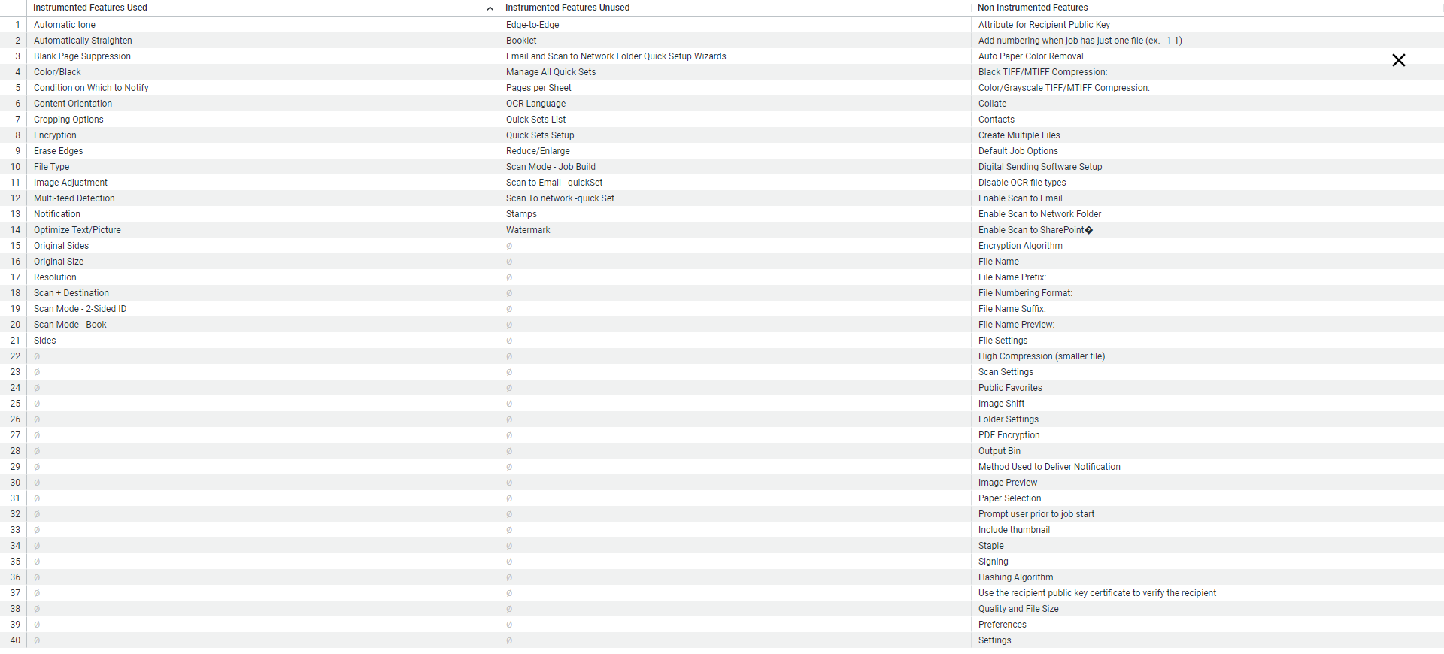
Insights
Many common features in Workflow are not yet tested though they are instrumented and we have many features not yet instrumented

Slide 12
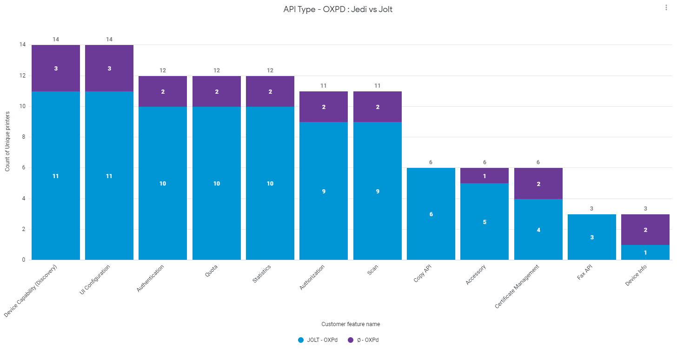
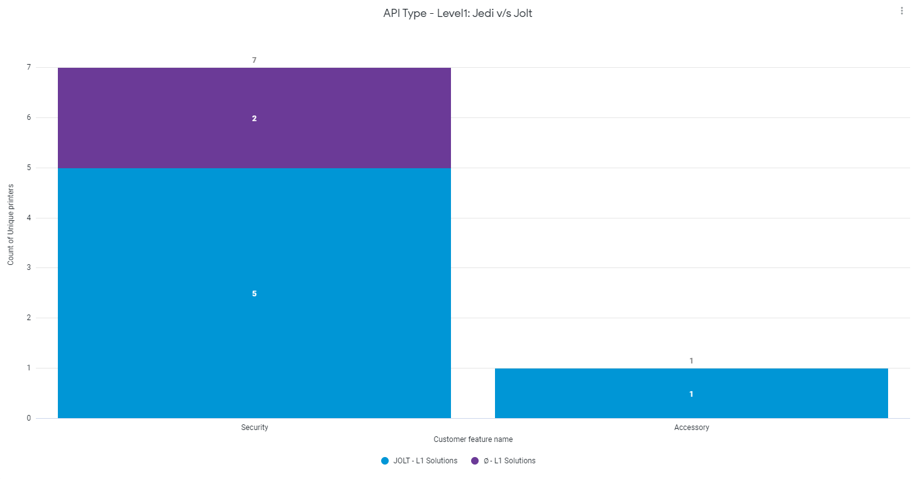
Insights
API Type - OXPD Testing is focused more on Jolt since we have insufficient data for Jedi
API Type - Level 1 Testing is focused more on Jolt since we have insufficient data for Jedi

Slide 13
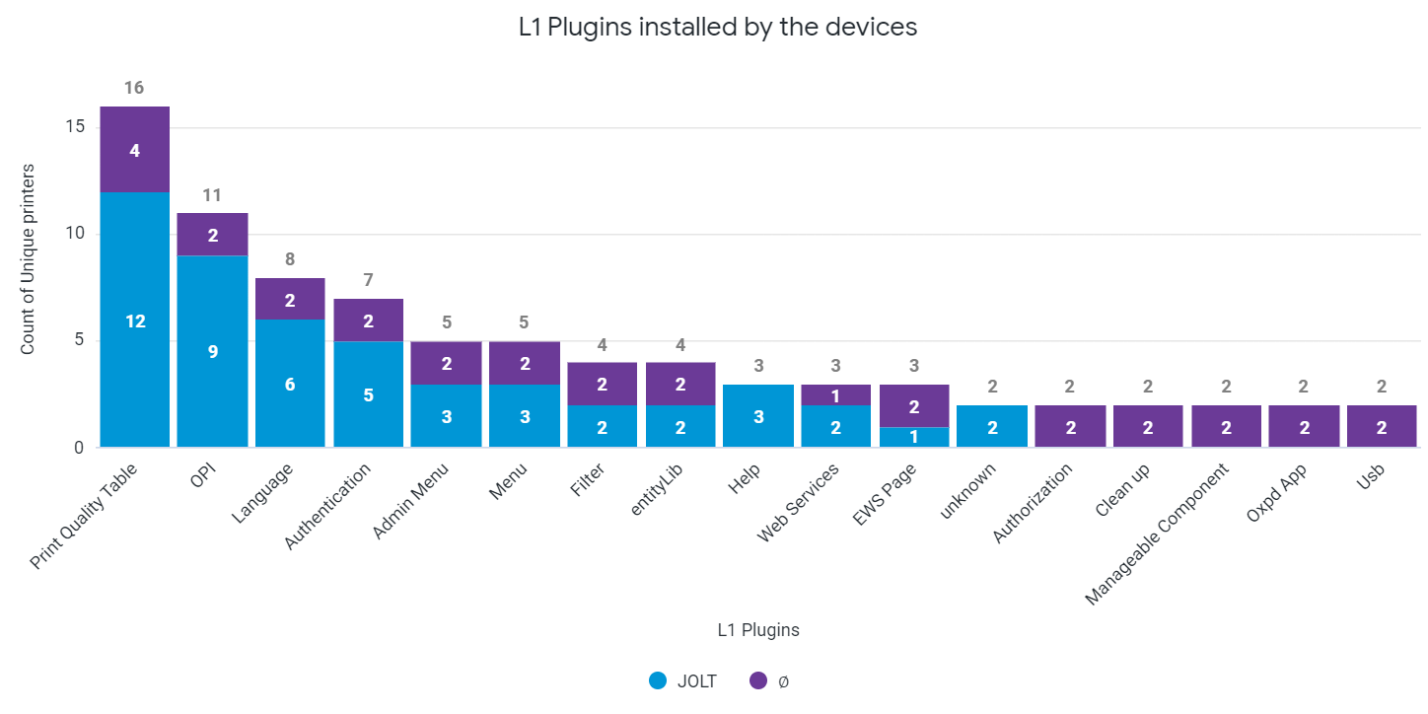
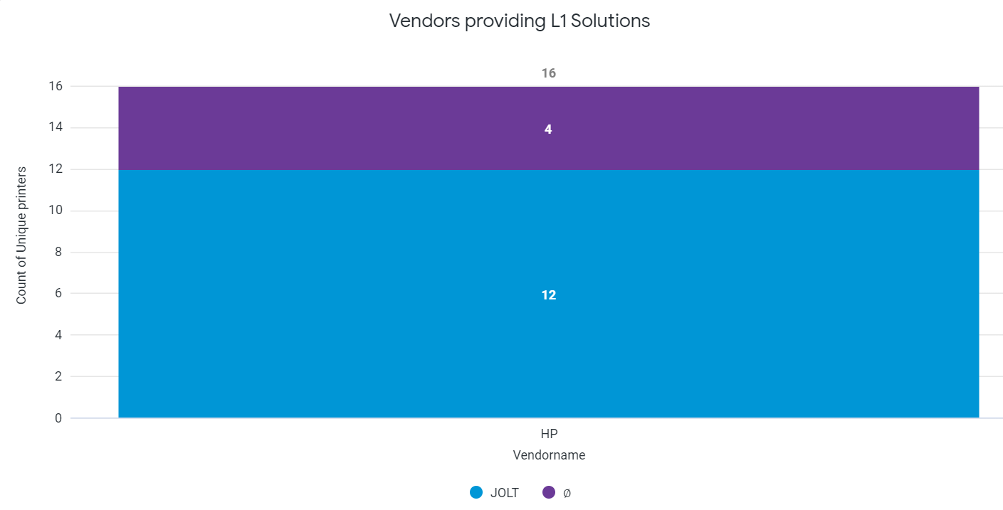
Insights
Solution Detail – L1 Plugins installed by the devices
Solution Detail – Vendor providing L1 Solution

Slide 14
Timeline
Creating the data Product (for the different pillars)
Onboarding and visualization of Field data once access to Field data
Introduction to the ecosystem and fundamentals
Data Visualization on Looker
(Workflow, Framework,
Solutionapi, Solutiondetail, Pdl)
Introduction to Feature Usage
Feb | Mar | Apr | May | June | July
Test data onboarding and python script for condensing files
Introduction to Looker
Further enhancements to the dashboard and optimizing pipeline
Completed
Pending
Future

Slide 15

Special thanks to Shobitha and Maheep for guiding me throughout my successful completion of the onboarding process.
Apart from that, I also thank Abhishek, and rest of the team to be very supportive in every way.
Thank you

