Slide 1
Customer Segmentation for Loan Offer
ABHISHEK KALE ANJALI GUPTA
NINAD KULKARNI SAKAR SRIVASTAVA
SIVARAMAKRISHNANA SRIRAM SUPRIYA BHATIA

Slide 2

AGENDA
Introduction – Objective
Project Roadmap
Exploratory Data Analysis
Key Segments
Next Steps
Appendix

Slide 3

OBJECTIVE
Profile top 10,000 customers for future targeting based on the customer data from last three years.

Slide 4
PROJECT ROADMAP
STAGE 01
Data Summary:
Salary data
Loan Data
STAGE 03
Data Cleaning and Imputation
STAGE 05
Modelling:
FICO Scorecard
STAGE 02
Exploratory Data Analysis
STAGE 04
Feature Importance
Using Correlation/ Random Forest

Slide 5



DATA SET SUMMARY
Dataset Source: Kaggle
Feature Importance:
Correlation Matrix (TBD)
Random Forest Regressor (TBD)
Dataset Observation: 145 Features available for 1048576 customers
More than 40% data is missing
Handling Missing Data: Deleted/ imputed data with columns > 40% data fields

Slide 6
SEGMENTATION PROCESS
Location:
SF
Titles:
Used Fuzzylogic in Python and to clean up the employees title
Salary:
High-end Salary
Average Salary
Low Earners

Slide 7
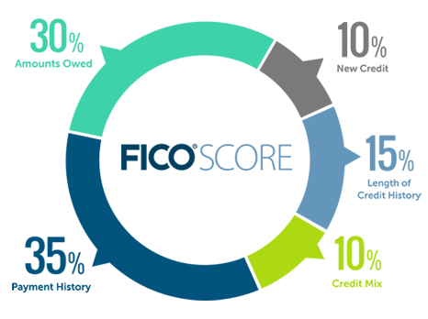
FUTURE STEPS
FICO Scores are calculated using many different pieces of credit data in credit report.
Poor: 579 or less (579 or less for typical scores)
Fair: 580-699 (580 – 639 for typical scores)
Average: 670-739 (640 – 699 for typical scores)
Good: 740-799 (700 – 749 for typical scores)
Excellent: 800+ (750 – 850 for typical scores)
Identify Key Feature/ Variables for FICO Scorecard

Slide 8

QUESTIONS

Slide 9
APPENDIX

