Slide 1
Robustification

Slide 2
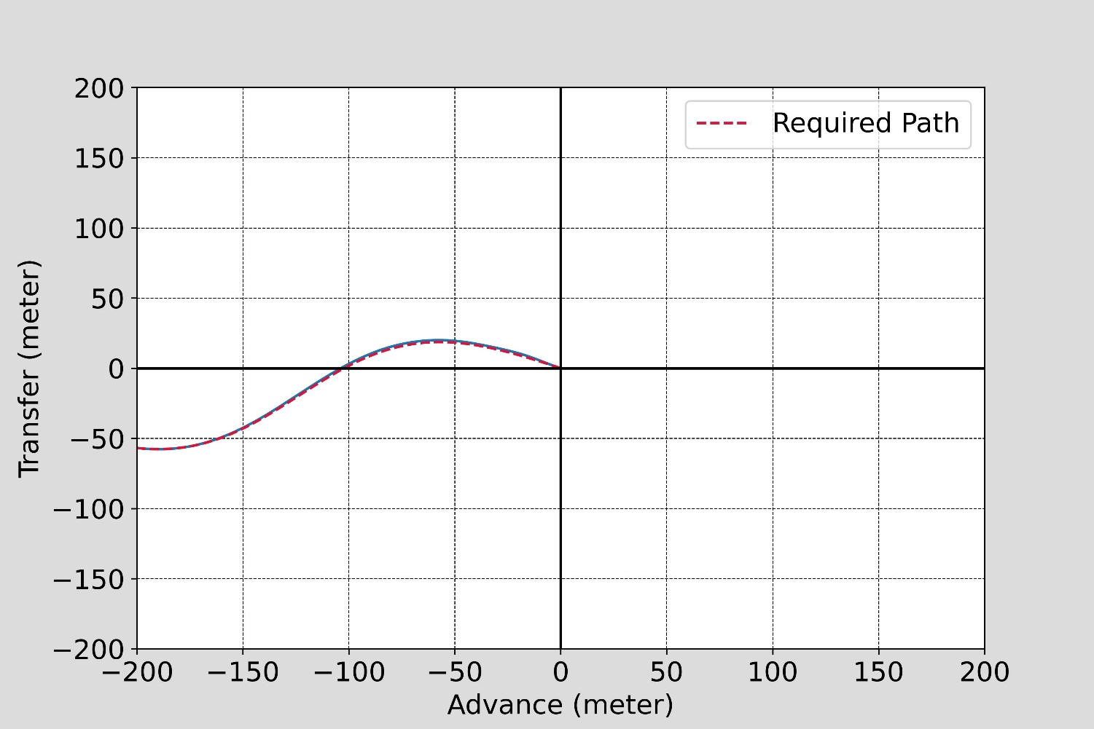
Sine waves

Slide 3
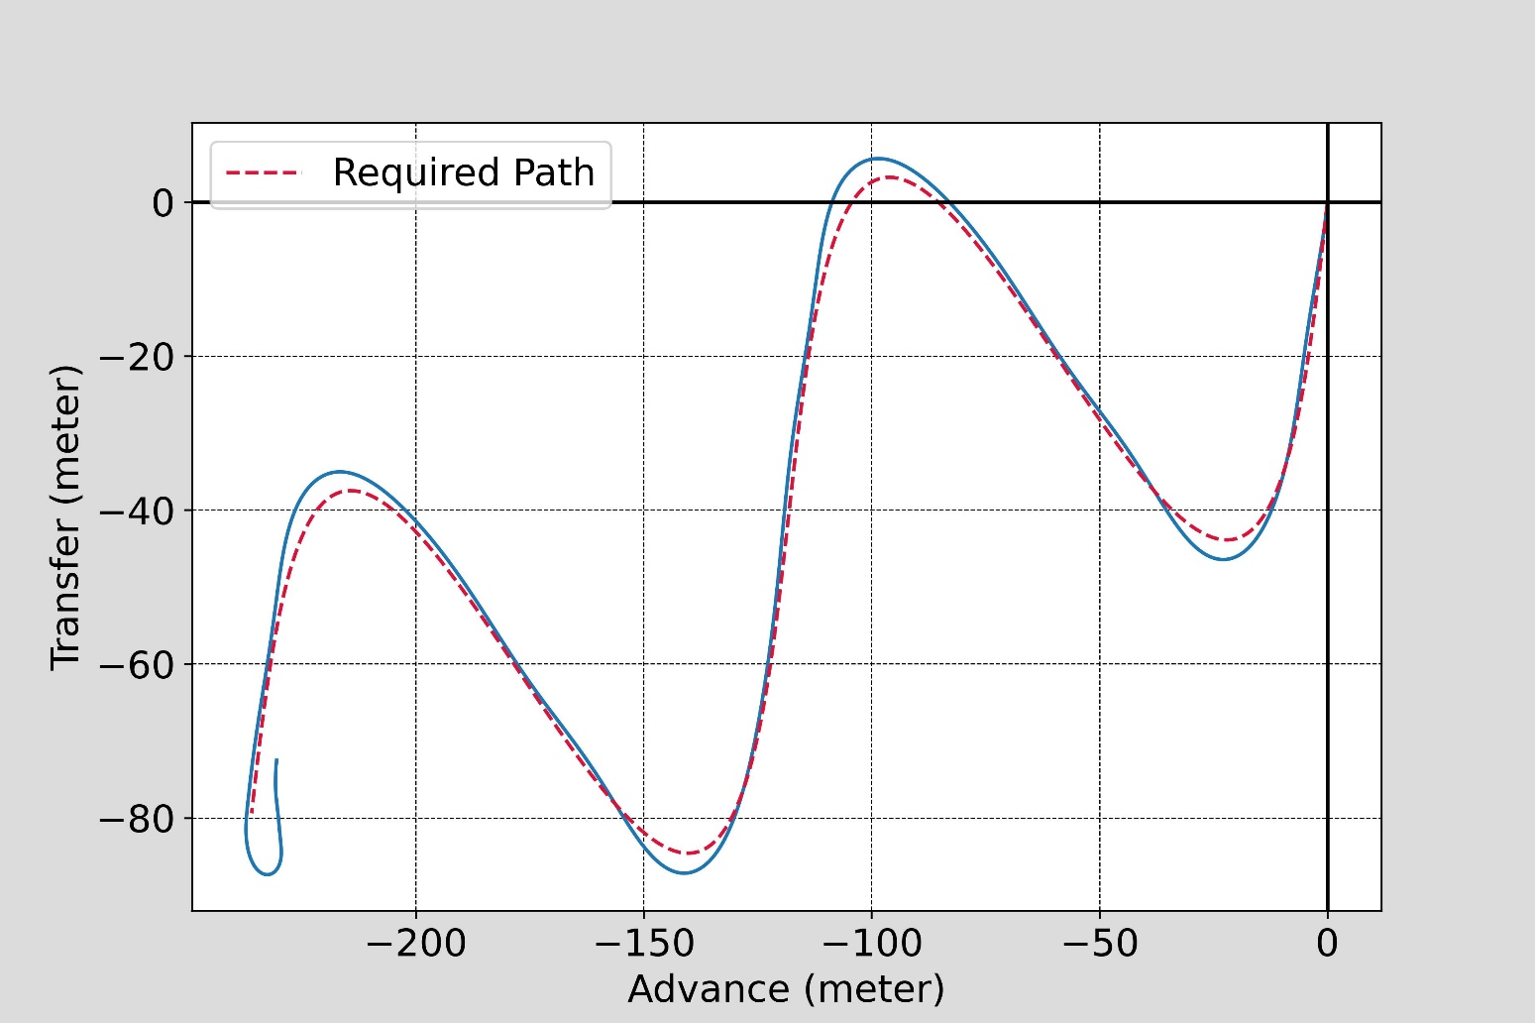
Sine waves

Slide 4
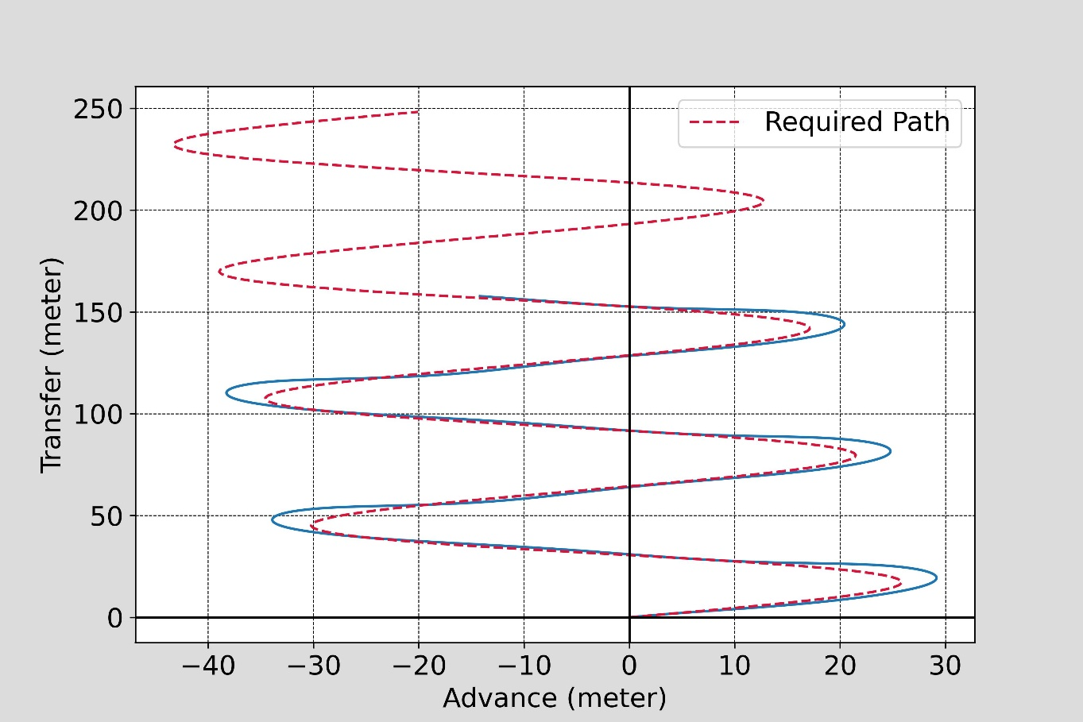
Sine waves 03

Slide 5
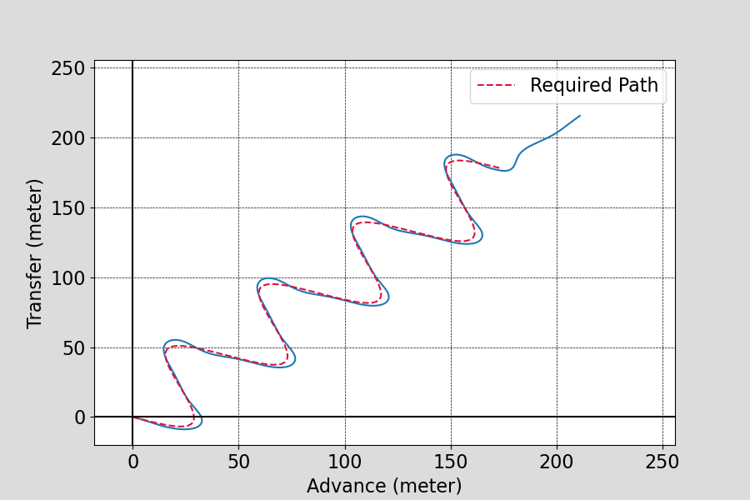
Sine waves 04

Slide 6
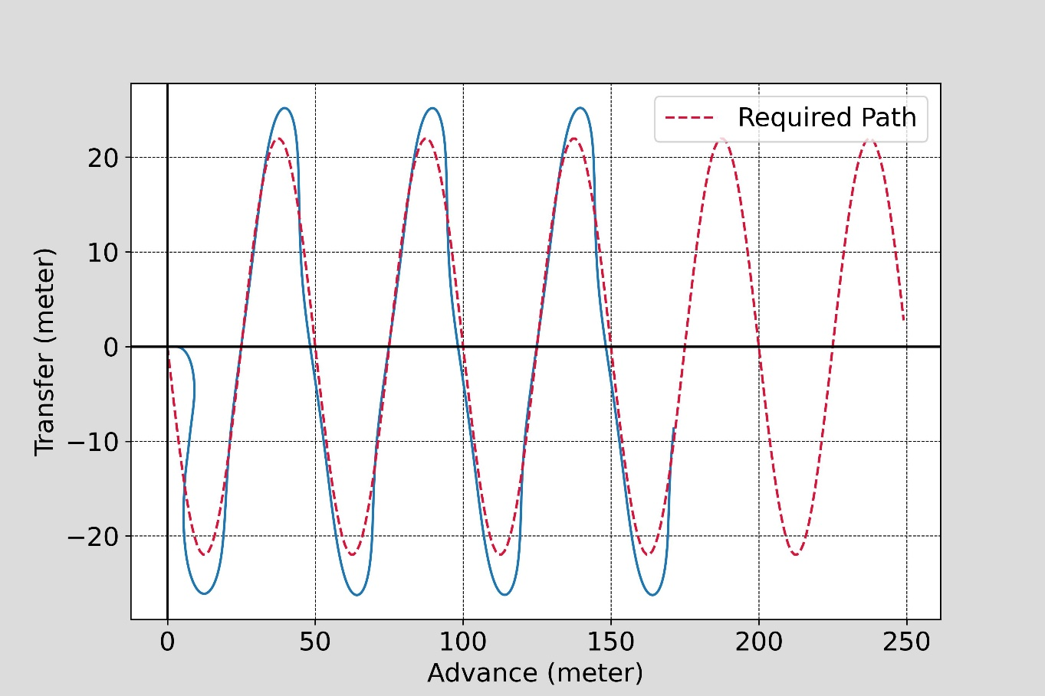
Sine waves 05 (starting from zero heading)

Slide 7
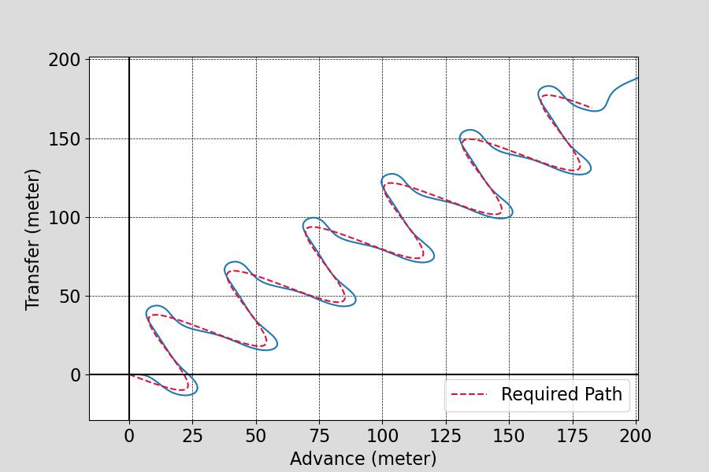
Sine waves 06 (starting from zero heading)

Slide 8
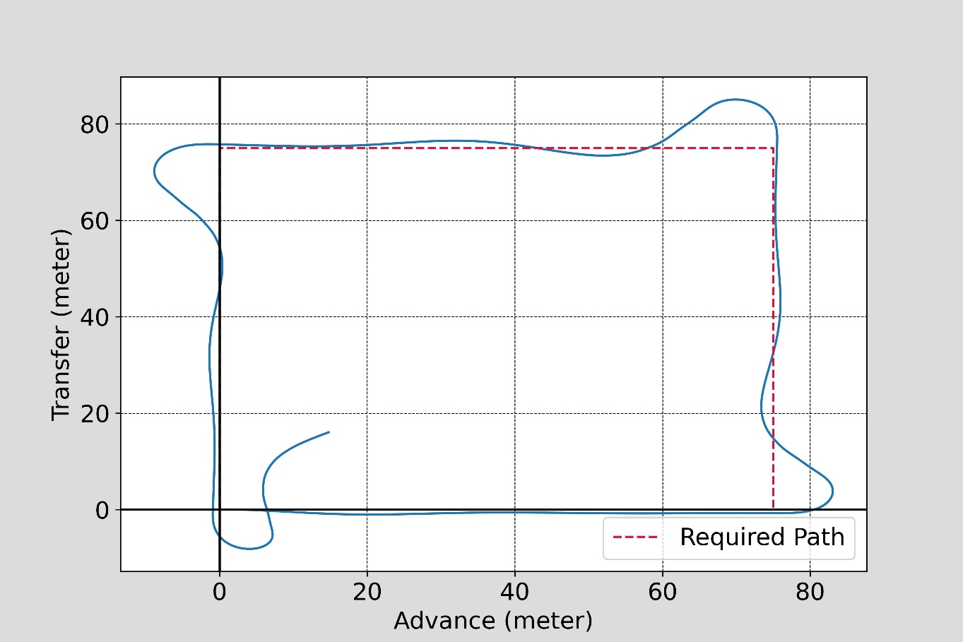
Sharp Turn Cases by Square -75

Slide 9
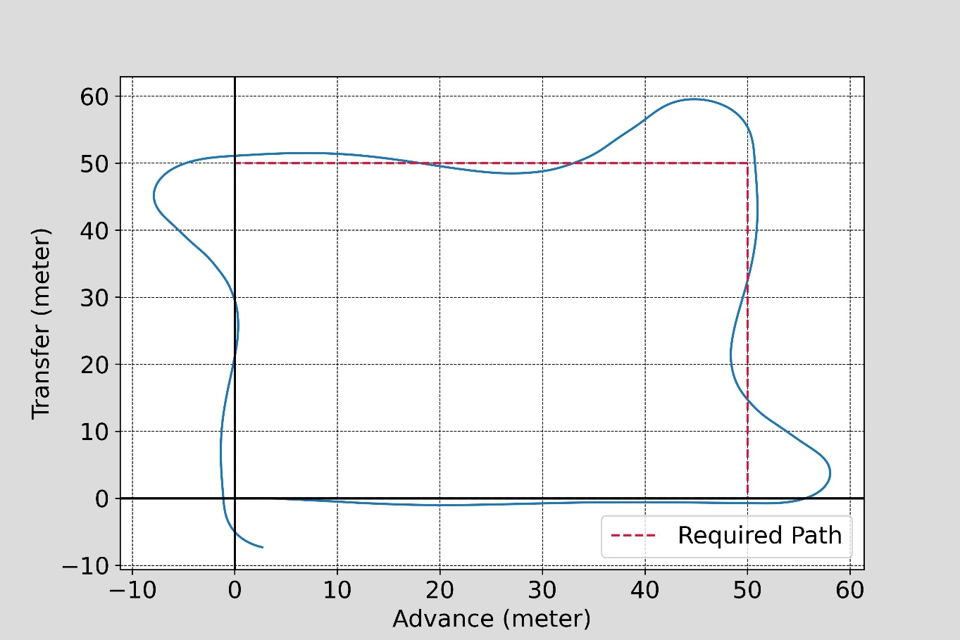
Sharp Turn Cases by Square -50

Slide 10
Comments Please…!

