Slide 1

Microsoft Illustration Library
March 2017
Illustrations may be used in internal and external audience presentations, but this slide library is not intended for distribution outside of Microsoft.
©2016 Microsoft Corporation. All rights reserved.

Slide 2
Contents
3 How to modify illustrations
6 Illustration color palette
7 People
9 Avatar portraits
10 Indoor objects and personal items
11 Outdoor objects and buildings
13 Animals
14 Transportation
15 Global
19 Places and landmarks
  Central America
  London
  New York
  Seattle
  Sydney
  Tokyo
  City avatars
23 Office items
25 Business
27 Industry
29 Devices
Surface
Laptops and desktops
Xbox and phones
Wearable
Hardware and accessories
35 Scenarios
Office/education
Device
Multi-screen
Cloud
Business
Industry

Slide 3
Illustrations can be modified to suit your needs. However, the ungrouped elements can easily be misplaced, or colored incorrectly. In PowerPoint, only minor edits can be made.
For extensive edits, work with designers who can edit the illustrations in Adobe Illustrator.
Get helpful references from
Brand Central.
Microsoft brand overview
Illustration guidelines
Original
Preferred edit:
Simple recoloring, moving, removing
or adding of elements.
Undesirable edit:
Mismatched color. Complicated
design. Unnecessary changes.

Slide 4
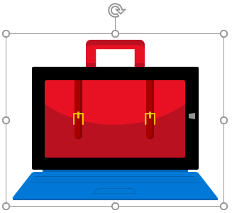
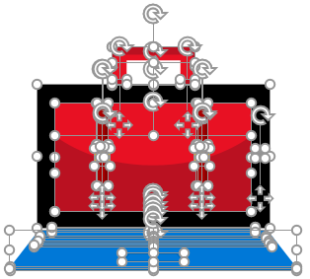
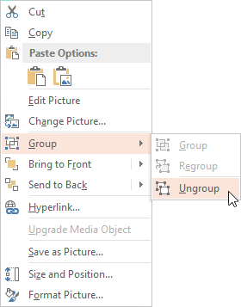
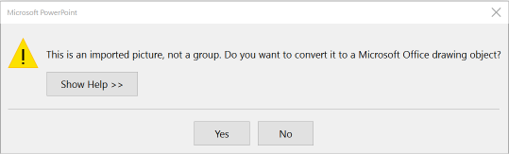
Easy steps to edit or recolor in PowerPoint
Click on the illustration to
select it.
Right-click and select Group > Ungroup. When prompted to convert it to a drawing object, click Yes.
Select Group > Ungroup a
second time.
You’ll see all the shapes.
Click off to the side to unselect.
Don’t panic.

Slide 5
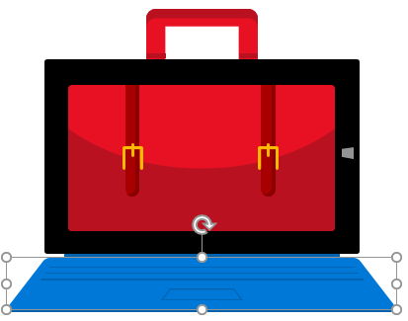
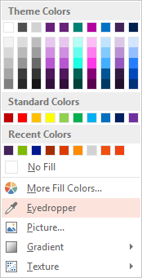
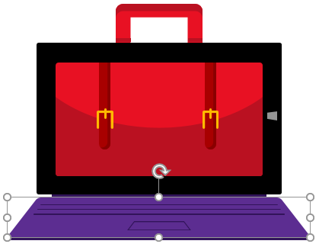

Easy steps to edit or recolor in PowerPoint (cont.)
When finished, be sure to regroup the graphic. Lasso the shapes
with your cursor, then type Ctrl+G
to Group.
To recolor a shape, Click to select it. Along the top menu, click on Drawing Tools Format > Shape Fill.
Scroll down to the Eyedropper.
With a shape selected, hover the eyedropper over any Brand color
and click. Two step if necessary.

Slide 6
Microsoft illustration color palette
Create dimension with highlights and shadows.
For illustrations, we have additional colors to work with. Each brand and accent color in the Microsoft color palette has three tints for shadows and highlights. Use a selection of them to create dimension in your illustration.
Single color (monochrome) illustration.
We prefer full-color, but it’s sometimes necessary to tone down the colorfulness of our illustration. Use our color palette to edit illustrations to suit your audience. We’ve also provided a sampling of monochrome illustrations.
Light Orange
Light Magenta
Light Purple
Light Blue
Light
T
eal
Light G
r
Light
Y
een
ellow
Y
ellow
Orange
Magenta
Purple
Blue
T
eal
G
r
R
een
ed
Dark
R
ed
Dark Magenta
Dark Purple
Mid Blue
Dark
T
eal
Dark G
r
een
Dark Blue
Use white, grays, and black for backgrounds, devices, highlights, and shadows.
Use these colors for skin tones.

Slide 7
People

Slide 8
People

Slide 9
Avatar portraits

Slide 10
Indoor objects and personal items

Slide 11
Outdoor objects and buildings

Slide 12
Outdoor objects and buildings (monochrome)

Slide 13
Animals

Slide 14
Transportation

Slide 15
Global 1

Slide 16
Global 2

Slide 17
Global 3

Slide 18
Global 4

Slide 19
Places and landmarks: Central America and London

Slide 20
Places and landmarks: New York City and Seattle
20

Slide 21
Places and landmarks: Sydney and Tokyo

Slide 22
City avatars
Seattle
Vancouver
Dulles
Washington DC
Wilsonville
Fargo
San Francisco
Reno
Charlotte
Ft Lauderdale
Mexico City
Bogota
London
Dublin
Munich
Paris
Sydney
Gurgaon, India
Korea
Chicago
Milan

Slide 23
Office items

Slide 24
Office items (monochrome)

Slide 25
Business

Slide 26
Business (monochrome)

Slide 27
Industry

Slide 28
Industry (monochrome)

Slide 29
Devices: Surface

Slide 30
Devices: Surface

Slide 31
Devices: Laptops and desktops

Slide 32
Devices: Xbox and phones

Slide 33
Devices: Wearables

Slide 34
Devices: Hardware and accessories

Slide 35
Illustrated scenarios
36 Office/education
41 Device
47 Multi-screen
59 Cloud
71 Business
  Insights
  Ideas
  Workflow
  Planning
  Growth
  IT and coding
  Security
82 Industry

Slide 36
Office/education scenarios

Slide 37
Office/education scenario 1

Slide 38
Office/education scenario 2

Slide 39
Office/education scenario 3

Slide 40
Office/education scenario 4

Slide 41
Device scenarios
Change image to Surface 3/Book/Hub

Slide 42
Device scenario 1

Slide 43
Device scenario 2

Slide 44
Device scenario 3

Slide 45
Device scenario 4

Slide 46
Device scenario 5

Slide 47
Multi-screen scenarios

Slide 48
Multi-screen scenario 1

Slide 49
Multi-screen scenario 2

Slide 50
Multi-screen scenario 3

Slide 51
Multi-screen scenario 4

Slide 52
Multi-screen scenario 5

Slide 53
Multi-screen scenario 6

Slide 54
Multi-screen scenario 7

Slide 55
Multi-screen scenario 8

Slide 56
Multi-screen scenario 9

Slide 57
Multi-screen scenario 10

Slide 58
Multi-screen scenario 11

Slide 59
Cloud scenarios

Slide 60
Cloud scenario 1

Slide 61
Cloud scenario 2

Slide 62
Cloud scenario 3

Slide 63
Cloud scenario 4

Slide 64
Cloud scenario 5

Slide 65
Cloud scenario 6

Slide 66
Cloud scenario 7

Slide 67
Cloud scenario 8

Slide 68
Cloud scenario 9

Slide 69
Cloud scenario 10

Slide 70
Cloud scenario 11

Slide 71
Business scenarios

Slide 72
Business scenario: Insights 1

Slide 73
Business scenario: Insights 2

Slide 74
Business scenario: Ideas 1

Slide 75
Business scenario: Ideas 2

Slide 76
Business scenario: Workflow

Slide 77
Business scenario: Workflow (monochrome)

Slide 78
Business scenario: Planning

Slide 79
Business scenario: Growth

Slide 80
Business scenario: IT and coding

Slide 81
Business scenario: Security

Slide 82
Industry scenarios

Slide 83
Industry scenario 1

Slide 84
Industry scenario 2

Slide 85
Industry scenario 3

Slide 86
©2016 Microsoft Corporation. All rights reserved.

