Slide 1
GOOGLE TREND ANALYSIS ON iPhone 17 & 17 Pro Sales
Project Presentation
Prepared by: Venkata Siva Reddy
Tools: Power BI | DAX | Data Modeling

Slide 2
Project Objective
Analyze sales performance of iPhone 17 & 17 Pro
Compare revenue, units sold and market share
Evaluate marketing efficiency (ROAS)
Identify regional and storage-based performance trends

Slide 3
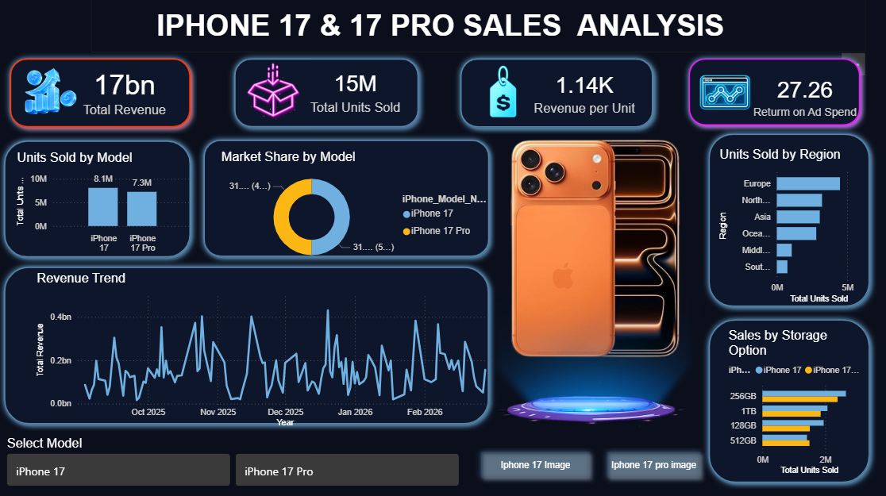
DASHBOARD INTERFACE

Slide 4
Dataset Overview
Time Period Covered: 2025–2026
Key Columns Used:
Model Name
Revenue & Units Sold
Region & Storage Variant
Marketing Spend & Date

Slide 5
Data Preparation & Modeling
Cleaned and structured raw data
Created calculated measures using DAX:
Total Revenue
Revenue per Unit
Return on Ad Spend (ROAS)
Built relationships between tables

Slide 6
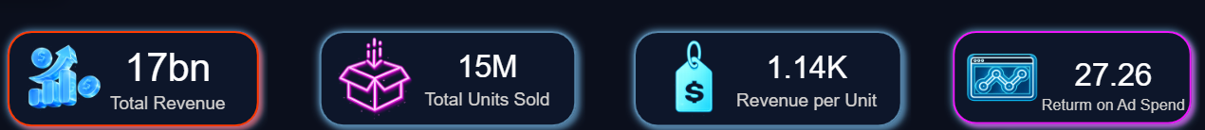
KPI Overview
Total Revenue – Overall financial performance
Units Sold – Sales volume measurement
Revenue per Unit – Pricing efficiency
ROAS – Marketing effectiveness indicator

Slide 7
Sales Performance Insights
Compared iPhone 17 vs iPhone 17 Pro performance
Analyzed revenue contribution by each model
Identified market share distribution
Observed performance differences between variants

Slide 8
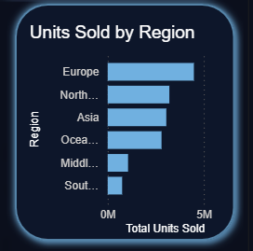
Regional Performance Analysis
Identified top-performing regions
Compared sales distribution across geographies
Analyzed regional contribution to total revenue

Slide 9
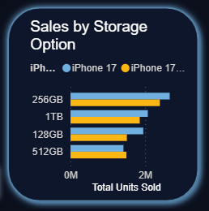
Storage Variant Insights
Evaluated demand by storage options (128GB, 256GB, 512GB, 1TB)
Identified most popular configuration
Compared storage preference by model

Slide 10
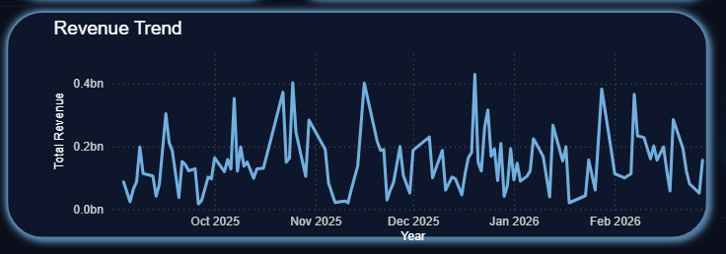
Revenue Trend Analysis
Analyzed monthly revenue fluctuations
Identified peak sales periods
Observed overall growth patterns over time

Slide 11
Conclusion & Key Learnings
Dashboard provides clear executive-level overview
Identified key drivers of revenue and sales growth
Strengthened DAX and data modeling skills
Demonstrated ability to convert raw data into insights

