Slide 1
WEBSITE TRAFFIC PREDICTION USING POLYNOMIAL REGRESSION
Presented by
Siva Reddy

Slide 2
Project Objective
Predict website visitors using historical traffic data
Understand relationship between sessions, pages, and visitors
Apply Polynomial Regression for prediction
Visualize data patterns

Slide 3
Dataset Overview
Dataset: Website Traffic Dataset
Contains information about website activity
Includes sessions, pages viewed, and visitors
Used to analyze traffic behavior

Slide 4
Dataset Columns
Date – Day of website activity
Sessions – Number of user visits
Pages – Average pages viewed per session
Visitors – Total website visitors

Slide 5
Tools & Technologies
Python Programming
Pandas – Data manipulation
Matplotlib & Seaborn – Data visualization
Scikit‑Learn – Machine Learning model
Using Polynomial Regression

Slide 6
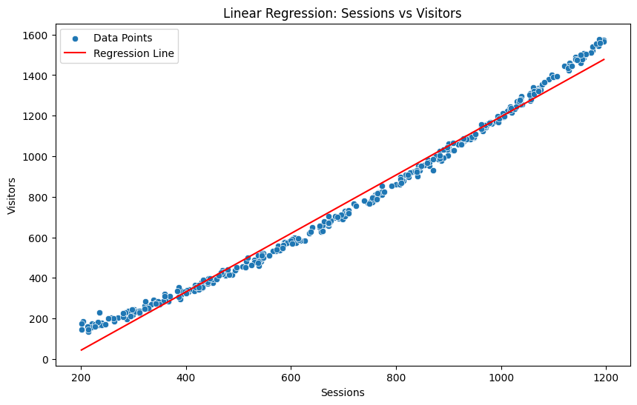
Linear Regression Visualization

Slide 7
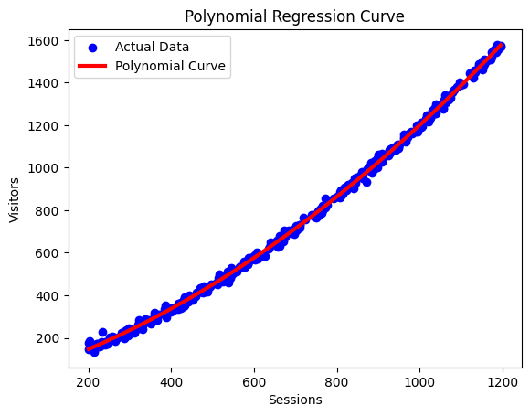
Polynomial Regression Visualization

Slide 8
Exploratory Data Analysis
Analyzed relationships between variables
Used correlation heatmap
Identified strong relationships between features
Visualized data patterns for better understanding

Slide 9
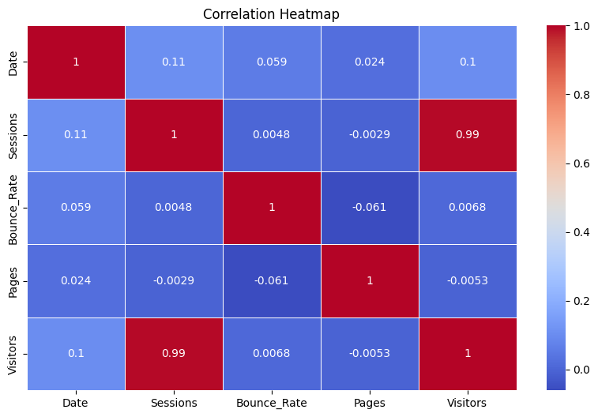
Heat Map Visualization

Slide 10
Model Building
Selected input features: Sessions
Target variable: Visitors
Split dataset into training and testing data
Applied Polynomial Regression model

Slide 11
Model Prediction
• Model trained using training dataset
• Used testing data for prediction
• Predicted visitor values using trained model
IF R^2 Score in b/w [0.7 – 1.0] is a Good fit

Slide 12
Conclusion
Polynomial Regression helps predict website visitors
Sessions influence visitor count
Model can support website traffic analysis
Useful for business planning and marketing strategies

