Slide 1
SALARY PREDICTION USING LINEAR REGRESSION
Name: P. Venkata Siva Reddy
Course: Data Science Internship
Company: Inno Fortune IT Pvt Ltd
Date: 06 March 2026

Slide 2
Introduction
Companies need a proper method to decide employee salaries.
Salary depends on factors like Experience, Education and Skill Level.
Machine Learning helps analyze data and predict salaries.
In this project we use Linear Regression to predict salary.

Slide 3
Objective
• Study relationship between experience and salary
• Prepare data for machine learning
• Train a Linear Regression model
• Evaluate model performance
• Predict salary for new employees

Slide 4
Data Visualization
Used visualizations:
• Experience vs Salary scatter plot
• Salary by education level
• Skill level distribution

Slide 5
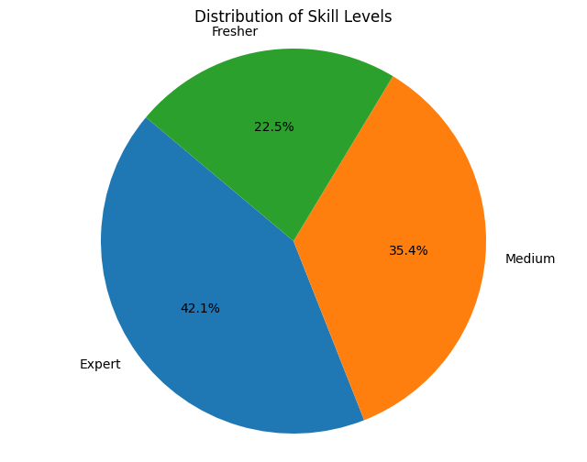
Pie Chart(Comparison)

Slide 6
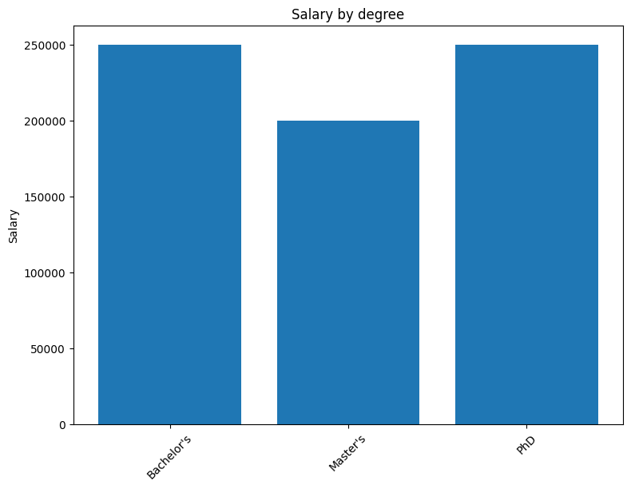
Bar chart (Comparison)

Slide 7
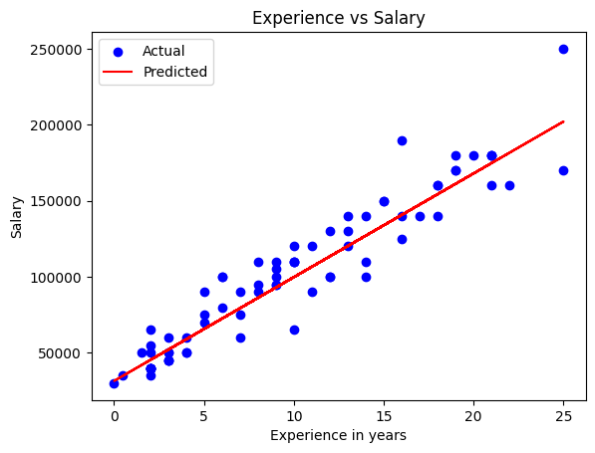
Regression Line vs Actual data

Slide 8
Linear Regression Model
Linear Regression finds relationship between input features
and the target variable (Salary).
Example:
Salary = b0 + b1X
Where X represents experience or other features.

Slide 9
Model Evaluation
Metrics used:
• Mean Absolute Error (MAE):
- To know avg absolute difference b/w Actual and Predicted
• Mean Squared Error (MSE):
- To know avg of squared difference b/w Actual and Predicted
• R² Score:
Measures how well the model explains the variation in the target variable.
Higher R² score means better model performance.

Slide 10
Results
The model predicts salary based on employee attributes.
Experience shows strong relationship with salary.
R² Score ≈ 0.9 meaning the model explains about 90% of salary variation.

Slide 11
Applications
• HR salary prediction systems
• Recruitment platforms
• Employee salary benchmarking
• Workforce analytics

