Slide 1
Introduction to Programming with Python
By Venkat Yadav

Slide 2
Pre-Requisites
Required Personal Interest.

Slide 3
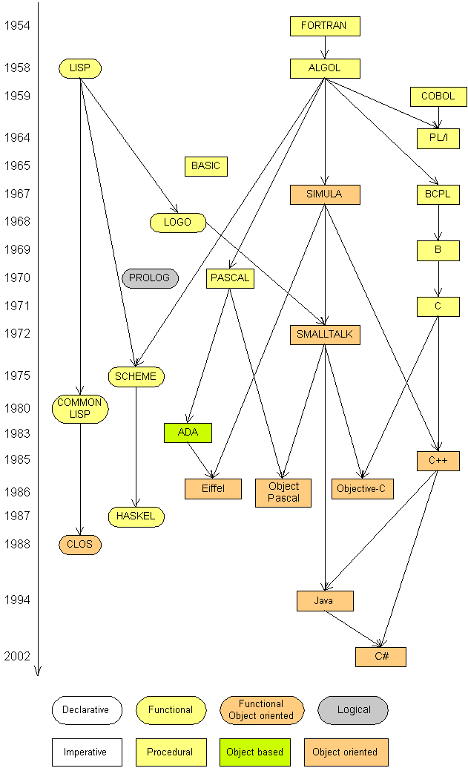
Introduction
Some influential ones:
  FORTRAN
    science / engineering
  COBOL
    business data
  LISP
    logic and AI
  BASIC
    a simple language

Slide 4
Introduction
Computer Programming languages are basically classified into two types - High Level Programming Language and Low Level Programming Languages.
Low level Programming languages: Assembly Language and Machine Language.
High level Programming Languages:- Python, Java, C, C++, Ruby, Perl, Python, Basic, JavaScript and many more.
high level languages will be converted into a machine readable form by a compiler or interpreter. DIFFERENCE BETWEEN THE HIGH AND THE LOW LEVEL LANGUAGE: Low level language is machine readable form of program. Whereas the high level language will be in human readable form

Slide 5




Compiling and interpreting
Many languages require you to compile (translate) your program into a form that the machine understands.
Python is instead directly interpreted into machine instructions.
compile
execute
source code
Hello.java
byte code
Hello.class
output
interpret
source code
Hello.py
output

Slide 6
Why Python
Easy to learn
Free Source
Interactive
Interpreted
Modular
Dynamic
Object-oriented-programming (OOPs)
Portable (UNIX-based systems, Mac OS, MS-DOS, OS/2, and various versions of Microsoft Windows)
High level & English Like
Extensible in C++ & C
Powerful in Analytics and Web programming (Scripting)

Slide 7
Python uses in
Google
YouTube
Facebook
NASA
NSA
Drop Box
Mozilla
Instagram
Spotify
Quora
Netflix
Reddit
Etc..

Slide 8
Course Objective
To understand why Python is a useful language for developers.
To learn how to design and program Python applications.
To learn how to use lists, tuples, and dictionaries in Python programs.
To learn how to identify Python object types.
To learn how to use indexing and slicing to access data in Python programs.
To define the structure and components of a Python program.
To learn how to write loops and decision statements in Python.
To learn how to write functions and pass arguments in Python.
To learn how to build and package Python modules for reusability.
To learn how to read and write files in Python.

Slide 9
Course Objective
To learn how to design object‐oriented programs with Python classes.
To learn how to use class inheritance in Python for reusability.
To learn how to use exception handling in Python applications for error handling.
To learn to how python useful for web scripting
To learn how Python is useful Machine Learning & data science.

Slide 10
Course Duration
Total – 30 days.
Approach hours – 45 hours.
Daily 1 hour and Weekends long sessions.

Slide 11
Python History
Python was conceived in the late 1980s, and its implementation began in December 1989 by Guido van Rossum at Centrum Wiskunde & Informatica (CWI) in the Netherlands

Slide 12
Python Environments & Download
From Python.org
Version 2.7
Version 3.6.X

Slide 13
IDE setup- Anaconda Distribution
  Anaconda Distribution set up.
Notes:
Dividing by 0 crashes the program.

Slide 14
Identifiers & Continuation & Assignment
Variables –
Functions –
Modules –
Classes –
All names starts with A to Z or a to z or _(underscore) & 0 to 9
Line Continuation -- \ (For [],(),{} continuation not required)
Comments for single line- #
Comments for multiple lines - “”” “””
Assignment: A=10, a=b=10, a,b,c = 1,’xyz’,10
Key words:- and, as, assert, break, class, continue, def, del, elif, else, except, exec, finally, for, from, global, if, import, in, is, lambda, not, or, pass, print, raise, return, try, while, with, yield

Slide 15
Python variables
Numbers
String
List
Tuple
Dictionary
Sets

Slide 16
Numbers
Integers
Floating
Long
Complex
-------------------------------------------------------
del x ,[y]
Number conversions

Slide 17
Functions on Numbers
Mathamatical abs(x) ceil(x) exp(x) Floor(x) Log(x) Max(x1,x2,..xn) Min(x1,x2,..) Pow(x,y) Sqrt(x) Round(x[,n]) | Random functions Choice(seq) randrange([start],stop,[,step]) Random() Seed([x]) Shuffle(list) Uniform(x,y) Trigonometric & otherfunctions Pi E All Trigonometric functions

Slide 18
raw_input
raw_input : Reads a string of text from user input.
Example:
  name = input("Howdy, pardner. What's yer name? ")
  print name, "... what a silly name!"
  Output:
  Howdy, pardner. What's yer name? Paris Hilton
  Paris Hilton ... what a silly name!

Slide 19
Strings
Index
Substrings : [],[:], [-1]
Concatenation: +
Repetition: *
\t,\b,\n,\s,\a etc..
in and not in
% - print (‘Student name: %name and total marks %s’ %(‘Rakesh’,367)

Slide 20
String Functions
len(string)
count(str, beg= 0,end=len(string))
find(str, beg=0 end=len(string))
isalpha()
isalnum()
isdigit()
islower()
Isupper()
isnumeric()
upper()
zfill (width)
capitalize()
center(width, fillchar)

Slide 21
String properties
len(string) - number of characters in a string
(including spaces)
str.lower(string) - lowercase version of a string
str.upper(string) - uppercase version of a string
Example:
name = "Martin Douglas Stepp"
length = len(name)
big_name = str.upper(name)
print big_name, "has", length, "characters"
Output:
MARTIN DOUGLAS STEPP has 20 characters

Slide 22
List
Define with : []
Index: [],[:],[-1]
Del list1[2]
List1 + list2 - Concatenation
Len(lis1)
Max(list1)
Min(list1)
List(seq) – convers tuple into list

Slide 23
List Functions
List.append(obj)
List.insert(index,obj)
List.remove(obj)
List.reverse()
List.sort()
List.count(obj)
List.extend(seq)
List.index(obj)
Try exercises on two dimensional lists (arrays)

Slide 24
Tuple
Define with : ()
Tuple id Immutable object – cannot edit or change the values of tuple elements.
Del tup1 - Removing individual tuple elements is not possible
Tup1+tup2 – Concatenation
Index: [],[:],[-1]
Cmp(tup1, tup2)
Len(tup1)
Max(tup1)
Min(tup1)
tuple(seq) – convers list into tuple

Slide 25
Dictionary
Define with – {key:value,…}
Dict[key]
For update – dict[key]=new value
Del dict[key] – remove entry with key
dict.clear() – remove all entries in dict
Del dict – delete entire dict
Len(dict)
Str(dict) – printable string representation of a dict
Type(variable) – return variable type

Slide 26
Dictionary functions
Dict.items() – return a list of dict’s (key,value) as tuple
Dict.keys() – return list of dict keys
Dict.get(key, default=None) – for Key key, returs value or default if key not in dict
Dict.fromkeys(seq[,values]) – create a new dict with keys from seq and values set to values.
Dict.copy() – returns shallow copy of dict.
Try Shallow copy and Deep Copy on Lists.
Dict.update(dict2) – adds dictinary dict2’s key-values pair to dict.
Dict.values() – retunrs only dict values.

Slide 27
Set
Set defines with: {x,y,..}
Type(set1)

Slide 28
input
input : Reads a number from user input.
  You can assign (store) the result of input into a variable.
  Example:
  age = input("How old are you? ")
  print "Your age is", age
  print "You have", 65 - age, "years until retirement"
  Output:
  How old are you? 53
  Your age is 53
  You have 12 years until retirement
Exercise: Write a Python program that prompts the user for his/her amount of money, then reports how many Nintendo Wiis the person can afford, and how much more money he/she will need to afford an additional Wii.

Slide 29
Arithmetic Operators-1
Operator Description Example
A=10, b=20.
+ Addition Adds values on either side of the operator. a + b = 30
- Subtraction Subtracts right hand operand from left hand operand. a – b = -10
* Multiplication Multiplies values on either side of the operator a * b = 200

Slide 30
Arithmetic Operators-2
/ Division Divides left hand operand by right hand operand b / a = 2
% Modulus Divides left hand operand by right hand operand and returns remainder b % a = 0
** Exponent Performs exponential (power) calculation on operators a**b =10 to the power 20
// Floor Division - The division of operands where the result is the quotient in which the digits after the decimal point are removed. 9//2 = 4 and 9.0//2.0 = 4.0

Slide 31
Comparison Operators-1
a=10, b=20
== If the values of two operands are equal, then the condition becomes true. (a == b) is not true.
!= If values of two operands are not equal, then condition becomes true. (a != b) is true.
<> If values of two operands are not equal, then condition becomes true. (a <> b) is true. This is similar to != operator.
> If the value of left operand is greater than the value of right operand, then condition becomes true. (a > b) is not true.
< If the value of left operand is less than the value of right operand, then condition becomes true. (a < b) is true.

Slide 32
Comparison Operators-2
>= If the value of left operand is greater than or equal to the value of right operand, then condition becomes true. (a >= b) is not true.
<= If the value of left operand is less than or equal to the value of right operand, then condition becomes true. (a <= b) is true.

Slide 33
Assignment Operators-1
= Assigns values from right side operands to left side operand c = a + b assigns value of a + b into c
+= Add AND It adds right operand to the left operand and assign the result to left operand c += a is equivalent to c = c + a
-= Subtract AND It subtracts right operand from the left operand and assign the result to left operand c -= a is equivalent to c = c - a
*= Multiply AND It multiplies right operand with the left operand and assign the result to left operand c *= a is equivalent to c = c * a
/= Divide AND It divides left operand with the right operand and assign the result to left operand c /= a is equivalent to c = c / a

Slide 34
Assignment Operators-2
%= Modulus AND It takes modulus using two operands and assign the result to left operand c %= a is equivalent to c = c % a
**= Exponent AND Performs exponential (power) calculation on operators and assign value to the left operand c **= a is equivalent to c = c ** a
//= Floor Division It performs floor division on operators and assign value to the left operand c //= a is equivalent to c = c // a

Slide 35
Bitwise Operators-1
a = 0011 1100 = 60
b = 0000 1101 = 13
----------------- -------
a&b = 0000 1100
a|b = 0011 1101
a^b = 0011 0001
~a = 1100 0011
*****************************************************************
& Binary AND Operator copies a bit to the result if it exists in both operands. (a & b) = 12 - (means 0000 1100)
| Binary OR It copies a bit if it exists in either operand. (a | b) = 61 - (means 0011 1101)
^ Binary XOR It copies the bit if it is set in one operand but not both. (a ^ b) = 49 (means 0011 0001)

Slide 36
Bitwise Operators-2
~ Binary - Ones Complement It is unary and has the effect of 'flipping' bits. (~a ) = -61 (means 1100 0011 in 2's complement form due to a signed binary number.
<< Binary Left Shift The left operands value is moved left by the number of bits specified by the right operand. a << 2 = 240 - (means 1111 0000)
>> Binary Right Shift The left operands value is moved right by the number of bits specified by the right operand. a >> 2 = 15 -(means 0000 1111)

Slide 37
Logical Operators
and
Logical AND If both the operands are true then condition becomes true. (a and b) is true.
or
Logical OR If any of the two operands are non-zero then condition becomes true. (a or b) is true.
not
Logical NOT Used to reverse the logical state of its operand. Not (a and b) is false.

Slide 38
Identity Operators
is Evaluates to true if the variables on either side of the operator point to the same object and false otherwise. x is y, here is results in 1 if id(x) equals id(y).
is not Evaluates to false if the variables on either side of the operator point to the same object and true otherwise. x is not y, here is not results in 1 if id(x) is not equal to id(y).

Slide 39
Membership Operators
in Evaluates to true if it finds a variable in the specified sequence and false otherwise. x in y, here in results in a 1 if x is a member of sequence y.
not in Evaluates to true if it does not finds a variable in the specified sequence and false otherwise. x not in y, here not in results in a 1 if x is not a member of sequence y.

Slide 40
Operators precedence
** Exponentiation (raise to the power)
~ + - complement, unary plus and minus (method names for the last two are +@ and -@)
* / % // Multiply, divide, modulo and floor division
+ - Addition and subtraction
>> << Right and left bitwise shift
& Bitwise 'AND'
^ | Bitwise exclusive `OR' and regular `OR'
<= < > >= Comparison operators
<> == != Equality operators
= %= /= //= -= += *= **= Assignment operators
is is not Identity operators
in not in Membership operators
not or and Logical operators

