Slide 1




searc
ems

Slide 2

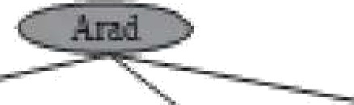


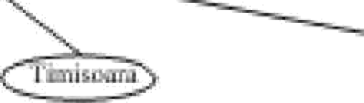


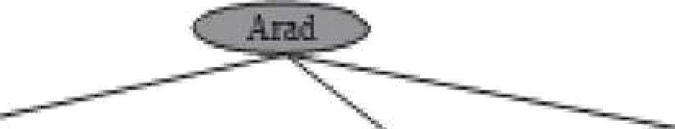
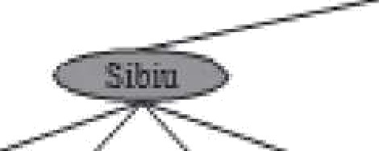
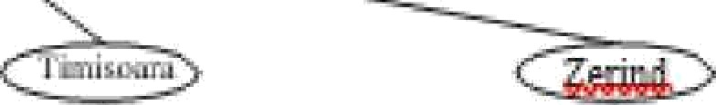
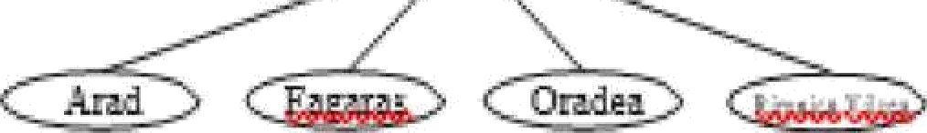
Searching for Solufions
search algorithms work by
(a) The initial state
considering various
possible
acñon sequences
The possible acñon sequences
staring at the initial state form a search tree with the initial state at the root; the branches are actions and the nodes correspond to states in
(b) After expanding Arad
the state space of the
(c) After ezpaoding Sibizz
problem
Partial search trees for finding a route
from Arad to Bucharest

Slide 3
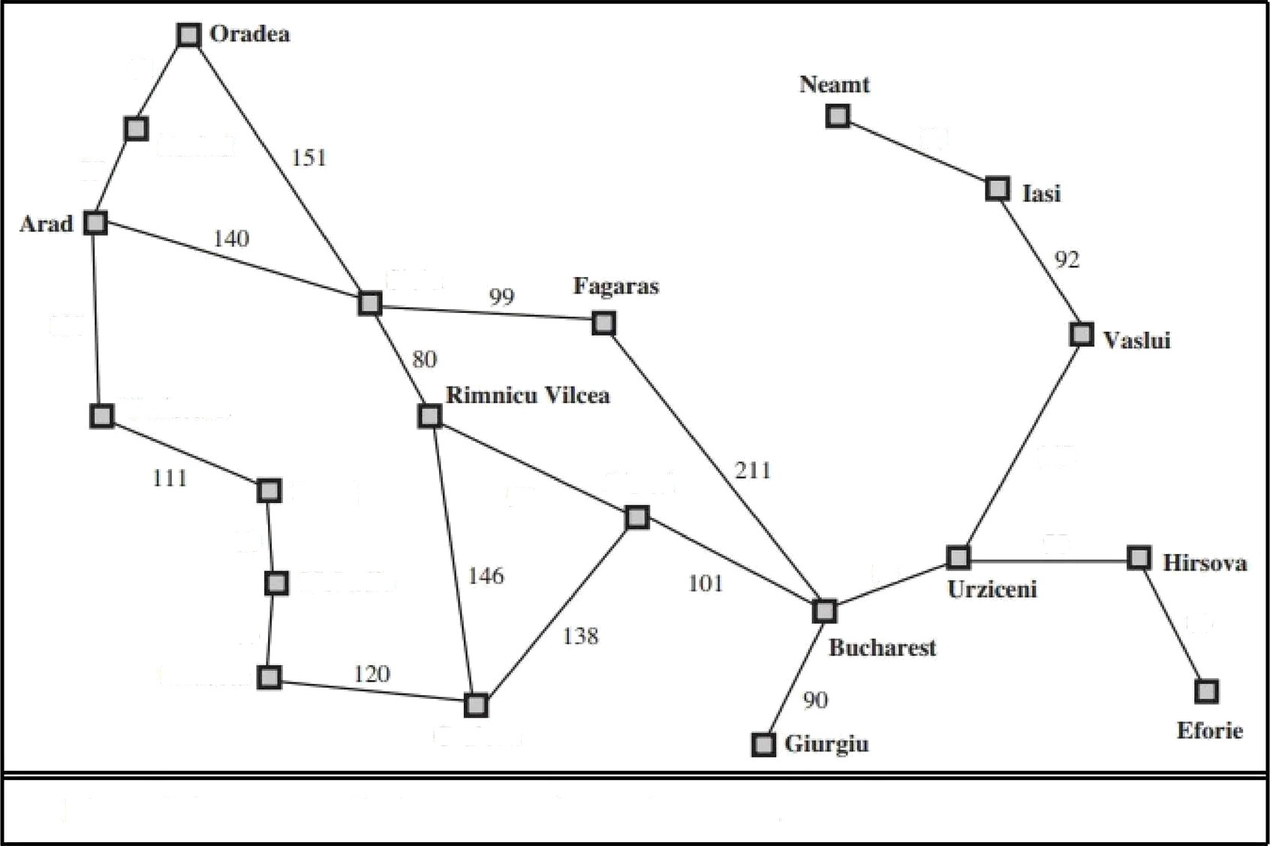


71
g,;gg
87
75
Sibíu
118
Lugoj
97
Piteuti
70
98
Metadia
7å
8ò
Figure 3.2
A simplified œad map of part of Romania.

Slide 4
The Concepts and Terminology of Searching
applying each legal acñon to a state — Expanding the State
The set of all leaf nodes available for expansion - Fronñer / Open List
Search Strategy - The process of expanding nodes on the frontier
continues until either a solution is found or there are no more states to expand
redundant paths, mulñple Paths that exist from one state to another
Ex: Arad—Sibiu (140 km long) & Arad—Zerind—0radea—Sibiu (297 km
long)
Loopy Paths are a special case of these Redundant Paths (Like Arad Sibiu — Arad)

Slide 5
General tree-search and graph-search algorithms
function TREE-SEARCHt’ problePt } remrns a solution, oi• failure
initialize the frontier using ie initial state of problem
loop do
if tiie Lontief is empty then return failure
choose a leaf node and remoa e it from the frontiei
if the node contakis a goal state then return the coi•responding solution
expand the chosen node. addiug the resulting nodes to the frontier
function GRAPH-SEARCHf problem ) returns a solutiou. or failure
initlalize ie frontier using the initial state of problem initiañze the e»plared set to be einpfi-
loop do
if the Lontier is empty then return failures
choose a leaf node and reiuoa e it from the out er
Also known as Open List
if the node contains a goal state then returnYr%cori•esponding sOlUtiOIl
add tiie node to tiie iored et
Alsoknown as Closed List
expand the chosen node. adding tiie i•esultiiig nodes to the froiitiei•
onij- if ao1 in llte frontier or explored set

Slide 6
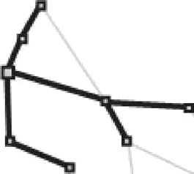
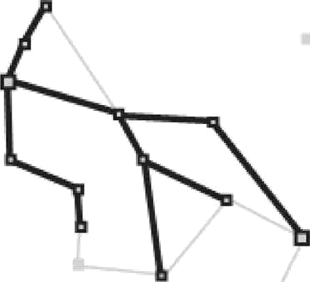
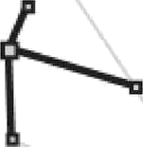
GRAPH-SEARCH algorithm
we can think Graph-Search as growing a tree directly on the state- space graph
i.e. the GRAPH-SEARCH algorithm contains at most one copy of each state

Slide 7
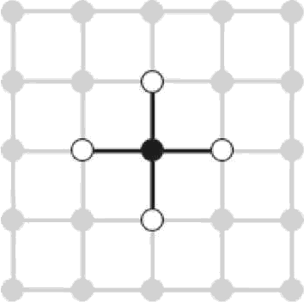
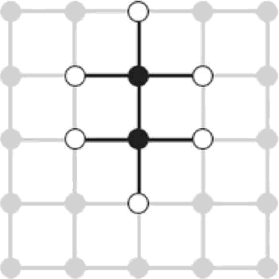
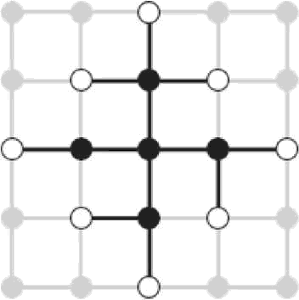

GRAPH-SEARCH algorithm
the fronñer separates the state-space graph into the explored region
and the unexplored region
(n) (b)
The frontier (white nodes) always separates the explored region of the state space (black nodes) from the unexplored region (gray nodes)

Slide 8
infrastructure for search algorithms
Search algorithms require a data structure to keep track of the search tree that is being constructed. For each node n of the tree, we have a structure that contains four components:
o ri.STATE: the state in the state space to which the node corresponds;
n.PARENT: the node in the search tree that generated this node;
n.ACTION: the action that was applied to the parent to generate the node;
n.PATH-COST: the cost, traditionally denoted by p(ri), of the path lrom the initial state
to the node, as indicated by the parent pointers.

Slide 9
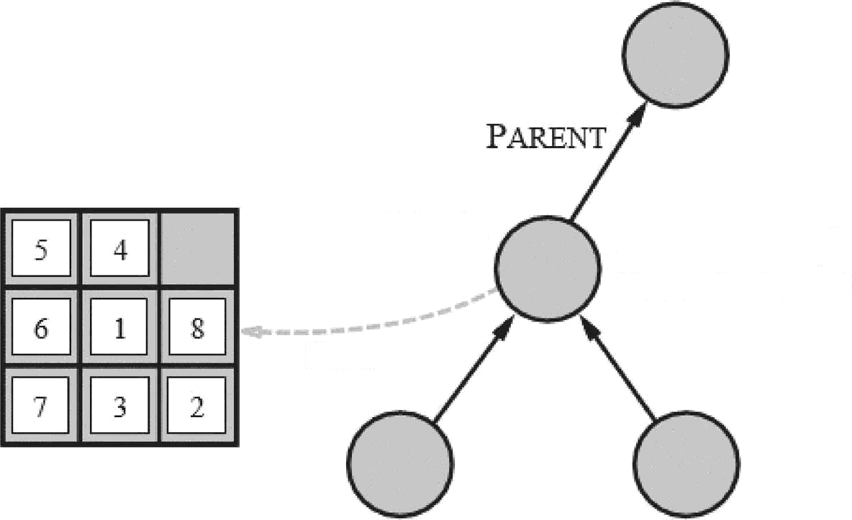
Node Data Structure
Nodes are the data
constructed
structures
from
which the search tree is
Node
ACTION = Aig/sf
PATH—COST 6
ST.4TE

Slide 10
Child-Node Computaùon
The funcùon CHILD-NODE takes a parent node and an acùon and
returns the resulüng child node
function CHILD-NODE(prol›lein, paient, action) returns a node
return a node with
STATE probl.‹:m.RESULT(J7nre.rit.STATE, col,i.t»’R),
I*ARENT J?ef eri/, 7$CTI ON cC2 it7D,
PATH-COST J?B› Pnt.PATH-COST + Q› 45/ria.STEP-COST(J70rent.STATE, 9c/i/7›/)
we use the SOLUTION funcñon to return the sequence of acñons
obtained by following parent pointers back to the root

Slide 11
Data Structure for Fronñer
The frontier needs to be stored in such a way that the search algorithm can easily choose the next node to expand according to its preferred strategy.
The appropriate data structure for this is a queue (FIFO›’LIFO/Priority)
EMPTY?(queue) returns true only if there are no more elements in the
queue.
POP(queue) removes the first element of the queue and returns it.
INSERT(element , queue) inserts an element and returns the resulting
queue.
The explored set can be implemented with a hash table to allow efficient checking for repeated states

Slide 12
Measuring problem-solving performance
We can evaluate an algorithm's performance in four ways:
Completeness: Is the algorithm guaranteed to find a solution when there is one?
Optimality: Does the strategy find the optimal solution?
Time complexity: How long does it take to find a solution?
Space complexity: How much memory is needed to perform the search?

Slide 13

Measuring problem-solving performance
Time and Space Complexity - size of the state space graph,
What if the graph is represented implicitly by the initial state, acñons, and transiñon model & Usually an Inñnite Graph
Then complexity is expressed in terms of three quanññes:
*‘b, the branching factor or maximum number of successors of any node;
**d, the depth of the shallowest goal node and
**m, the maximum Ien@h of any path in the state space.
Time is often measured in terms of the number of nodes generated during the search, and space in terms of the maximum number of nodes stored in memory

Slide 14


Slide 15
Breadth—first search
These strategies have no additional information about states beyond
that provided in the problem definition
All they can do is generate successors and distinguish a goal state from a non-goal state.
All search strategies are distinguished by the order in which nodes are expanded
Strategies that know whether one non-goal state is “more promising” than another are called informed search or heuristic search strategies

Slide 16
Breadth—first search
Breadth-first search is a simple strategy in which the root node is expanded first, then all the successors of the root node are expanded next, then their successors, and so on
In other words all the nodes are expanded at a given depth in the search tree before any nodes at the next level are expanded, i.e. the shallowest unexpanded node is chosen for expansion
FIFO queue is used for the frontier
goal test is applied to each node when it is generated
rather than when it is selected for

Slide 17

Breadth-first search
funcñon BREADTH-NIRST-SEARCH(pTOblem) re$ums a solution, or fallure
node a node with STATE prohfeez.INITIAL-STATE, &ATH-COST - O i£ profifexn.GOAL-TEST(Rode.S4ATs) then return SOLUTION(node) fmntier •=- a FIFO queue wi:h node as tiie only element
ezplomd an empty set
i$ CMPTY?(frontier} Gen return failure
nade POP(,/ronfier) /* chooses the shallowest node in /rontier */
add code.STATE to ezg!ored
for each ac!ion in problem.ACTIONS(node.STATE) do
child CHILD-NODE(problem, node, nction)
i£ cfiiId.STATE is not in explored or /roofier &en
if proh/em.GOAL-TEST(cfii/d.STATE) then return SOLUTION(chi!d) j7onfier INSERT(chéId, frontier)

Slide 18
Breadth—first search Time Complexity
Imagine searching a uniform tree where every state has b successors.
The root of the search tree generates b nodes at the first level,
each of which generates b more nodes, for a total of b²at the second
level.
Each of these generates b more nodes, yielding b³ nodes at the third level, and so on.
Now suppose that the soluñon is at depth d. In the worst case, it is the last node generated at that level. Then the total number of nodes generated is
:y 2 cy 3 + ...
⁺ bd = O(b^{d})

Slide 19















euris cs
Hill climbing, A* ,AO*
Algorithms

Slide 20
INFORMED (HEURISTIC) SEARCH STRATEGIES
These strategies use problem-specific knowledge
beyond the
definiñon of the problem itself — Efficient way of finding Soluñons
The general approach is called best-first search — which is a
Tree›’Graph Search mechanism in which a node is selected for
expansion based on an evaluation function, f(n)
Most best-first algorithms include as a component of f a heurisñc funcñon, denoted h(n):
h(n) = esñmated cost of the cheapest path from the state at node n to a goal state.
Ex: In Travelling from one city to other problem, straight-line distance
from current state to the goal state could be used as Heuristic Estimate if n is a goal node, then h(n) = 0

Slide 21
71
g,;gg
87
75
Sibíu
118
Lugoj
97
Piteuti
70
98
Metadia
7å
8ò
Figure 3.2
A simplified œad map of part of Romania.

Slide 22
Sibiu
Arad Bucharest Craiova Drobeta Eforie Fagaras Giurgiu | 366 0 i60 242 161 176 77 | Mehadia Neamt Oradea Pitesti Rimnicu Vilcea Timisoara | 234 380 100 i93
Hirsova | 151 | Urziceni | 80
lasi | 226 | Vaslui | 199
Lugoj
244 Zerind
straight-line distances to Bucharest.
374
Values of hs‹D

Slide 23

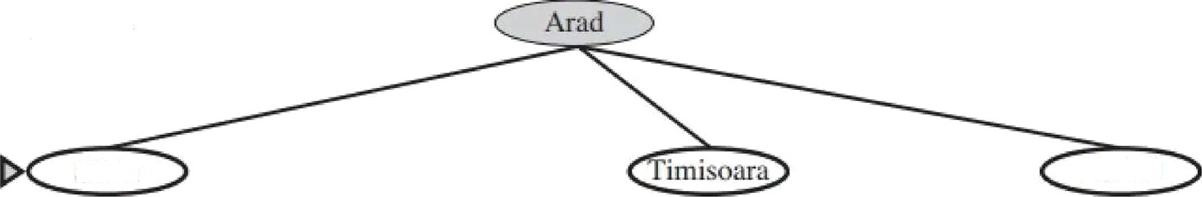


(a) The initial state
Arad
(b) After expanding Arad
Sibiu i5J
374

Slide 24
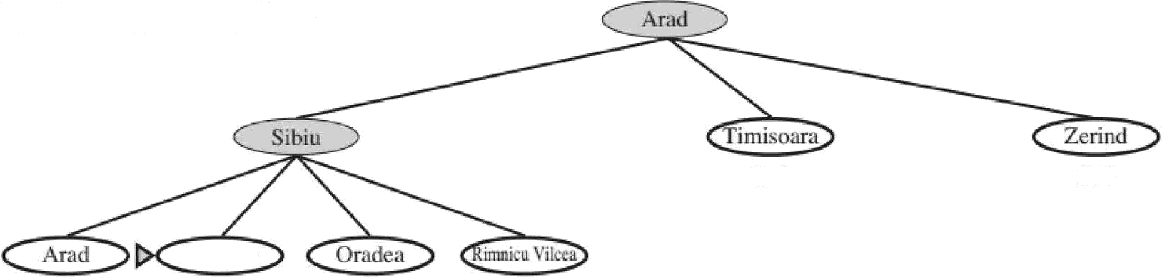
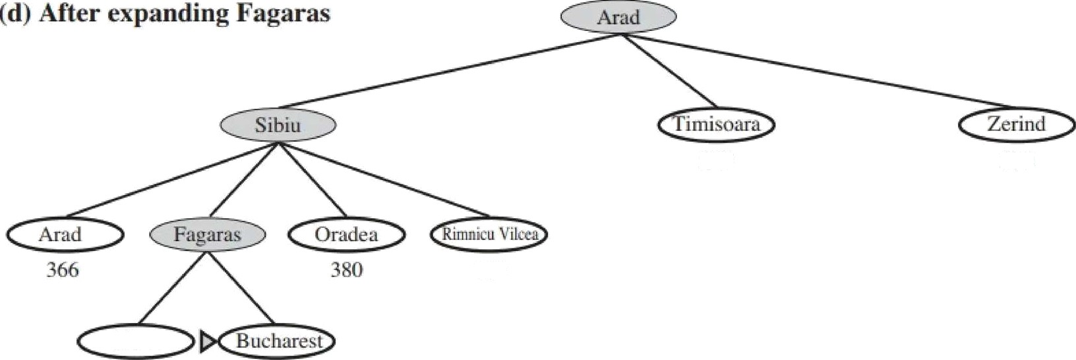
(c) After expanding Sibiu
329
374
Fagaras 176
3d6
380
193
329
374
193
253
0

Slide 25
Greedy best-lrst search
Greedy best-first search tries to expand the node that is closest to the
goal, on the grounds that this is likely to lead to a soluñon quickly.
Thus, it evaluates nodes by using just the heuristic funcñon; that is,
f(n) = h(n)
we use the straight line distance heuristic, which we will call h_{SLD}
greedy best-first search using
^{h}SLD
finds a soluñon without ever
expanding a node that is not on the solution path; hence, its search
cost is minimal. It is not egt1+eat
32 kilometers longer (Via Fagaras = 99 + 211 = 310) than the path through Rimnicu - Vilcea — Pitesti (80 + 97 + 101 =278)
“greedy” at each step it tries to get as close to the goof as it can

Slide 26








Greedy best-lrst search
Greedy best-first tree search is incomplete even in a finite state space,
much like depth-first search.
Consider the problem of getting from "°
lasi to Fagaras
57
The algorithm will never find this solution
lit l
L rzieeni

Slide 27
A* search: Minimizing the total esñmated soluñon cost
The most widely known form of best-first search is called AY
It evaluates nodes by combining
g(n), the cost to reach the node, and
search
h(n), the ESTIMATED cost to get from the node to the goal:
f(n) = g(n) + h(n) , esñmated cost of the cheapest solution through n
A4 search is both complete and opñmal

Slide 28
Conditions for optimality: Admissibility and consistency (Monotonicity)
An admissible heurisñc is one that never overesñmates the cost to reach the goal, thus making f(n) such that it never overesñmates the true cost of a soluñon along the current path through n
Admissible heurisñcs are by nature opñmisñc because they think the
cost o(solving the problem is less thon it actuo/fy is - Ex: h_{SLD}
A heurisñc h(n) is consistent if, for every node n and every successor n’ of n generated by any acñon a, the esñmated cost of reaching the goal from n is no greater than the step cost of getting to n’ plus the esñmated cost of reaching the goal from n".
h(n) s c(n, a, n’) + h(n’)
Consistency is therefore a stricter requirement than admissibility

Slide 29

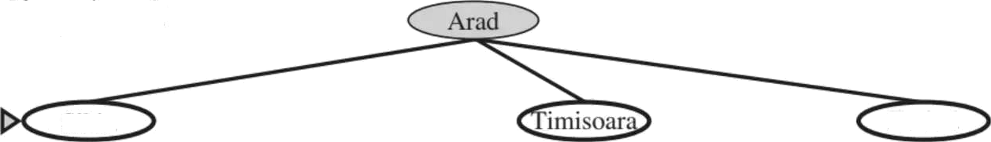
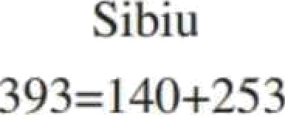

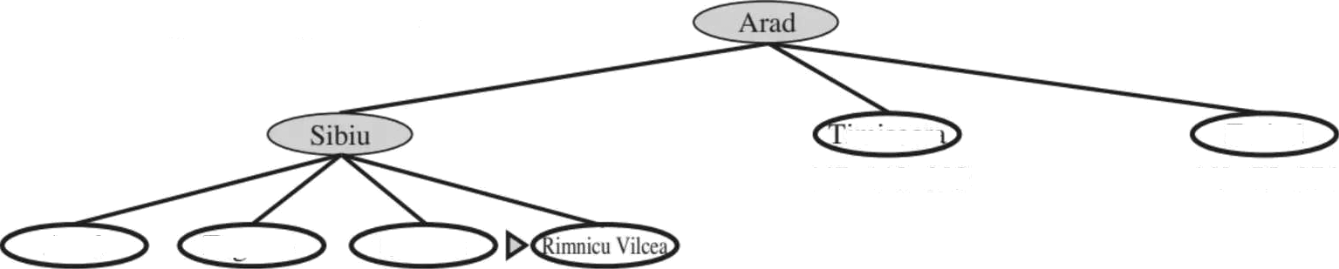
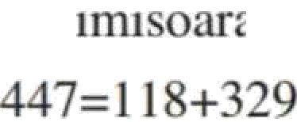

A* in Action for Arad to Bucharest
(a) The initial state
AraU
366=O+566
After expanding Arad
Zerind
449=7ii+J74
(c) After expanding Sibiu
Zerind
Amid Fa•ai as Oradc‹i M6=28t)+366 4 l 1=239+ 1 76 671 —291 +3S(I
413=220+ 193

Slide 30
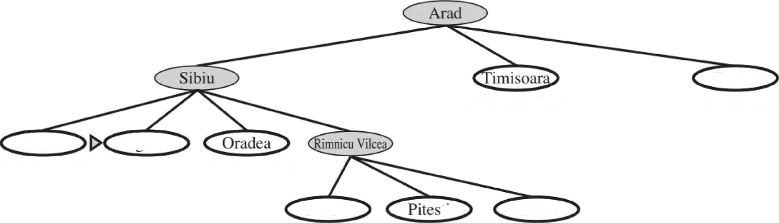

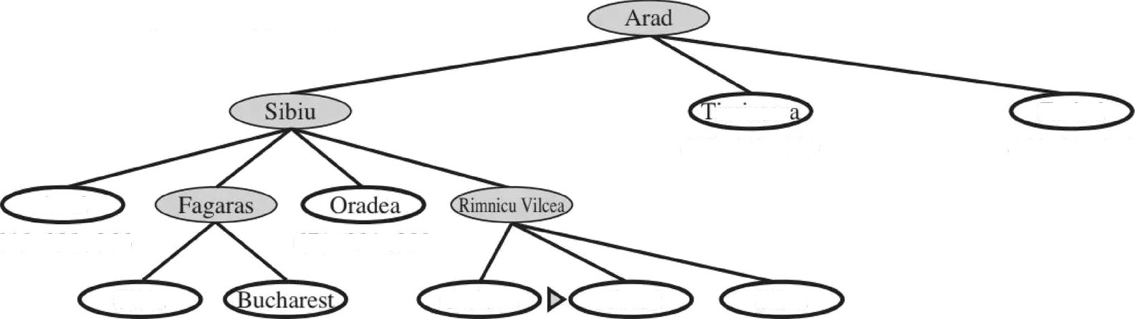

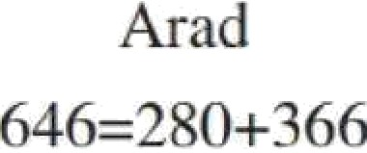

(d) After expanding Rimnicu Vilcea
447= I I 8+329
449=7?+374
Aiad Fagaras
646=2S0+366 415=239+ 17A 671=291+380
Craiova ti
526=366+160 4l7=317+100
Sibiu
ñ53=300+2ñ3
(e) After expanding Fagaras
Zerind
-l49=75+374
M7=11S+J?9
Sibiu
591=33S+253
Ci‘aiova Pitesti
526=366+ 160 417=3l7+100
Sibiu
55s=300+253
450=450+0

Slide 31
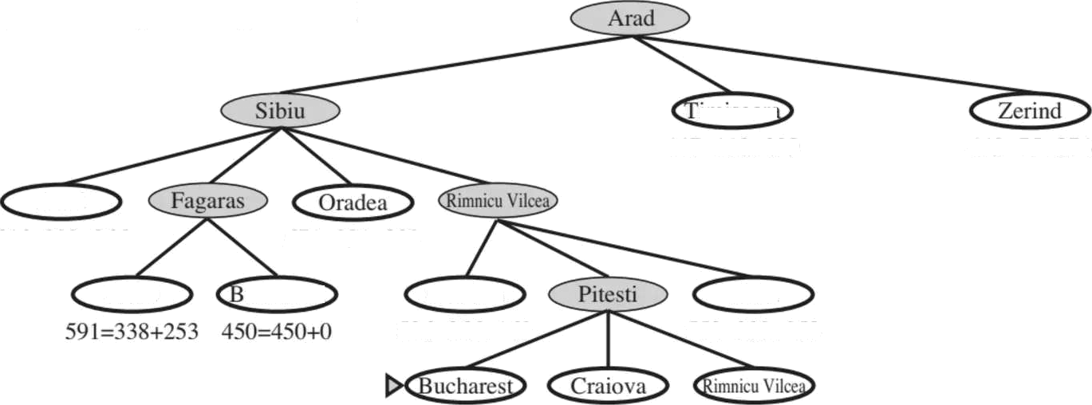






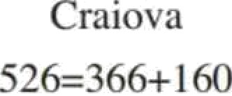
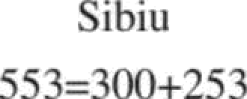
(f) After expanding Pitesti
447=118+329
4iS—4is+o 6is=4ss+lto s07=414+i93
Figure 3.24 Stages in an A* search for Bucharest. Nodes are labeled with fi values are the straight-line distances to Bucharest taken from Figure 3.22.
p + fi. The

Slide 32


Opñmality of A'
The tree-search version of A* is opñmal if h(n) is admissible, while the graph-search version is opñmal if h(n) is consistent
1. i( h(n) is consistent, then the values o( f(n) along any path are Increasing. The proof follows directly from the definiñon of consistency. Suppose n’ is a successor of n;
then g(n’) = g(n) + c(n, a,n’) for some acñon a, and we have
2. The next step is to prove that whenever A* selects a node n for expansion, the optimal path to that node has been found

Slide 33
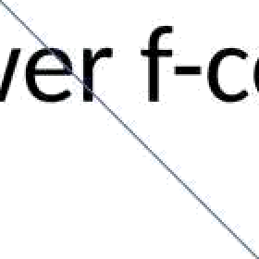
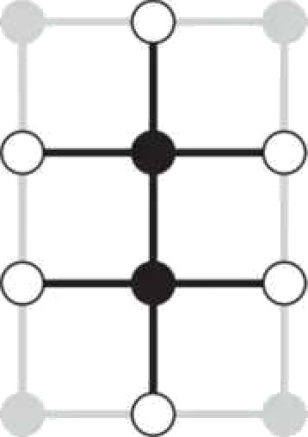
Opñmality of A'
Were this not the case, there would have to be another frontier node n’ on the optimal path from the start node to n, by the graph separation property f is nondecreasing along any path, n’ would have low f-cost than n and would have been selected first
The fronñer (white nodes) always separates the explored region of the state space (black nodes) from the unexplored region (gray nodes)
”
From the two preceding observations, it follows that the sequence of nodes expanded
by A‘ using GRAPH-3EARCH is in nondecreasing order of J(n). Hence, the first goal node selected for expansion must be an optimal solution because J is the true cost for goal nodes (which have /i 0) and all later goal nodes will be at least as expensive.

Slide 34
Contours in the State Space
The fact that f-costs are nondecreasing along any path also means that we can draw contours in the state space, just like the contours in a topographic map
With uniform-cost search (AY search using h(n) = 0), the bands will be “circular” around the start state.
With more accurate heurisñcs, the bands will stretch toward the goal
state and become more narrowly focused around the opñmal path

Slide 35
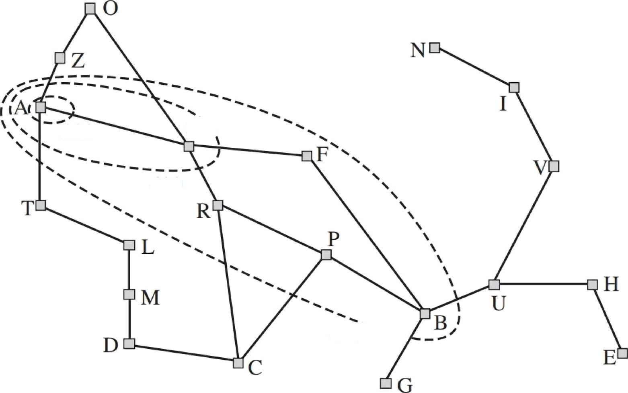
Map of Romania showing contours at
380,
400, and
380
S‘•
400
420**--

Slide 36


em uc
AND-OR Graphs, AO” Algorithms

Slide 37
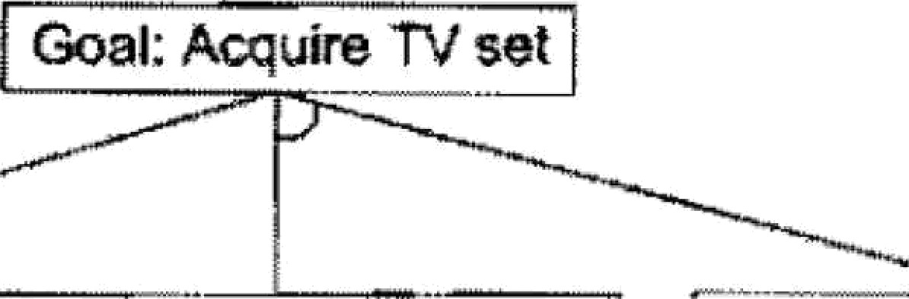
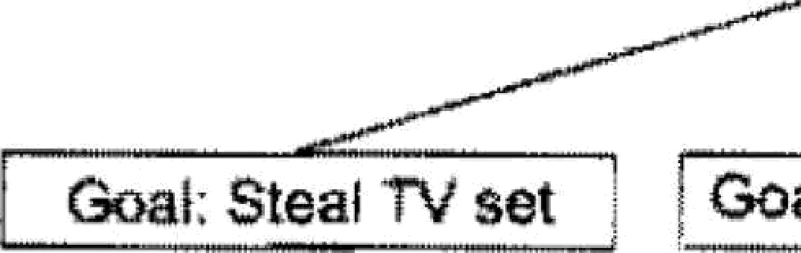
Problem Reducñon AND OR Graphs
AND-OR graph is useful for represenñng the soluñon of problems that can be solved by decomposing them into a set of smaller
problems, all of which must then be solved
One AND arc may point to any number of successor nodes, all of which must be solved in order for the arc to point to a soluñon
OR graph, several arcs may emerge from a single node, indicañng a variety of ways in which the original problem might be solved
Goal: Acquire TV set
Goal: Steal TV set
Goal: yet
t
Ftg. 3.6
A Simple AND-DR Craph

Slide 38
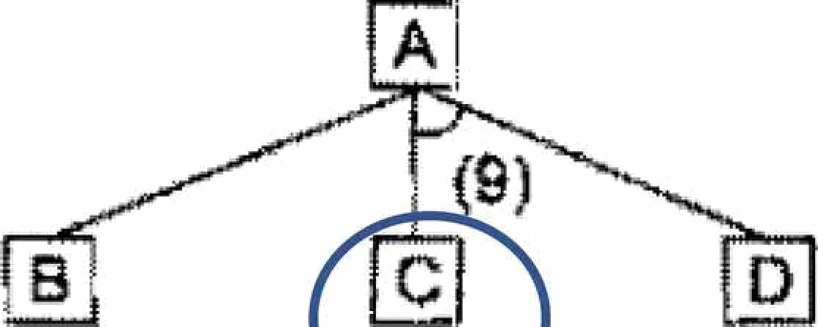
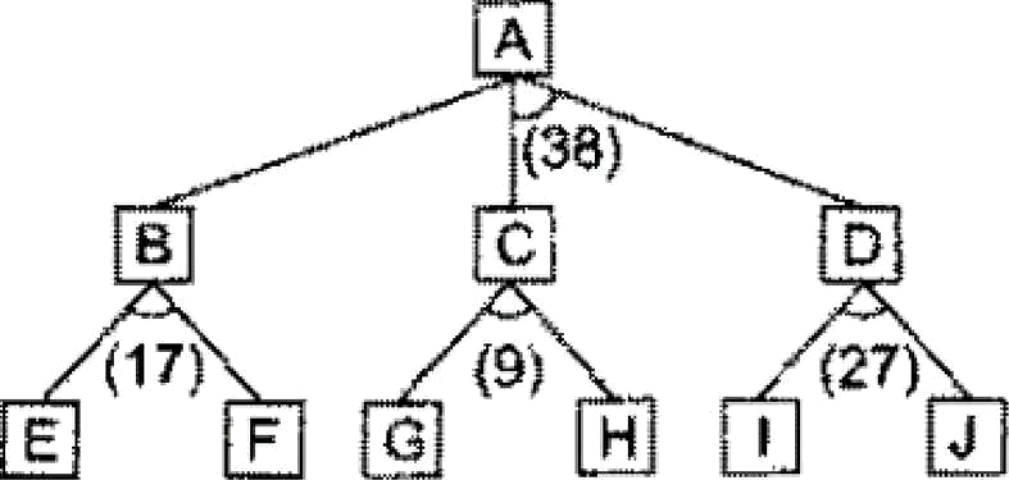


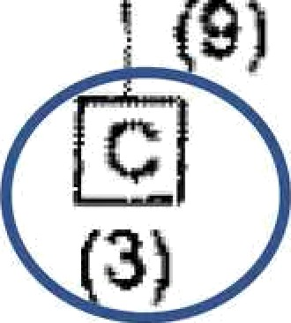
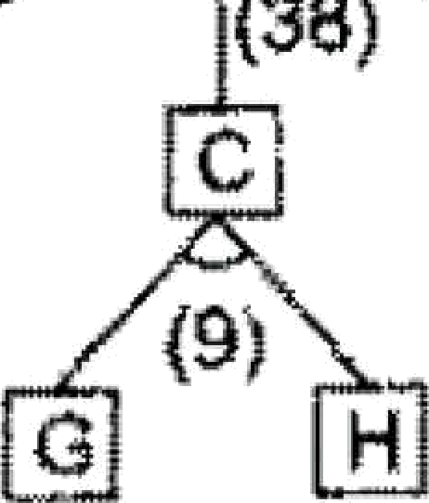



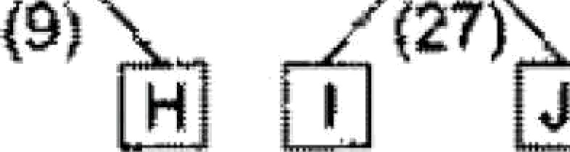
Why best-lrst search algorithm is not adequate?
The problem is that the choice of which node to expand next must depend not only on the f' value of that node but also on whether that node is part of the current best path from the iniñal node
B
‹s›
D
C
D
{4)
(17)
E
(fi)
F G
(10) (6)
(’*)
(15)
(10)
Fig. 3.7
4ND-DR €raphs

Slide 39
FUTILITY
If the estimated cost of a solution becomes greater than the value of
FUTILITY, then we abandon the search.
FUTILITY should be chosen to correspond to a threshold such that any solution with a cost above it is too expensive to be practical, even if it could ever be found

Slide 40
Algorithm: Problem ReducTon
Initialize the graph to the starting node,
Loop until the starting node is labeled SOL'VED or until its cost goes above FUTILITY
  Traverse the graph, starting at the initial node and following the current best path. and accumulate the set of nodes that are on that path and have not yet been expanded or labelled as solved.
  Pick one of these unexpanded nodes and expand it If there are no successors, assign FUTILITY as the value of this node, Otherwise, add its successors to the graph and for each of them compute f’ (use only h’ and ignore g. for reasons we discuss below), If of any node is 0, mark that node as SOL'VED,

Slide 41
Algorithm: Problem ReducTon
(i) Change the f’ esñmate of the newly expanded node to reflect the new informañon provided by its successors
  Propagate this change backward through the graph. If any node contains a successor arc whose descendants are all solved, label the node itself as SOLVEO.
  At each node that is visited while going up the graph, decide which of its successor arcs is the most promising and mark it as part of the current best path, This may cause the current best path to change.
  This propagañon of revised cost esñmates back up the tree was not necessary in the best-first search algorithm because only unexpanded nodes were examined. But now expanded nodes must be reexamined so that the best current path can be selected. Thus it is important that their f’ values be the best esñmates available

Slide 42
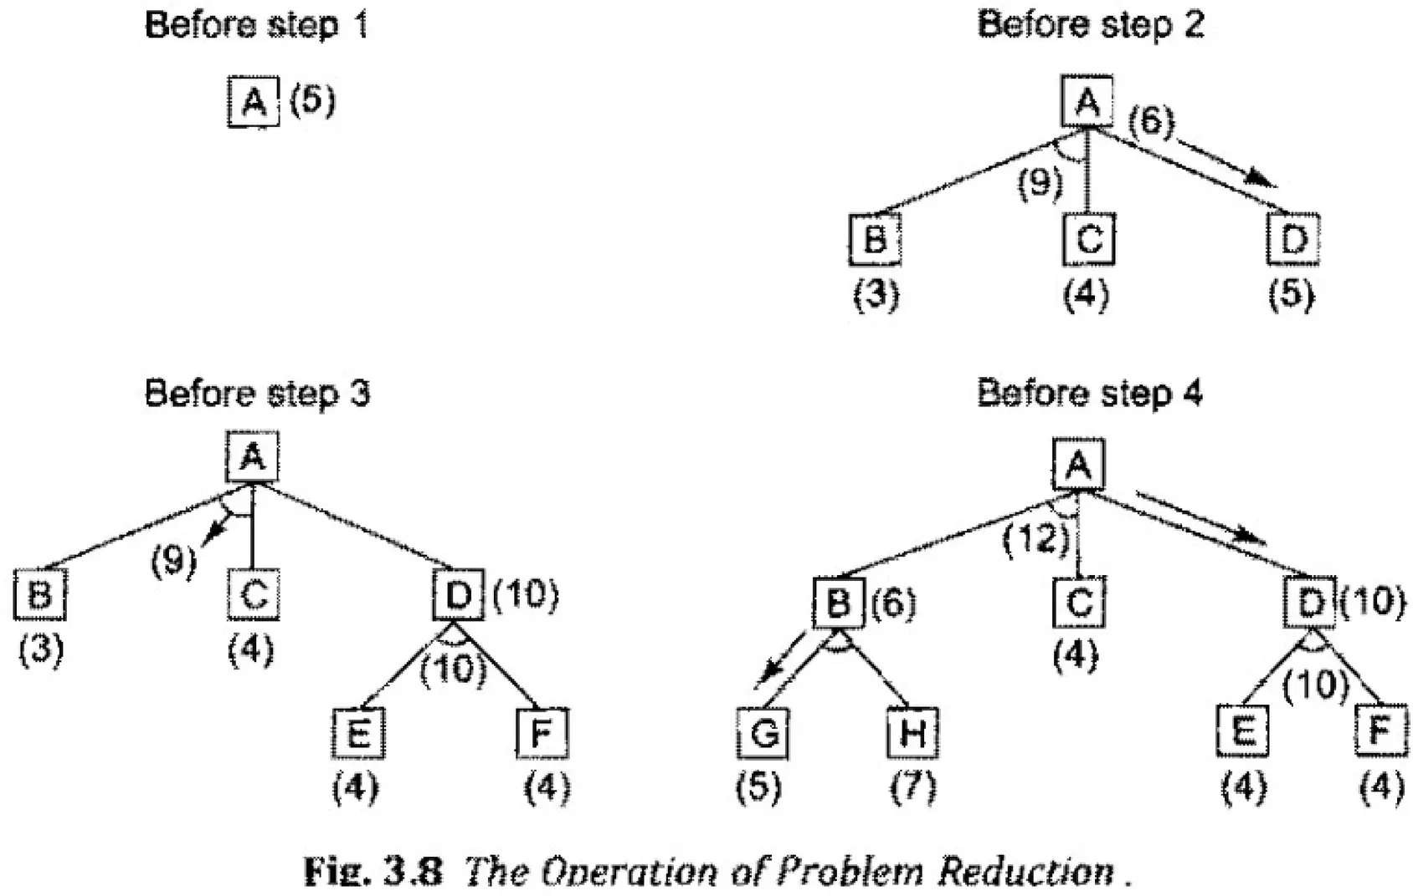

Slide 43
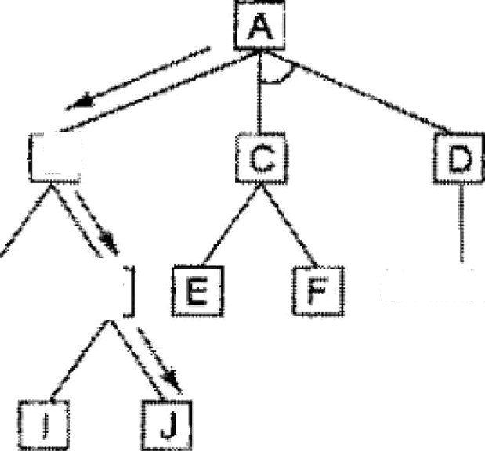
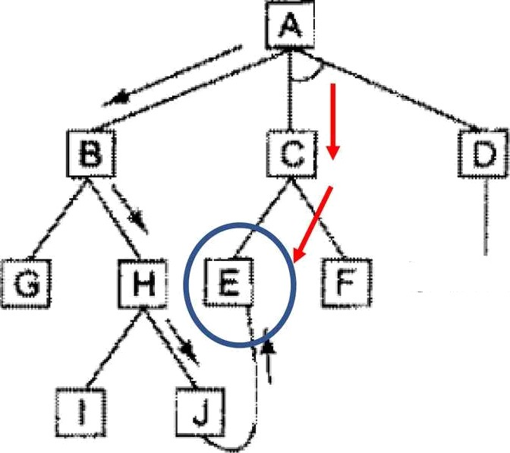

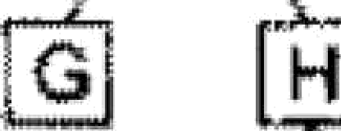



Difierencefrom Best-First
the desired path from one node to another with the lowest cost
need not always the one
Unsolvabte
Fig. 3.9
Larger Path
8«

Slide 44
Limitafion
No interacùon between subgoals

Slide 45
The AO’Algorithm (More generic AND/OR Search)
AO* algorithm will use a single structure GPAPH Rather than OPEN and CLOSED Lists
Each node in the graph will point both down to its immediate successors and up to its immediate predecessors
We will not store g as we did in the A* algorithm because of the top-down traversing of the best-known path, which guarantees that only nodes that are on the best path will ever be considered for expansion. So h’ Will serve as the esñmate of goodness of a node

Slide 46

1. Lnt GRA#H consist only of the node mpres<•nting the iniiial aate. lCall this node INIT. j f?ompute
h’(INIT j
?. Cntil INIT is labeled SOLVED or until INlT's li’ value becomes greaier lan £JTfLf7T, repeai the
foUowing procedure:
‹a) Trace ie labeled arcs £rom INIT and select for expansion one of the at yet unexpanded niAes that
twcum on this path. Call ie selected node NODE.
lbl &neraie the succesmm or NODE. If there are none. ihen ansign FUI“IHTY in the h’ value of NODI3. This is equivalent lo saying that NGDE is nor solvable. IF there we successoi«, then fot each one (culled SUCCESSGRI that is not alw m ancestor of NODE ño tke following:
fiJ Add SYt f?£SSPA io GR4#F.
(ii) If SUCCESSOR is a terminal node. label it SOLVED md assipn ii an li’ value of h.
tiiil If SUCCESSOR is not a ierminal node, compuie its /r’ value.
(c) Propagate the newly discovered information up the graph by doinp ihe following: Let S tie a set of nodes thai have been labeled SOLVED or whose h’ values have been changed and so need to have values propagated back to their parent.«. Initialize 5 to NODF.. UniilS is em@y. repe« ie, following

Slide 47














































occuc in
(i)
.ible. select from
a
none w
fmm .S.
hose
in
. IS
select any
this
mmove it from
the cosl o(each
ins
cost o£ each arc is
lo tiie sum of the
o£ the
at the end
ore itself is.
as
from ii.
h’
minimum
eosa just
for xrcs
SOLVED if all of ie
SOLVED.
(v)

Slide 48
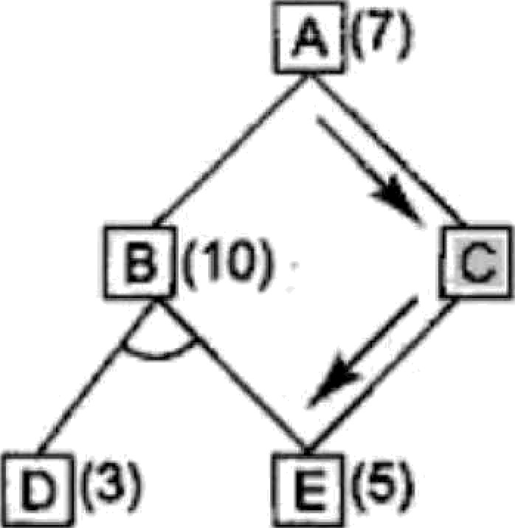
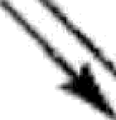
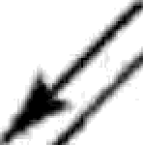

The AO”Algorithm Issues
1. In step 2(c)(v) the ancestors of anode whose cost was altered are added to the set of nodes whose costs must also be revised. As stated, the algorithm will insert all the node's ancestors' into the set. which may result in the propagañon of the cost change back up through a large number of paths that are already known not to be
very good
tt
A
Do We need to Update node B?
Isn't the work expended on the path through B is wasted ?
What if the cost of node E is updated as 10 and is not
propagated to B ?
B (10)
c (6)
g (3)
E (1)
Backward

Slide 49
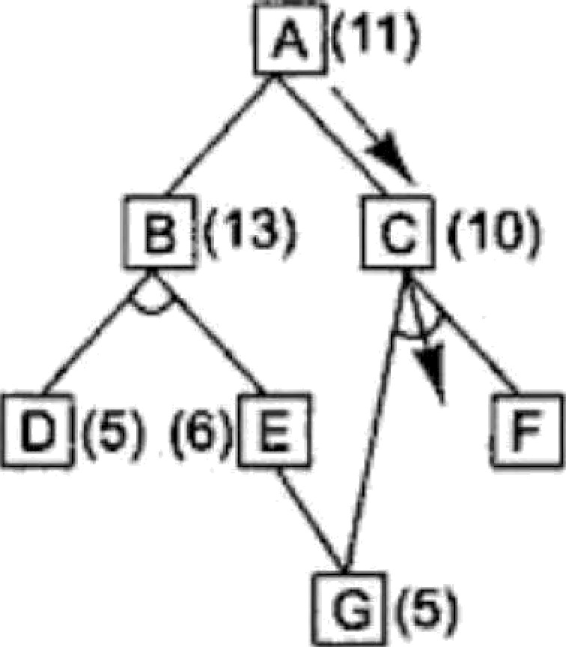



The AO”Algorithm Issues
2. if the node whose cost has changed is farther down in the search Graph, the error may never be detected
A (14)
A (11)
If the cost of G is revised
and if it is not
B (13)
C (15)
B (›3)
C (10)
immediately propagated
back to
change
E, then the
will never be
and a
D (5) (6) E
F (3)
D (5) (6) E
F (3)
recorded nonoptimal through discovered
G {5)
G (10)
solution
B may be
i»j
Fig. 3.12
ibj
A Necessary Backward Pmpa§afion

Slide 50



ame versaria earc
Games, mini-max algorithm,
optimal decisions in multiplayer games, Problem in Game playing, Alpha-Beta pruning,
Evaluation functions.

Slide 51


Adversarial Search (games)
competitive environments, in which the agents goals are in conflict, giving rise to adversarial search problems
In AI, the most common games are of a rather specialized kind what game theorists call determinisñc, turn-taking, two-player, zero-sum games of perfect information (such as chess).
In our terminology, this means determi "sñc, environments in which two agents act altern tel uñlity values at the end of the game are always eq
fully servable
a in which the
and opposite.
For example, if one player wins a game of chess, the other player necessarily loses. It is this opposiñon between the agents' uñlity funcñons that makes the situañon adversarial.

Slide 52
Why Games?
Games are interesting because they are too hard to solve.
For example, chess has an average branching factor of about 35, and games often go to 50 moves by each player, so the search tree has about 35¹⁰⁰ or 10¹⁵⁴nodes
Games, like the real world, therefore require the ability to make
some decision even when calculañng the optimal decision is
infeasible.
3. Games also penalize inefficiency severely.
A»h search that is half as efficient will simply take twice as long to
run to completion, a chess program that is half as efficient in using its available time probably will be beaten into the ground

Slide 53
What we learn
Techniques for choosing a good move when time is limited
Pruning allows us to ignore portions of the search tree that make no diPerence to the final choice
Heuristic evaluation functions allow us to approximate the true utility of a state without doing a complete search.
Some games like bridge, which includes elements of imperfect information because not all cards are visible to each player

Slide 54
Two player Games -formulaTon
We first consider games with two players, whom we call
MAX and MIN MAX moves first, and then they take turns moving
unñl the game is over.
At the end of the game, points are awarded to the winning player and penalties are given to the loser.
A game can be formally defined as a kind of search problem with the following elements:
o 5/ : The initial state, which specifies how the game is set up at the start.
PLAYER(s): Defines which player has the move in a state.
7$CTIONS(s): Returns the set of legal moves in a srate.
RESULT(q, n): The transition model, which defines the result of a move.

Slide 55

Two player Games -formulafion
TERMINAL-TEST(s): A terminal test, which is true when the game is over and false
otherwise. States where the game has ended are called terminal states.
UTILITY s, p): A utility function (also called an objective function or payofl” function), defines the final numeric value for a game that ends in teiminal state .s for a player p. In chess, the outcome is a win, loss, or draw, with values +1, 0, or ¹ Some games have a wider variety of possible outcomes; the payoffs in backgammon range from 0 to -1-1iJ2. A zero-sum game is (confusingly) defined as one where the total payoff to all players is the same for every instance of’ the game. Chess is zero-sum because every game has payoif of either 0 -;- 1, 1 + 0 or @ -F ;;. “Constant-sum” would have been a better term, but zero-sum is traditional and makes sense if you imagine each player is charged an entry t”ee of @.

Slide 56
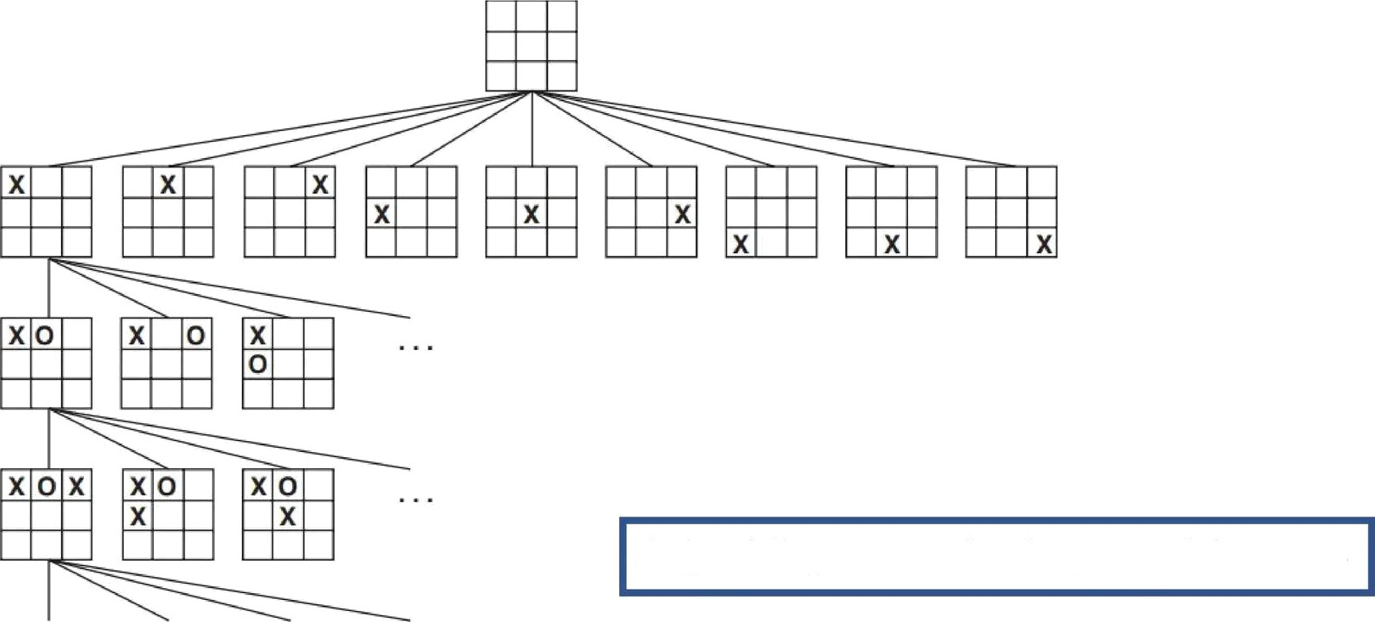
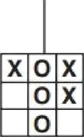
MIN (o)
MAX (x)
MAX (x)
MIN (O)
A (partial) game tree for the game of tic-tac-toe
X | O | X
O | O | X
X | X | 0
X | 0 | X
 | X
X | 0 | 0
•
TERMINAL
Utility —l
0
+ I

Slide 57





The minimax algorithm
MAX
MIN
y B
¿ D
? 4 6 lJ ?i *
A two-ply game tree. The fi nodes are “MAX nodes,” in which it is MAX’s
Figure 5.2
turn to move, and the W nodes are “MIN nodes.” The terminal nodes show the utility values
for MAX; the other nodes are labeled with their minimax values. MAX’s best more at the root
is o;, because it leads to the slate with the highest minimax value, and MIN's best reply is because it leads to the state with the lowest minimax value.
1

Slide 58

MiniMax Value
Given a game tree, the optimal strategy can be determined from the
minimax value of each node, which we write as MINIMAX(n)
Given a choice, MAX prefers to move to a state of maximum value, whereas MIN prefers a state of minimum value.
So we have the following:
MINIMAX(s)
UTILITY (.s)
Iï1àNq¡q qp¡, „,(,J MINI MAX (RESULT ,s. n))
min„p,; t; „ (,) MINIMAX(RES ULT(«, o) )
íf TERMINAL-TEST (es)
if PLAYER (›i) MAX
íf PLAYER(s) MÍN

Slide 59
function MiNlMAX-DEClSIONt,›tnfe) returns on nr/ton
return arg max, _{e ACTION S‹.},) MIN-VALUE(RESULT(sta/e, n))
function MAx-VALUE( s/o/e) returns n ufi/i/y uoIt›e
if TERMINAL-TEST(.s/ale) then return UTILITY(.strife)
for each n in AcvIONS(strife) do
u ‹- MAx( i , MIN-VALUE(RESULT(s, a)))
return u
function MIN -VALUEt,s/c/c) returns ‹z uti/if;j velue
if TERMINAL-TEST(.sfnfe) then return UTILITY(stole)
t› ‹- v
for each n in AcTiON S( tfnfe) do
r +- MIN( r, MAX-VALUE(RESULT(.s“, n)))
return r
Figure 5.3 An algorithm for calculating minimax decisions. It returns the action corre- sponding to the best possible move. that is, the move that leads to the outcome with the best utility, under the assumption that ihe opponeni plays to minimize utility. The functions MAX-VALuE and MiN-VA LUE go through the whole game iree, all the way to ihe leaves, to determine the backed-up value of a state. The notation nvgnxnx ; g f ct) computes the element Q of set .'7 that has the maximum value of f{:s!.

Slide 60
MiniMax Complexity
The minimax algorithm performs a complete depth-first exploration of the game tree.
If the maximum depth of the tree is m and there are b legal moves at each point, then the ñme complexity of the minimax algorithm is 0(b ).
The space complexity is 0(bm) for an algorithm that generates all actions at once, or O(m) for an algorithm that generates actions one at a bme

Slide 61
OpñmaT decisions in muiñplayer games
When we extend the minimax idea to multiplayer games some interesting new conceptual issues arise
we need to replace the single value for each node with a vector of values.
For example, in a three-player game with players A, B, acd C, a vector
<v_{A},v_{B},v_{C}> is associated with each node.
For terminal states, this vector gives the utility of the state from each player's viewpoint. (In two-player, zero-sum games, the two-element vector can be reduced to a single value because the values are always opposite.)
The simplest way to implement this is to have
the UTILITY function return a vector of utilities.

Slide 62
OpñmaT decisions in muiñplayer games
Mulñplayer games usually involve alliances, whether formal or
informal, among the players.
Alliances are made and broken as the game proceeds.
suppose A and B are in weak positions and C is in a stronger posiñon. Then it is often opñmal for both A and B to attack C rather than each other, lest C destroy each of them individually. In this way, collaborañon emerges from purely selfish behavior.
Of course, as soon as C weakens under the joint onslaught, the alliance
loses its value, and either A or B could violate the agreement.
a social stigma attaches to breaking an alliance, so players must balance the immediate advantage of breaking an alliance against the long-term disadvantage of being perceived as untrustworthy.

Slide 63

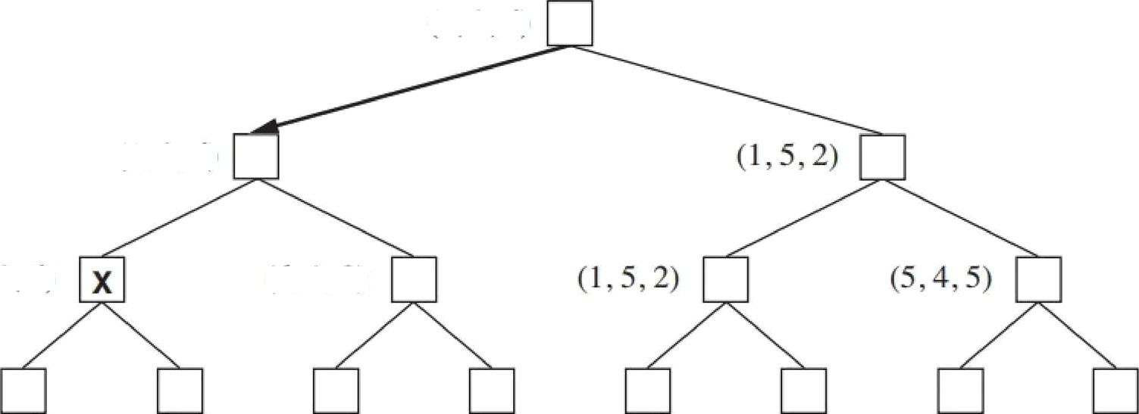





to move
( l. ?, 6l
( 1 . ñ. 6)
(6. l . 2)
A
(1 , ?, 6) (4, ?. ?) (6. l . ?) (7. 4 1) I?i,l ,l ) ( l . fi. ?)
(7, 7 1)
(5i. 4, ?i)
Figure 5.4 The ñ°rst three plies of a game tree with three players Each node is
labeled with values from the viewpoint of each player. The best move is marked at the root.

Slide 64
Alpha-Beta Pruning
The problem with minimax search is that the number of game states it has to examine is exponenñal in the depth of the tree.
Unfortunately, we can't eliminate the exponent, but it turns out we
can effecñvely cut it in half.
alpha-beta pruning, When applied to a standard minimax tree, it returns the same move as minimax would, but prunes away branches that cannot possibly influence the final decision.
Let the two unevaluated successors of node C have values x and y
MINIMAX(root)
max(ruin(3, 12. 8), min( 3’•. r) ruin(14, o, 2))
max(3. min(2. .z. y), 2)
max(3. c, 2) where r min(2. .z, y) 2
3.

Slide 65
Alpha-Beta Pruning
minimax decision are independent of the values of the pruned leaves
x and
Alpha—beta pruning can be applied to trees of any depth, and it is oken possible to prune entire subtrees rather than just leaves

Slide 66
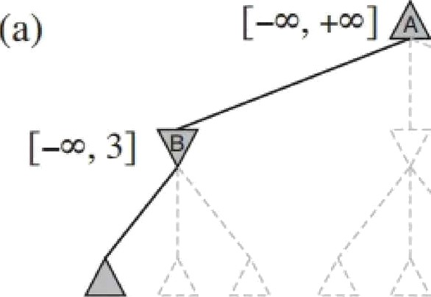
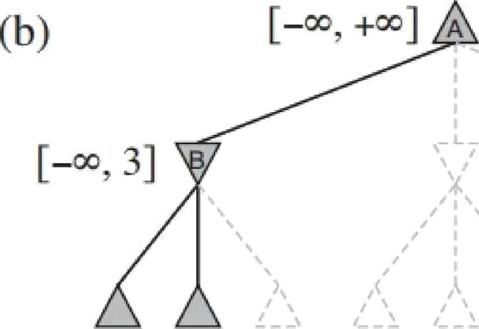


3
(c)
[3, + ]
[— =, 2]
2
2

Slide 67



(e)
[3, 14]
[—'°, 2]
[—<, 14]
[à, 3]
[—>, 2]
[2, 2]
12 8 2
t4
3 12 ß 2
14 5 2
This Need not be expanded

Slide 68
Evaluañon funcñons
An evaluation function returns an esñmate of the expected uñlity of the game from a given posiñon (Just like the heuristic funcñons of which return an estimate of the distance to the goal)
the performance of a game-playing program depends strongly on the quality of its evaluation function.
An inaccurate evaluation funcñon will guide an agent toward
positions that turn out to be lost.
How exactly do we design good evaluañon funcñons?
states that are wins must evaluate better than draws, which in turn must be better than losses - order the terminal states
the computañon of Evaluañon Funcñon must not take too long!

Slide 69
Evaluañon funcñons
for nonterminal states, the evaluañon funcñon should be strongly
correlated with the actual chances of winning
  Most evaluation funcñons work by calculañng various features of the
state for example, in chess, we would have features for the number
of white pawns, black pawns, white queens, black queens, and so on
The features, taken together, define various cotegories or equivalence classes of states: the states in each category have the same values for all the features
Ex: one category contains all two-pawn vs. one-pawn endgames
Any given category will contain some states that lead to wins, some that lead to draws, and some that lead to losses

Slide 70
Evaluañon funcñons
The evaluation function cannot know which states are which (Loss / Win / Draw leading), but it can return a single value that reflects the proporñon of states with each outcome.
For example, suppose our experience suggests that 72⁰% of the states encountered in the two-pawns vs. one-pawn category lead to a win (utility +1); 20^{O}ñi to a loss (0), and 8^{O}ñi to a draw (1/2).
Then a reasonable evaluation for states in the category is the expected value: (0.72 « +1) + (0.20 x 0) + (0.08 x 1/2) = 0.76
As with terminal states, the evaluañon function need not return actual
expected values as long as the ordering ot the states is the same

Slide 71
Evaluañon funcñons
In principle, the expected value can be determined for each category, resulting in an evaluation function that works for any state.
In practice, this kind of analysis requires too many categories and hence too much experience to estimate all the probabilities of winning
Instead, most
evaluañon funcñons compute separate numerical
contribuñons
the total value
from each feature and then combine them to find

Slide 72
Evaluañon funcñons
For example, introductory chess books give an approximate material value for each piece:
each pawn is worth 1, a knight or bishop is worth 3, a rook 5, and the queen 9.
Other features such as “good pawn structure” and “king safety” might be worth
. These feature values are then simply added up to obtain the
evaluation of the posiñon.
A secure advantage equivalent to a pawn gives a substantial likelihood of
winning
and
a secure advantage equivalent to three pawns should give almost certain
victory

Slide 73
weighted linear funcfion
7
EVA&(.1) zf; /}(.s) —t- /Aty/g(.s) —t-
—|- u:„,/„,(.1)
-t1';/*¿(.s)
where each w, is a weight and each f_{i} is a feature of the posiñon
Disadv:- involves a strong assumption that the contribuñon of each feature
is independent of the values of the other features
Hence, the current programs for chess and other games also use nonlinear
combinations of features.
For example, a pair of bishops might be worth slightly more than twice the value of a single bishop, and a bishop is worth more in the endgame

