Slide 1
Who Stole the Painting?
In-class Resolution Refutation Problem
N(x) – “x is a knight”
K(x) – “x is a knave”
R(x) – “x is a regular”
N(A) -> ~N(A) = ~N(A)
K(A) -> ~(~N(A)) = ~K(A) V N(A)
N(B) -> ~N(A) = ~N(B) V ~N(A)
K(B) -> ~(~N(A)) = ~K(B) V N(A)
N(C) -> ~R(B) = ~N(C) V ~R(B)
K(C) -> ~(~R(B)) = ~K(C) V R(B)
~N(x) <--> (R(x) V K(x)) =
N(x) V R(x) V K(x)
~R(x) V ~N(x)
~K(x) V ~N(x)
(N(x) ^ ~R(x) ^ ~K(x)) V
(~N(x) ^ R(x) ^ ~K(x)) V
(~N(x) ^ ~R(x) ^ K(x))
N(A) V N(B) V N(C)
(N(A) ^ ~N(B) ^ ~N(C)) V
(~N(A) ^ N(B) ^ ~N(C)) V
(~N(A) ^ ~N(B) ^ N(C))

Slide 2
DNF to CNF
(a ^ b) V (b ^ c) V (a ^ c) ≡ (a V b) ^ (b V c) ^ (a V c)
Proof:
(a ^ b) V (b ^ c) V (a ^ c)
= [(a^b) V (b^c)] V (a^c)
= [((a^b) V b) ^ ((a^b) V c)] V (a^c)
= [(a V b) ^ b ^ (c V a) ^ (b V c)] V (a^c)
= [((a V b) ^ b ^ (c V a) ^ (b V c)) V a] ^
[((a V b) ^ b ^ (c V a) ^ (b V c)) V c]
= (a V b) ^ (a V b) ^ (a V c) ^ (a V b V c) ^ (a V b V c) ^
(b V c) ^ (a V c) ^ (b V c)
= (a V b) ^ (b V c) ^ (a V c)

Slide 3
Knowledge Representation and Reasoning
CMSC 471
Chapter 10.1-10.2, 10.6
Adapted from slides by
Tim Finin and
Marie desJardins.
Some material adopted from notes by Andreas Geyer-Schulz,
and Chuck Dyer.

Slide 4
Outline
Approaches to knowledge representation
Deductive/logical methods
  Forward-chaining production rule systems
  Semantic networks
  Frame-based systems
  Description logics
Abductive/uncertain methods
  What’s abduction?
  Why do we need uncertainty?
  Bayesian reasoning
  Other methods: Default reasoning, rule-based methods, Dempster-Shafer theory, fuzzy reasoning

Slide 5
Introduction
Real knowledge representation and reasoning systems come in several major varieties.
These differ in their intended use, expressivity, features,…
Some major families are
  Logic programming languages
  Theorem provers
  Rule-based or production systems
  Semantic networks
  Frame-based representation languages
  Databases (deductive, relational, object-oriented, etc.)
  Constraint reasoning systems
  Description logics
  Bayesian networks
  Evidential reasoning

Slide 6
Semantic Networks
A semantic network is a simple representation scheme that uses a graph of labeled nodes and labeled, directed arcs to encode knowledge.
  Usually used to represent static, taxonomic, concept dictionaries
Semantic networks are typically used with a special set of accessing procedures that perform “reasoning”
  e.g., inheritance of values and relationships
Semantic networks were very popular in the ‘60s and ‘70s but are less frequently used today.
  Often much less expressive than other KR formalisms
The graphical depiction associated with a semantic network is a significant reason for their popularity.

Slide 7
Nodes and Arcs
Arcs define binary relationships that hold between objects denoted by the nodes.
mother
age
Sue
john
5
age
wife
father
husband
mother(john,sue)
age(john,5)
wife(sue,max)
age(max,34)
...
34
Max
age

Slide 8
Semantic Networks
The ISA (is-a) or AKO (a-kind-of) relation is often used to link instances to classes, classes to superclasses
Some links (e.g. hasPart) are inherited along ISA paths.
The semantics of a semantic net can be relatively informal or very formal
  often defined at the implementation level
Animal
isa
hasPart
Bird
isa
Wing
Robin
isa
isa
Rusty
Red

Slide 9
Reification
Non-binary relationships can be represented by “turning the relationship into an object”
This is an example of what logicians call “reification”
  reify v : consider an abstract concept to be real
We might want to represent the generic give event as a relation involving three things: a giver, a recipient and an object, give(john,mary,book32)
giver
john
give
recipient
object
mary
book32

Slide 10
Individuals and Classes
Genus
Many semantic networks distinguish
  nodes representing individuals and those representing classes
  the “subclass” relation from the “instance-of” relation
Animal
subclass
instance
hasPart
Bird
subclass
Wing
Robin
instance
instance
Rusty
Red

Slide 11
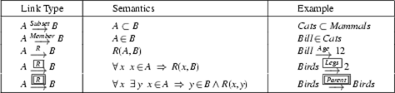
Link types

Slide 12
Inference by Inheritance
One of the main kinds of reasoning done in a semantic net is the inheritance of values along the subclass and instance links.
Semantic networks differ in how they handle the case of inheriting multiple different values.
  All possible values are inherited, or
  Only the “lowest” value or values are inherited

Slide 13
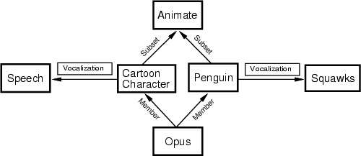
Conflicting inherited values

Slide 14
Multiple inheritance
A node can have any number of superclasses that contain it, enabling a node to inherit properties from multiple “parent” nodes and their ancestors in the network.
These rules are often used to determine inheritance in such “tangled” networks where multiple inheritance is allowed:
  If X<A<B and both A and B have property P, then X inherits A’s property.
  If X<A and X<B but neither A<B nor B<Z, and A and B have property P with different and inconsistent values, then X does not inherit property P at all.

Slide 15
Nixon Diamond
This was the classic example circa 1980.
Person
subclass
subclass
pacifist
Quaker
Republican
pacifist
TRUE
FALSE
instance
instance
Person

Slide 16
From Semantic Nets to Frames
Semantic networks morphed into Frame Representation Languages in the ‘70s and ‘80s.
A frame is a lot like the notion of an object in OOP, but has more meta-data.
A frame has a set of slots.
A slot represents a relation to another frame (or value).
A slot has one or more facets.
A facet represents some aspect of the relation.

Slide 17
Facets
A slot in a frame holds more than a value.
Other facets might include:
  current fillers (e.g., values)
  default fillers
  minimum and maximum number of fillers
  type restriction on fillers (usually expressed as another frame object)
  attached procedures (if-needed, if-added, if-removed)
  salience measure
  attached constraints or axioms
In some systems, the slots themselves are instances of frames.

Slide 18
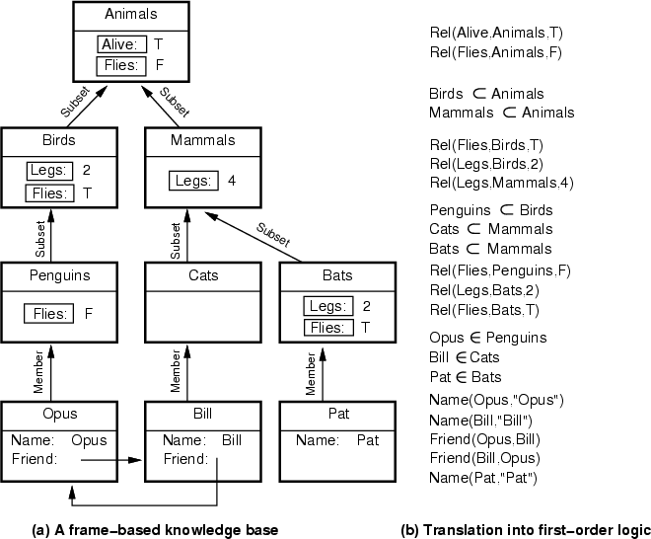

Slide 19
Description Logics
Description logics provide a family of frame-like KR systems with a formal semantics.
  E.g., KL-ONE, LOOM, Classic, …
An additional kind of inference done by these systems is automatic classification
  finding the right place in a hierarchy of objects for a new description
Current systems take care to keep the languages simple, so that all inference can be done in polynomial time (in the number of objects)
  ensuring tractability of inference

Slide 20
Abduction
Abduction is a reasoning process that tries to form plausible explanations for abnormal observations
  Abduction is distinctly different from deduction and induction
  Abduction is inherently uncertain
Uncertainty is an important issue in abductive reasoning
Some major formalisms for representing and reasoning about uncertainty
  Mycin’s certainty factors (an early representative)
  Probability theory (esp. Bayesian belief networks)
  Dempster-Shafer theory
  Fuzzy logic
  Truth maintenance systems
  Nonmonotonic reasoning

Slide 21
Abduction
Definition (Encyclopedia Britannica): reasoning that derives an explanatory hypothesis from a given set of facts
  The inference result is a hypothesis that, if true, could explain the occurrence of the given facts
Examples
  Dendral, an expert system to construct 3D structure of chemical compounds
    Fact: mass spectrometer data of the compound and its chemical formula
    KB: chemistry, esp. strength of different types of bounds
    Reasoning: form a hypothetical 3D structure that satisfies the chemical formula, and that would most likely produce the given mass spectrum

Slide 22
Abduction examples (cont.)
  Medical diagnosis
    Facts: symptoms, lab test results, and other observed findings (called manifestations)
    KB: causal associations between diseases and manifestations
    Reasoning: one or more diseases whose presence would causally explain the occurrence of the given manifestations
  Many other reasoning processes (e.g., word sense disambiguation in natural language process, image understanding, criminal investigation) can also been seen as abductive reasoning

Slide 23
Comparing abduction, deduction, and induction
A => B
A
---------
B
Deduction: major premise: All balls in the box are black
minor premise: These balls are from the box
conclusion: These balls are black
Abduction: rule: All balls in the box are black
observation: These balls are black
explanation: These balls are from the box
Induction: case: These balls are from the box
observation: These balls are black
hypothesized rule: All ball in the box are black
A => B
B
-------------
Possibly A
Whenever A then B
-------------
Possibly
A => B
Deduction reasons from causes to effects
Abduction reasons from effects to causes
Induction reasons from specific cases to general rules

Slide 24
Characteristics of abductive reasoning
“Conclusions” are hypotheses, not theorems (may be false even if rules and facts are true)
  E.g., misdiagnosis in medicine
There may be multiple plausible hypotheses
  Given rules A => B and C => B, and fact B, both A and C are plausible hypotheses
  Abduction is inherently uncertain
  Hypotheses can be ranked by their plausibility (if it can be determined)

Slide 25
Characteristics of abductive reasoning (cont.)
Reasoning is often a hypothesize-and-test cycle
  Hypothesize: Postulate possible hypotheses, any of which would explain the given facts (or at least most of the important facts)
  Test: Test the plausibility of all or some of these hypotheses
  One way to test a hypothesis H is to ask whether something that is currently unknown–but can be predicted from H–is actually true
    If we also know A => D and C => E, then ask if D and E are true
    If D is true and E is false, then hypothesis A becomes more plausible (support for A is increased; support for C is decreased)

Slide 26
Characteristics of abductive reasoning (cont.)
Reasoning is non-monotonic
  That is, the plausibility of hypotheses can increase/decrease as new facts are collected
  In contrast, deductive inference is monotonic: it never change a sentence’s truth value, once known
  In abductive (and inductive) reasoning, some hypotheses may be discarded, and new ones formed, when new observations are made

Slide 27
Sources of uncertainty
Uncertain inputs
  Missing data
  Noisy data
Uncertain knowledge
  Multiple causes lead to multiple effects
  Incomplete enumeration of conditions or effects
  Incomplete knowledge of causality in the domain
  Probabilistic/stochastic effects
Uncertain outputs
  Abduction and induction are inherently uncertain
  Default reasoning, even in deductive fashion, is uncertain
  Incomplete deductive inference may be uncertain
Probabilistic reasoning only gives probabilistic results (summarizes uncertainty from various sources)

Slide 28
Decision making with uncertainty
Rational behavior:
  For each possible action, identify the possible outcomes
  Compute the probability of each outcome
  Compute the utility of each outcome
  Compute the probability-weighted (expected) utility over possible outcomes for each action
  Select the action with the highest expected utility (principle of Maximum Expected Utility)

Slide 29
Bayesian reasoning
Probability theory
Bayesian inference
  Use probability theory and information about independence
  Reason diagnostically (from evidence (effects) to conclusions (causes)) or causally (from causes to effects)
Bayesian networks
  Compact representation of probability distribution over a set of propositional random variables
  Take advantage of independence relationships

Slide 30
Other uncertainty representations
Default reasoning
  Nonmonotonic logic: Allow the retraction of default beliefs if they prove to be false
Rule-based methods
  Certainty factors (Mycin): propagate simple models of belief through causal or diagnostic rules
Evidential reasoning
  Dempster-Shafer theory: Bel(P) is a measure of the evidence for P; Bel(¬P) is a measure of the evidence against P; together they define a belief interval (lower and upper bounds on confidence)
Fuzzy reasoning
  Fuzzy sets: How well does an object satisfy a vague property?
  Fuzzy logic: “How true” is a logical statement?

Slide 31
Uncertainty tradeoffs
Bayesian networks: Nice theoretical properties combined with efficient reasoning make BNs very popular; limited expressiveness, knowledge engineering challenges may limit uses
Nonmonotonic logic: Represent commonsense reasoning, but can be computationally very expensive
Certainty factors: Not semantically well founded
Dempster-Shafer theory: Has nice formal properties, but can be computationally expensive, and intervals tend to grow towards [0,1] (not a very useful conclusion)
Fuzzy reasoning: Semantics are unclear (fuzzy!), but has proved very useful for commercial applications

